Slide 1
SHOOTING SPORTS
AND ITS SEGUE TO HUNTING
Teresa Carroll
National Wild Turkey Federation
Education & Outreach Program Coordinator

Slide 2
Our Mission

Slide 3
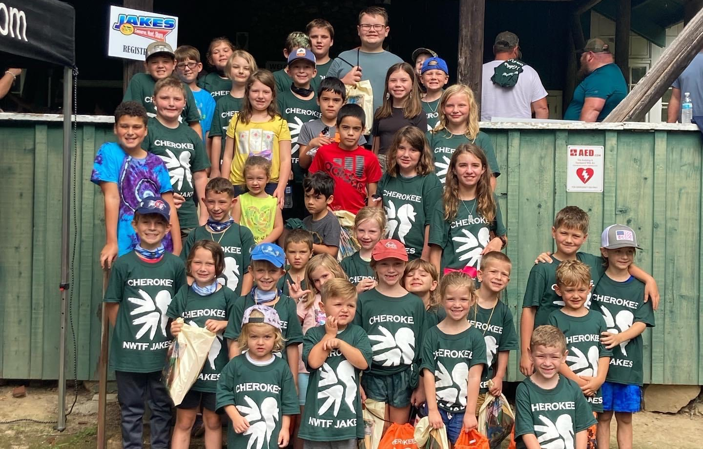
EDUCATION & OUTREACH PROGRAMS
Notes:
The NWTF has been investing in the shooting sports and hunter recruitment for decades with programs like JAKES which started in 1981.

Slide 4
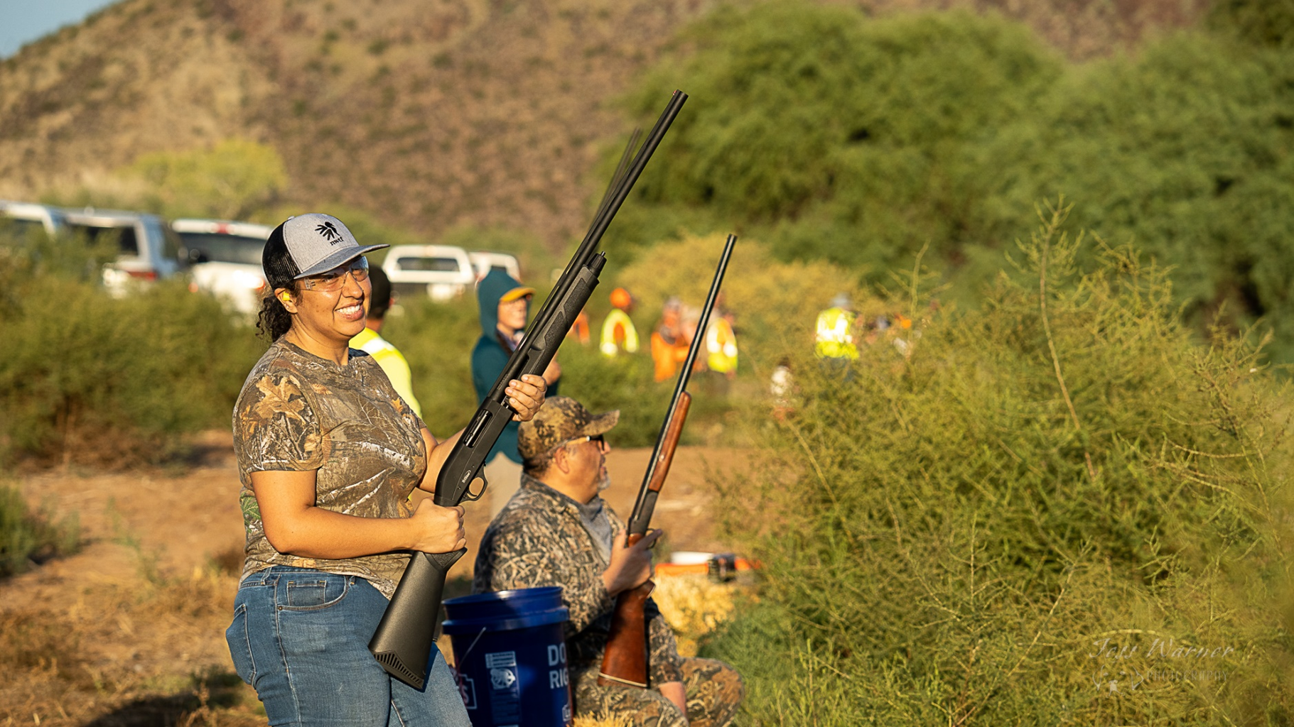
EDUCATION & OUTREACH PROGRAMS
Notes:
Women in the Outdoors followed in 1998.

Slide 5
Notes:
And finally Wheelin’ Sportsmen began in the year 2000. Our chapters host an average of 1000 events per year to introduce hundreds of thousands of people to the outdoors, hunting and shooting.

Slide 6
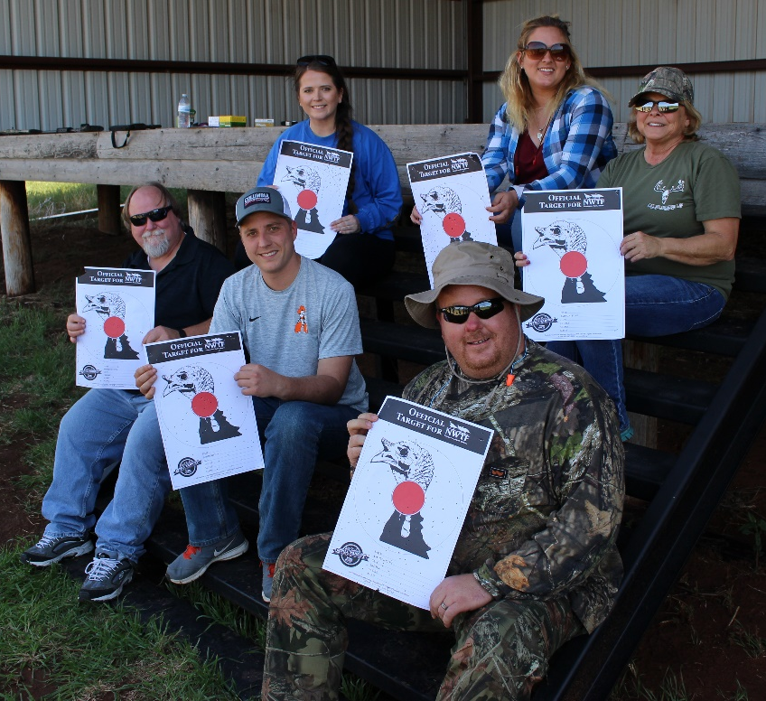
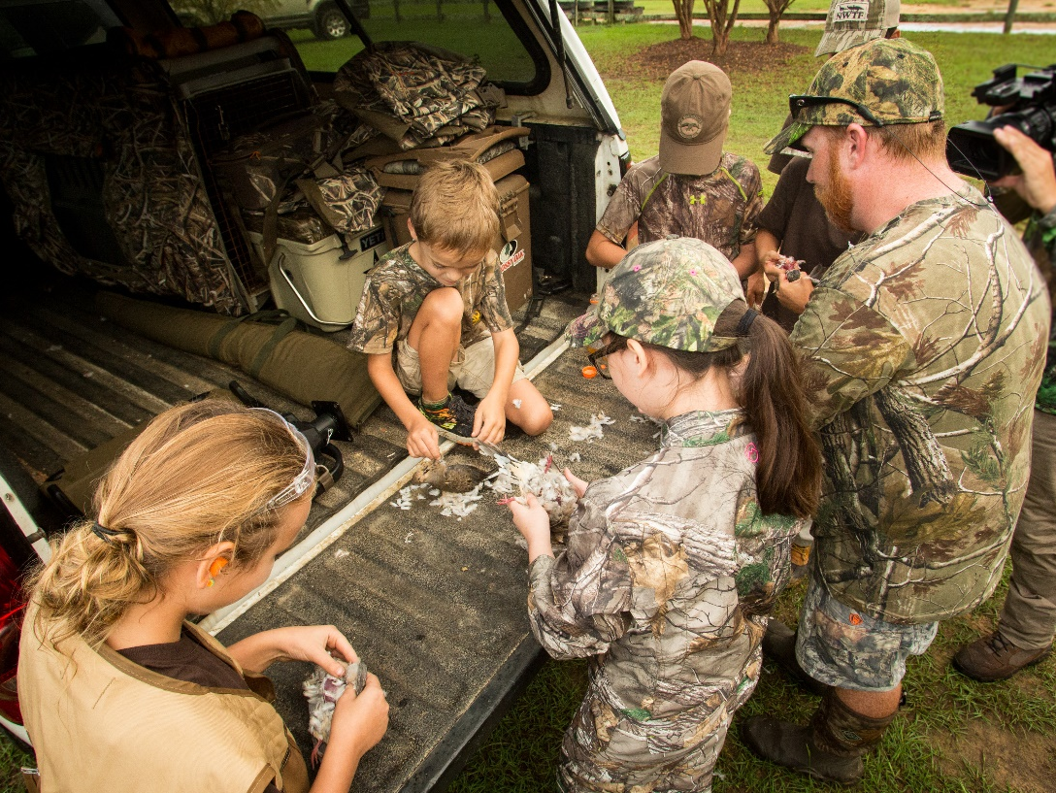
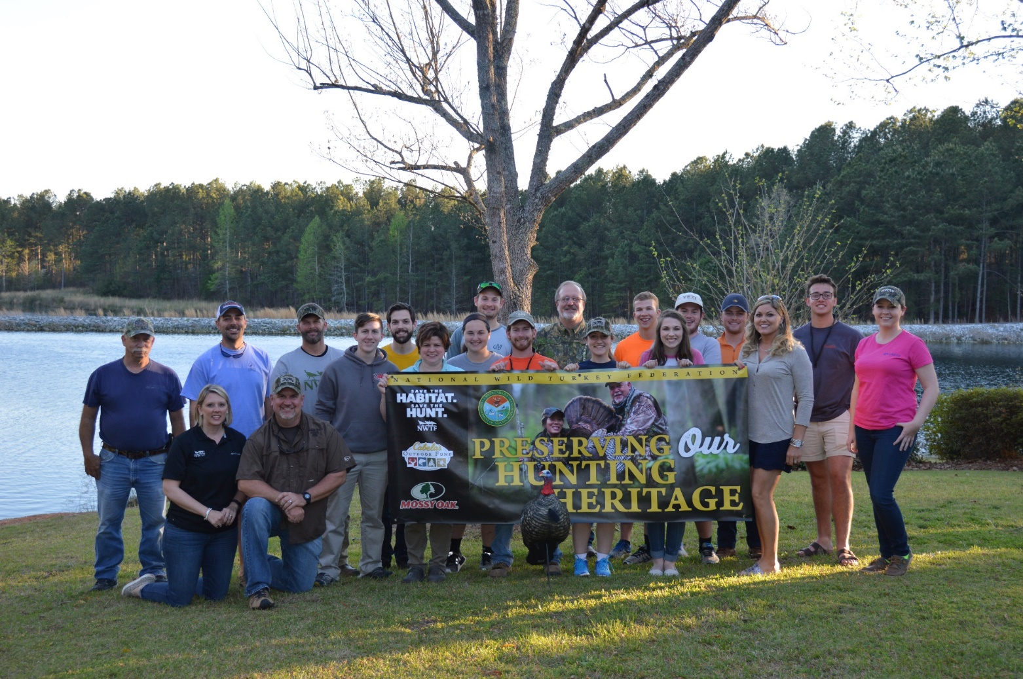
Collegiate and Adult Events
Family Events
Notes:
In 2014 we joined the R3 movement, RECRUITMENT, RETENTION AND REACTIVATION of hunters and shooters. This was a college cohort – turkey 101 following by a mentored turkey hunt.

Slide 7
SHOOTING SPORTS NATIONAL FUNDING
Since 2002 NWTF chapters have contributed through the NWTF Super Fund
$500K toward shooting range support
$2.1 million toward various Shooting Sports teams
This does not include funding chapters provide outside of the Super Fund.

Slide 8
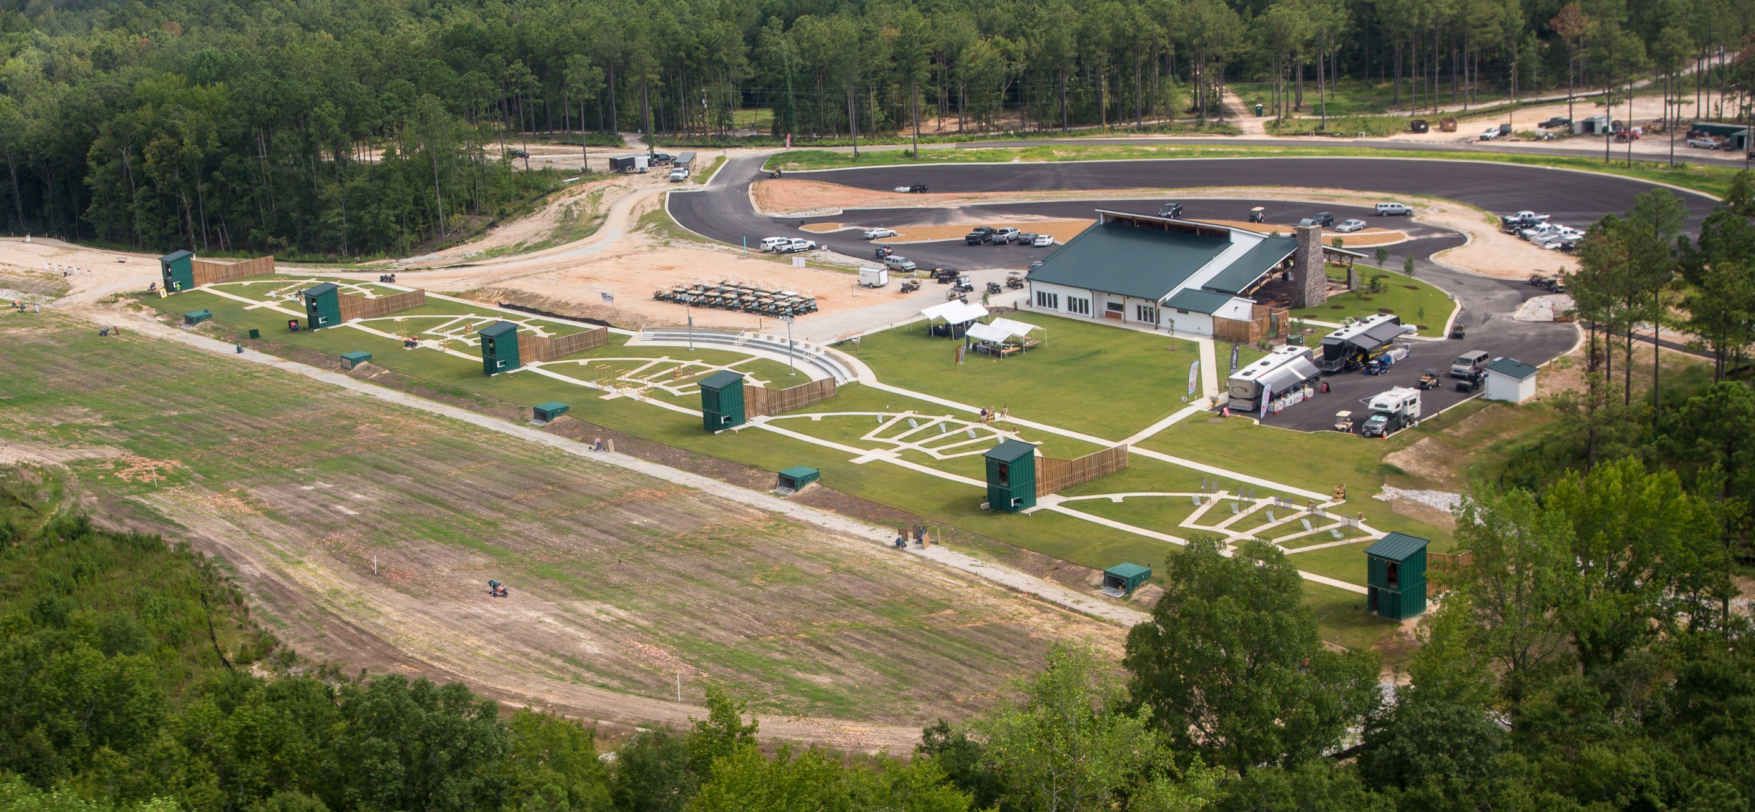
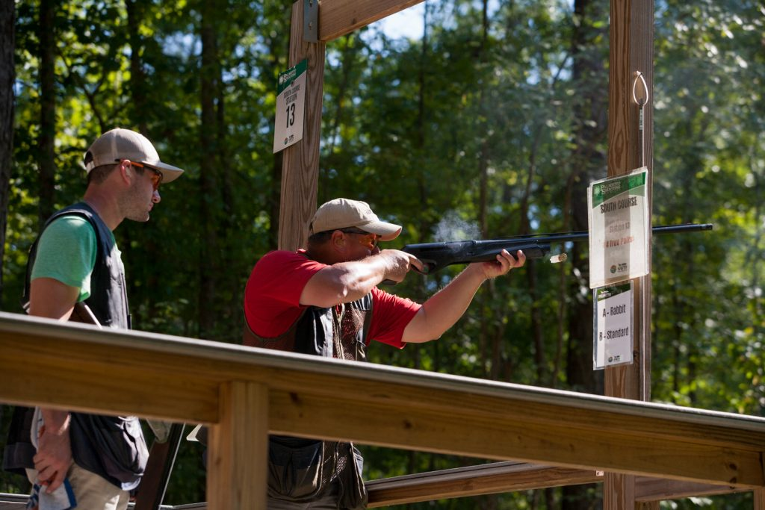
Palmetto Shooting Complex

Slide 9
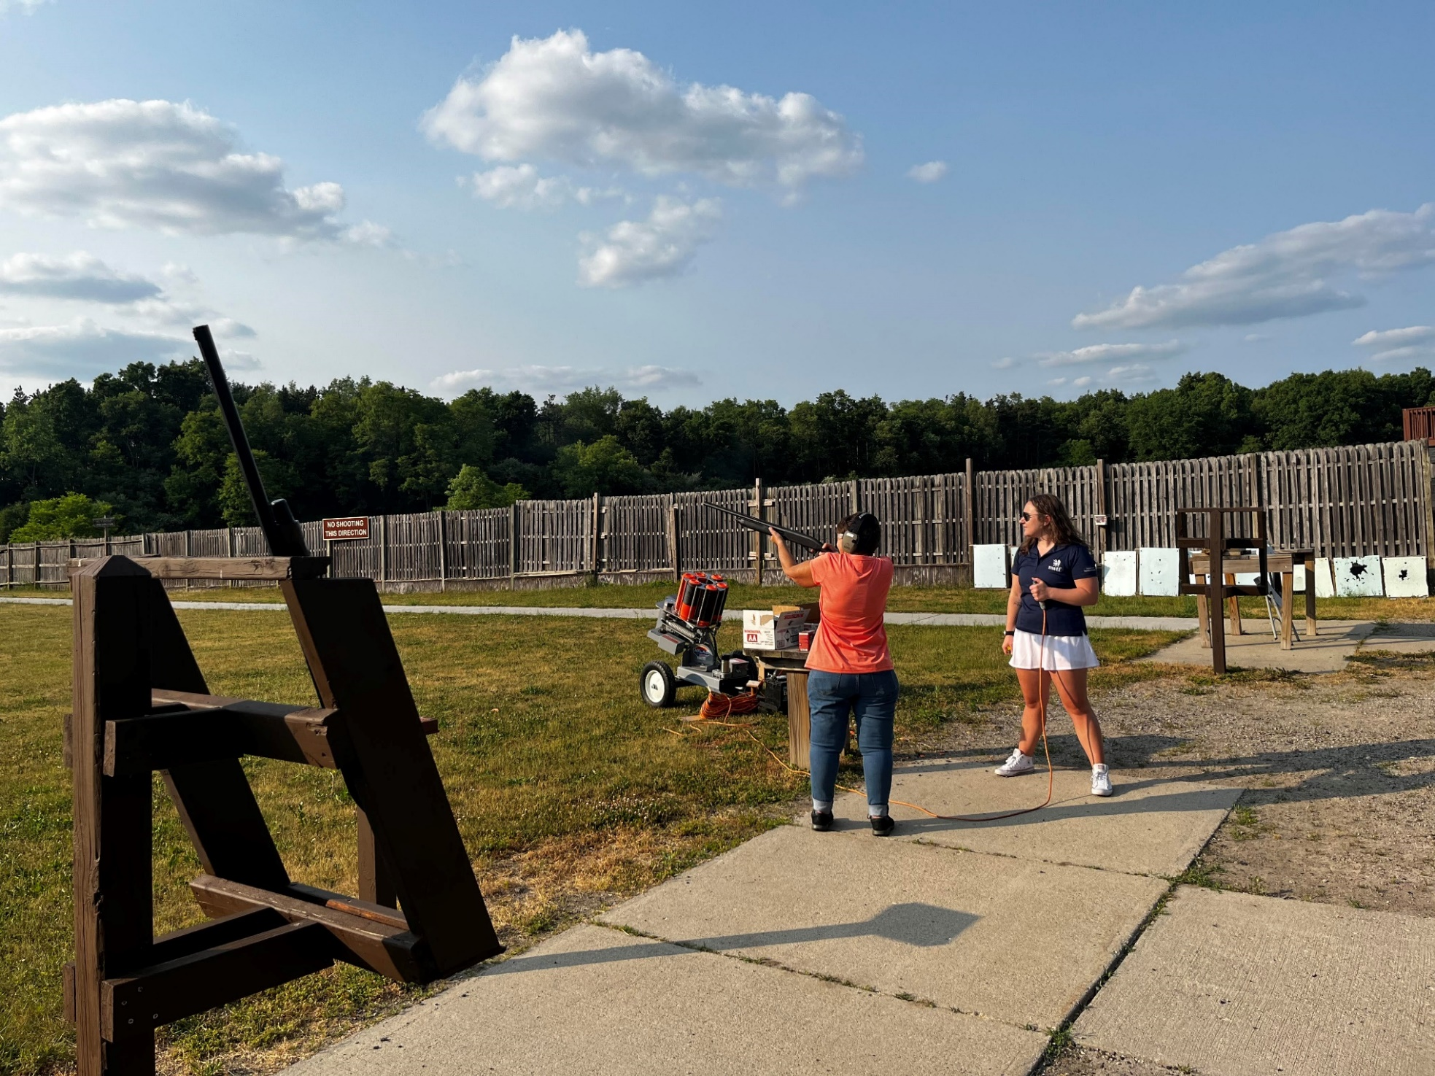
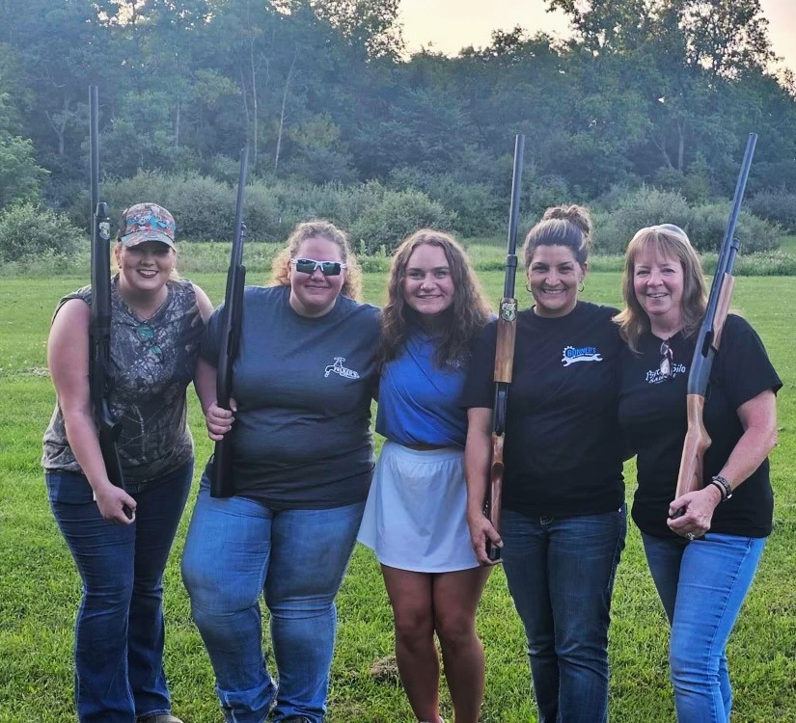
PARTNERSHIPS
Notes:
MI hosts approximately 30 events a year with some component of shooting sports included. JAKES Day, Wing Shooting Clinics, Mentored Hunts, Field Days … Michigan has a great partnership w/ Pheasant’s Forever and MI DNR where they host 12-15 wing shooting classes. Courses take place at shooting ranges near urban populations. These opportunities help build community in order for participants to feel comfortable moving forward in next step events.

Slide 10
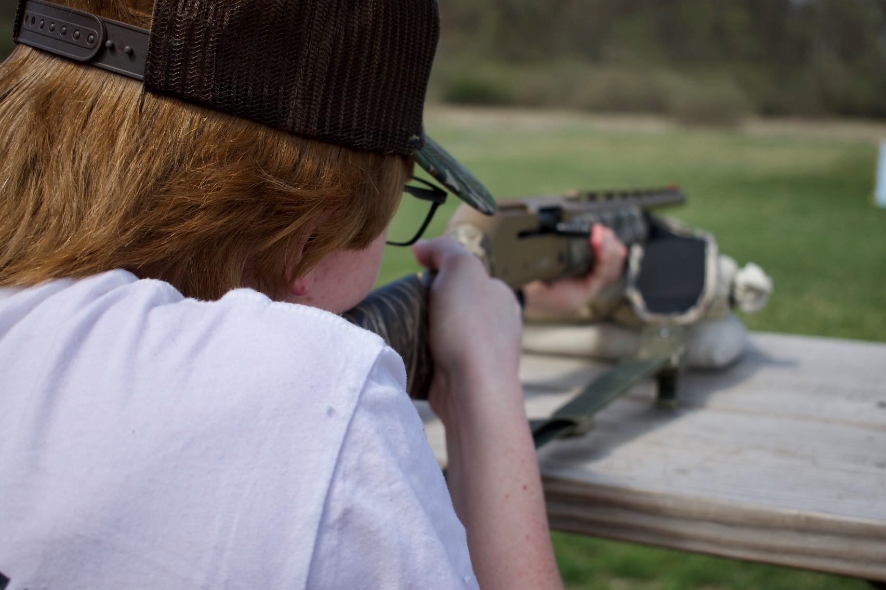
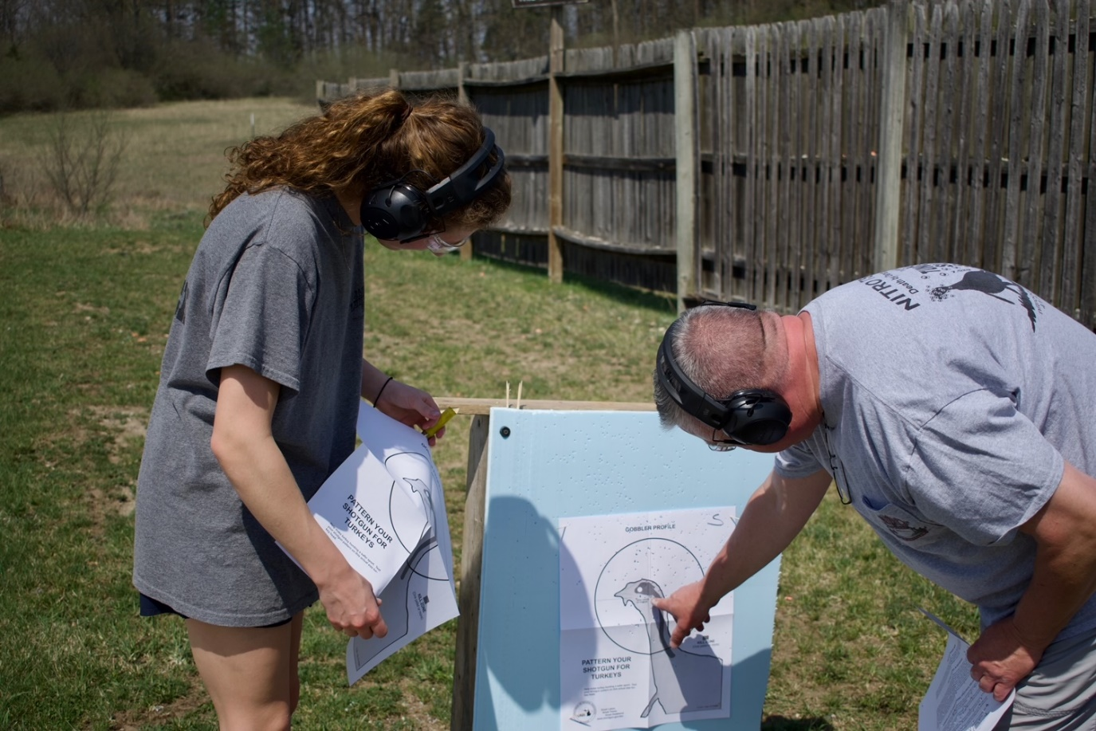
Notes:
This was a patterning day prior to a mentored hunt. State agency w/ PR funds helped with the events by funding ammo and targets.

Slide 11
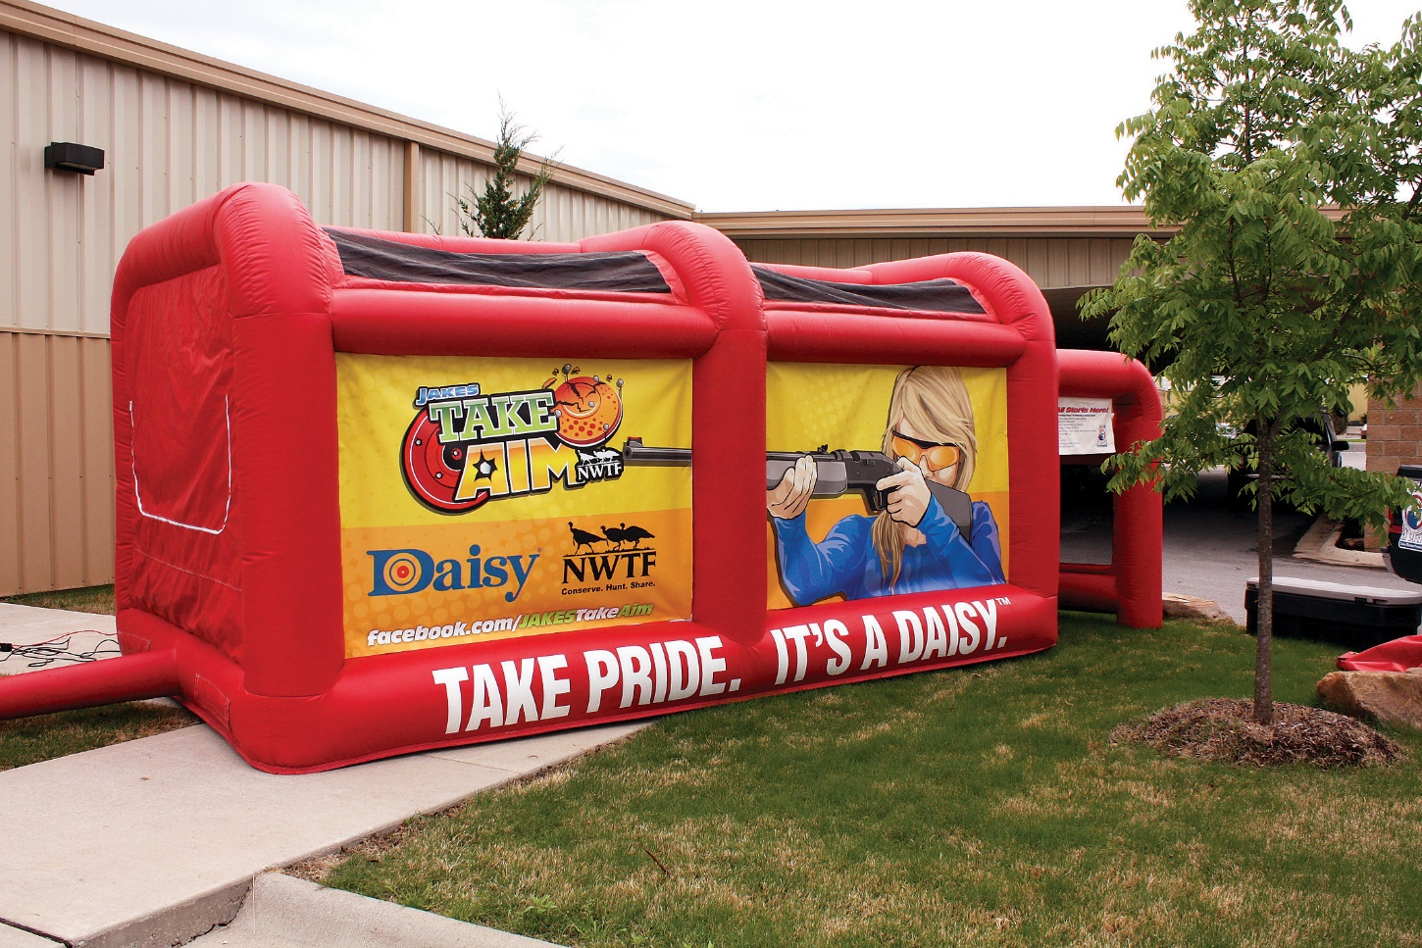
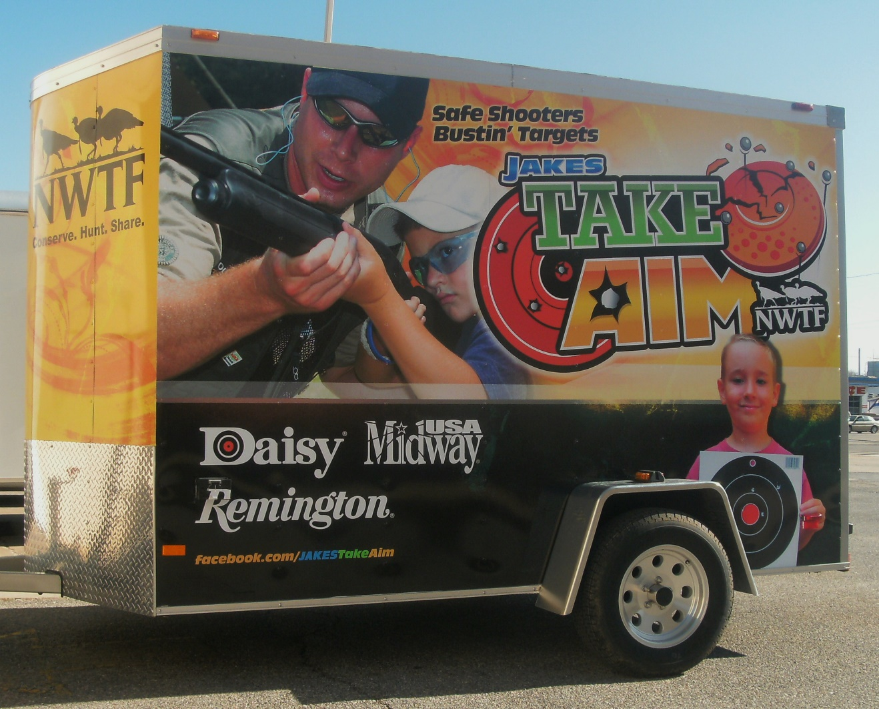
Notes:
Through a generous partnership with the MidWay USA Foundation and the Potterfields in 2010 48 trailers were purchased. We also partnered with Daisy Outdoor Products who provided inflatable air rifle ranges and equipped the trailers with the range and starter kits of various BB guns. This is one of our volunteers favorite tools they have been able to use to introduce the shooting sports around the country. Many states purchased additional trailers and ranges.

Slide 12
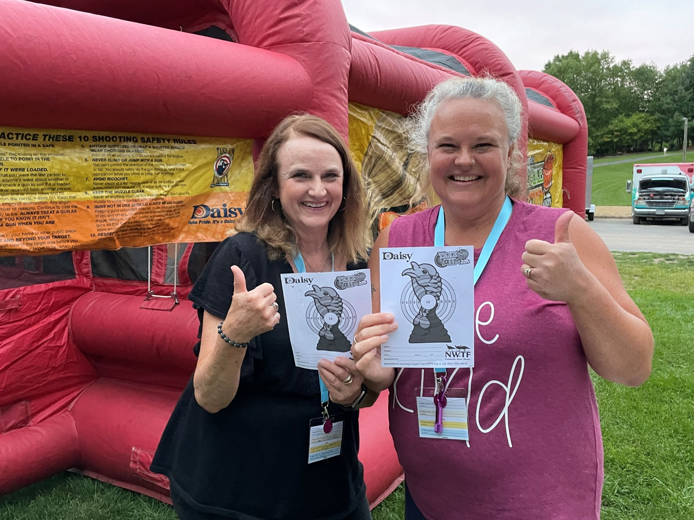
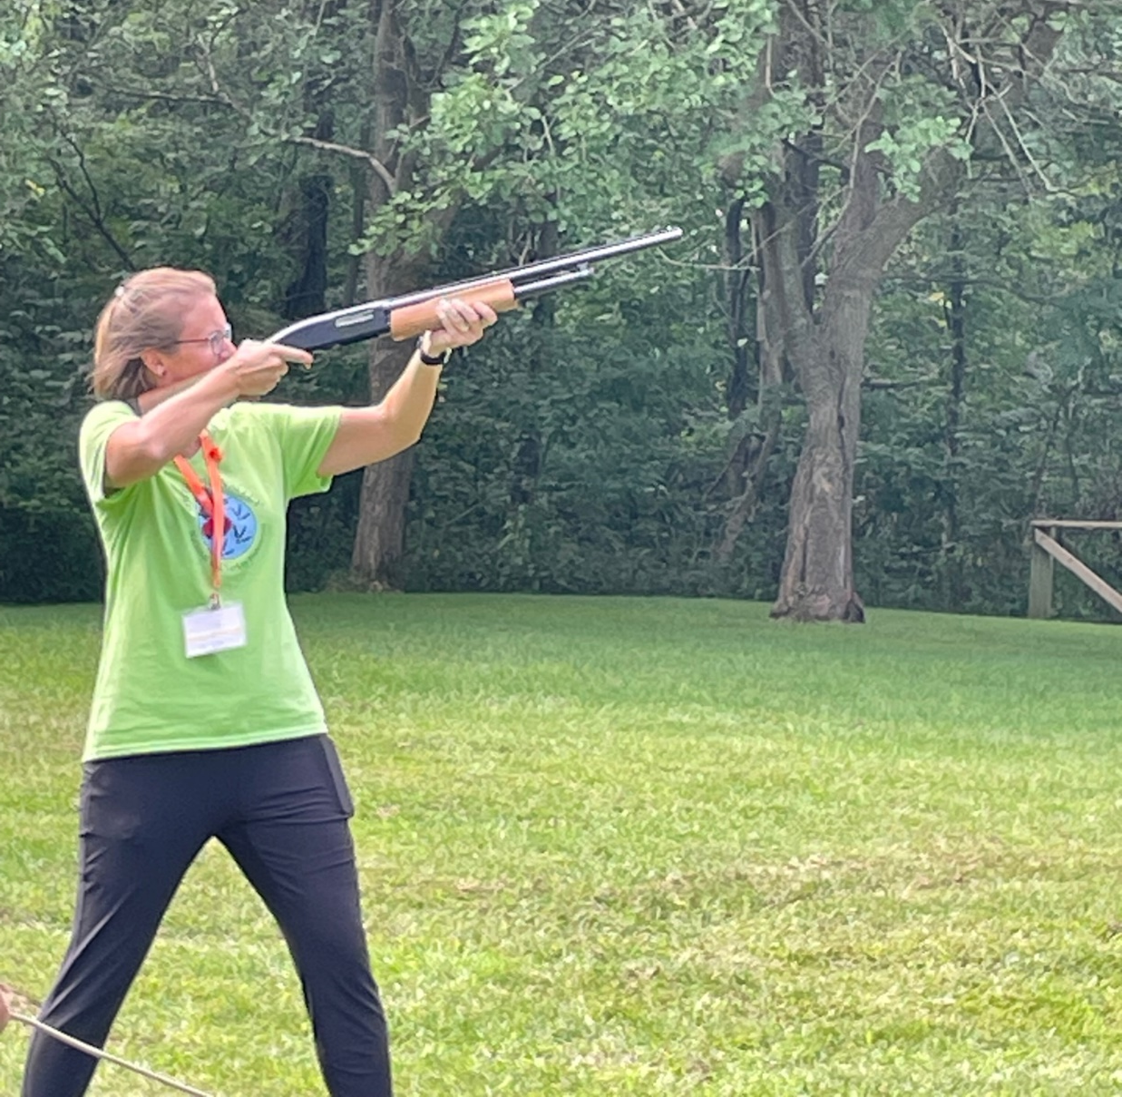
Notes:
WITO Event in Hastings, MI

Slide 13
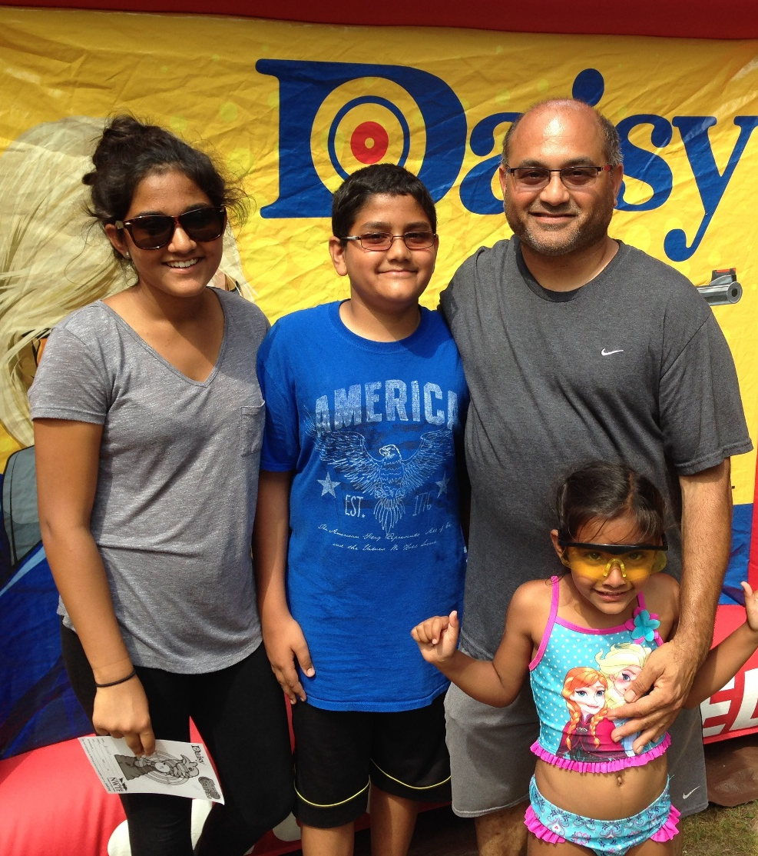
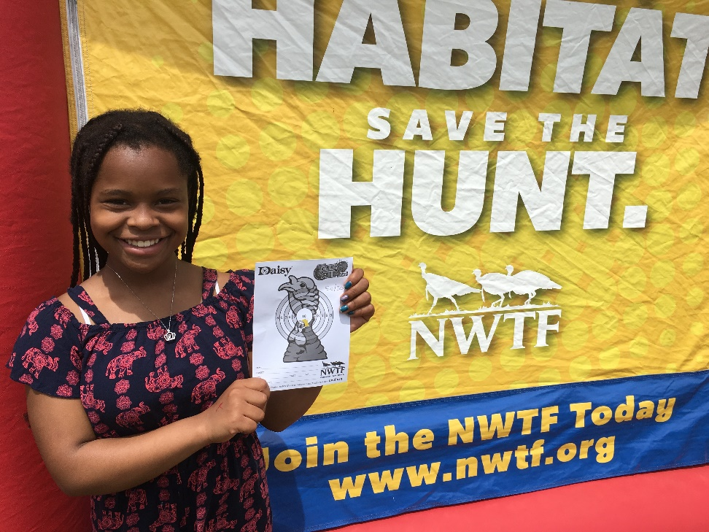
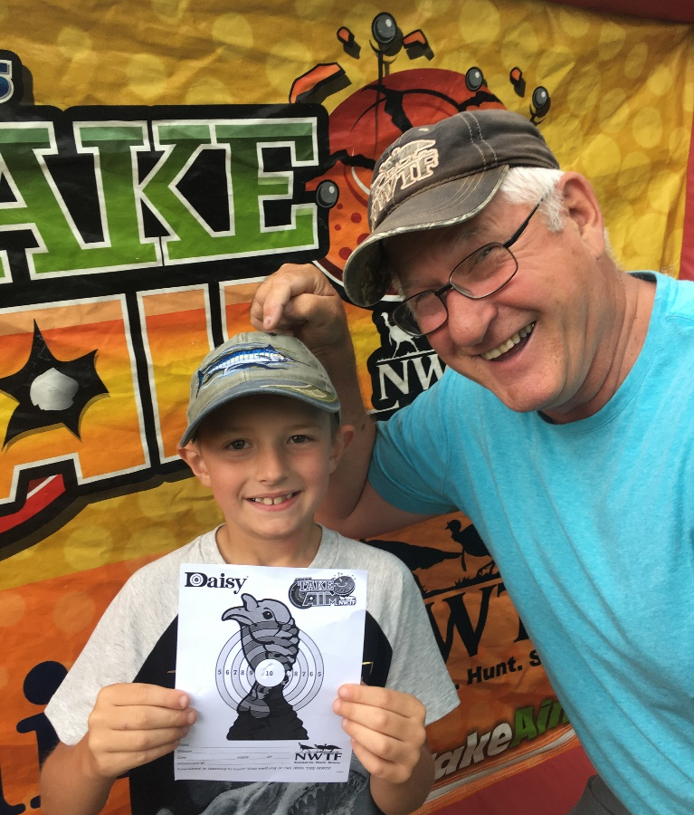
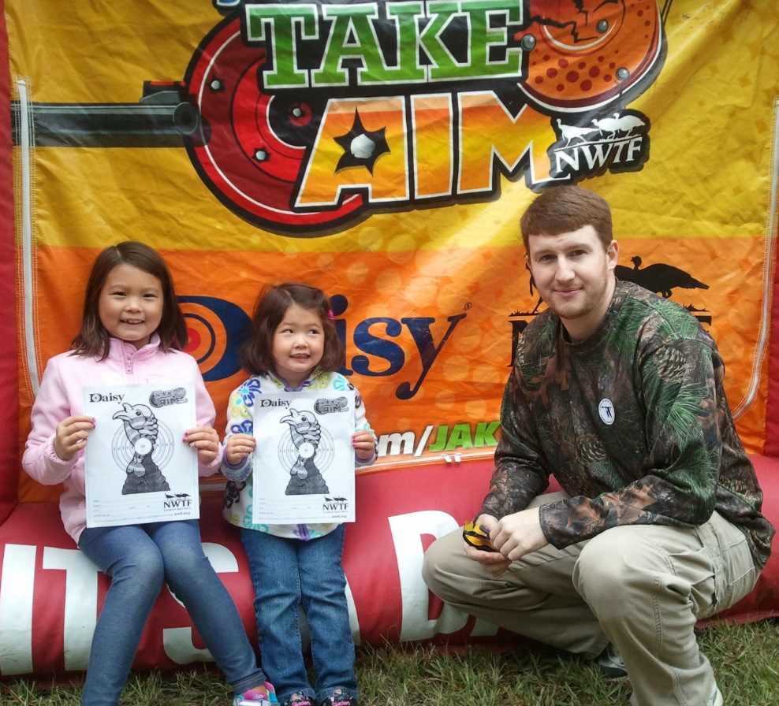
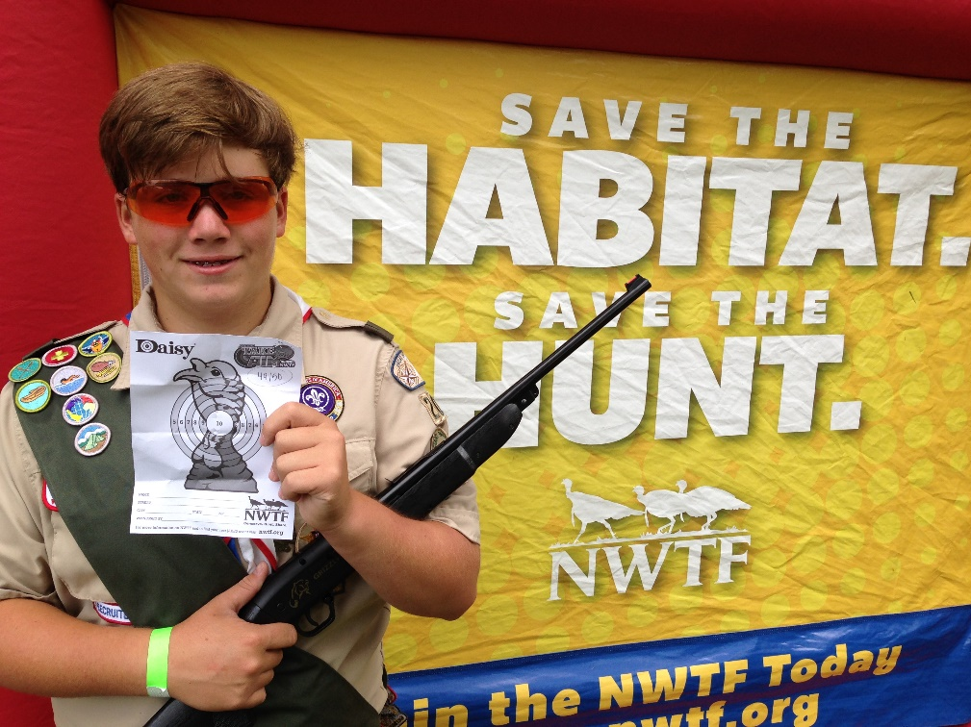
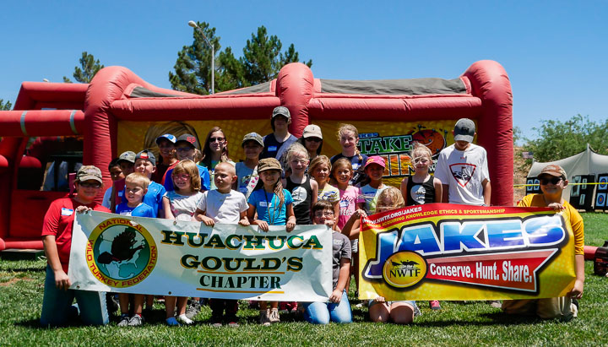
Notes:
The Glassen Foundation provided funding in Michigan to provide programming through the inflatable ranges in state parks across the country. This has brought in the family unit and many of whom have never shot a firearm at all. These individuals are invited back to other events including wing shooting and mentored hunts and we’ve been able to bring folks into the hunting family starting with these ranges.

Slide 14
60 Local NWTF chapters
Hosted 43 Education & Outreach
events this year
Nearly 11K participants
4H Shooting Sports - $5K in support
this year with over $100K given
over the years
MN High School Clay Target League - $8K for state along with $5K in local grants
($250 each)

Slide 15
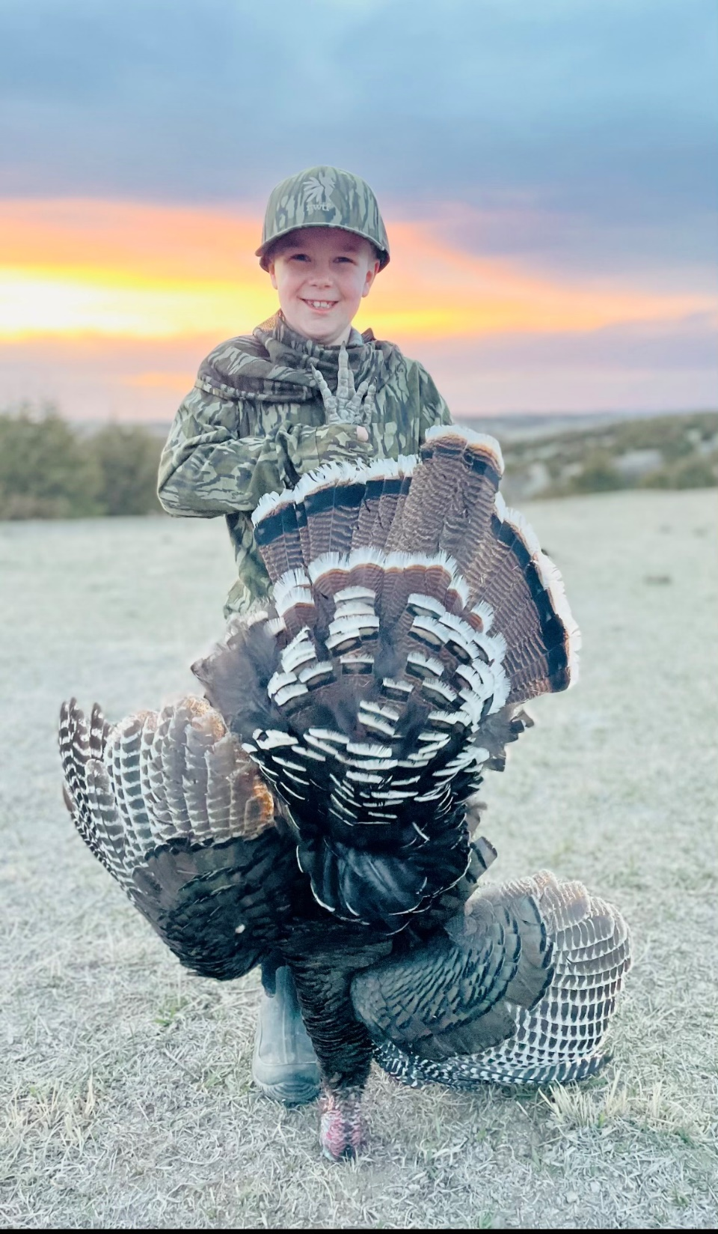
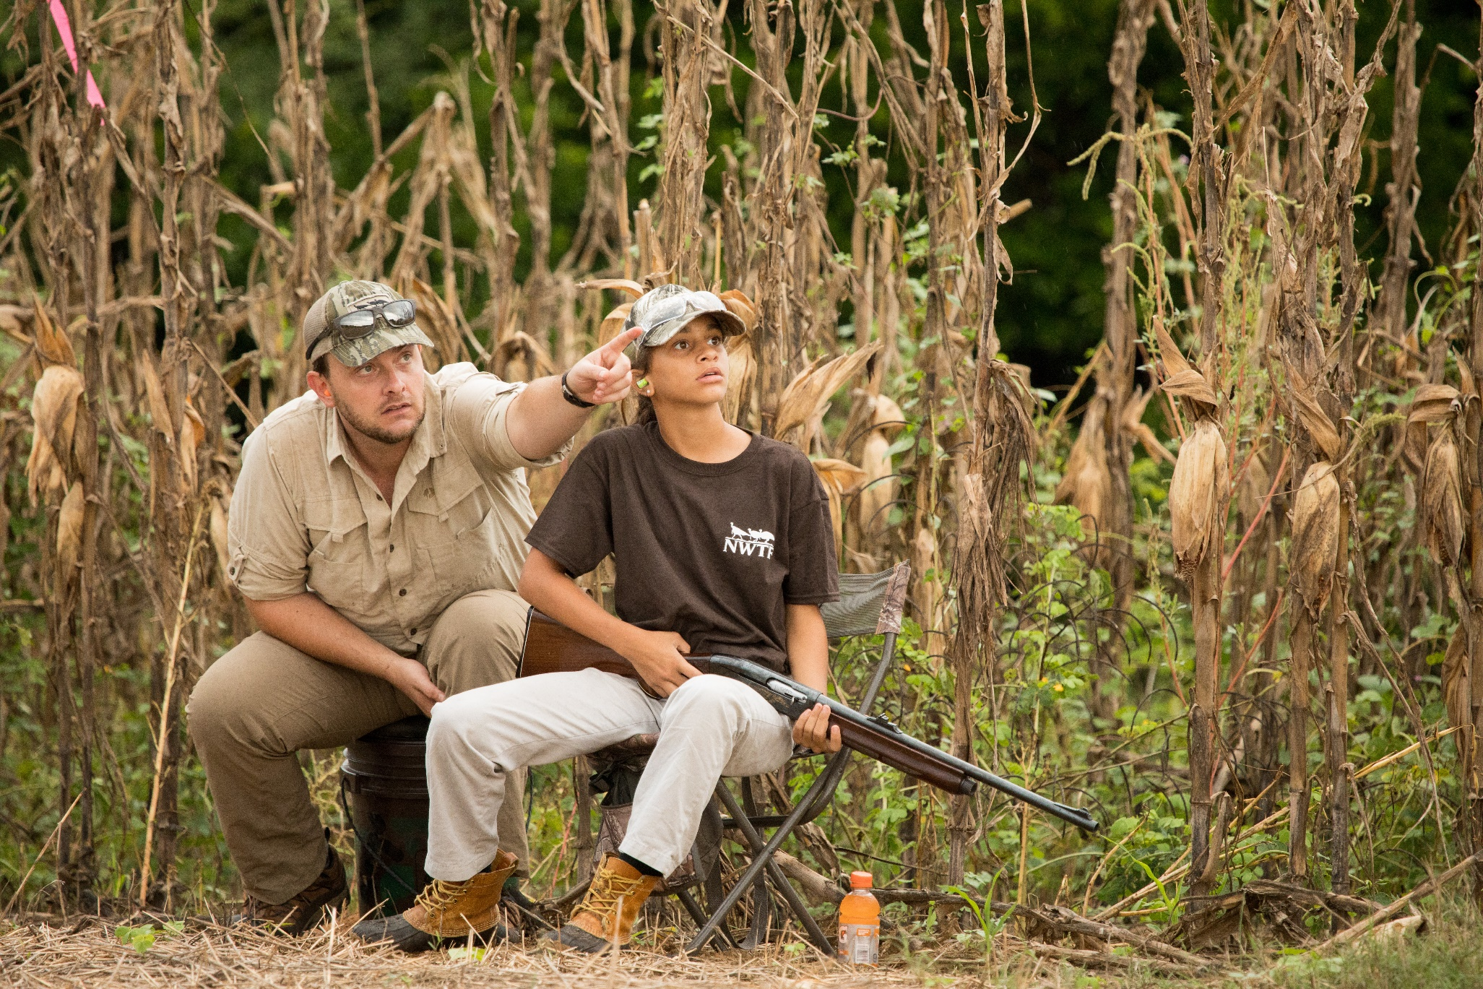
Notes:
Being comfortable around firearms and building up that community piece – these smaller aspects like shooting clinics and time with the bb gun range where small steps happen. Share about the lady from the WITO event who struggled with hunting due to the shooting aspects. You can’t hunt without learning how to shoot.

Slide 16
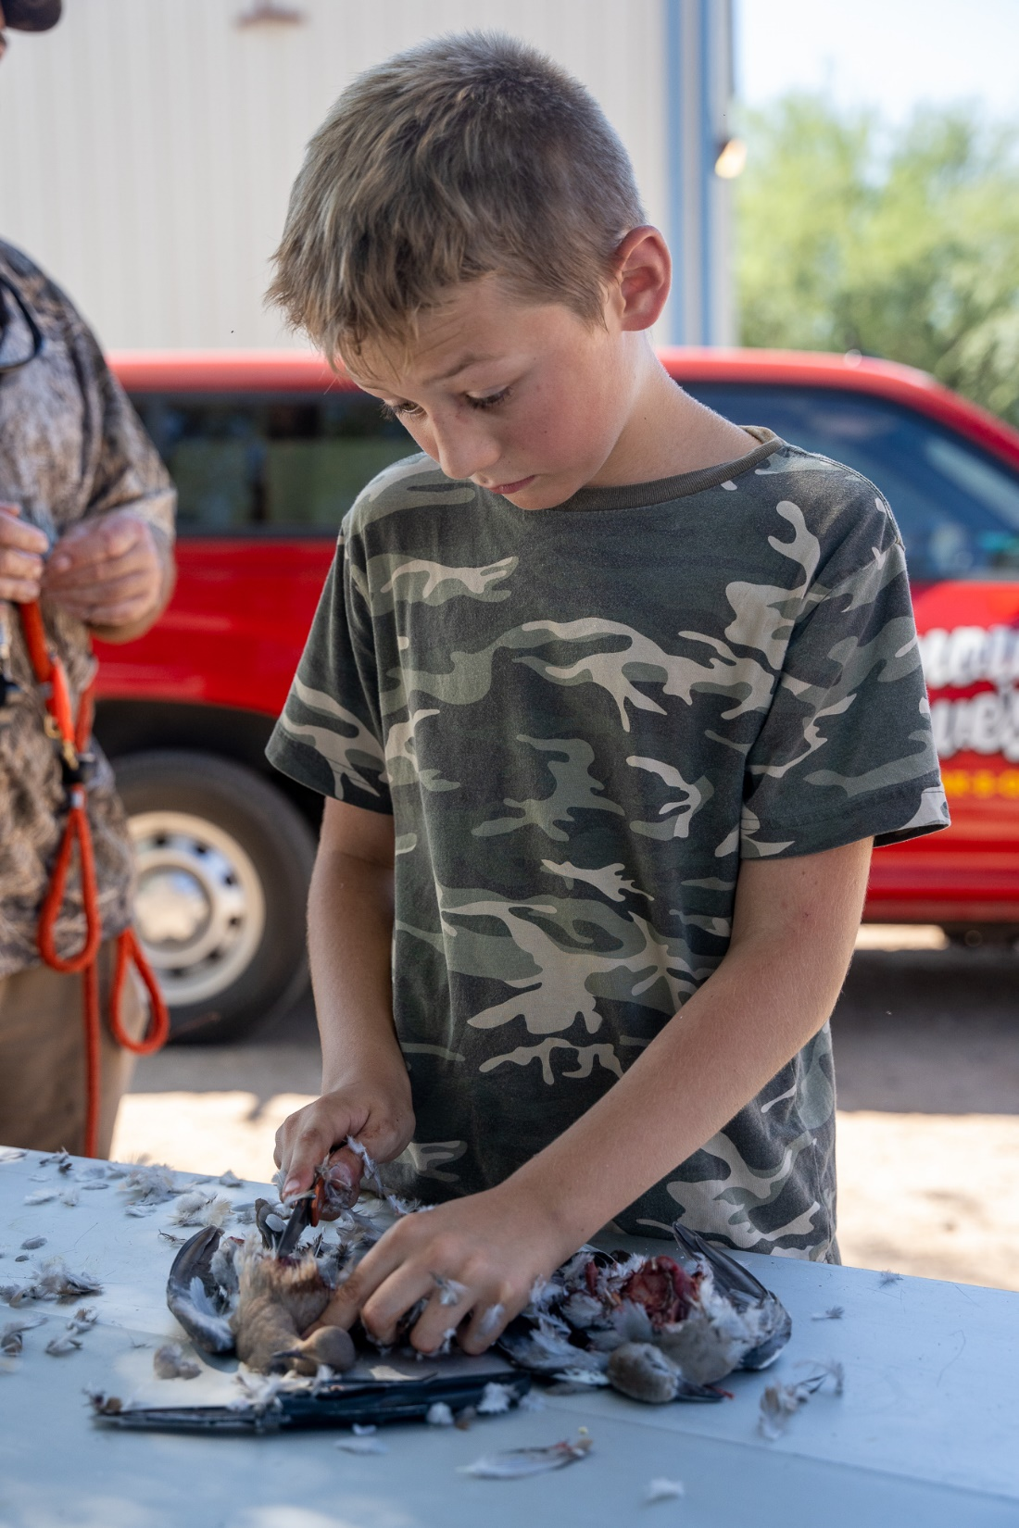
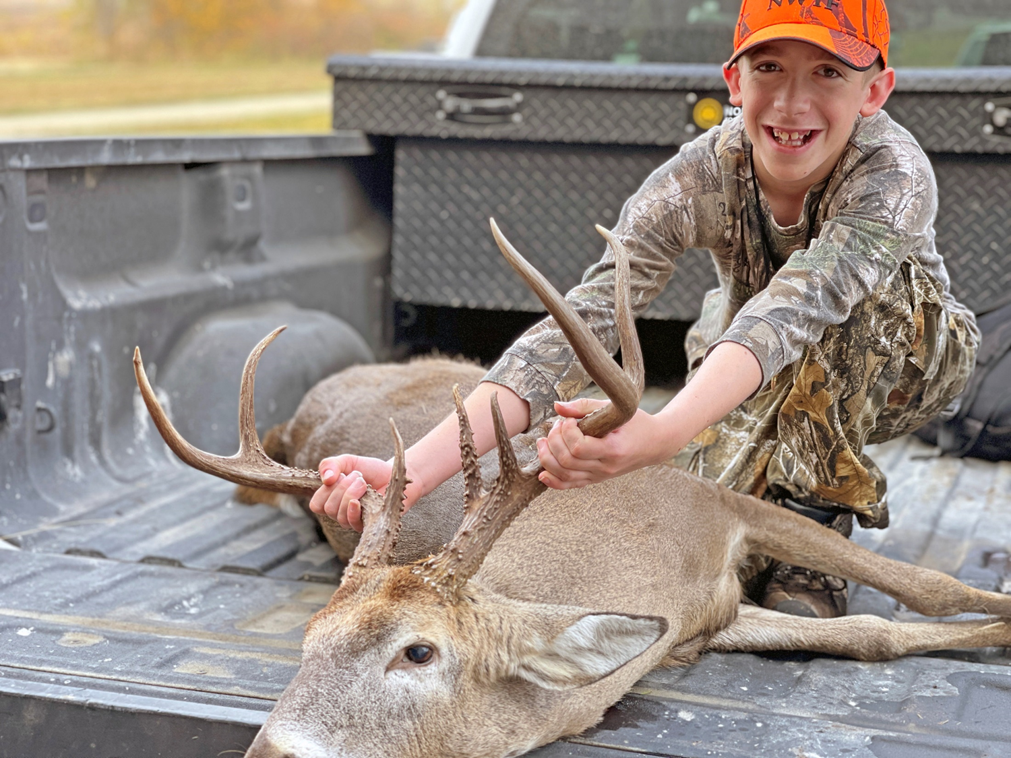

Slide 17
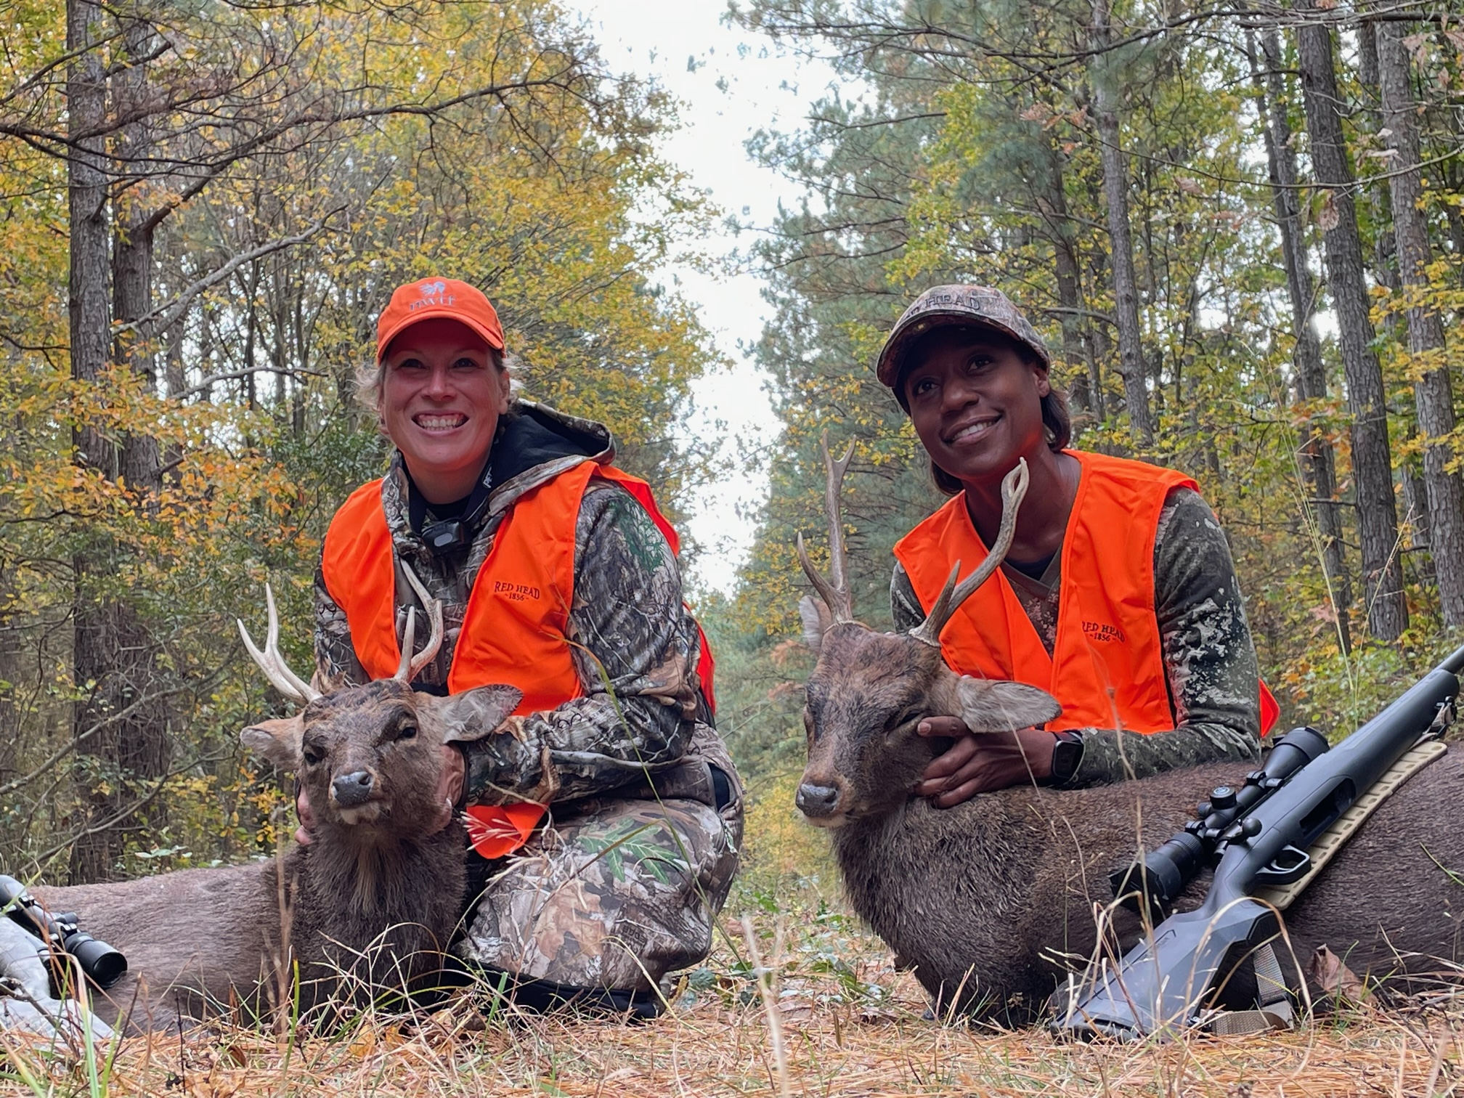

Slide 18
Teresa Carroll
National Wild Turkey Federation
Education & Outreach Program Coordinator
tcarroll@nwtf.net

