Slide 1
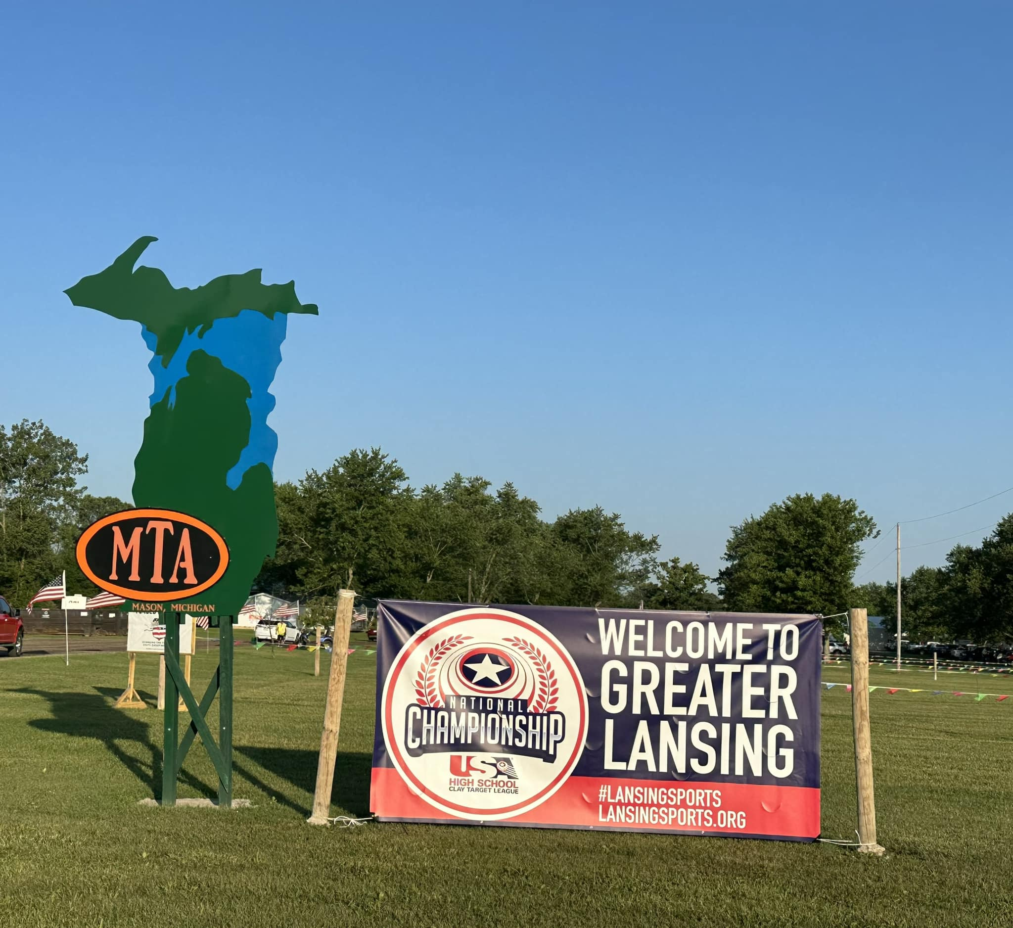
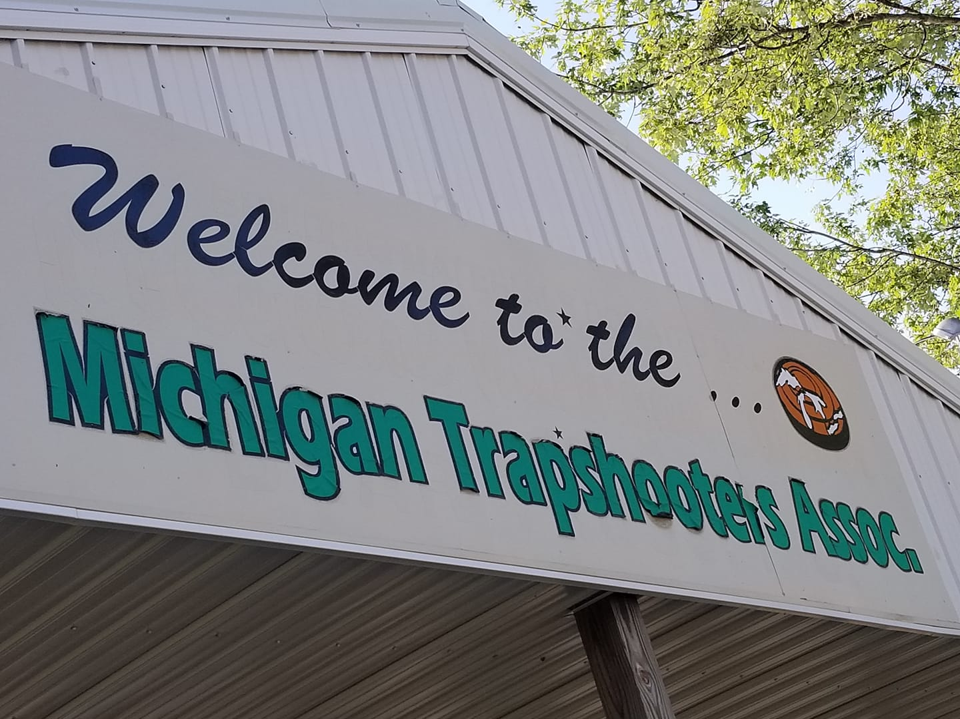
Michigan Trapshooting Association Home Grounds Becomes the Home of Michigan SCTP
Michigan Trapshooting Association Home Grounds Becomes the Home of Michigan SCTP

Slide 2
The Challenge – Venue Capacity
The size and participation in the Michigan SCTP program has grown steadily over the past ten plus years that I have been Vice President of the Board of Directors. Michigan has a strong skeet following but with limited facilities.
Michigan’s largest skeet facility has seven operable fields. This limitation required our organization to extend the State Tournament to three days…and we still had to turn away some athletes wishing to shoot skeet for lack of space.

Slide 3
The Solution – Partnership with Midway USA Foundation, MTA & MISCTP
The MTA previously held only trap events. Sporting 43 trap fields but on 270 acres with over 150 camp sites, situated about 10 miles south of the Michigan capitol and near ample lodging and restaurant infrastructure to facilitate very large events.

Slide 4
Unforeseen Design Complications
Typically, a combination skeet trap field requires 120 feet between the high house and the low house. When MTA was built, they did not envision adding additional disciplines, so the trap fields were spaced at 90 feet.
The surface infrastructure (sidewalks, lights etc.) were also installed without consideration for adding skeet fields in the future

Slide 5
The Design Solution

Slide 6
Design Solution cont’d

Slide 7
Design Solution Cont’d

Slide 8
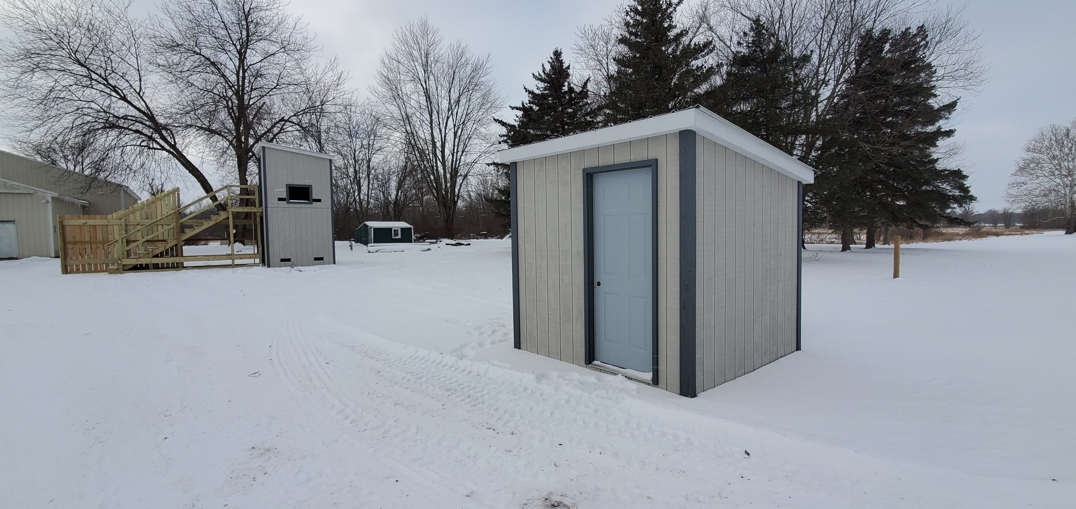
Interference with Trap Events
In order to ensure no interference with trap operations, the skeet fields were made modular, so as to be removed when not in use for events.

Slide 9
The Overlay
In order to maintain the correct orientation of a skeet field, connect to existing power supply and utilize existing lighting and grounds layout, it was necessary to build the bases for the skeet houses on every other trap field, maintaining the correct shotfall zones from the edge of the property.

Slide 11
Sk. 1

Slide 12
SK 2

Slide 13
Three Phase project with MUSAF and local partnerships
With assistance from local foundations, MTA, MISCTP and many individuals, the 50% match for phase 1 and phase 2 has been realized.
Phase 2 will be completed in early spring ‘24 and will boost the offering of the shooting grounds to: 43 trap fields, 8 skeet fields, 1 5-Stand and one 16-station sporting clays course.
Phase 3 planning has begun and at completion of the project, MTA will boast a total of 10 skeet fields, a second 16-station sporting clays course, a Helice ring and possible pistol bays to facilitate SASP and other rimfire or centerfire events.
This will make MTA the premier shooting grounds in the State and Region

Slide 14
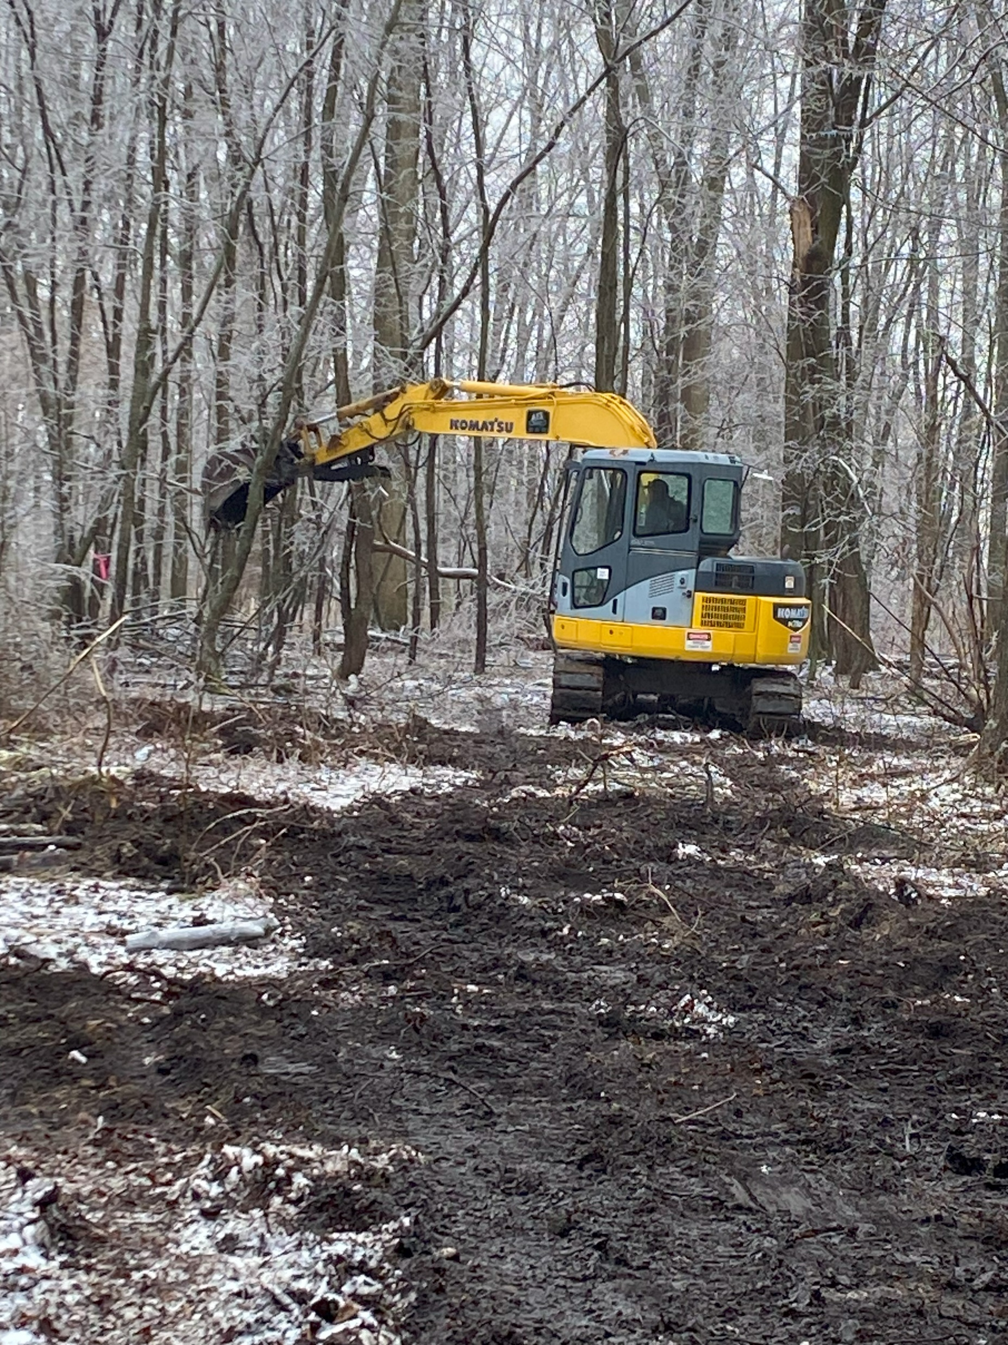
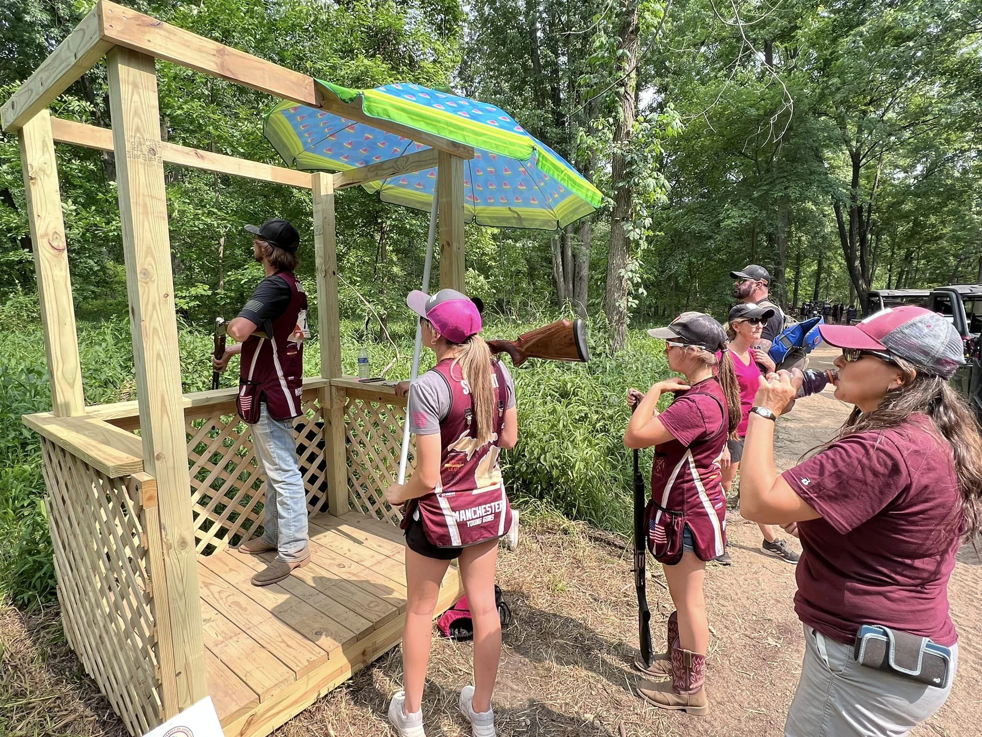
Sporting Clays Course – Perfect mix of woods and fields
The available acreage made for a course designers dream, with terrain and generous space for layouts.

Slide 15
Impact on Youth Shooting in the Region
Affiliates Who utilize the grounds: MISCTP, AIM, USCCTL (State), USCTL (Nationals), 4H, Michigan Sporting Clays Association, Michigan Trap Association.
With the available facilities more than 400 teams with a minimum of 10,000 total student athletes will benefit from this range improvement project.
Additional Events available to host: Michigan Skeet Championships, Michigan Sporting Clays Championship, Great Lakes Championship, Regional SCTP Invitational, Helice Tournaments.

Slide 16
This would not be possible without MUSAF

Slide 17
Questions???
Matthew Gay - MISCTP – Board of Directors - Vice President – Sporting Course Designer
Roger Marks PE – MISCTP Director - Project Coordinator/Skeet field Design
William Saylor – MISCTP Board of Directors – President
Loraine Malloy – MISCTP Board of Directors – Treasurer
Jeff Russell – MTA – Facilities and Construction Manager
Countless members of MTA, local donors and benefactors.

