Slide 1
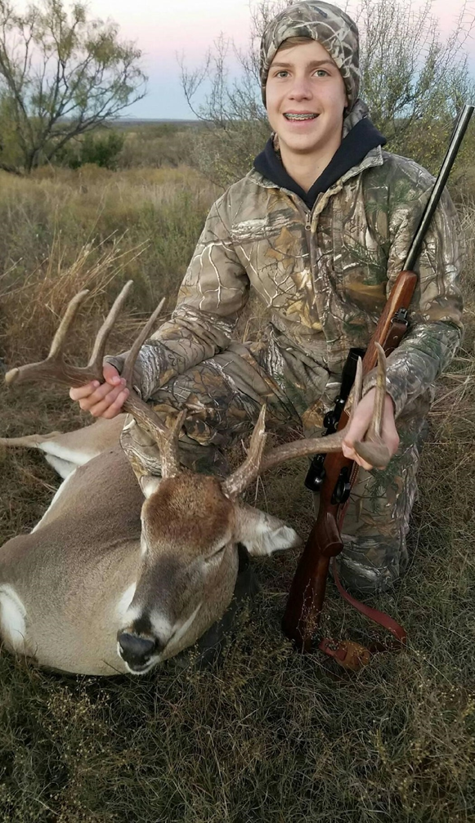
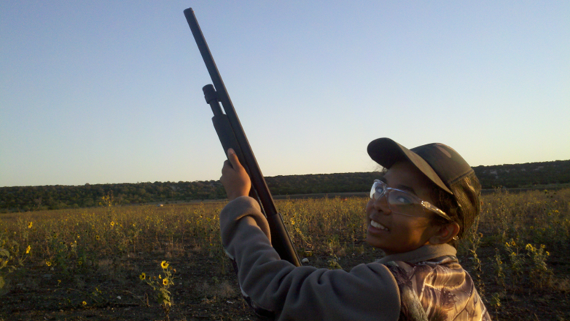
Outdoor Adventures K-12 is for ALL Students
Securing the Future of Hunting, Fishing and Wildlife Conservation through Outdoor Education

Slide 2
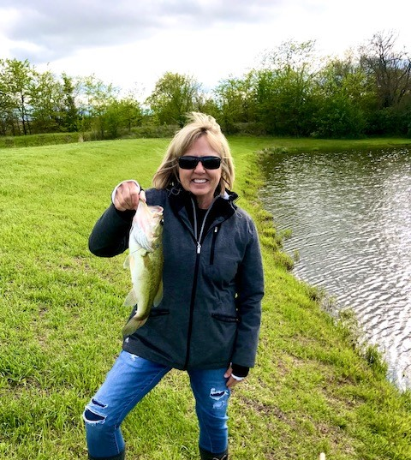
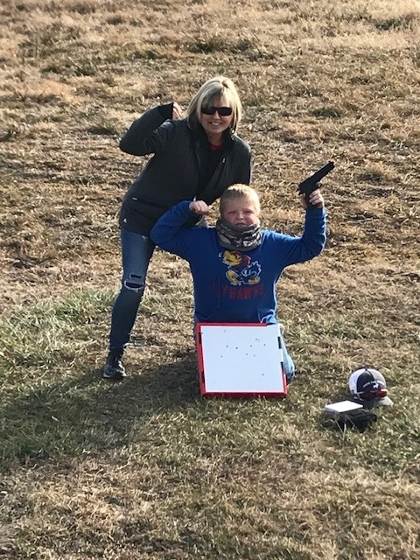
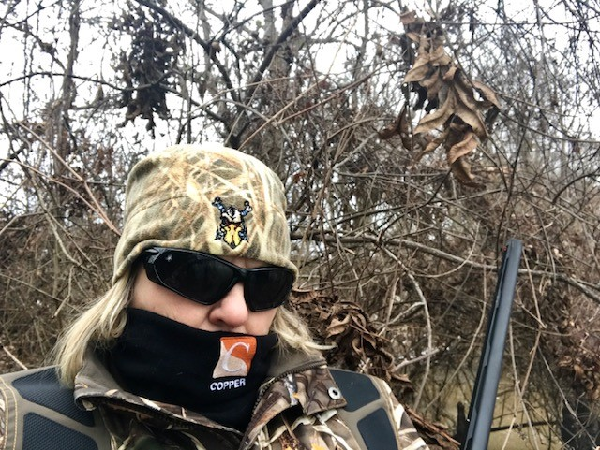
Tari Garner has taught physical education and adapted physical education for 40 years and has experience with elementary through university age students. She taught at the high school level for 19 years and was a head coach for two sports for 20+ years. Tari is a national board-certified teacher, SHAPE America board member and 2013 CD Teacher of the Year. She taught as an adapted specialist with the State School for Severely Disabled. She believes strongly in the benefits of Outdoor Adventure and has been fortunate to teach OA throughout her career. Tari is currently the Outdoor Adventure Coordinator for the Outdoors Tomorrow Foundation. She is a past MOSHAPE and Central District SHAPE America President and has been involved in a variety of leadership positions during her career. Tari is an advocate for Outdoor Adventures and teachers across the Nation.

Slide 3
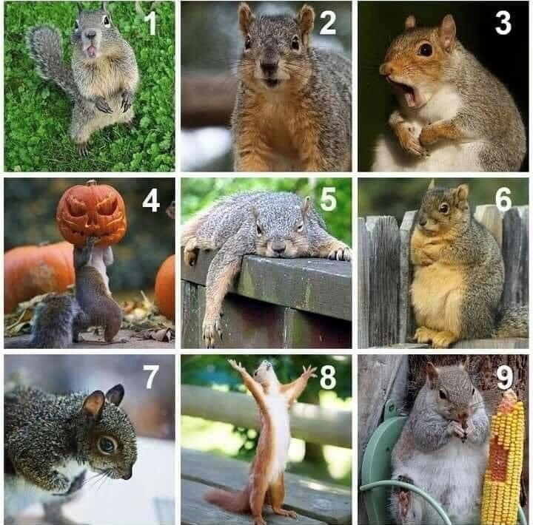
Ho
How do you feel about today?

Slide 4
MISSION
The mission of
Outdoors Tomorrow Foundation
is to teach outdoor education and
to promote and fund conservation
of wildlife worldwide

Slide 5
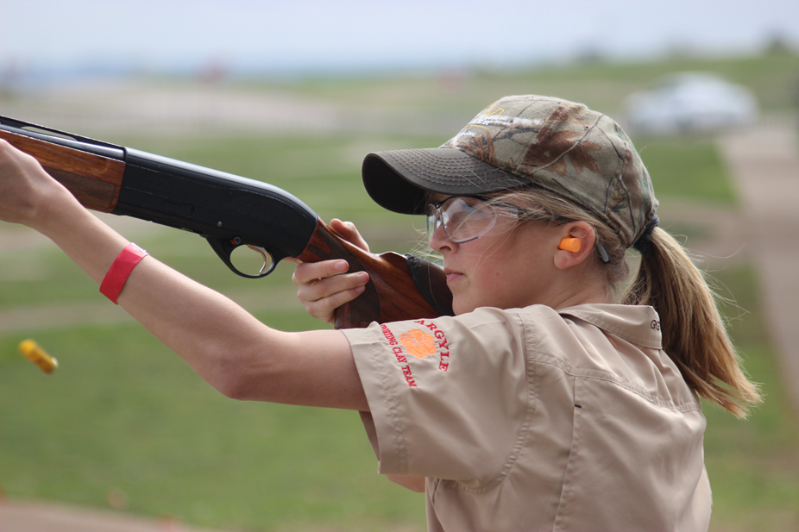
OTF 2023 Sponsors

Slide 6
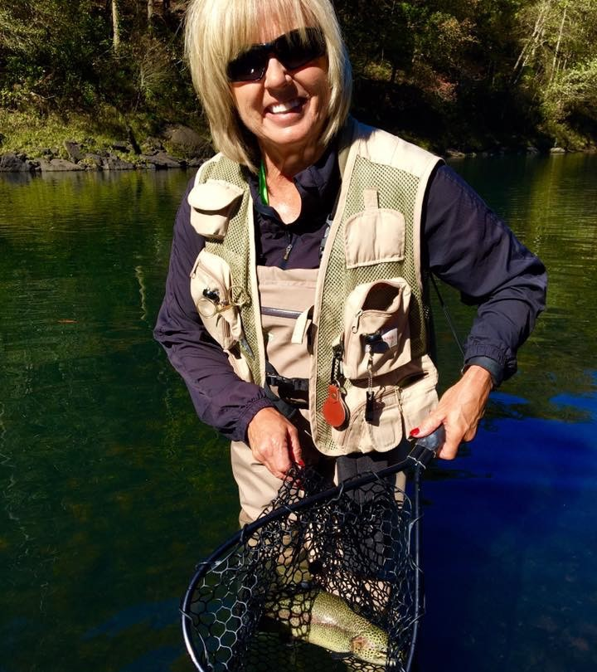
THINK ABOUT…

Slide 7
THE GOOD NEWS!
The Nature Alliance finds through their research Outdoor Education provides a host of Mental Health benefits including:
Enhanced brain development
Increased academic performance
Boundary exploration
Increased collaboration and communication skills
Improved resilience and self-regulation
Decreased ADHD symptoms
Increased physical activity/fitness levels
Understanding consequences
Promotes life-long outdoor learners and overall well-being.

Slide 8
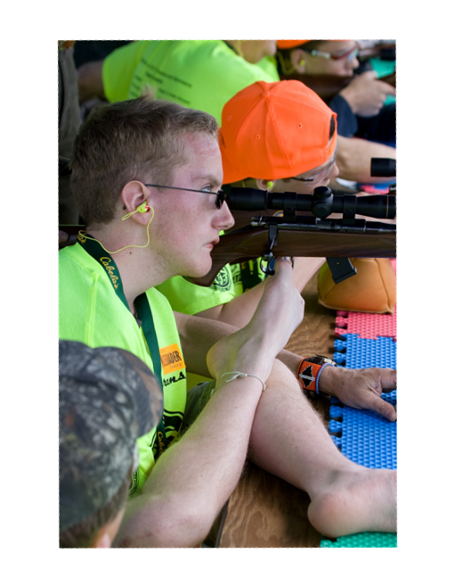
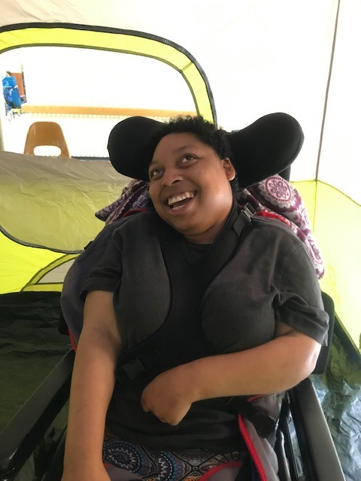
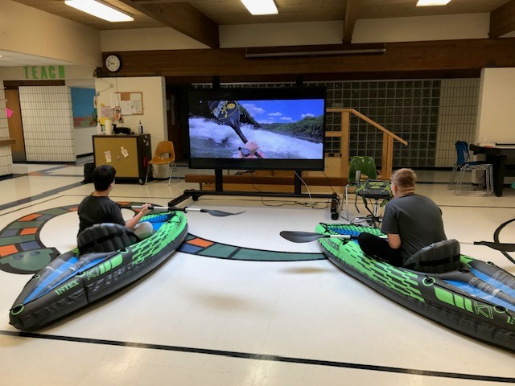
OUTDOOR ADVENTURE CURRICULUM IS INCLUSIVE FOR ALL STUDENTS

Slide 9
Outdoor Adventures
program includes:
Quail Conservation (PCQ)
Trapping
ATV Safety Course
Sling Shots
Fly Tying
3D Archery
Water Safety
Birding
Wildlife Photography
Archery NASP
Hunter Education
Boater Education
Orienteering and GPS
Survival Skills
First Aid/CPR
Angling
Backpacking
Camping
Challenge Course
Camp Cooking
North American Model Wildlife Conservation
Ice Fishing
Snowshoeing
Cross Country Skiing
Fauna Flora/Wilderness Medicine
Bikepacking
Rock Climbing
Paddle Sports
Shooting Sports Introduction
Water Buoyancy Project
Water Safety
OA Elementary K - 5
Hiking
Camping
Orienteering
Angler Education
NASP
Wildlife Conservation
Paddling
Survival
* additional 7 units for elementary with recommended grade level lessons and activities.

Slide 10
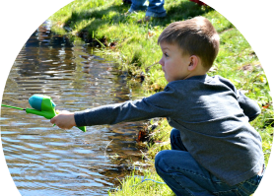
Curriculum Overview
Scope/Sequence for K - 12
Daily Lesson Plans and Slides, over 360 lessons
Standards aligned
Lesson objectives
Student expectations
Detailed class activities
Cardiovascular component
Enrichments
Distance Learning
Assessments
Modifications for different learners
Flexible, creative, allows for
teacher adjustments

Slide 11
19,800 Hunter Education Certificates
2023
Students are . . .
being taught wildlife conservation,
becoming certified in hunter education,
buying hunting and fishing licenses,
and being introduced to shooting sports.
1200
Schools
in 48 states
120,000+
Students/
Year
635,000+
Students
To Date

Slide 12
24.6 Million Contact Hours in 2023!
180
days/ hours
120,000
Students/
Year
21.6 Million Contact Hours

Slide 13
2023 Lesson 2: Types and Parts of a Shotgun
Course | Unit | Objective of lesson | Estimated Time Frame
Outdoor Adventures | Firearm Safety | The student is expected to understand the types of shotguns and their parts. | 45 minutes
Standards: |  | Materials Needed | Resources
National P.E. Standards: Standard 1: The physically literate individual demonstrates competency in a variety of motor skills and movement patterns. Standard 2: The physically literate individual applies knowledge of concepts, principles, strategies and tactics related to movement and performance. Standard 3: The physically literate individual demonstrates the knowledge and skills to achieve and maintain a health-enhancing level of physical activity and fitness. Standard 4: The physically literate individual exhibits responsible personal and social behavior that respects self and others. Standard 5: The physically literate individual recognizes the value of physical activity for health, enjoyment, challenge, self-expression and/or social interaction. TEKS 116.63 The student is expected to: c2(B) identify critical elements for a successful performance during a specific activity. c4(E) design a personal wellness plan that includes time engaging in outdoor pursuits. c5(A) list and describe safety equipment used in selected lifetime recreation and outdoor pursuits. c5(B) explain and follow safety procedures during selected lifetime recreation and outdoor pursuits. c5(G) design safe practices and procedures to improve skill during an activity. |  | Computer or internet device A projector if using 2023 - Firearm Safety - Lesson 2 - Types and Parts of a Shotgun Slides | Video: Introduction to Firearms: Basics of Shotguns Video: Schools Challenge TV - How to buy your first shotgun Video: Hunting Shotgun choices and chokes Video: Types of Chokes Article: 10 Fun Activities for Kids to Work on Shoulder Strengthening Article: Choose Shotgun Shells and Chokes: 12 Steps Video: Firearm Science - Types of Shotguns - YouTube Article: Shotguns

Slide 14
Day 2 Open 2023 - Firearm Safety - Lesson 2 - Types and Parts of a Shotgun Slides Introductory Activity: How does a safety work on firearms? Can safety devices be trusted? No Classroom Discussion: Where are safety devices found on a shotgun? By the trigger, on top of the stock near the breach Cardiorespiratory Activity: What are some of the strength exercises necessary to help build accuracy and stamina while shooting firearms? Review upper body strength exercises/lifts necessary to be competitive in shooting sports. Practice these activities – 10 minutes. Exercises: 10 Fun Activities for Kids to Work on Shoulder Strengthening Types and parts of a shotgun: Video: Introduction to Firearms: Basics of Shotguns Article: Shotguns Video: Schools Challenge TV - How to buy your first shotgun Video: Hunting Shotgun choices and chokes Types of shotguns: Firearm Science - Types of Shotguns - YouTube Hinge Action, Single Barrel or Double Barrel (Over and Under or Side by Side) Pump Action, Semi-Auto Action, Lever Action, Bolt Action Parts of a shotgun: Stock, Bolt, Trigger, Trigger guard, Barrel, Bolt Spring, Hammer, Firing pin, Front sight, Magazine, Chamber, Ejector, Extractor, Safety, Fore end https://tpwd.texas.gov/education/hunter-education/online-course/firearms-and-ammunition-1 Use the following weblinks to cover the contents on shotgun shells and chokes: Choose Shotgun Shells and Chokes: 12 Steps Shot shells: Parts of a shot and slug shell: Case, Primer, Powder, Wad, Shot/Slug Shotgun gauges: 10 ga., 12 ga., 16 ga., 20 ga., 28 ga., .410 ga. Chokes – A good YouTube video on chokes: Types of Chokes Types: Full, Modified, Improved Modified, Cylinder, Improved Cylinder Assessment: Students can “pair and share” What are some different types of shotguns? What is important to choose before you go hunting?
Vocabulary | Handgun, trigger, hammer, firing pin, hinge action, single barrel, double barrel, pump action, semi-auto, lever action bolt action, stock, bolt, bolt spring, front sight, magazine, chamber, ejector, extractor, fore end, case, primer, powder, wad, shot, slug, gauge, modified, cylinder.
Formative Assessments |  | Summative Assessments | Suggested Modifications | Enrichment/Distance Learning
Participation in physical activity, Teacher observation, Peer assessment, Journal Entry notes/worksheet, unit quiz. |  | Firearm Safety Exam or individual firearm quizzes in lesson 8. | Provide guided notes for the articles and videos. | Compare and contrast the different actions, gauges and spread of shot. Create 3D models of shotshells. Visit a local gunsmith shop. Have a police officer show how to load and unload each type of action if appropriate for school – get school approval first.

Slide 15
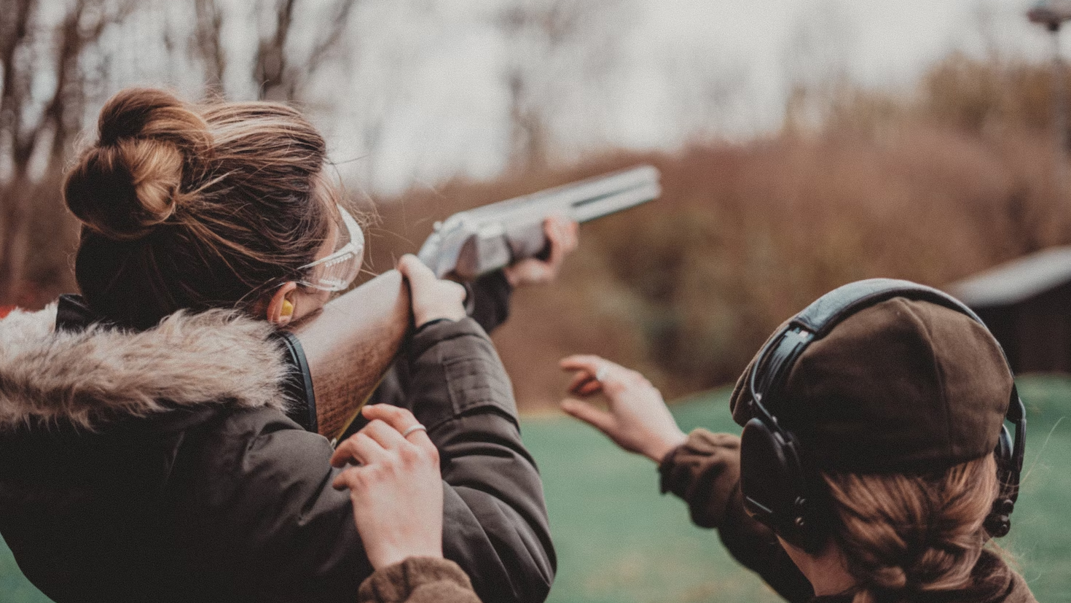
Types of Shotguns
Hinge Action
Single Barrel or Double Barrel (Over and Under or Side by Side)
Pump Action
Semi-Auto Action
Lever Action
Bolt Action

Slide 16
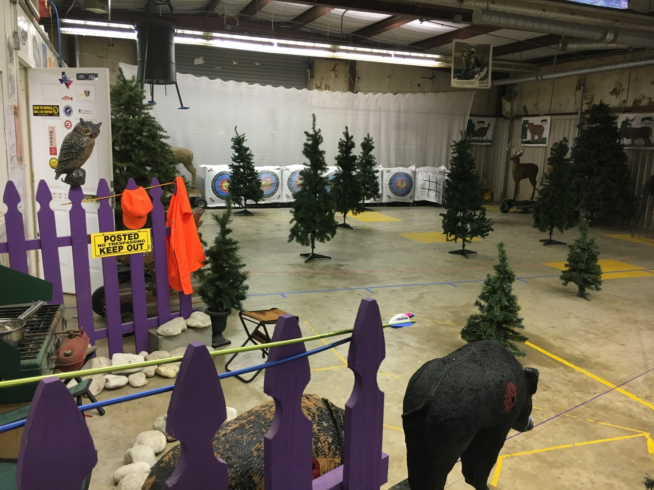
Archery Clubs and Archery Ranges
CREATIVE
CLASSROOM
DESIGN

Slide 18
THANK YOU
Tari Garner
Tari@GoOTF.com www.GoOTF.com
816-739-1107 cell
@garnert10s

