Slide 1
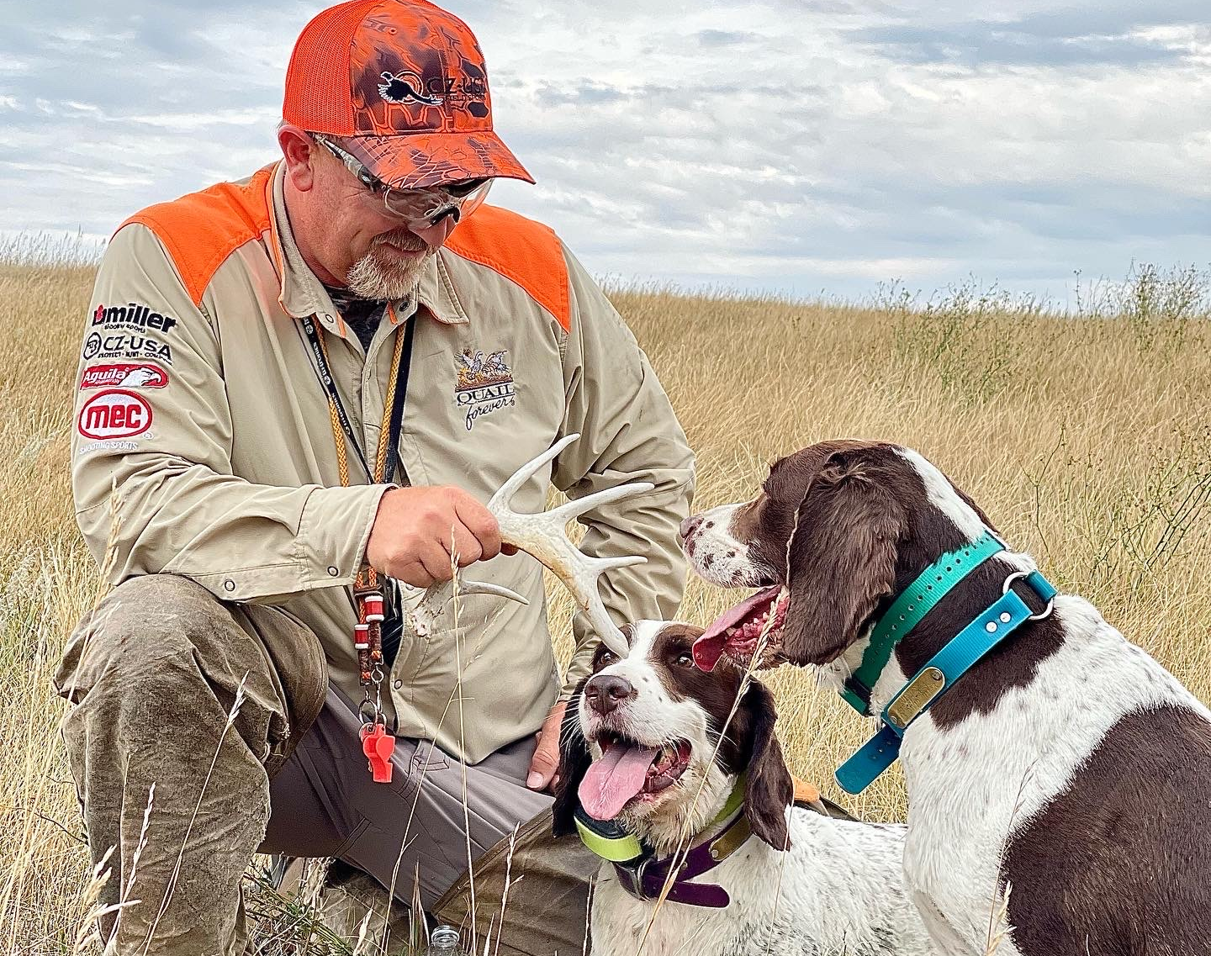
David Miller
National Sporting Clays Association Level 3 Instructor and Level 1 Certifying Instructor
Two-time Guinness World Record Holder in clay shooting
The Most Clay Targets Shot In One Hour - Total 3653
The Most Clay Targets Shot In 12 Hours By A Team Of Five – Total 14,167
Employed as the CZ-USA Shotgun Expert 16 years
Expert Gun Fitter
NRA Range Safety Officer Certified
NRA Shotgun Instructor Level 1
Scholastic Clay Target Program Shooting Coach
Multi-State American Sporting Clays & English Sporting Champion
17 Year Master Class Competitor
Professional Sporting Clay Course Designer
Pro Shooter “American Bird Hunter” TV Series
Professional Exhibition Shooter
Avid Upland Bird Hunter

Slide 2
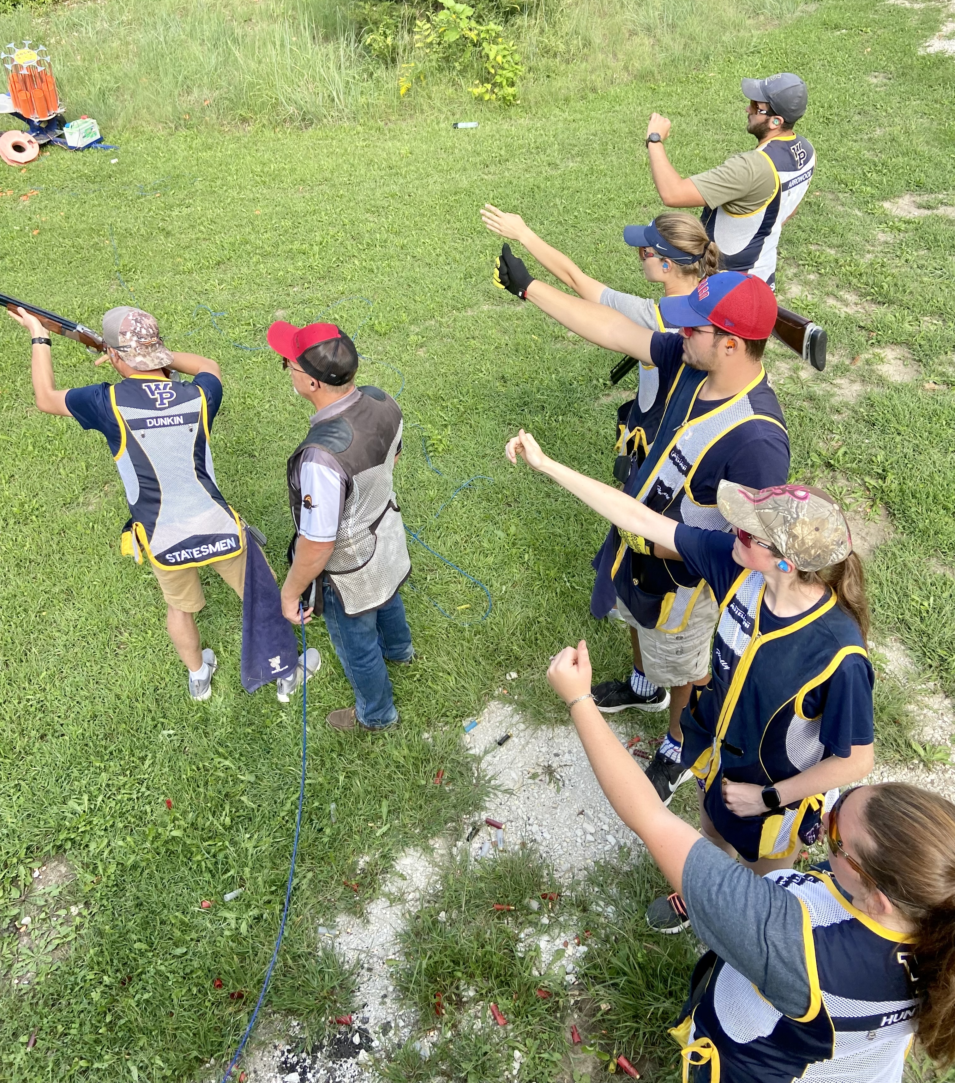
MSS Programs
Shooting Team Clinics
Athlete Development from Novice to Advanced Shooters
Training Programs for Sporting Clays Games, Trap, and Skeet
Coach Development Clinics
Gun Fit basic
6 parts to shot planning
Three guns mounts, when to use them
How to view targets
Training - vs - Practice
Team Practice Development Programs
Running productive weekly practice sessions
Evaluation of performance

Slide 3
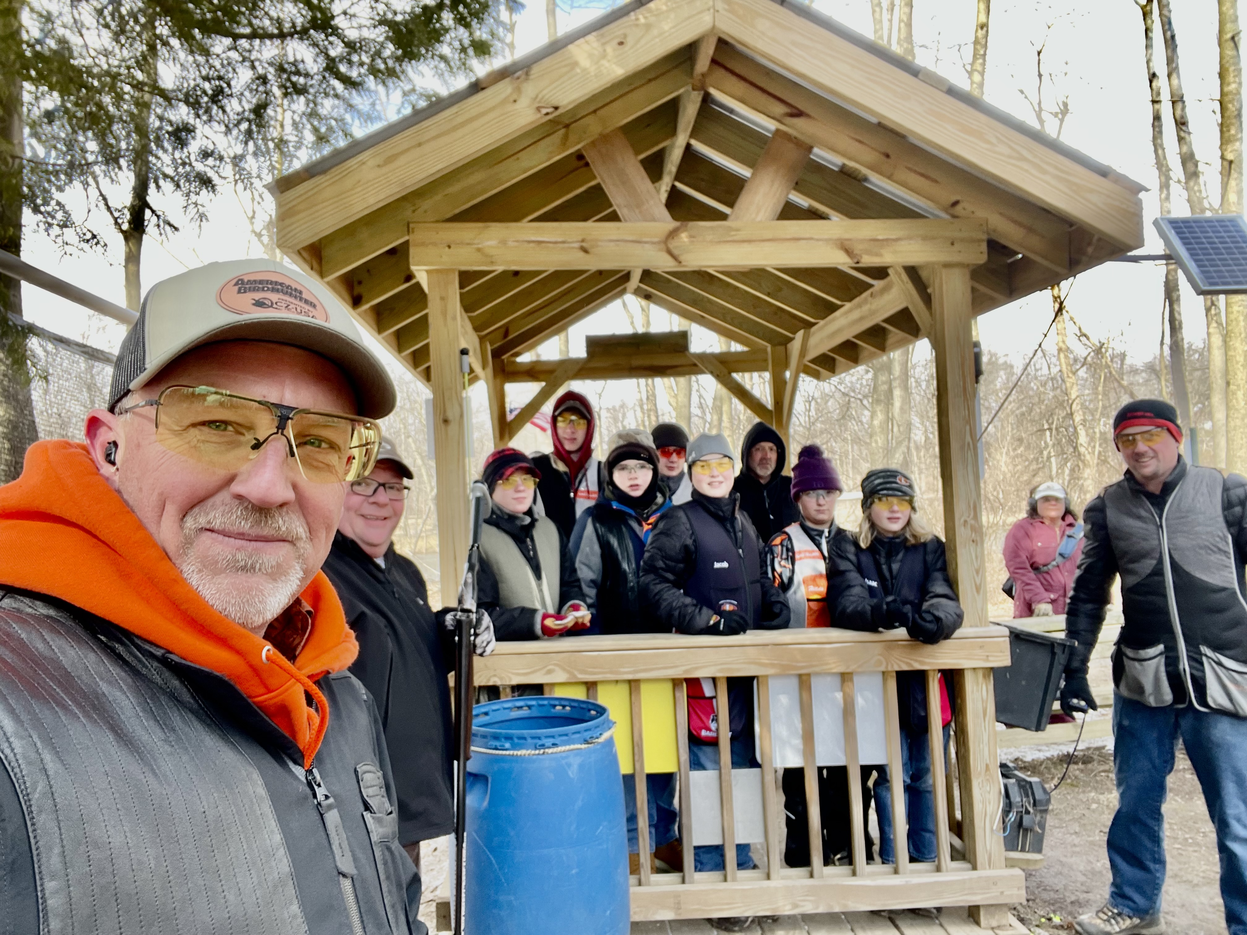
Best Practices for developing Shooting Sports Leaders
Always start with a conversation about gun safety and range etiquette.
Ask the coaches questions
Find out what their challenges are.
Don’t question their processes simply start with what you know works.
Understand what their weekly practices are, this will help find opportunities for growth.

Slide 4
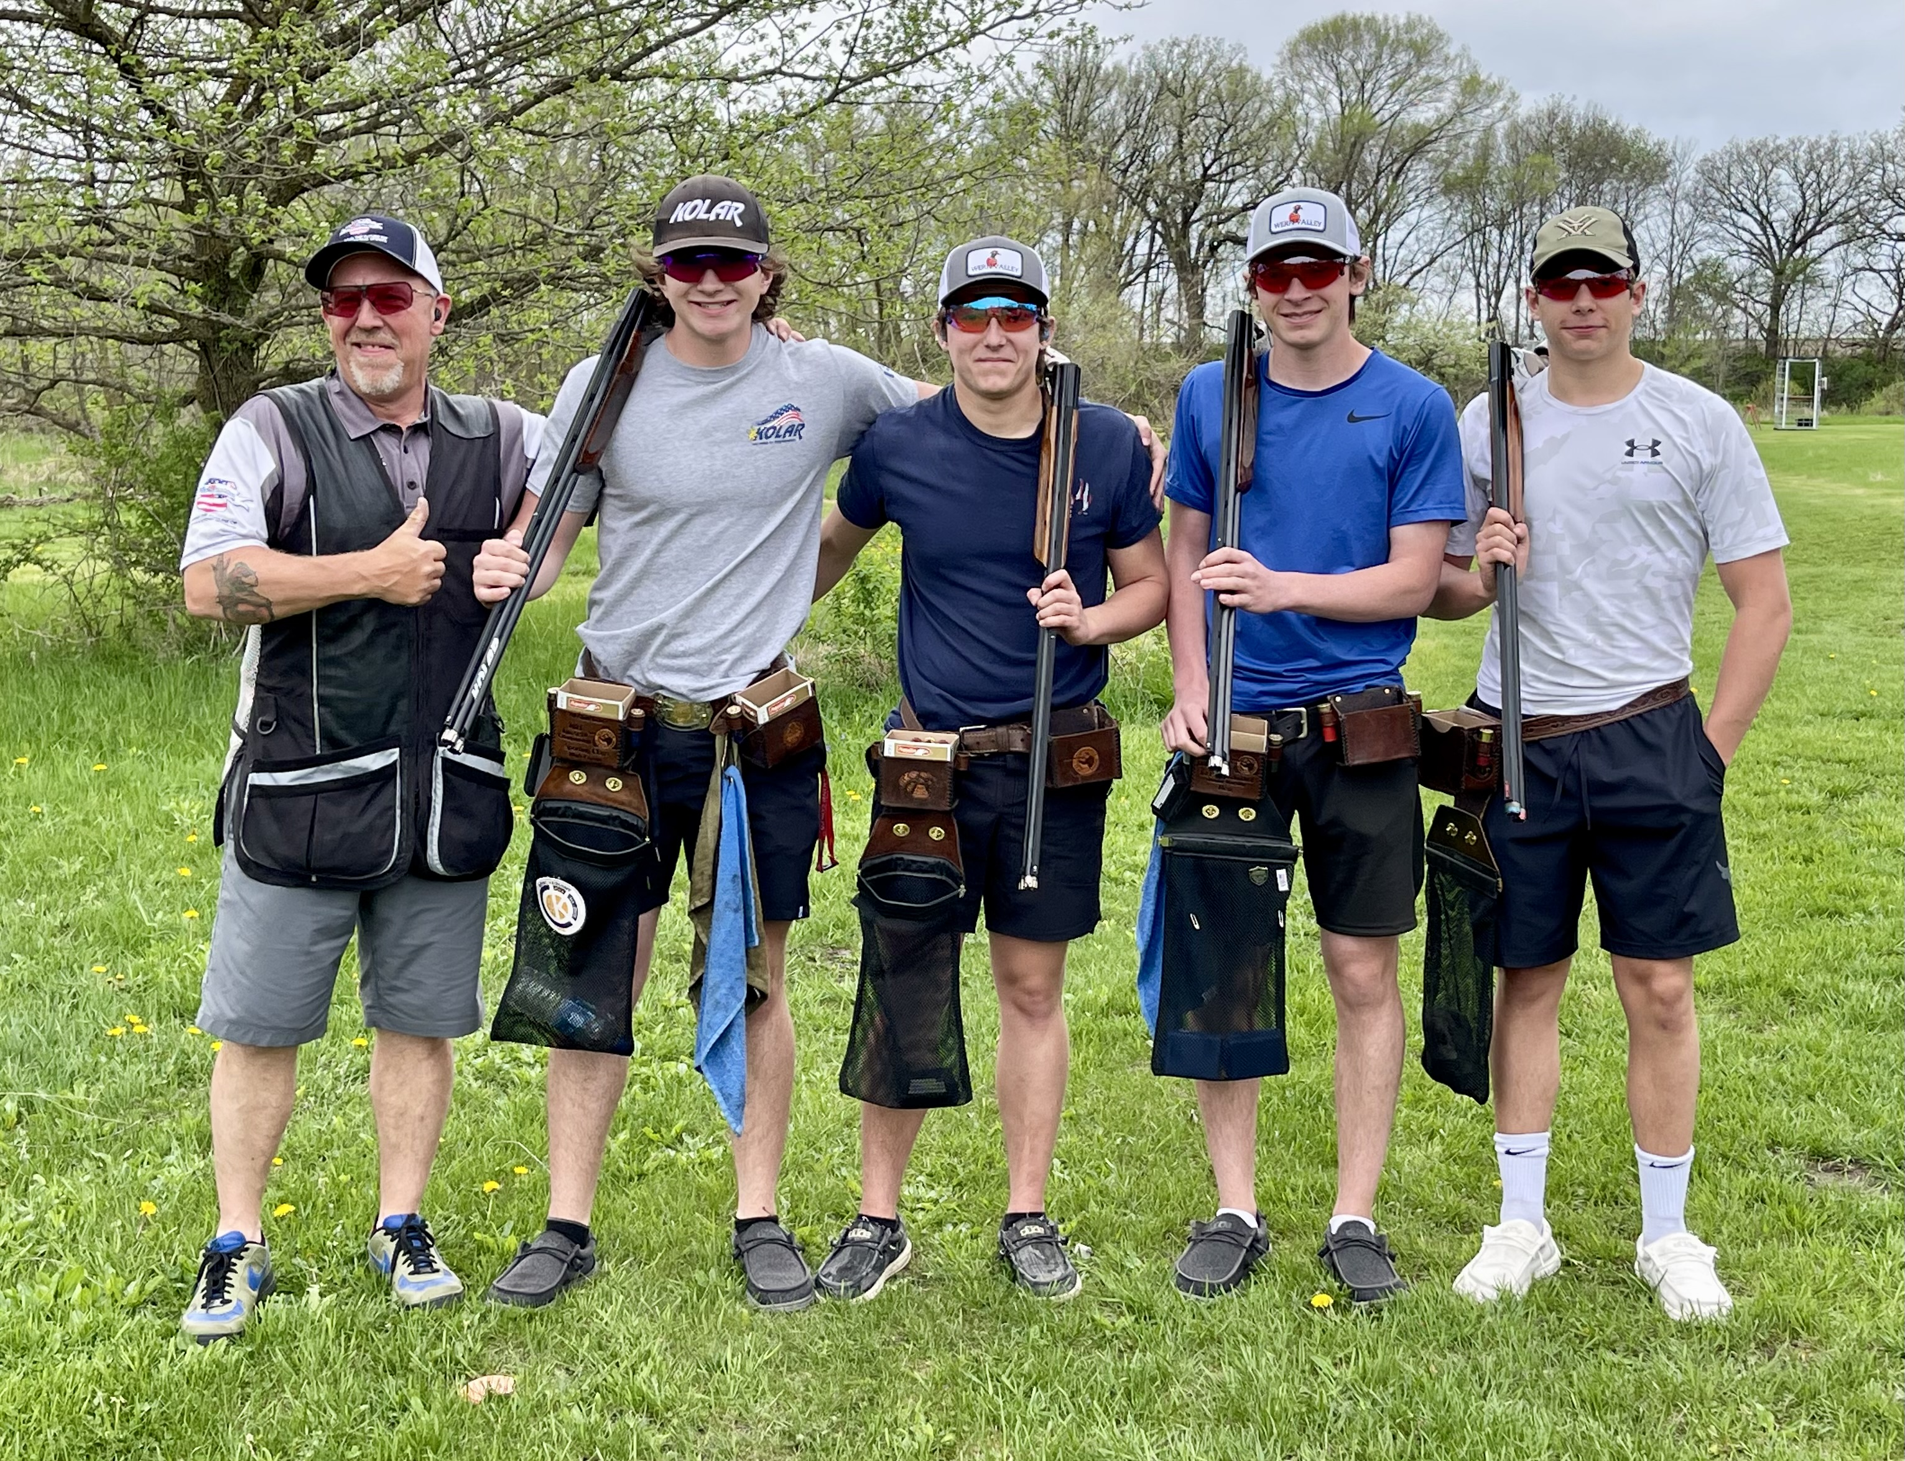
Best Practices for developing Shooting Sports Leaders –continued
Coaches must engage in the new fundamentals; they must see and feel the value before they will sell it to others.
Keep things simple, people are masters at complicating these games.
In American Trap a full right target from post #5 is not a Hard right.
Celebrate the hits, never speak about a loss
Terminology is important
It’s a Break Area not a Break Point

Slide 5
Mystery of Gun Fit What do shotgun stock dimensions really mean to us as wing and clay shooters ?

Slide 6
Rib Line
A

Slide 7
Rib Line
B

Slide 8
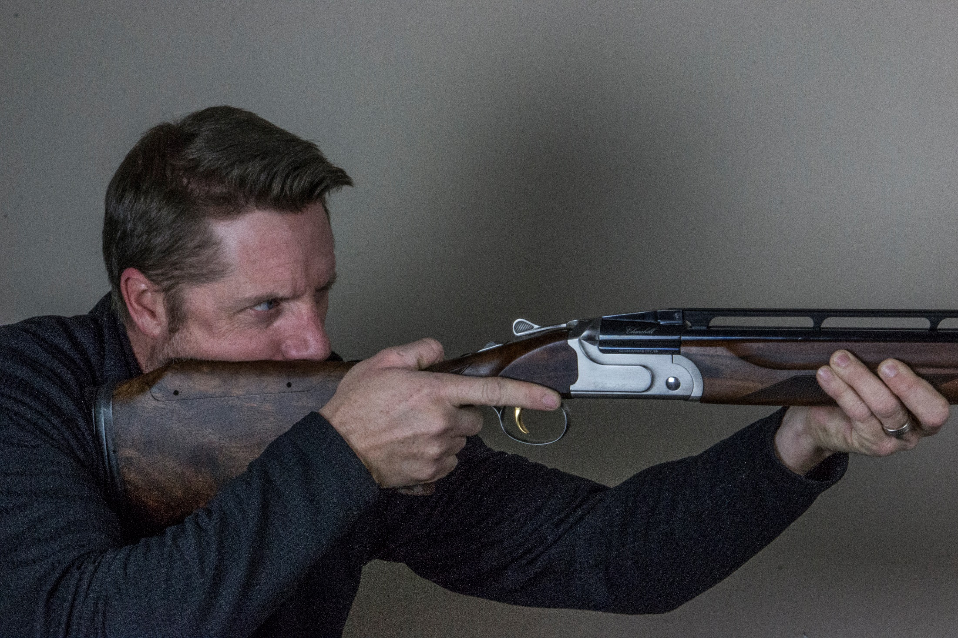
Rib Line should match line of sight
D

Slide 9
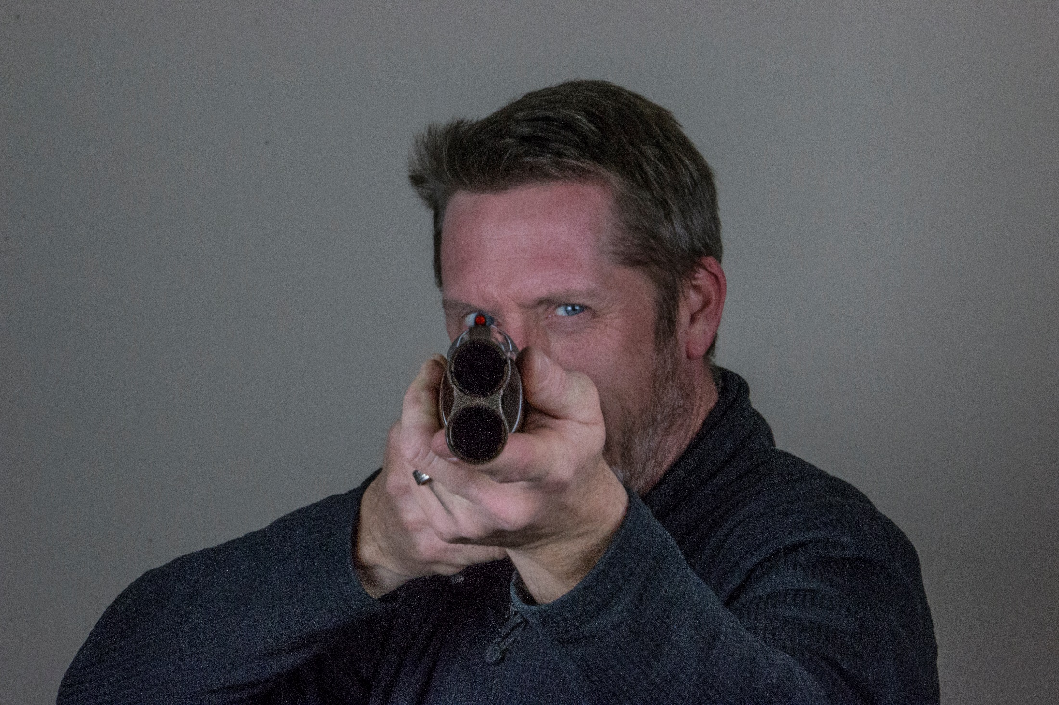
Eye Pupil setting directly over and in line with rib
E

Slide 10
Drop at Heel & Toe
G

Slide 11
Drop at Heel
Rib Line
Drop at Toe
H

Slide 12
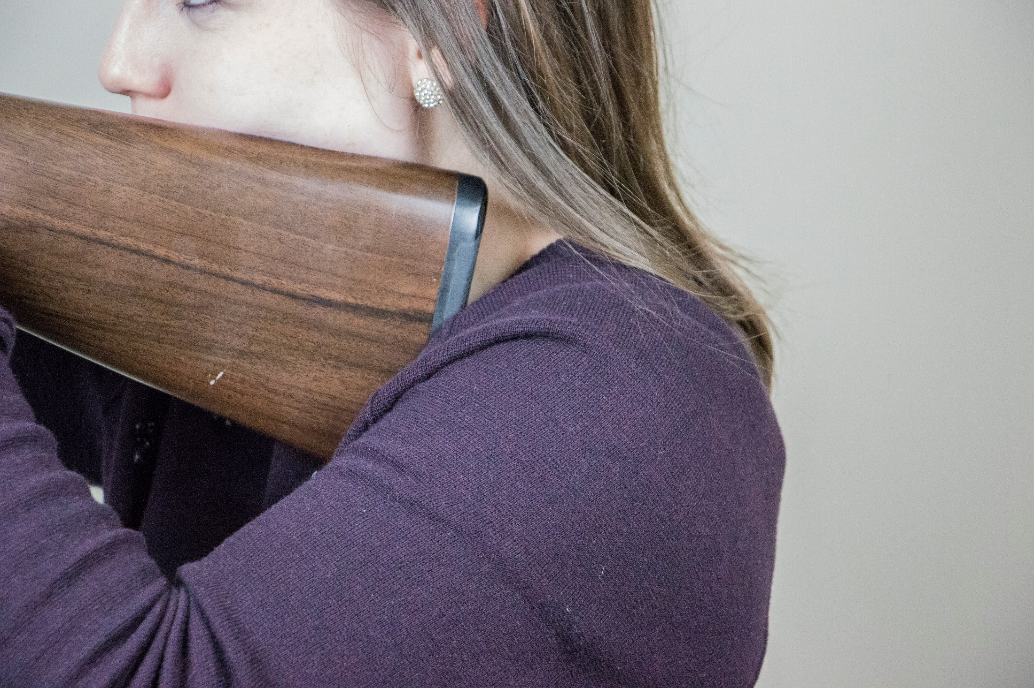
Not enough Drop at Heel
Not enough Drop at Toe
I

Slide 13
Sufficient Drop at Heel
Sightline over rib is correct
Sufficient Drop at Toe
K

Slide 14
Drop at Comb & Nose Comb
M

Slide 15
Drop at Comb
Drop at Nose Comb
Rib Line
N

Slide 16
Drop at Nose Comb
Drop at Comb
Rib Line
O

Slide 17
Length of Pull & Grip Length
S

Slide 18
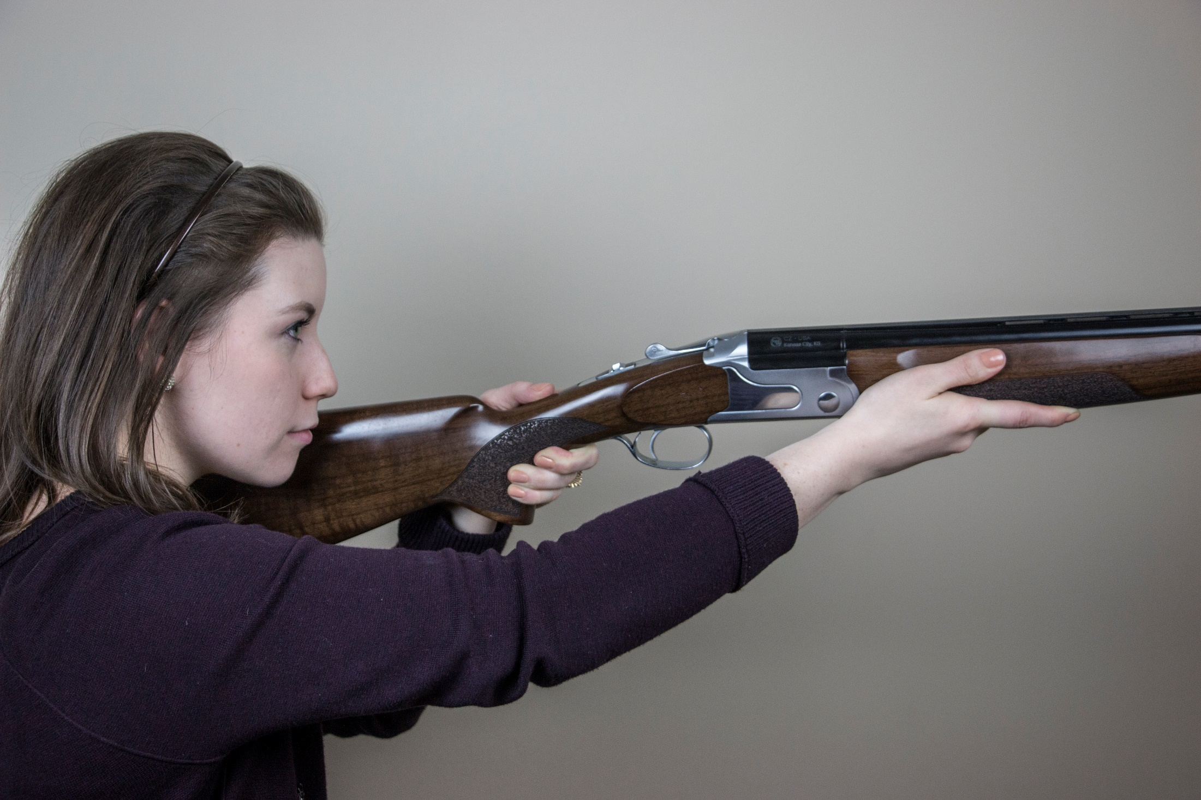
Length of Pull is too long
U

Slide 19
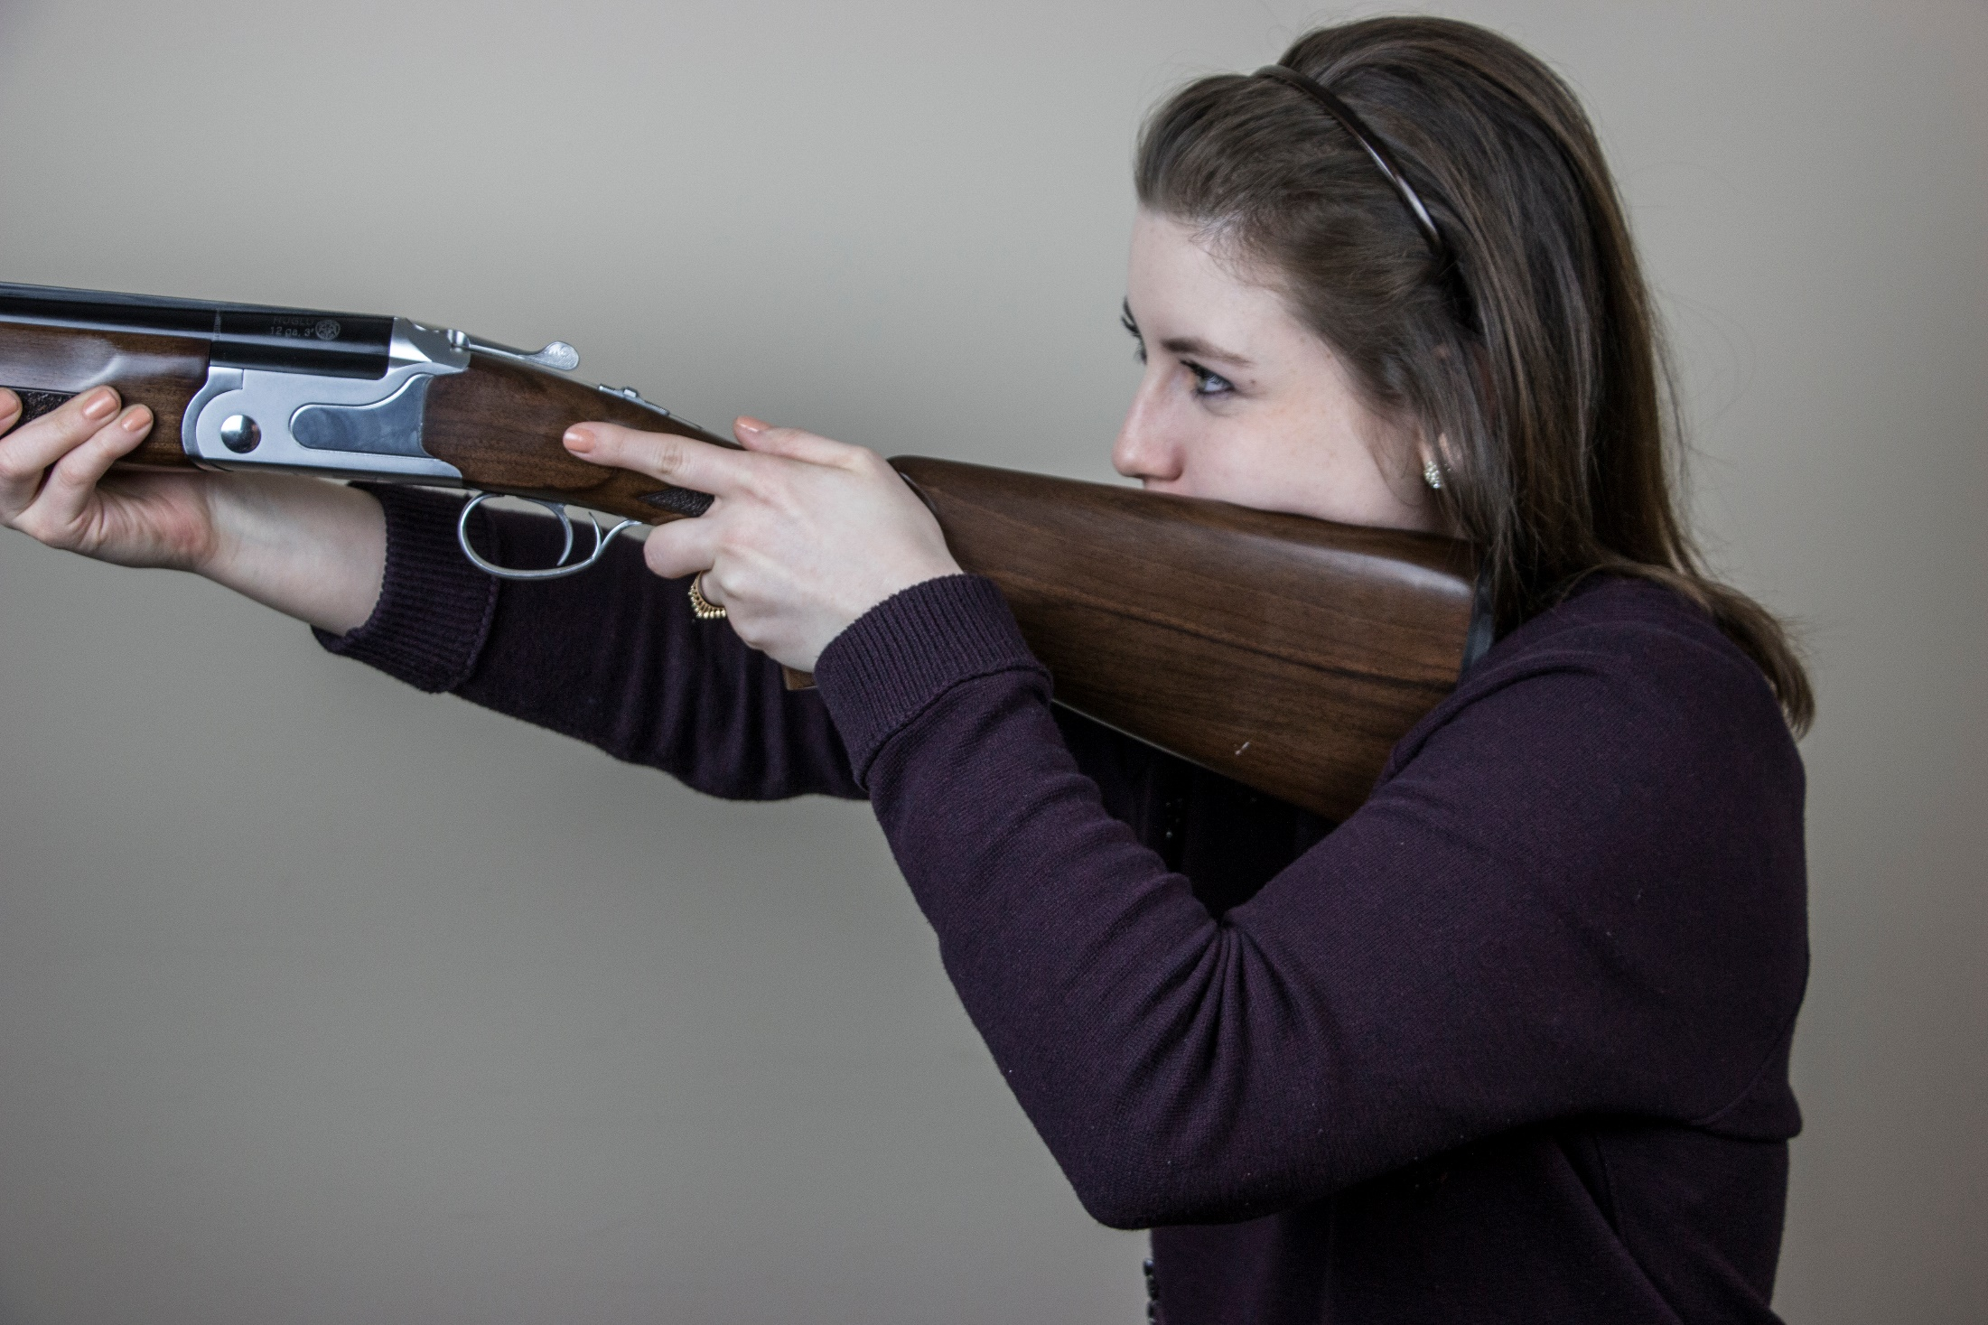
Length of Pull is too long
Length of Grip is too long
V

Slide 20
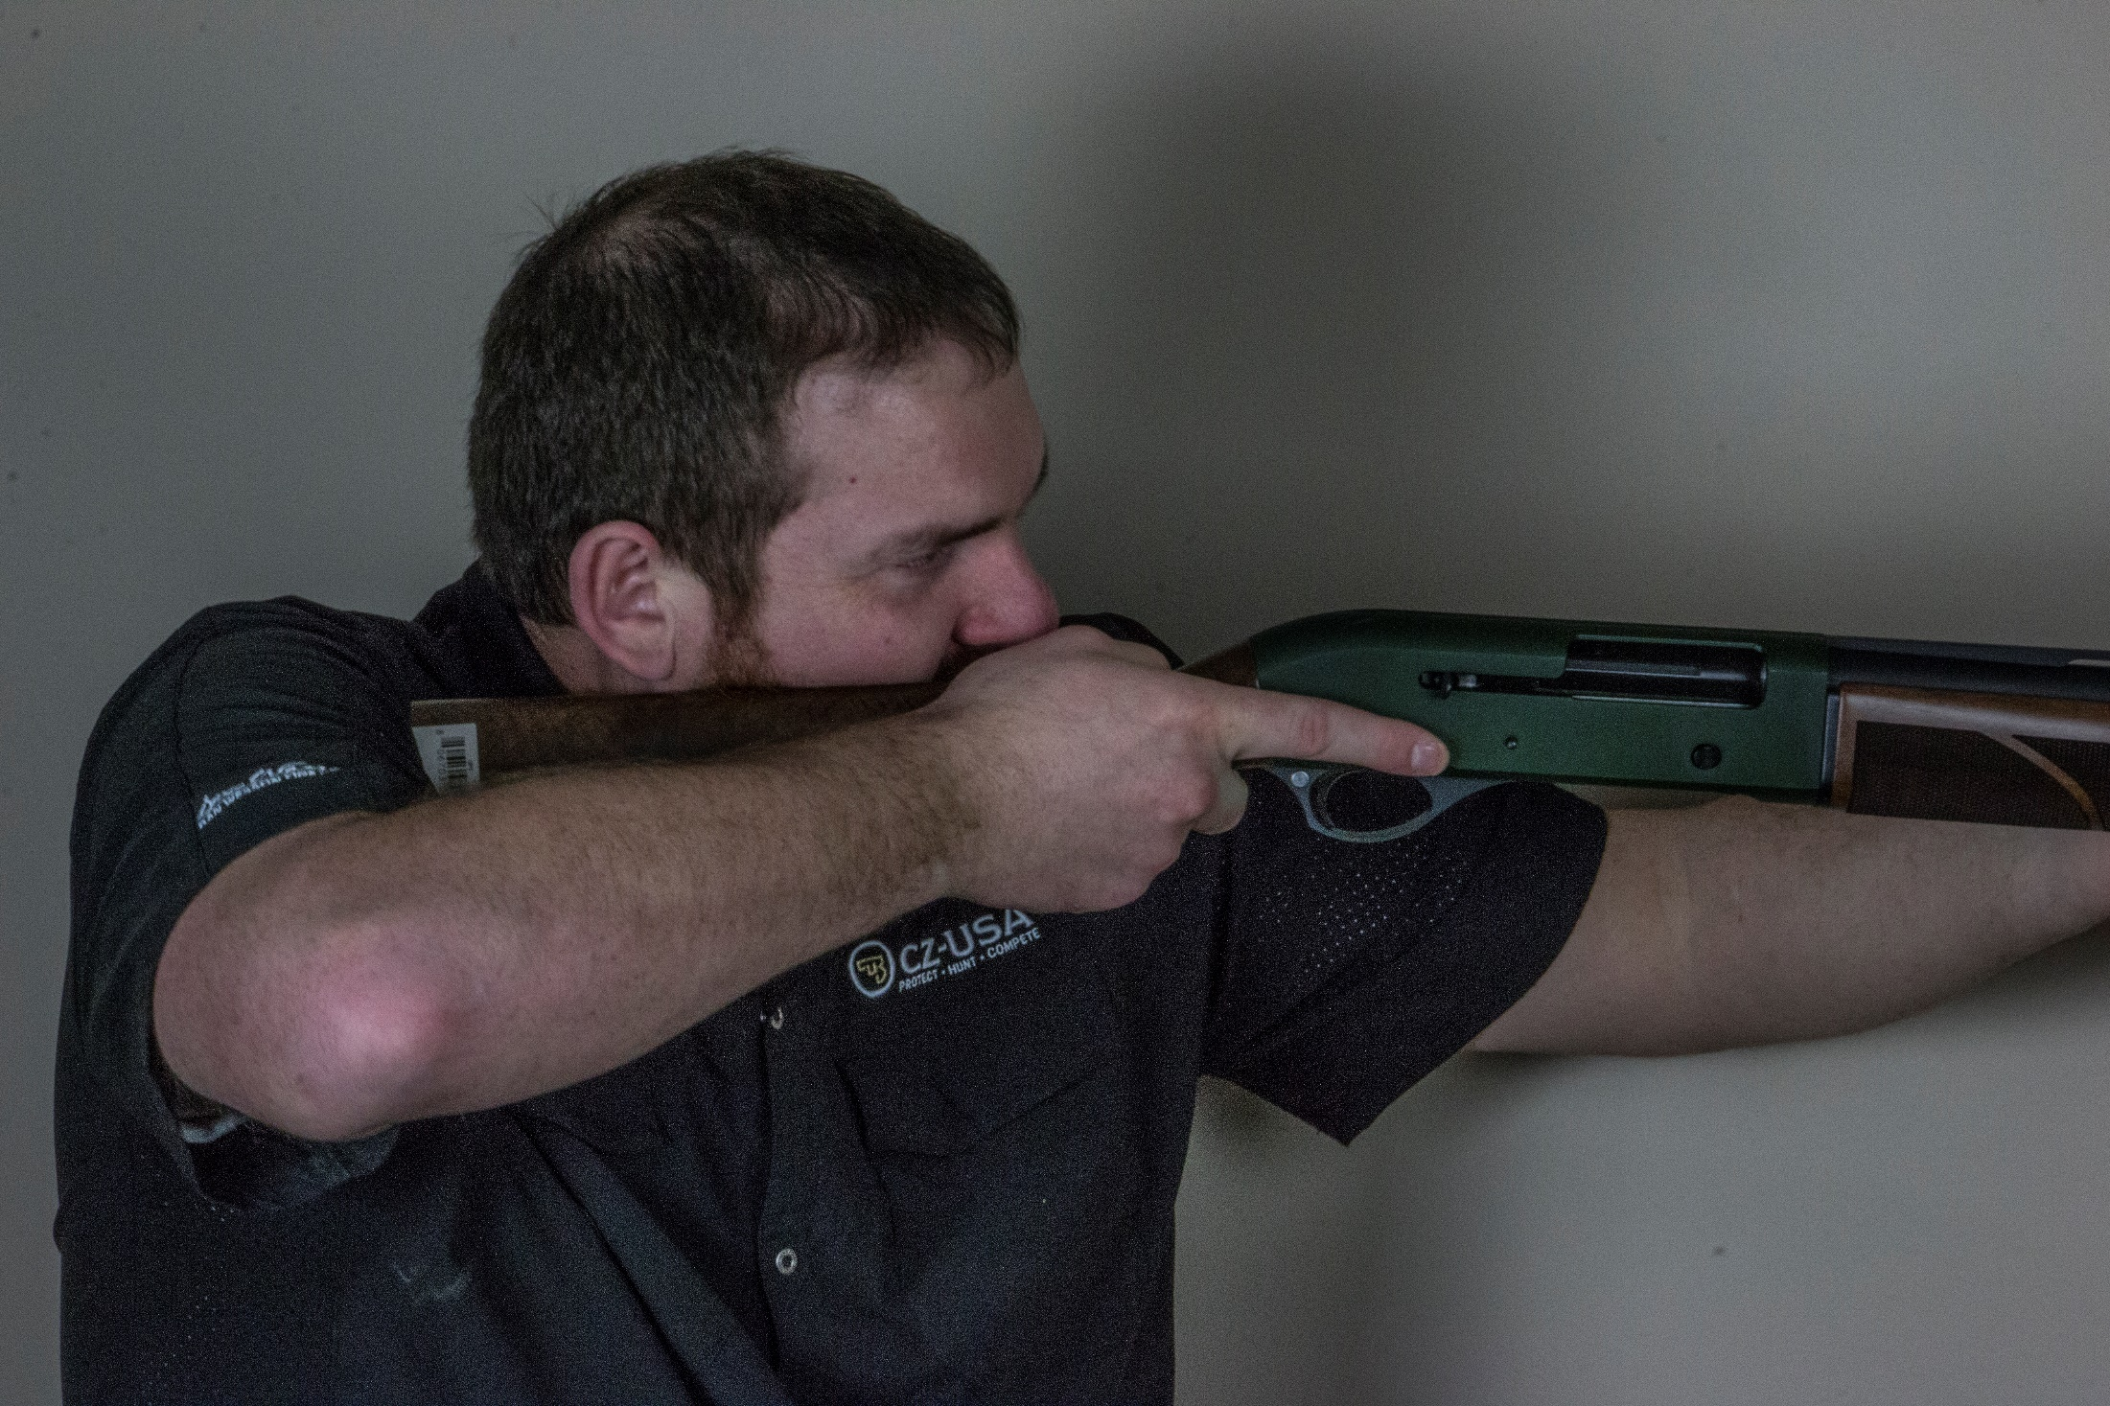
Length of Pull is too short
Length of Grip is too short
X

Slide 21
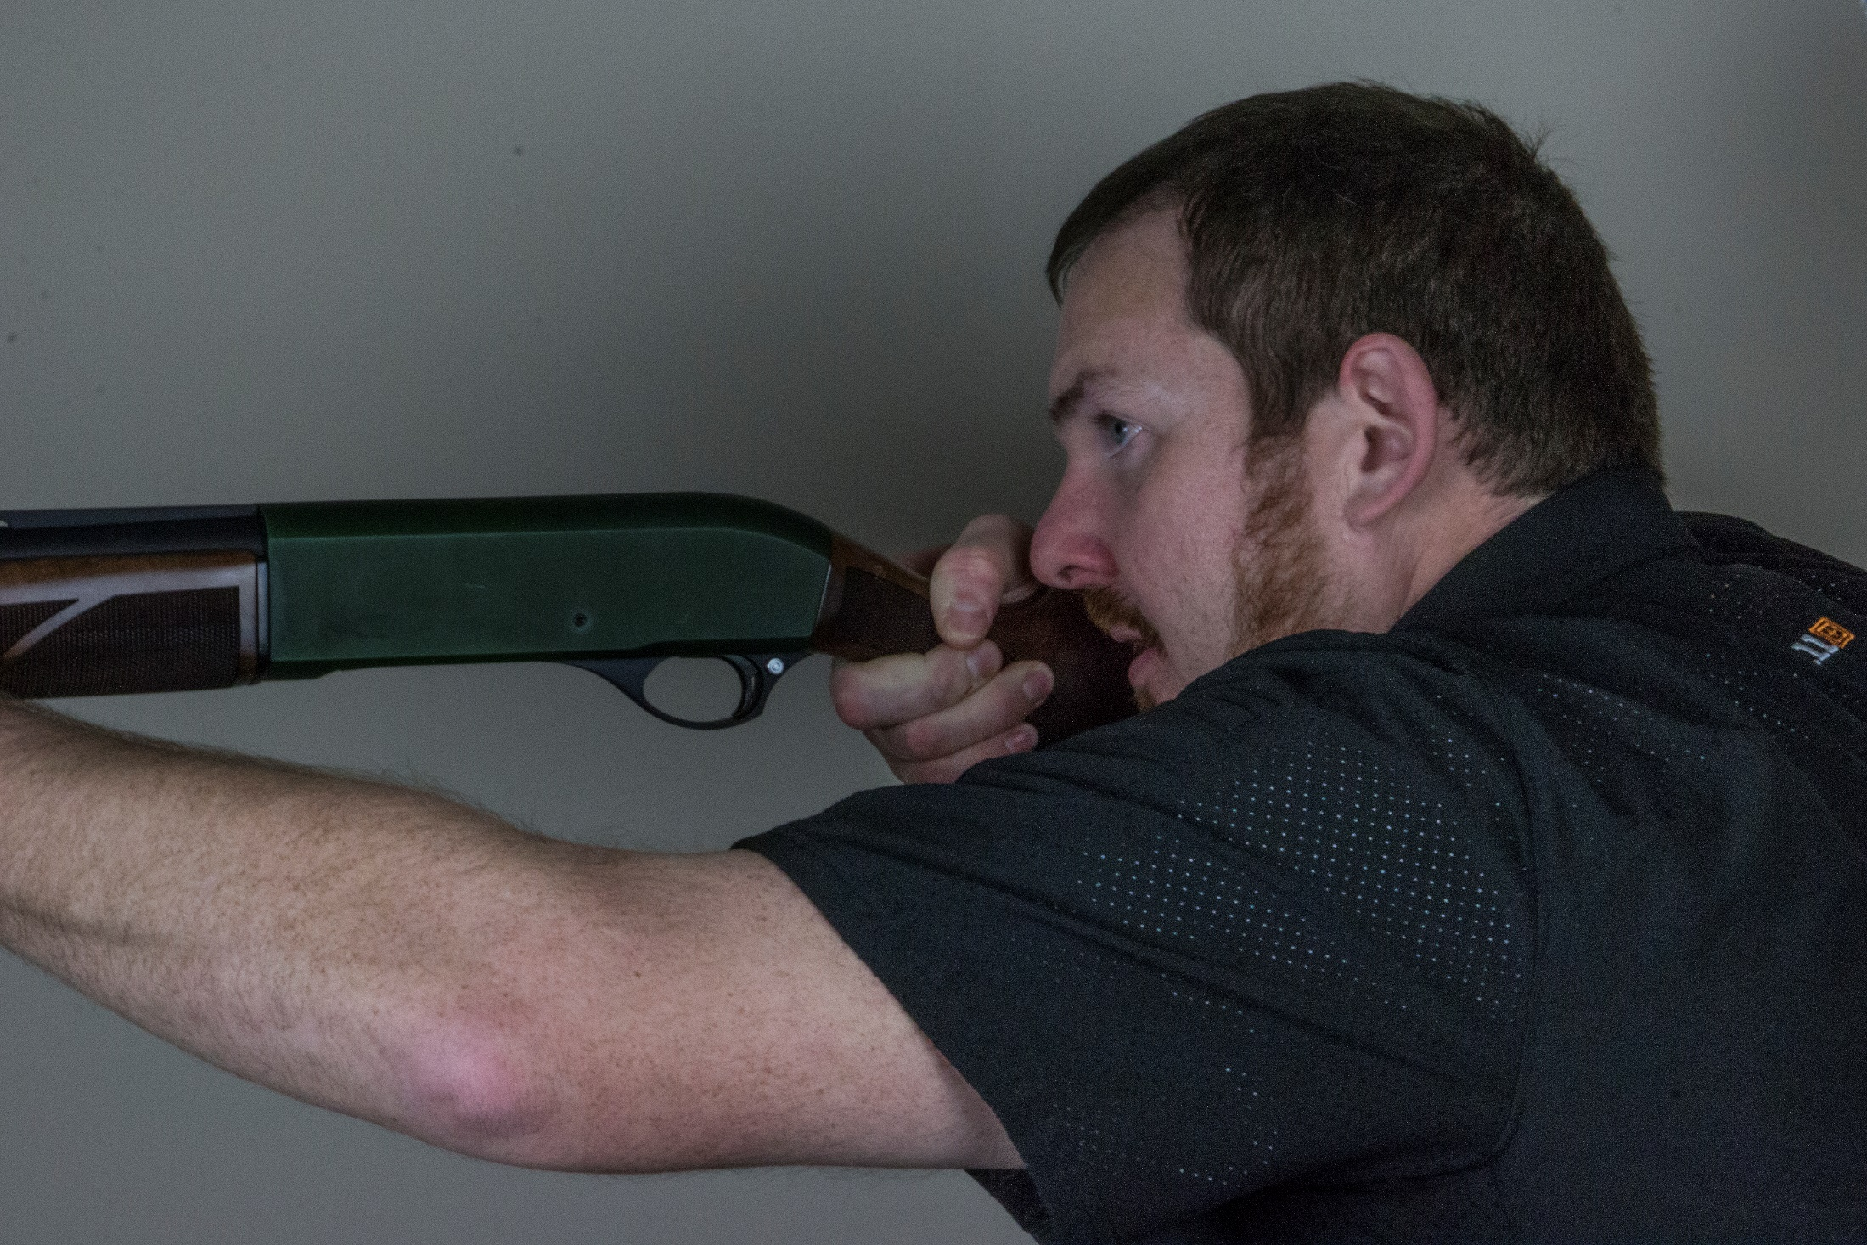
Length of Pull is too short
Y

Slide 22
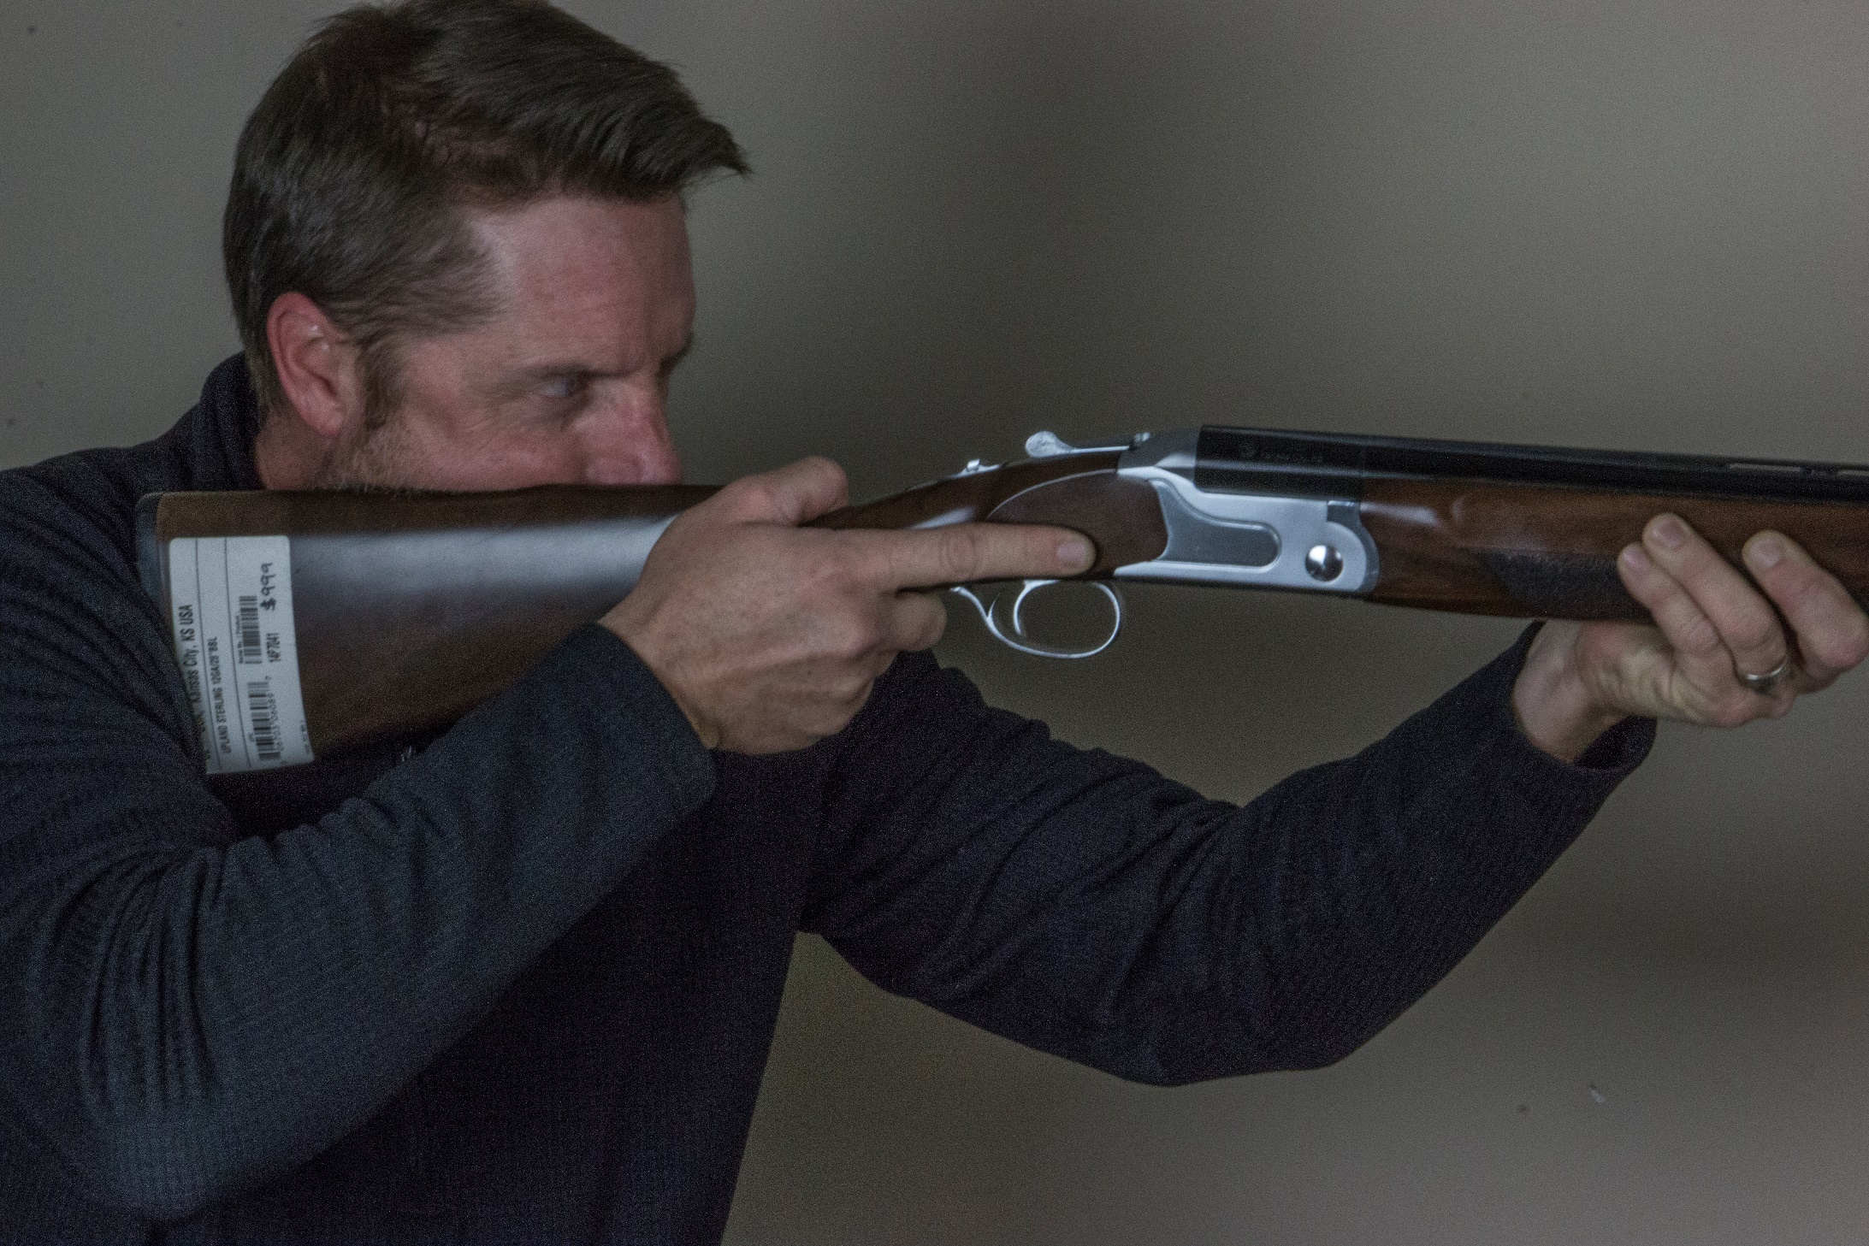
Length of Pull is correct
Length of Grip is correct
AA

Slide 23
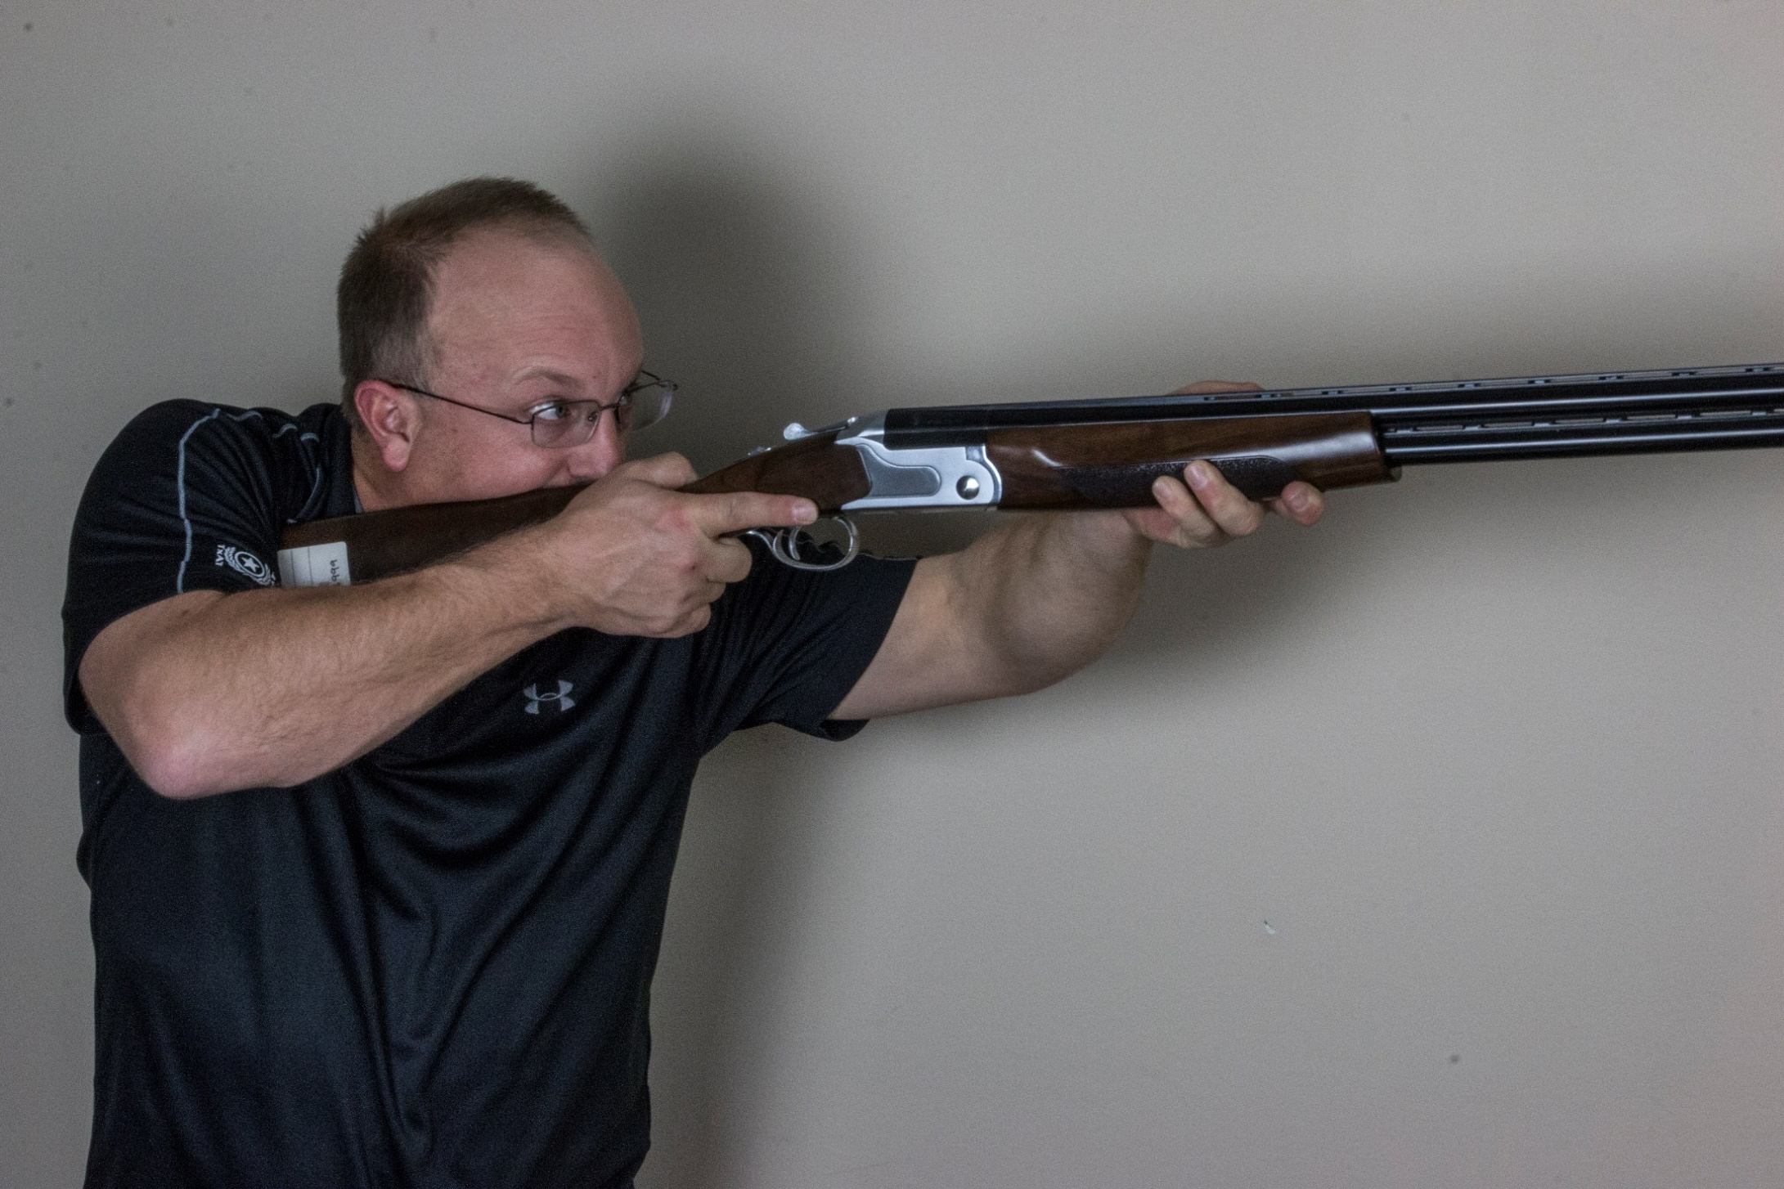
Rib Line should match line of sight
AC

Slide 24
Degrees of Pitch
AE

Slide 25
90°
Rib Line
Degrees of Pitch
CZ-USA Upland Ultralight Green
AF

Slide 26
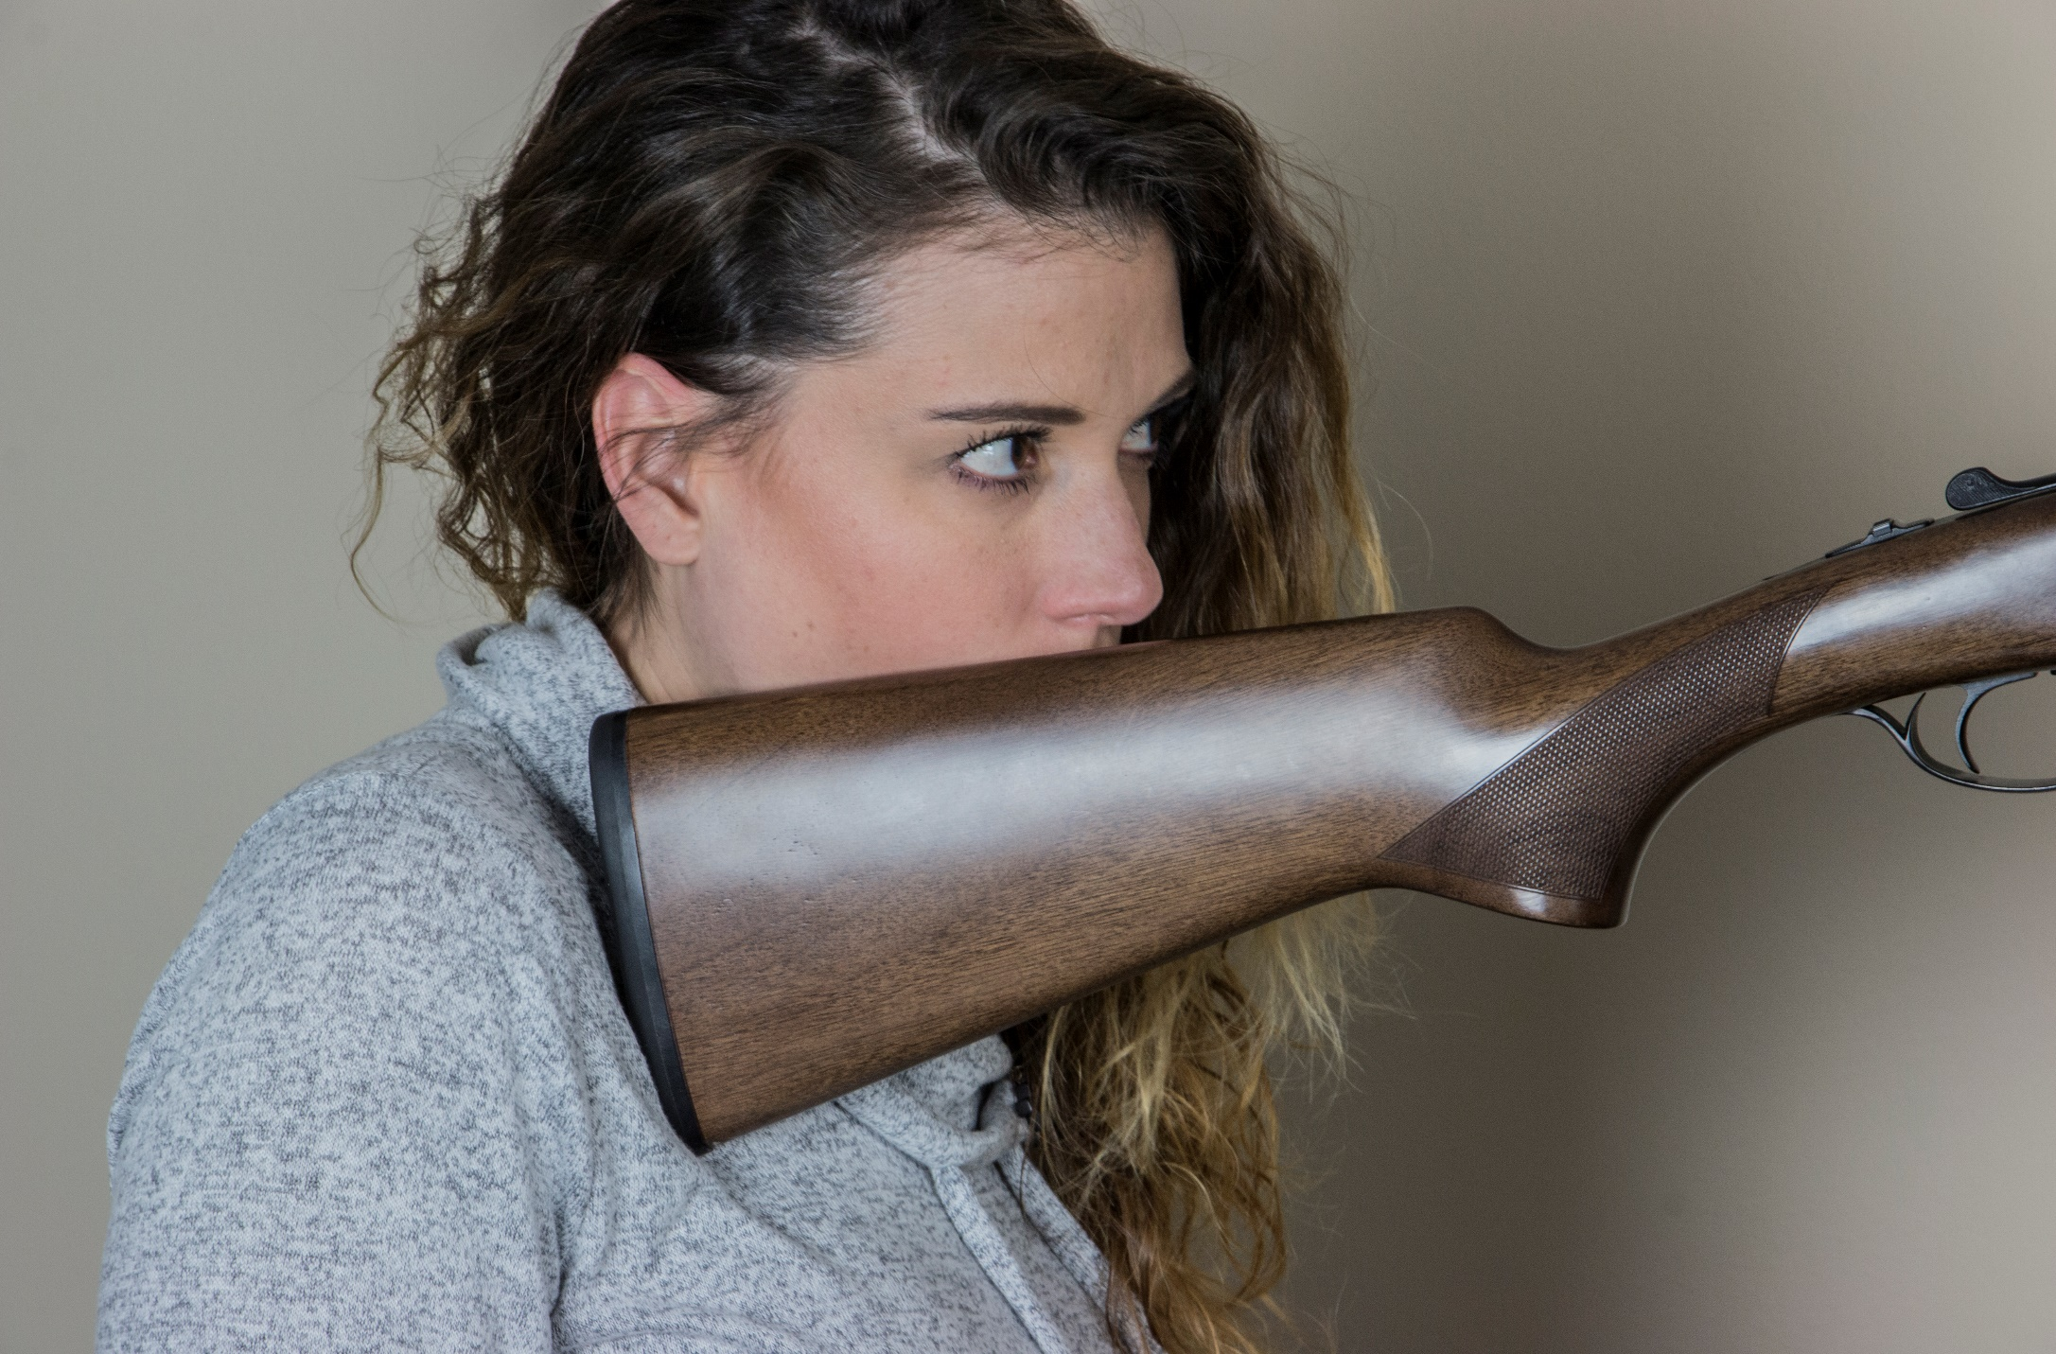
90°
More pitch required , very little butt pad-to-shoulder contact
Rib Line
Degrees of Pitch
AG

Slide 27
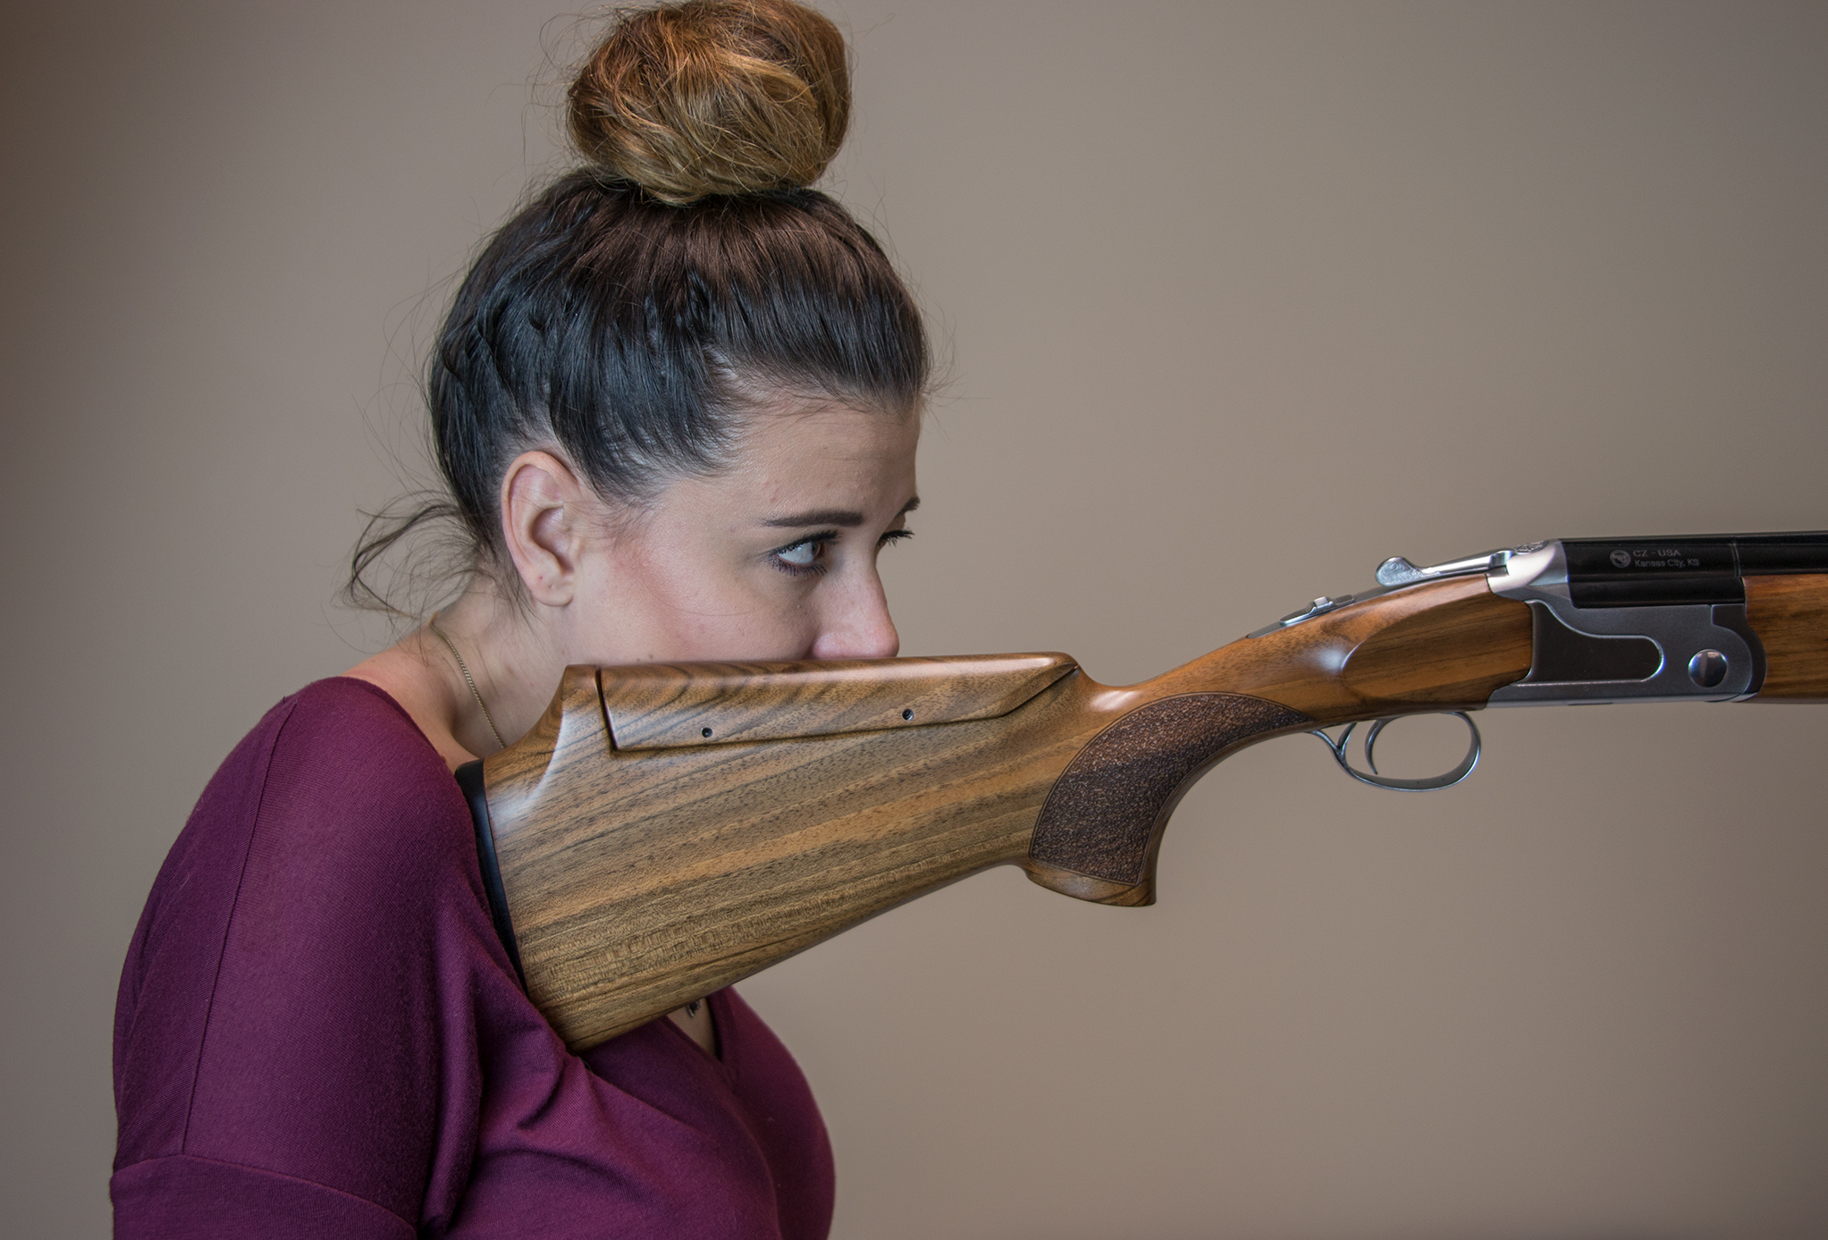
90°
Proper butt pad-to- shoulder contact
Rib Line
Degrees of Pitch
AH

Slide 28
90°
Drop at Heel
Drop at Comb
Drop at Nose Comb
Rib Line
Gun Fit Basics
Length of Pull
Length of Grip
Drop at Toe
Degrees of Pitch

Slide 29
Cast
On for Left shoulder shooting
Off for Right shoulder shooting
AJ

Slide 30
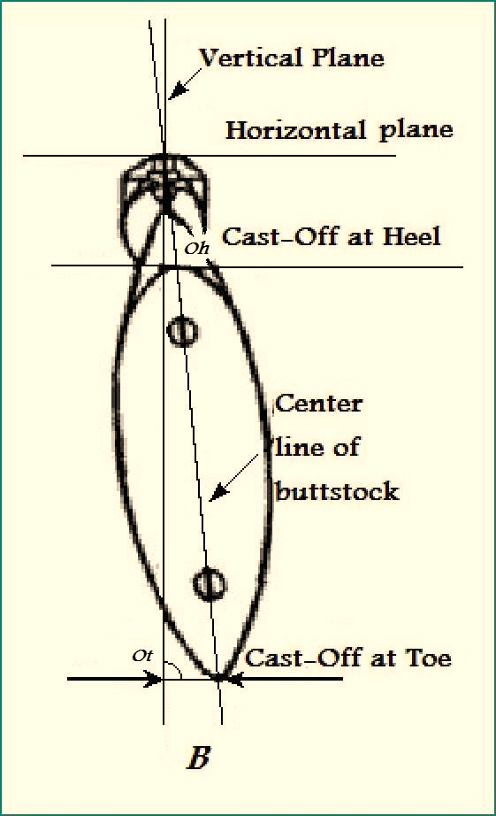
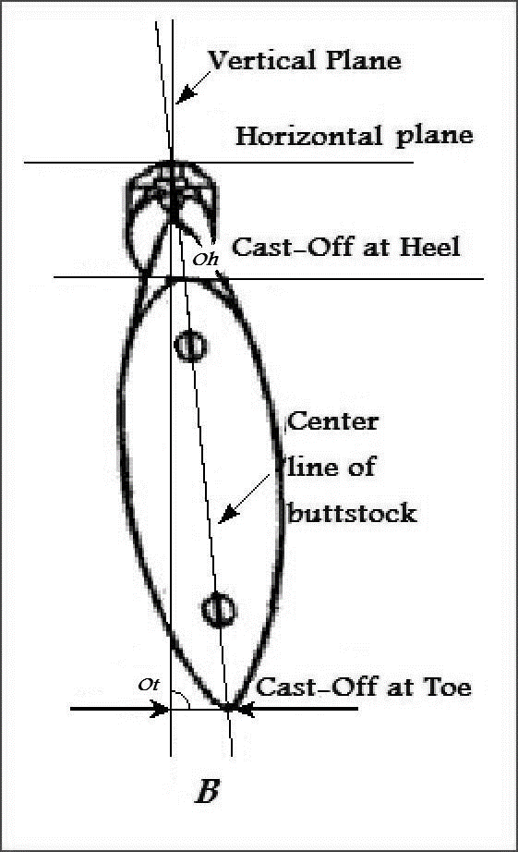
Vertical plane of the rib
Vertical plane of the rib
Horizontal plane of rib
Horizontal plane of rib
Cast ON at heel
Cast OFF at heel
Center line of the buttstock
Center line of the buttstock
Cast ON at toe
Cast measured in inches
Cast OFF at toe
Cast measured in inches
AK

Slide 31
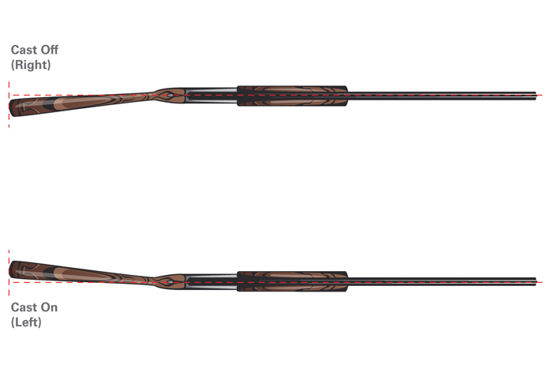
Cast OFF
Gun Fit Basics
Center of gun starts at the center of the rib/barrels
Cast ON
Exaggeration of cast

Slide 32
Pitch angle is less than 90°
Drop at Heel
________
Drop at Comb
_________
Drop at Nose Comb
__________
Rib Line
Length of Pull
___________
Length of Grip
__________
Grip Circumference
__________
Drop at Toe
___________
Degrees of Pitch
__________
Measurements submitted in millimeters & degrees

Slide 33
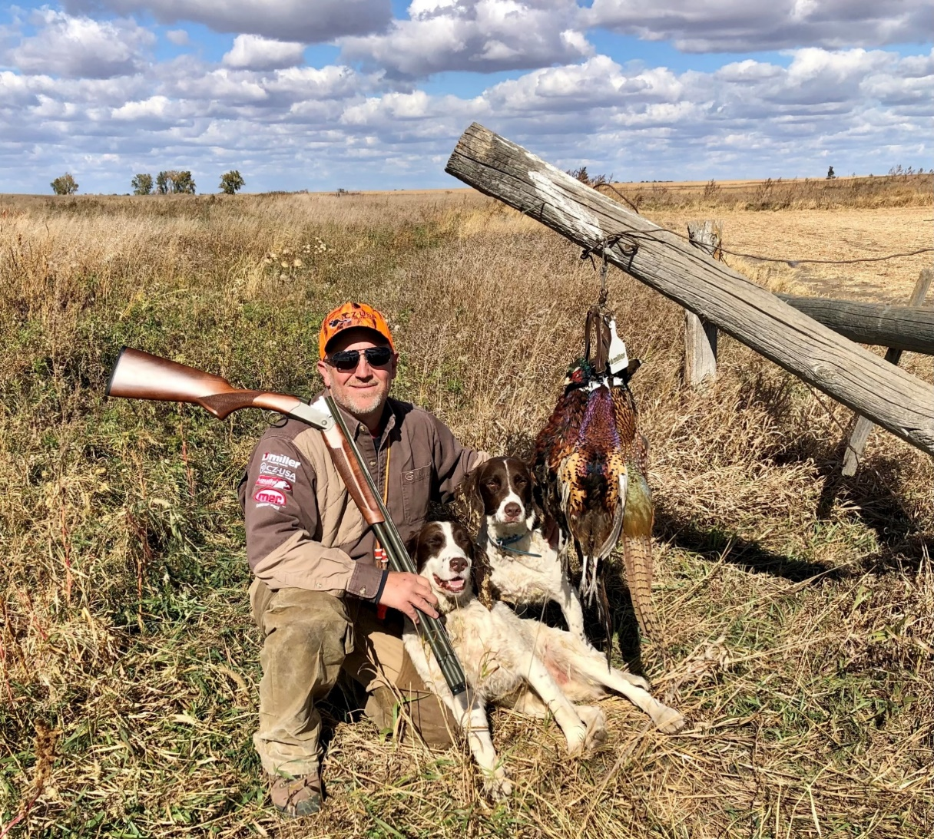
Is sponsored by these fine companies :

