Slide 1
SSSF Update
2022-2023 Season Review

Slide 2
Rick Leach
Scholastic Shooting Sports Foundation Co-President
Scholastic Action Shooting Program National Director
Joined SSSF staff in 2015
Coached in both programs before that
Retired police sergeant and currently also a part-time police chief

Slide 3
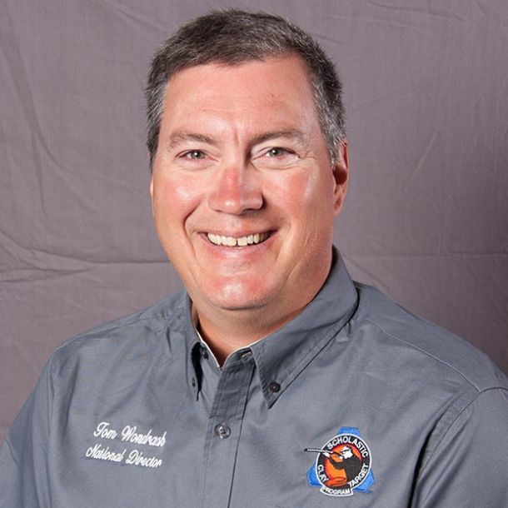
Tom Wondrash
Co-President SSSF
National Director Scholastic Clay Target Program

Slide 4
What is SSSF
The Scholastic Shooting Sports Foundation is a 501c3 not for profit that has two youth shooting programs the Scholastic Clay Target Program (SCTP) and the Scholastic Action Shooting Program (SASP) which are youth development programs in which adult coaches and other volunteers use shooting sports to teach and demonstrate sportsmanship, responsibility, honesty, ethics, integrity, teamwork, and other positive life skills. Athletes compete in team-based shooting sports where there is no such thing as being “benched”, offering a truly level playing field to all.

Slide 5
SCTP
SCTP was started in 2001 by National Shooting Sports Foundation(NSSF) The Firearm Industry Trade Association. As the Scholastic Trap Program
In 2007 the industry with the assistance of the Potterfield family started SSSF to take over NSSF’s trap program, and the name was change to the Scholastic Clay Target Program.

Slide 6
SASP
2012 with the assistance of the industry and Larry and Brenda the Scholastic Pistol Program was added to SSSF as an action shooting program
2016 we added rifle and rebranded as the Scholastic Action Shooting Program
2021 Added International Air Pistol, Precision and Sporter Air Rifle, and Sport Pistol.
2021 began running the Intercollegiate International Pistol Program for the NRA

Slide 7
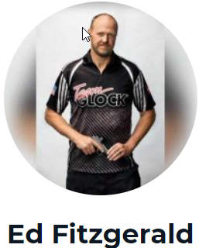
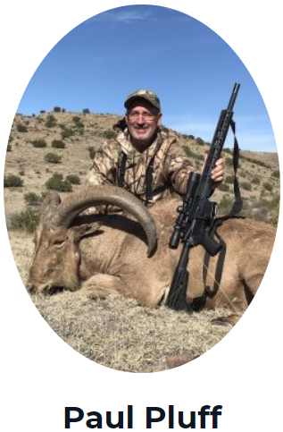
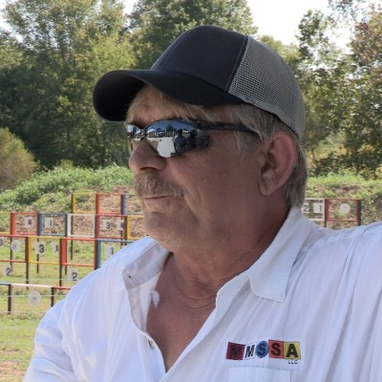
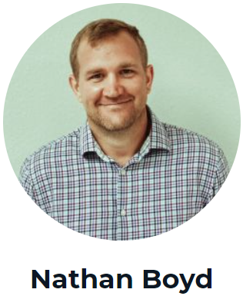
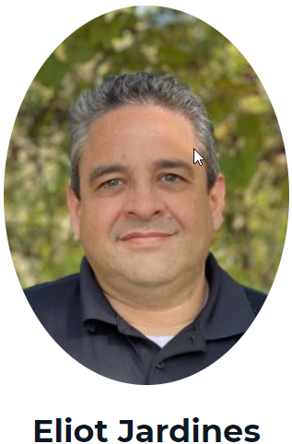
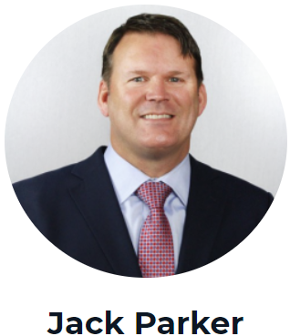
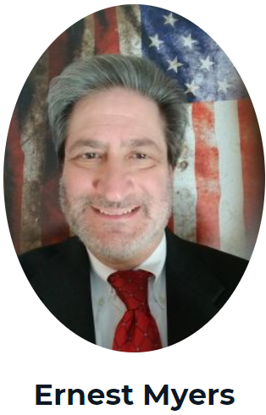
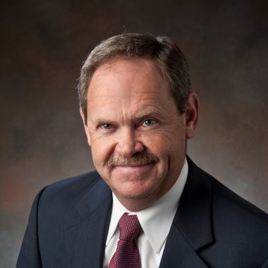
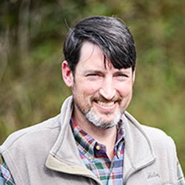
SSSF Board of Directors
Ed White
Executive Committee
Jen Ramsay
Bernie Till
JW Worthen

Slide 8
What’s New
1420 County Road 276 Columbia, MO 65202
phone / fax: 573.387.4747

Slide 9
SCTP 2023
Averaged 11.24% increase each year over the past 13 year.

Slide 10
SASP 2023
Averaged 12% growth each year over the past 10 year

Slide 11
SCTP Nationals
Events | Entries
Skeet | 1479
Sporting Clays | 1685
Trap | 2807
Sub Total | 5971
Double Trap | 799
Double Skeet | 697
Handicap Trap | 685
Bunker Trap | 104
I Skeet | 34
5-Stand | 237
Make a Break Team | 444
Subtotal | 3000
Total | 8971
Athletes | 3131
Nation’s Largest American Trap Event
World’s Largest Skeet Event for past 7 years
Second Largest Sporting Clay Event
Over 2 Million Competition Targets Thrown Plus Side Events
22 pallets per trailer x 63 cases a pallet = 1386 cases a trailer
Case has 135 targets x 1386 x 15 semi =2,806,650 targets

Slide 12
SASP National
31% Female participation SCTP 22%

Slide 13
SASP Nationals
World’s Largest Action Shooting or Steel Match
USPSA Steel Challenge- started about 2006
Our nationals is over 4 times their nationals' size.
Next closest largest action match GLOCK’s GSSF
375,000 rounds fired in competition

Slide 14
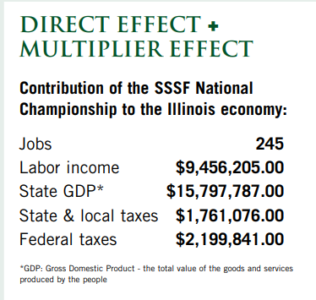
Economic Impact of Nationals 2023
2015 NSSF Study Results
2023 numbers adjusted for growth and cost of living
9900 competitors, parents, coaches attended event
Average Spending while at the event: $1859.00
Average Spending while Traveling to/from event: $585
Event Organizer Spending: $884500
SCTP Nationals Total Clay Targets : over 2,000,000
Jobs 335
Labor income = $16,903,000
State GDP = $27,725,000
State Taxes = $3,090,700
Federal taxes = $3,860,700

Slide 15
QUESTIONS
Lastly, could we replace the pistol with a Glock (a pistol manufacturer). I'm attaching a picture (glock.jpg) I think if you just flip the image it should be fine. Glock is a founding partner of the Scholastic Action Shooting Program so we'd like to highlight their gun, plus we have the right to use their logo and gun images so we have no issues with copyright.

Slide 16
THANK YOU!
Lastly, could we replace the pistol with a Glock (a pistol manufacturer). I'm attaching a picture (glock.jpg) I think if you just flip the image it should be fine. Glock is a founding partner of the Scholastic Action Shooting Program so we'd like to highlight their gun, plus we have the right to use their logo and gun images so we have no issues with copyright.
Rick Leach
rick@mysasp.com
262-894-4284

Slide 17
Divider

