Slide 1
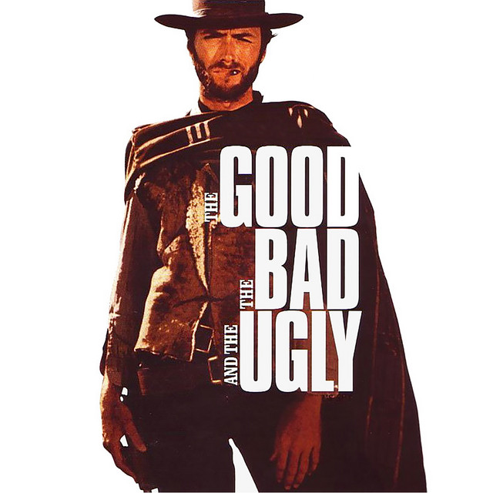
The Media’s Role in the Shooting Sports
Impact and Engagement

Slide 2
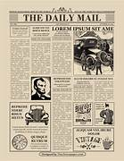
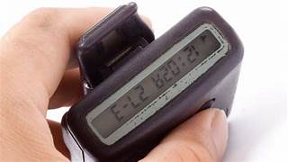
Communication has changed at an unbelievable pace in terms of both methodology and level of consumption – Although digital has been the craze, data shows Gen Z is returning to print media at a significant rate – Mom and Pop bookstores are thriving and magazine titles are increasing, mostly founded by 20-somethings. Gen Z grew up with digital media as the norm and view print media as a different experience. As a result of the ease with which any yahoo can post information on a digital platform, studies show that Gen Z trusts print more than digital media.

Slide 3
The Good…
The free and unfiltered flow of information has never been better. Many platforms exist both in print and digitally which allow dissemination of (almost) all points of view.
Prior to the advent of social and expanded print media, the shooting sports have existed in a muffled state in terms of publicity and notoriety. Although it has not always been this way. Starting in the late 1800’s the shooting sports garnered hundreds of competitors and thousands of spectators. (Rifle, pistol and shotgun)
Thanks to the outreach of youth shooting programs and access to modern media outlets, the shooting sports have seen a resurgence, and popularity is increasing rapidly.

Slide 4
Recognition and Normalization
From March 2020 to March 2022 one in five households purchased a firearm. During that same period one in 20 Americans purchased their first firearm. From 1972 to 2023 the percentage of homes owning firearms has increased two percent…BUT the population has increased by 135 million individuals.
Much of the increase in use and ownership of firearms is due to the normalization and recognition of the shooting sports, hunting and self defense as a mainstream ideal.
From the plethora of magazines on the newsstand to podcasts, youtube and other social media platforms, much of the stigma previously associated with firearms no longer exists within the ranks of the average American. (Caveat)

Slide 5
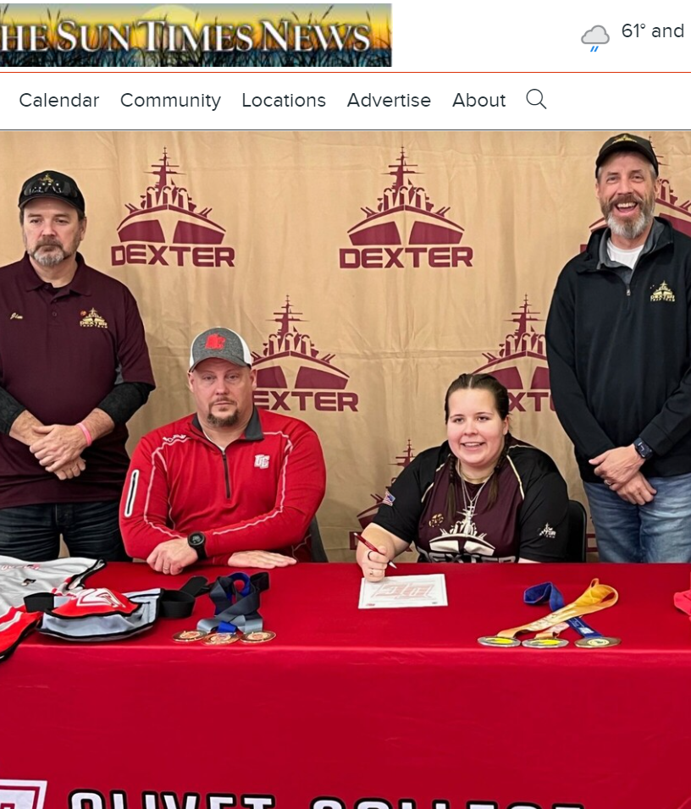
Getting the Word Out
It is important to seek and gain notoriety for the great work we all are doing with youth, first time shooters, veterans and let's not forget about our elders. I owe my love of the shooting sports and outdoors to my grandfather and my mentor, who I now take on excursions.
These programs and the good they do need to be highlighted and promoted. Reach out to local news media and utilize social media. Peer to peer networking is powerful.

Slide 6
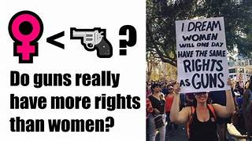
THE BAD
Unfortunately, media outlets have been used since the beginning of the concept to direct public opinion in a direction based on the agenda of the outlet in question.
Although unfair and disingenuous, the millions of responsible American gun owners are sometimes viewed in the same vein as some lunatic who committed crimes with a firearm.
This is an uphill battle but one that can be won with an educational approach.
The power of the media narrative – FBI Uniform Crime Statistics
Hands and Feet (600) – Rifles (364) 2019
Media plays to the lowest form of deductive reasoning ie: feelings
Social Media Bullying is rampant – Hunting and Shooting Sports
Story of My recruit pictured in the previous slide - Bullied

Slide 7
The Ugly….
Social Media Bullying is rampant – Hunting and Shooting Sports
Story of My recruit pictured in the previous slide – Bullied
The logo of a shooting team is not a scarlet letter
Purposely twisting the narrative is the modus opporendi of some outlets and some moderators
Most people fear what they do not understand – It is our job to educate

Slide 8
What can we do?
We all work to bring these wonderful sports to a new generation of individuals who may not have ever considered participating in them.
We must engage both national media outlets (print and social)
We should be proud of the work we do and let that enthusiasm show through to those who otherwise would not get exposed to our sports.
Social media outlets – get and maintain them. Showcase your successes and the impact those efforts have on the community as a whole.
If not for the various shooting sports, some of these student athletes may not have the opportunity to learn the lessons that can only be taught in a team environment.

Slide 9
What else can we do?
National Magazines – reach out for event coverage and lifestyle or heartfelt stories of successes and impacts. Do not limit your reach to sport shooting centric magazines.
Invite your local paper out to a practice, competition or an event.
If you have a school-based youth program, try to engage the school newspaper or newsletter.
Get your teams engaged in community activities (parades, holiday celebrations, community service type work) AND ANNOUNCE IT LOUDLY

Slide 10
Drive the Narrative
Choose and require the employment of the correct verbiage: (Firearm vs Weapon), (Sport vs shooting), (Student Athlete vs Shooter), (Competition vs Shoot)
Cite statistics – The Shooting Sports are statistically the safest high school sport in existence –
The most dangerous???
Focus on the lives changed, life skills learned and a sport which can be participated in by nearly all individuals despite physical condition and even disability status.
Sponsor a local media day. Local TV station, Local newpaper etc.

Slide 11
Questions???
Matthew Gay
Managing Editor – Outdoor Lifestyles Media Group
Editor in Chief – The Sporting Life
Founder/Editor/Publisher – Wing & Clay Life (New Dec 2023)
Editor – ClayShooting USA Magazine
matthew@sportinglifellc.com

