Slide 1
HEAD
HUNTERS
NW
ENCOURAGING YOUTH TO SEEK CAREERS IN THE OUTDOOR INDUSTRY & WHY IT IS CRUCIAL TO OUR LEGACY

Slide 2
WHO AM I?
Shaylene Keiner
President of HeadHunters NW
Several decades of experience in the Shooting, Hunting, And Outdoor Industries

Slide 3
WHAT IS HHNW?
We are more than just an executive recruiting agency. We are committed to being a trusted partner and an invaluable resource for the entire firearm industry.
Our philosophy revolves around three core pillars:
Building Trust
Shaping Excellence
Empowering The Industry
We are dedicated to fostering trust with clients by consistently delivering exceptional service.
Comitted to sharing valuable industry insights & being a source of expertise and guidance.
We are passionate about helping our clients identify & retain top-tier talent.

Slide 4
THE ROLE OF INTERNSHIPS
WAYS TO IMPLMENT
Launchpads for young talent in our industry that provide:
Essential Skill Development
Industry Exposure
Networking
Mutual Benefits:
Youth: Experience & Networking
Organizations: Fresh ideas & Talent
In one organizations case, up to 90% of new hires come directly from internships
Paid & Unpaid internships
Shadowing
High School Co-op Programs
One-on-One mentoring

Slide 5
Internship / Youth program
HOW DID YOU GET YOUR START IN THIS INDUSTRY?
Traditional Application / Transition

Slide 6
LEVERAGING INDUSTRY EVENTS
& ORGANIZATIONS
From trade shows, to non-profits, to conferences and shooting competitions, all of these events are pivotal for youth development & networking.

Slide 7
NAVIGATING LIFE AS YOUTH IN OUR INDUSTRIES
The path for youth in a mature industry can be challenging but also full of growth.
Advice for youth:
Speak with leaders
Ask questions
Say yes to opportunities
Advice for industry leadership:
Be approachable
Parental & Familial Involvement

Slide 8
HARNESSING THE POWER OF SOCIAL MEDIA
Social media has become a powerful tool for career development.
Whether you are staying on top of industry trends, new products or networking, social media has proven itself to be valuable for many in our industry.
Instagram & YouTube: For Creatives
LinkedIn: For professionals.

Slide 9
VOLUNTEERING & INITIATIVE
Much like internships, volunteering can be mutually beneficial for everyone involved.
Young professionals benefit through career growth & networking opportunities while actively contributing to our industry.
Organizations & leaders benefit by volunteering time & resources while encouraging young individuals to do the same.

Slide 10
ADVICE FROM INDUSTRY LEADERS
“Be Approachable & Willing to Learn, Whether you are asking questions or the one being asked.”
Ask Questions
Form Groups
Self Educate
Engage with local experts such as; game wardens, conservationists, biologists and range personnel
With like minded peers through school or local organizations; become a leader
Use your resources, 4H clubs, local ranges & gun shops, industry events, etc.

Slide 11
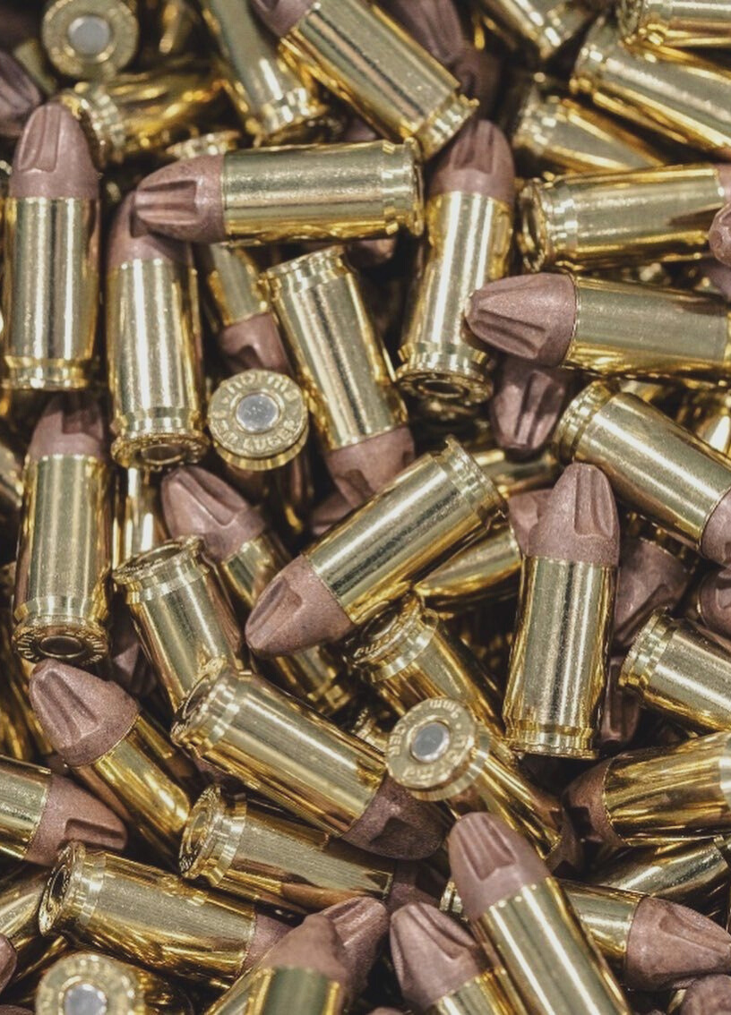
CONCLUSION
Today's youth are tomorrow's trailblazers & the future of our industry is directly tied to the experiences we create for them today. It's not just about teaching them to fish, camp or shoot; it's about instilling values, driving innovation, and ensuring organizations thrive for decades to come. By putting youth at the forefront, we can cement our industry's legacy.

Slide 12
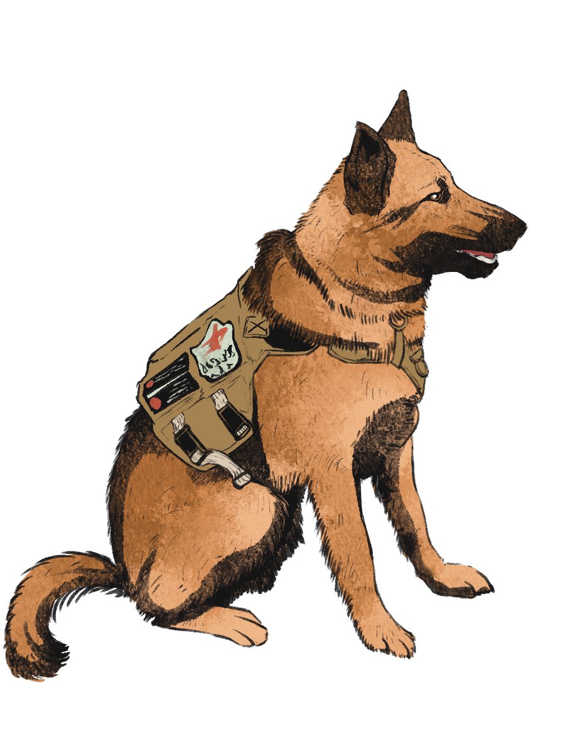
CLOSING REMARKS
Thank You!
For your dedication to our industries future.
We are not just focusing on personal growth but the industry's growth as a whole.
We are currently in the process of developing surveys that will collect valuable data that aims to paint a clearer picture of our industry, its trends, challenges, and opportunities.
Please look forward to participating in this effort with us in the coming weeks.

Slide 13
THANK YOU
PO Box 570
Edgemont, SD 57735
605-600-1709
www.headhuntersnw.com

