Slide 1
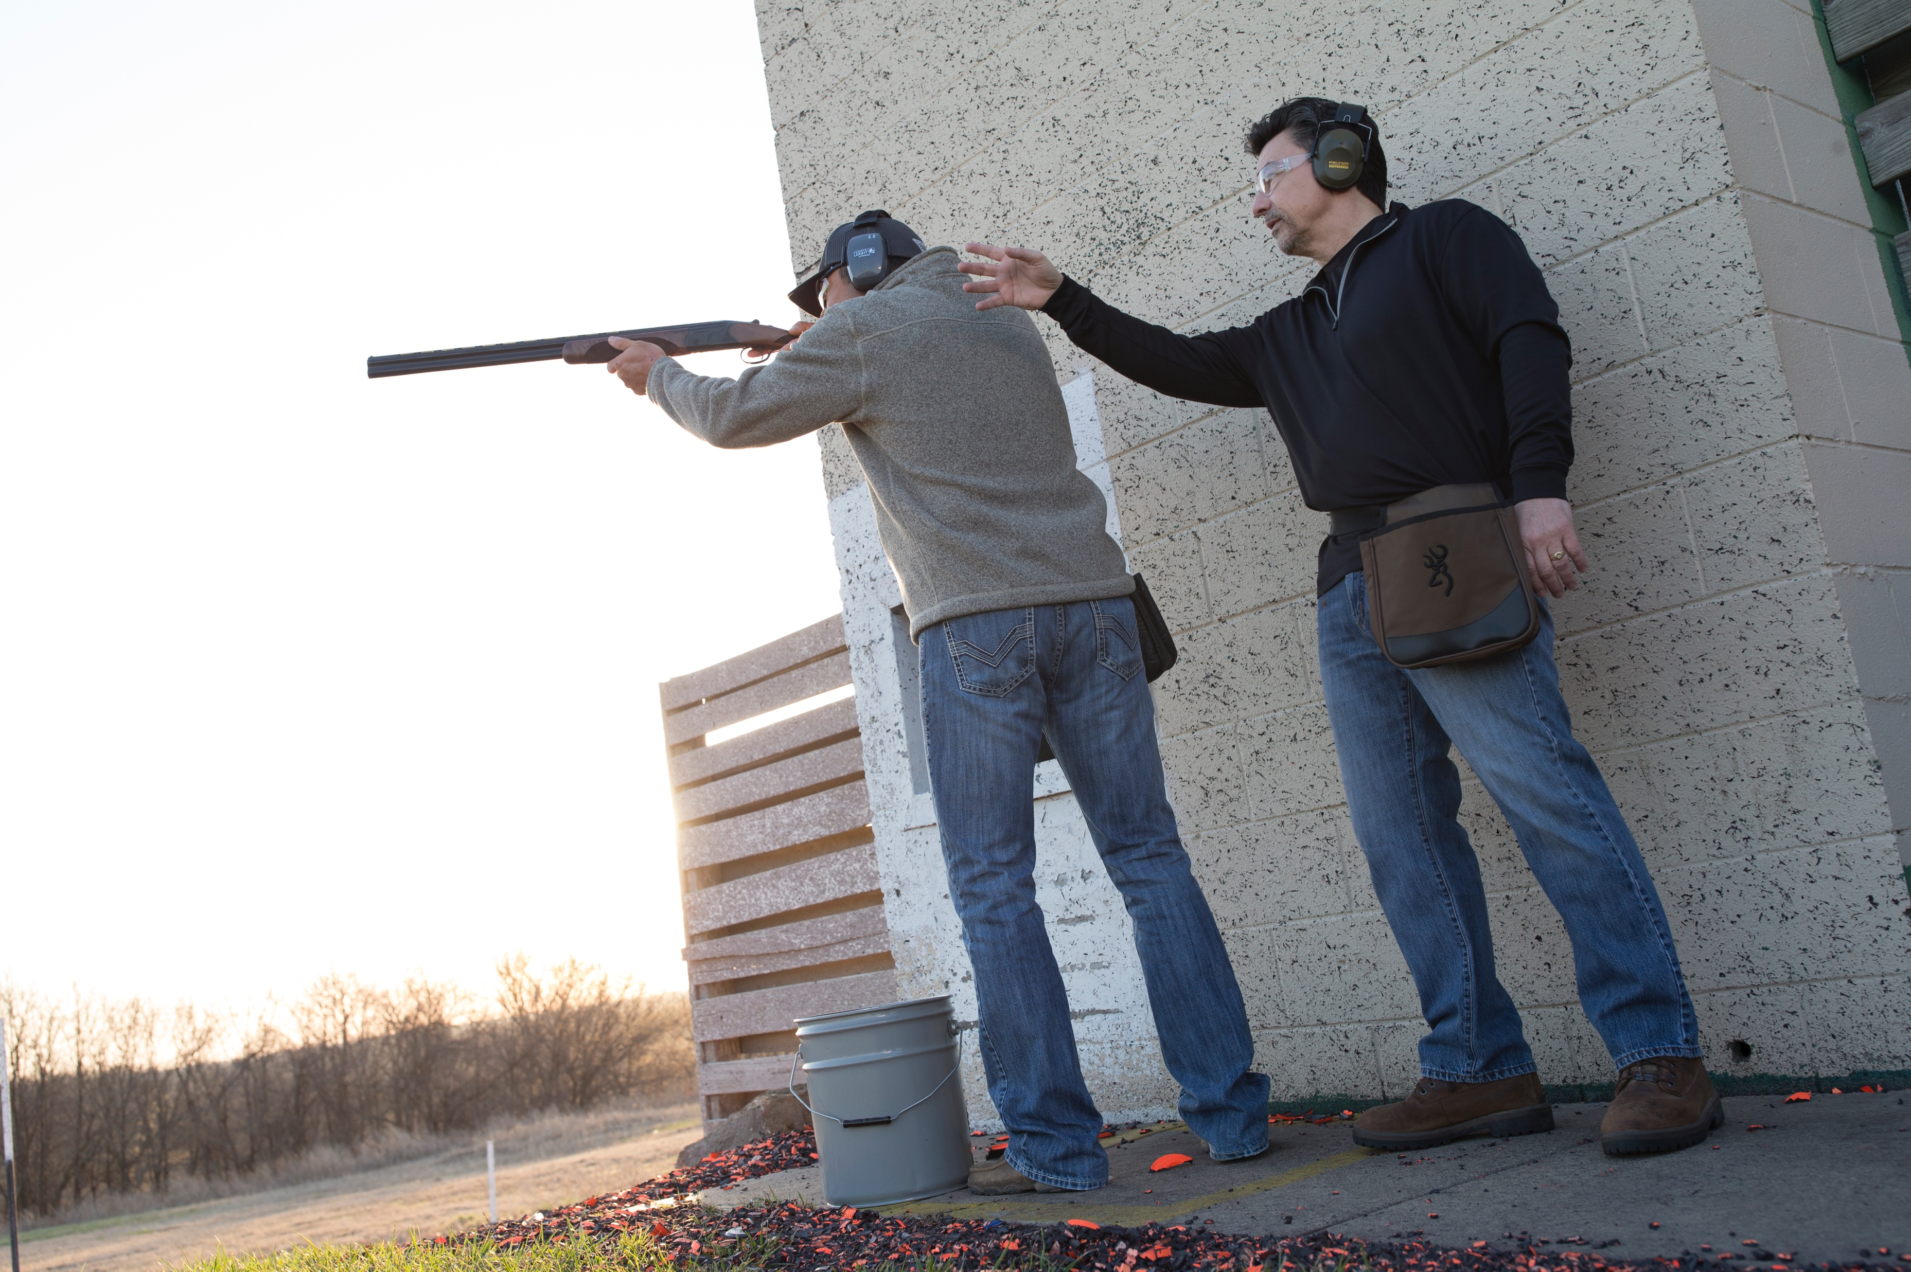



WHERE TO SHOOT
Join the +ONE movement today!
Thousands of shooting ranges
in the palm of your hand.
nssf.org/plusone
wheretoshoot.org

Slide 2


NSSF’s Mission
To promote, protect and preserve hunting and the shooting sports
Formed in 1961, NSSF has a membership of thousands of manufacturers, distributors, firearms retailers, shooting ranges, sportsmen’s organizations and publishers nationwide
Why do most companies join and participate? To support the mission, stay and grow the business!
2
Notes:
We do this:
By advocating to safeguard our industry from hostile legislation and regulations
Live Events and Online Educational offerings
Developing programs to help increase participation.
Communicating efforts to promote responsible gun ownership.
Why do most join and participate? To support the mission, stay and grow the business!

Slide 3

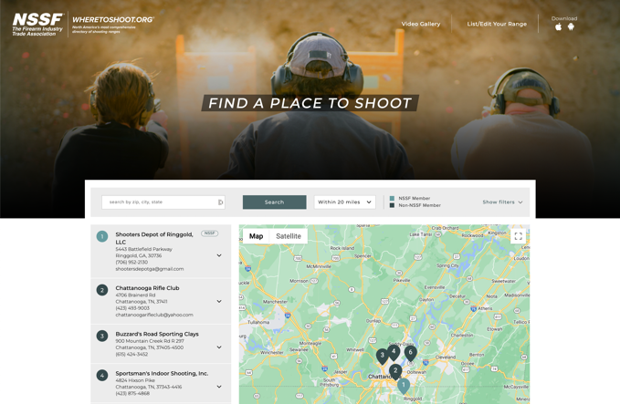
Where To Shoot
Website & App
The largest and most comprehensive database of shooting ranges. Search for ranges near you—or anywhere in North America—and see what each range has to offer.
  History
  WTS App Revamp Objectives
3
Notes:
- original WTS app (was one of the most popular / downloaded free apps in the apple store) in the early era of Apps back in 2012
- minimal enhancements were made over the years – this prompted the need to develop a whole new App for it
- 6 months ago we started working with app developer to create a new and improved version of the solution
– main objectives to improve the user experience / incorporate new resources & features
- Increase and highlight member ranges to serve as an added value benefit for our members

Slide 4

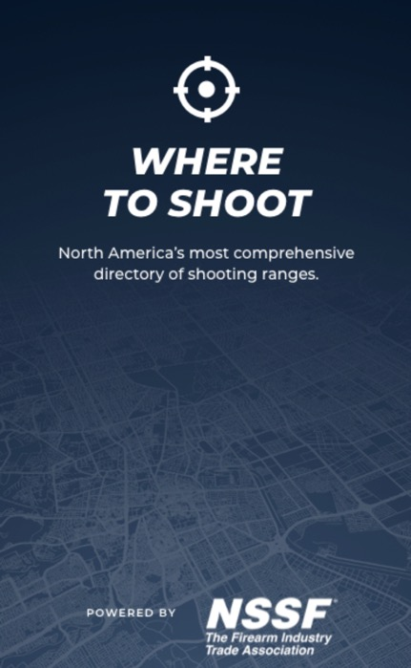
Where To Shoot App 2.0
Relaunched on App Store this June
Fully Redesigned and Built from Ground Up
Packed with Features and Resources for New and Established Target Shooters
4

Slide 5
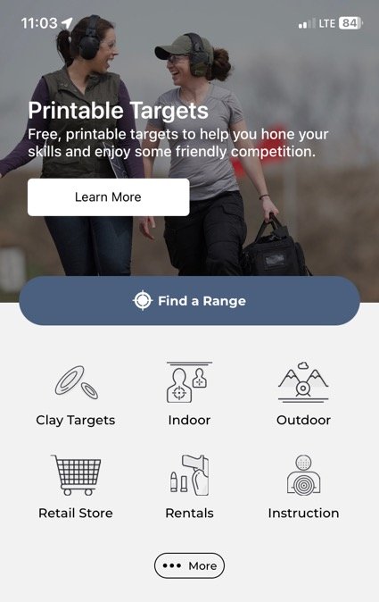
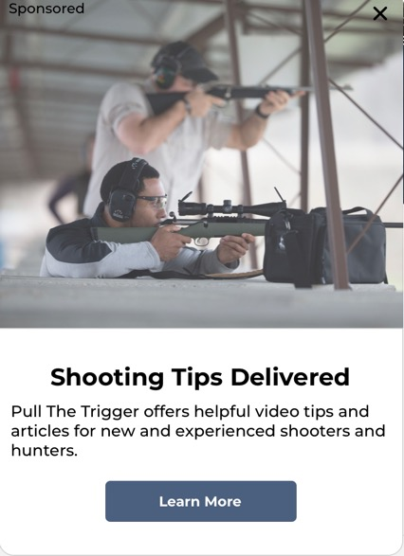
Where To Shoot
Home Page
Sponsors Pop Up
Rotating Tile Header
Search Options
5
Notes:
- you can navigate the entire app right from the home page
- rotating tile header serves as a user resource and to increase awareness (printable targets, find a local store to buy gear at, promoting The +ONE Movement) – these features can be changed
- 3 ways users can search – first way is by tapping the find a range button will populate all ranges within the user's location, second is by tapping on one of the 6 Quick Filter Icons or users can drill down further

Slide 6
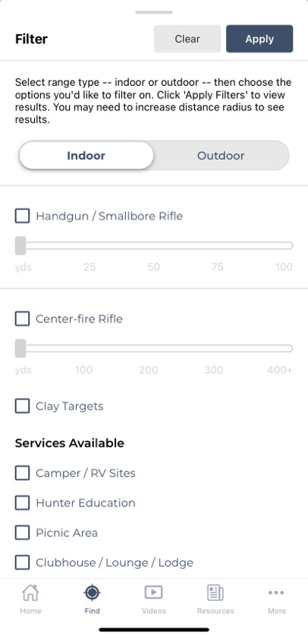
Where To Shoot
Expanded Filter Options
Range Type
Range Distance for Rifle/Handgun Shooting
Services Available
6

Slide 7
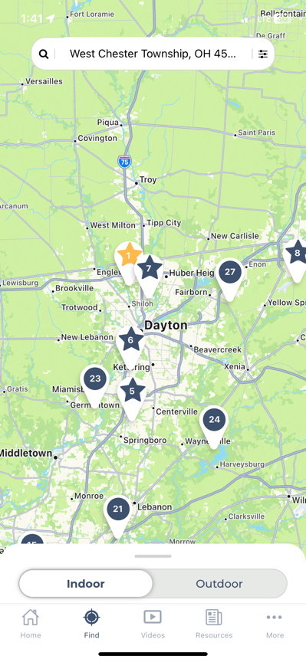
Where To Shoot
Map Display
Pin Distinctions
Use Search Bar to Explore Beyond Current Location
7

Slide 8
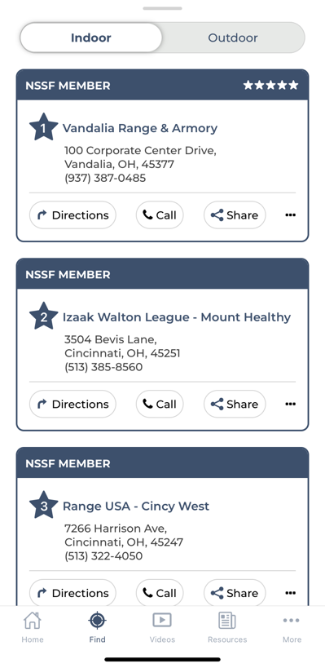
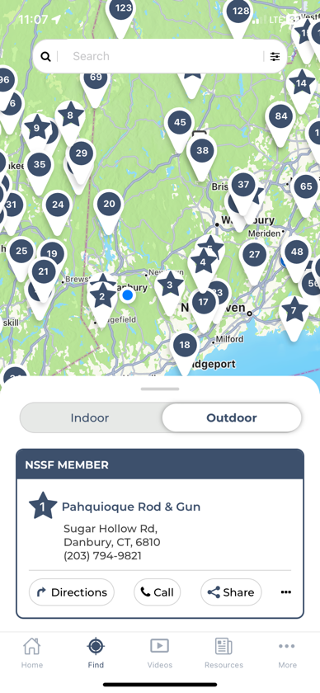
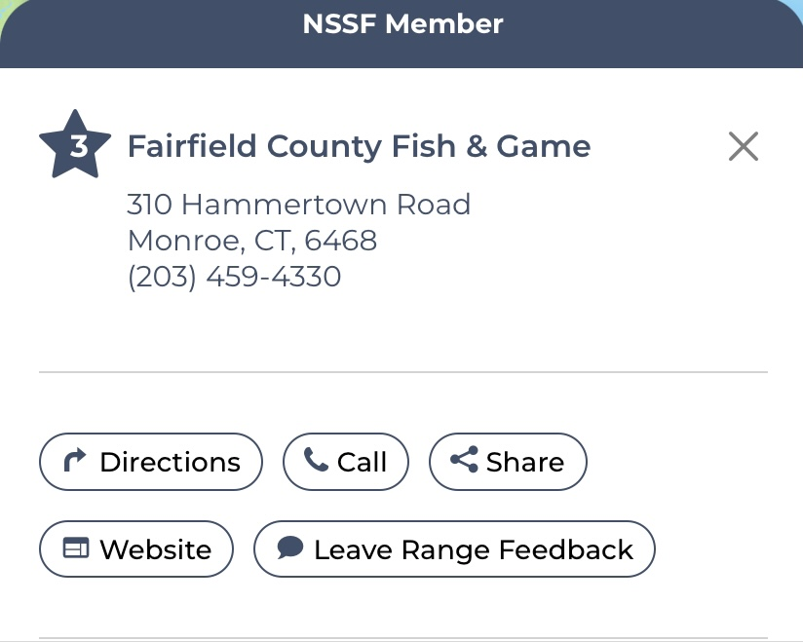
Where To Shoot
Range Info Display
Two Ways to Review Range Information
8
Notes:
- once you tap a pin the specific range detail will appear / expand the display to go to website or to leave range feedback

Slide 9
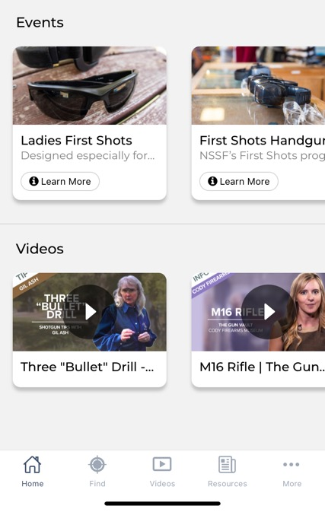
Where To Shoot
New Features & Resources
Featuring Host Ranges’ First Shots Events (plan to expand in future versions)
Videos To Build Knowledge Base and Encourage Increased Trigger Time
9

Slide 10
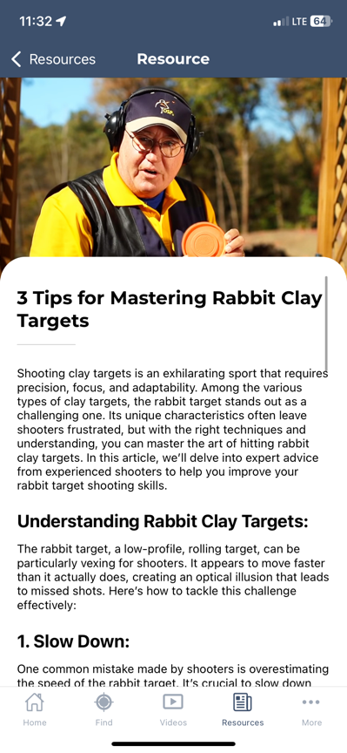
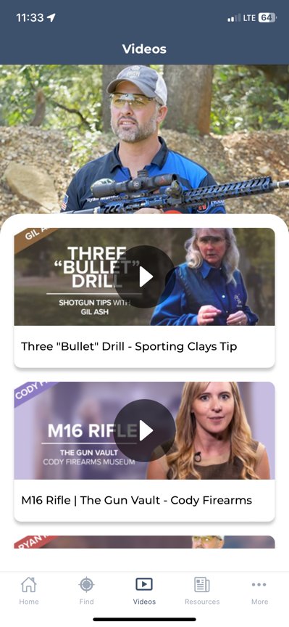
Where To Shoot
Bottom Navigation Options
Resources
Video Gallery
10
Notes:
Click on “Resources” tab to read blog posts that include how to’s, tips to get you on target and other activities/intiatives to participate in (NSSM, National Safety Month, Suicide Prevention Month, etc.)
Click on “Videos” to see the complete gallery filled with safety and shooting tips (over 600 videos)

Slide 11
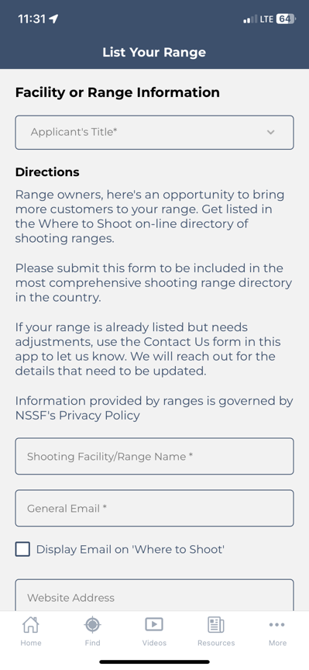
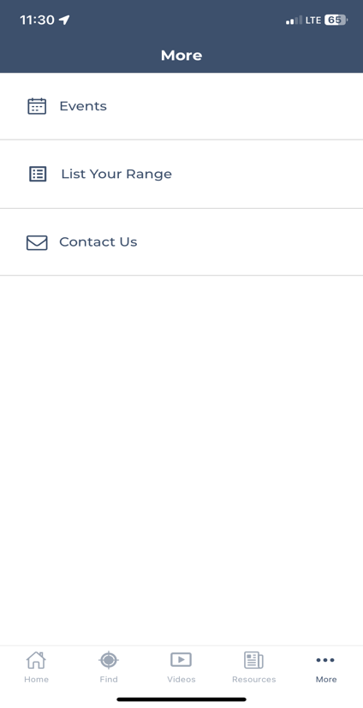
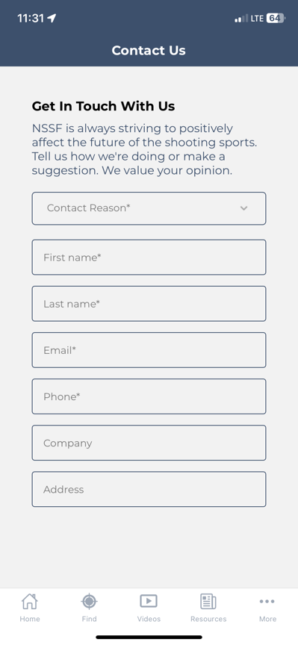
Where To Shoot
Bottom Navigation - …More
11

Slide 12
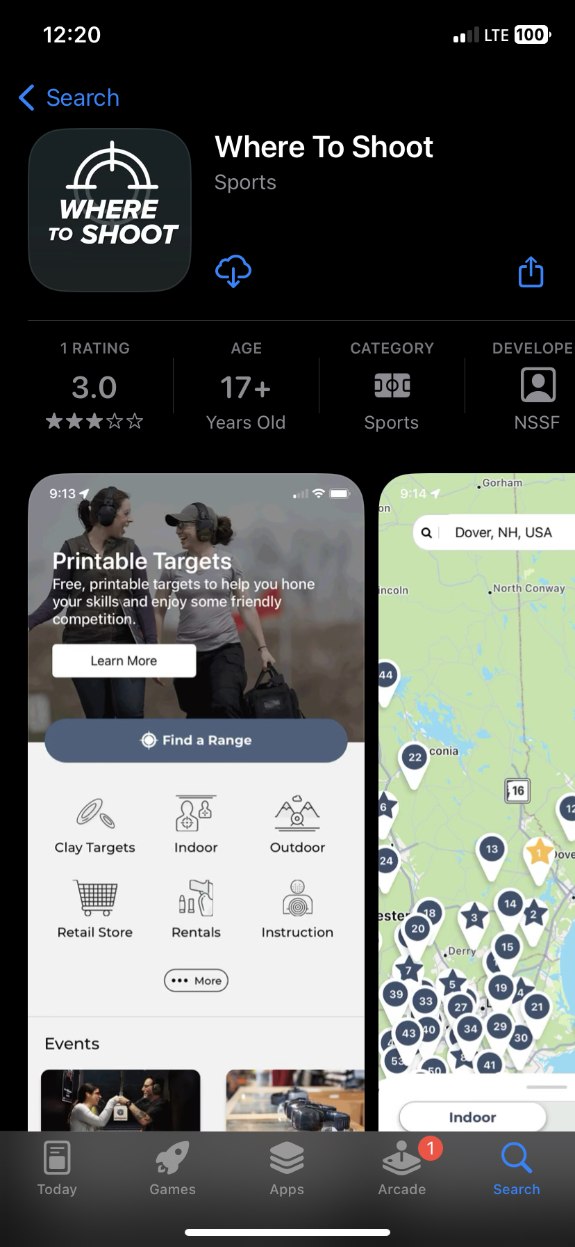
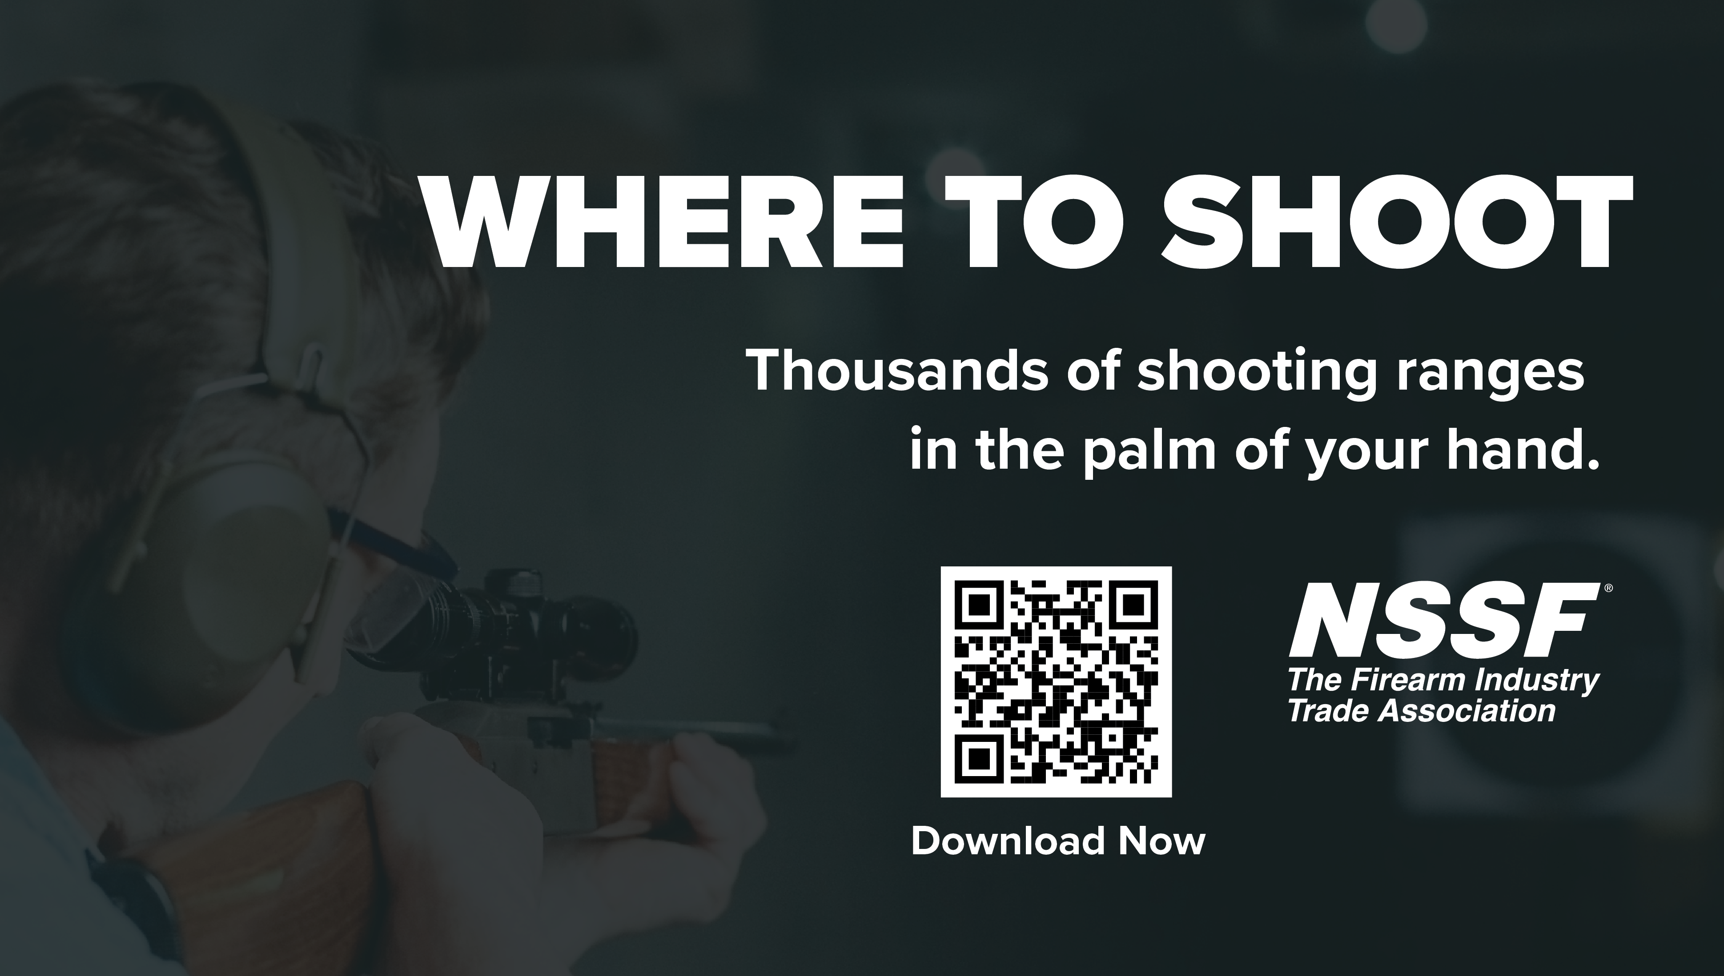
Where To Shoot
Download & Share Today!
Android Version Coming Soon
12

Slide 13

Efforts to Help Secure the Future of Hunting & Target Shooting
Get Involved & Share!
Notes:
How many of you started shooting because your parents?
How many of you started shooting because of a friend?
How many of you have never hunted?

Slide 14

In 2022, younger shooters made up the largest portion of shooters, whereas the largest share in every other survey year was the 35‐ to 54‐year‐old age group.
In 2022, new shooters and nontraditional shooters (such as those who did not grow up in a household with a firearm that was used at least twice a year, and those who did not shoot until they were adults) went shooting at an indoor range markedly more
often than their counterparts did.
The importance of self defense as a motivation for shooting has continued to rise over the years among new shooters. This trend provides further evidence of the growth of nontraditional entry into shooting.
Source: Firearm Ownership and Sport Shooting Participation in the U.S. in 2022
14
Notes:
Younger shooters = 18-34 age group
Went to indoor ranges more often
Self Defense – Primary motivator

Slide 15
According to the Firearm Ownership and Sport Shooting Participation in the U.S. in 2022 survey data …
Approximately 5% of respondents did not go hunting and 4% did not go target shooting for two reasons – and we’ve heard them before:
  Don’t know where to go / no access / no place nearby
  No one to go with / not invited to go
In addition, according to the survey data, 1% did not go hunting because they “don’t know how”.
Approximately 56% of respondents did not go hunting and 54% of respondents did not go target shooting for one main reason –
  No Interest

Slide 16
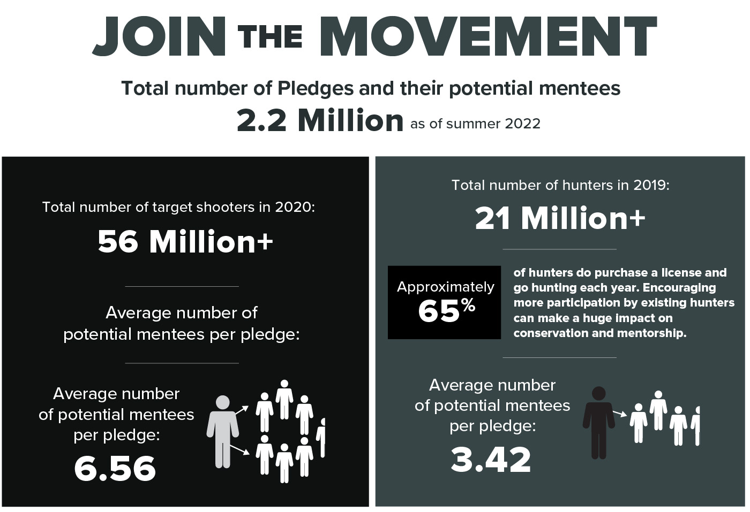
16

Slide 17
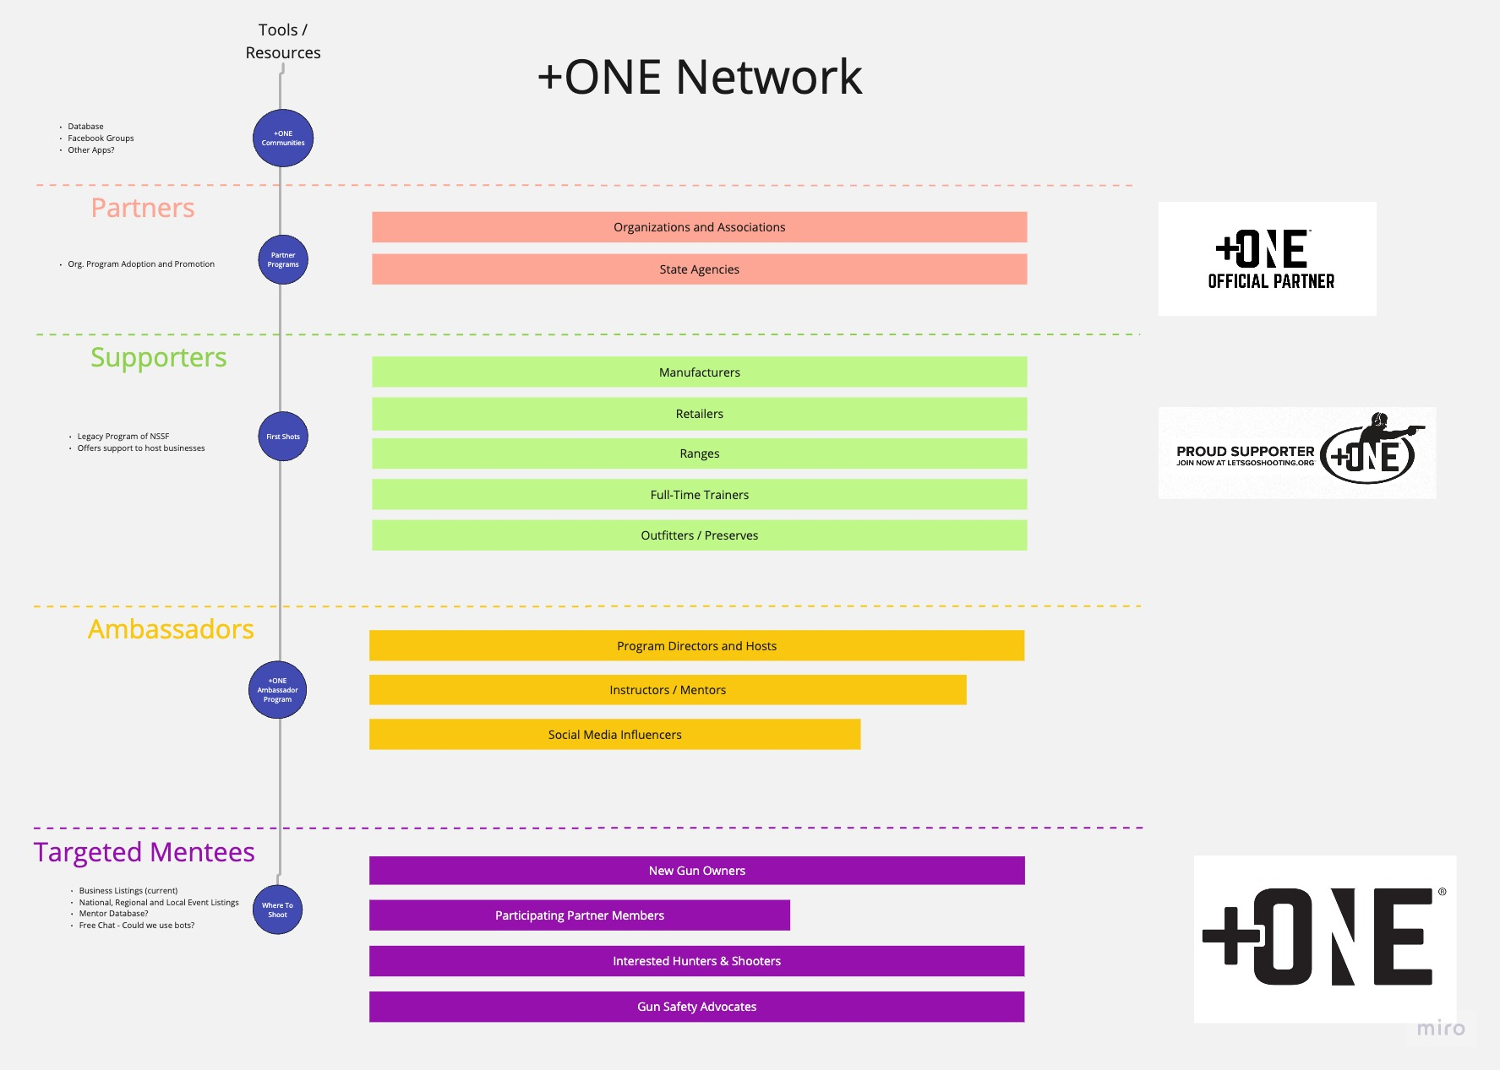

Slide 18





18

Slide 19

Resources
Digital Tools
Build Out +ONE Promotions
Share Shooting Mentorship Moments | +ONE Movement Facebook Page – 22K followers
NSSF.ORG/PLUSONE
LETSGOSHOOTING.ORG/PLUSONEMOVEMENT
19
Notes:
I’m sure all of you can remember that first time you went target shooting and hunting
Afterall, there lifetime memories. A great way to relive it, is when we take a friend or family member out for that same experience
This what the +ONE Movement is all about. Encouraging target shooters and hunters to take the pledge to introduce someone new
Since inception in 2018, 2.26 million people have taken the +ONE pledge.

Slide 20
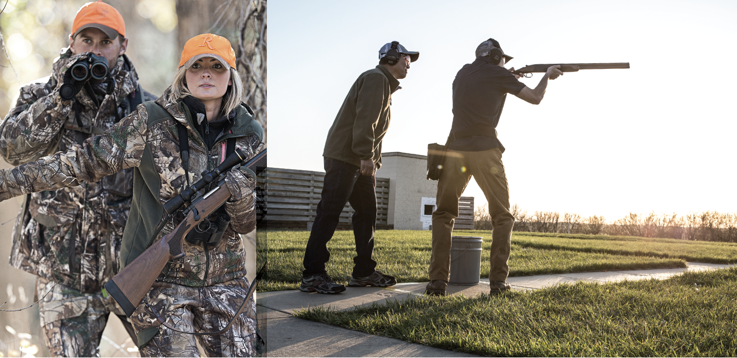
Join the +ONE Community
Become an official partner, supporting business or ambassador
  Be part of the story.
  Be a leader in education.
  Help secure the future of hunting and shooting sports.
Contact Zach Snow zsnow@nssf.org or Justin Morrissey jmorrissey@nssf.org
THANK YOU!
Notes:
Becoming a partner or supporter does many things, including:
Increase public approval
Increase opportunities for the industry to be supported more openly by legislators for what we already do.
Show your business is part of a larger cause
Represents your business and what it believes in
Welcomes customers and anyone interested who has questions.
Expand the industry network relating to educators
Prioritizes safety, learning and mentorship in alignment with a larger network

