Slide 1

Council Update
National Youth Shooting Sports Conference
MidwayUSA Foundation

Slide 2

History of the Council
PURPOSE:
Ensure support for and active participation in hunting and the
shooting sports for future generations.
2007
  AFWA Industry/Agency Summit (Washington, D.C.)
  First earnest discussion about the need for the Council
2008
  White House Conference on North American Wildlife Policy
  Plan emerged, Educating, Recruiting, and Retaining Hunters
  ”Create a hunting and shooting foundation similar to the Recreational Boating and Fishing Foundation”
2009
  Council to Advance Hunting and the Shooting Sports officially chartered
VISION:
An America where hunting and the
shooting sports are an integral part of
mainstream culture and where hunters
and shooters are widely recognized as
premiere conservation contributors.
MISSION:
Facilitate the promotion and growth of
hunting and the shooting sports and the
education of the public on the contributions
that hunters and shooters make towards wildlife conservation.

Slide 4
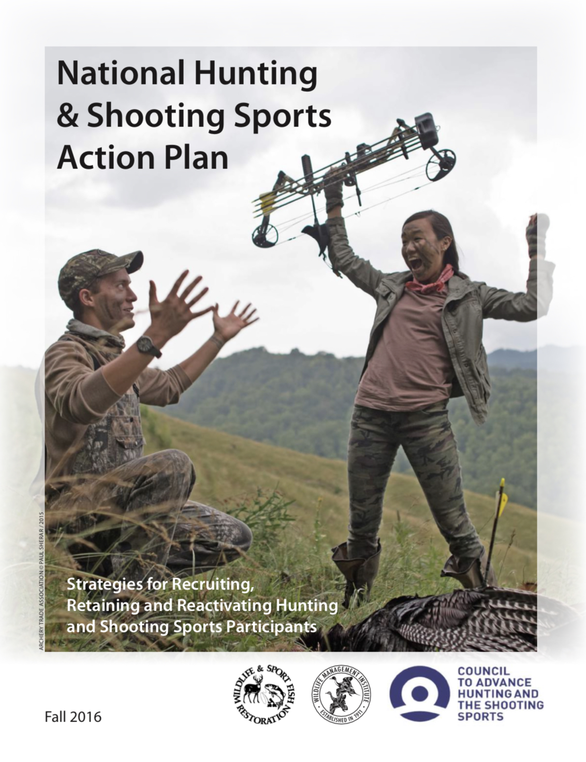

Slide 5
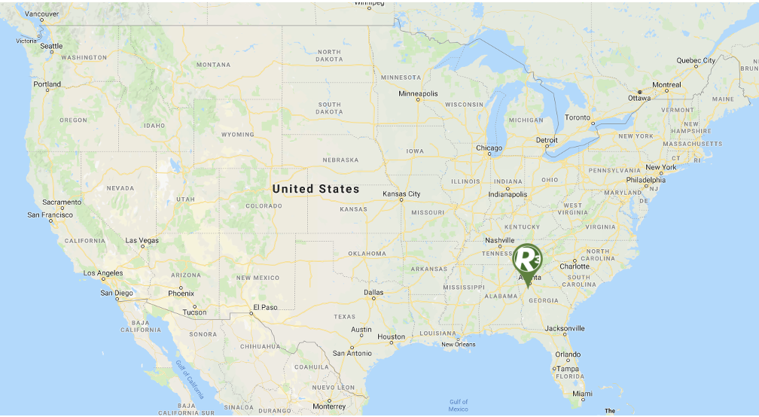

Slide 6
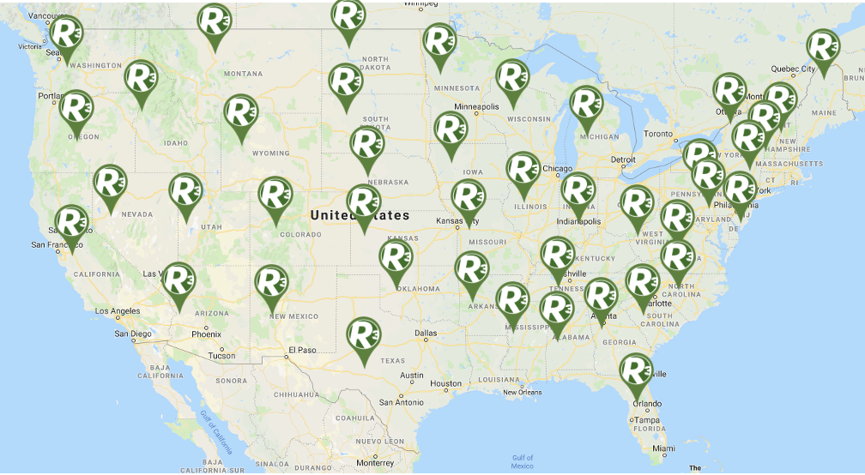

Slide 7
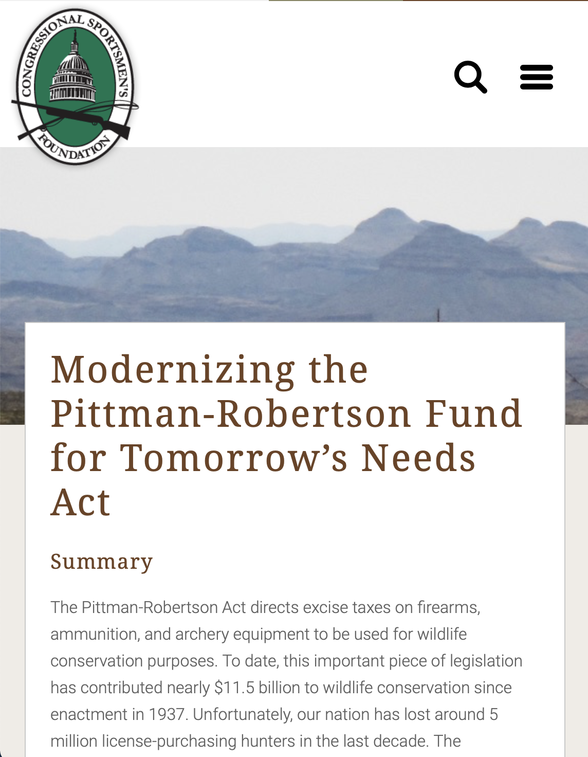

Slide 8
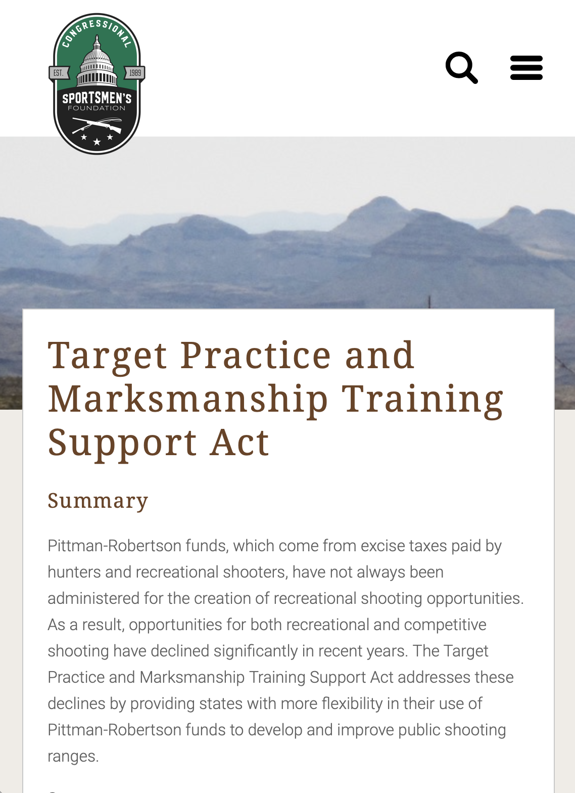

Slide 9
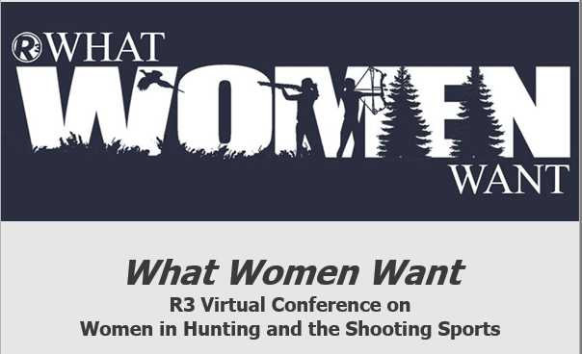

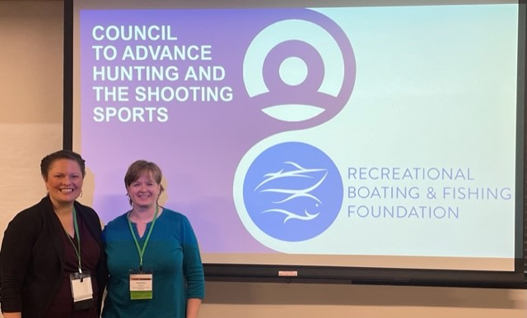
Council Services
Partnered or provided assistance on 15 MSCGP Projects
Provided technical assistance on 16 organization-level R3 strategic planning efforts
Hosted, facilitated, or assisted with 8 state-specific R3 trainings, workshops or summits
Hosted 11 R3 webinars
Hosted 4 in-person R3 trainings for practitioners at every level of their careers
Lead or facilitated 6 research projects (license sales, regulation complexity, etc.)

Slide 10


Slide 11
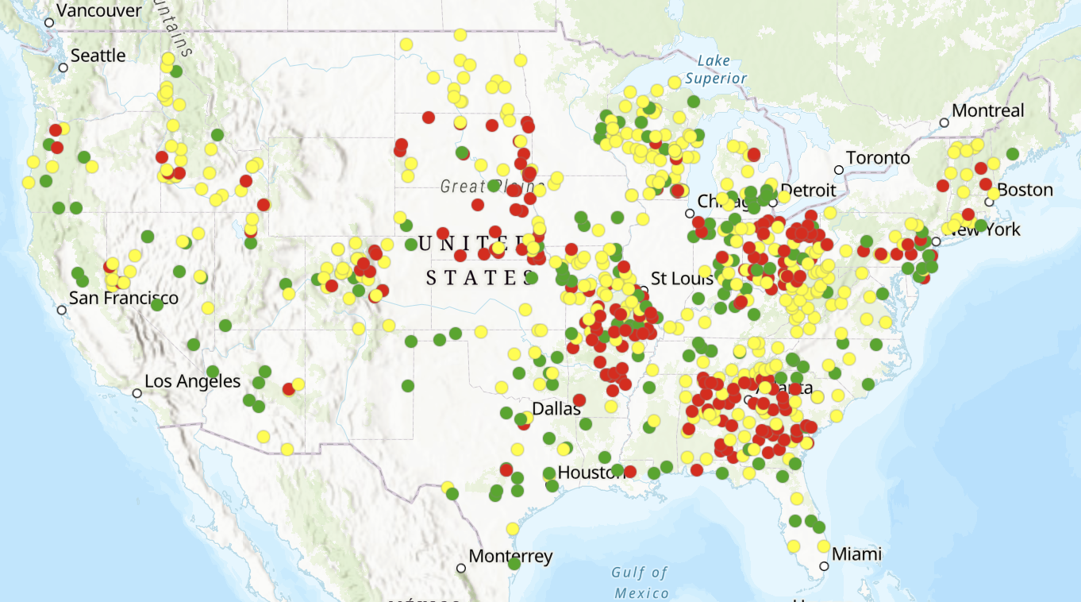

Shooting Ranges
partnerwithapayer.org
Notes:
63 million people shot in 2022
Large increases in all sorts of nontraditional
Pushing agencies to build public shooting ranges and treat shooters as stand alone constituents
Almost 800 PR funded ranges
Partnerwithapayer.org
107m in grants submitted since tarmark

Slide 12
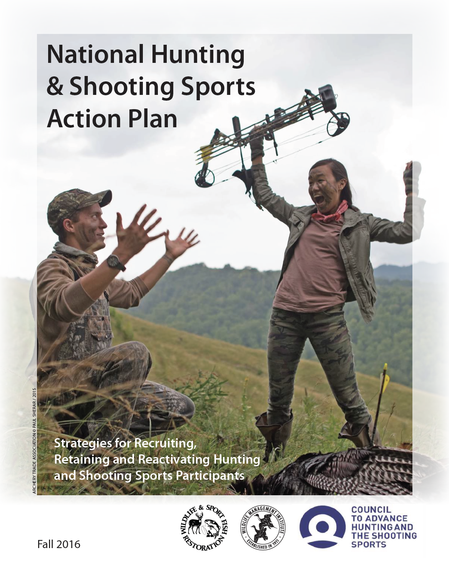
National Hunting and Shooting Sports Action Plan
Current plan:
  Spearheaded by Council and WMI
  Plan development workgroup
  2013 (initiated) > 2016 (published)
Next iteration:
  In partnership between the Council and The Assessment Group (TAG), Regional R3 Committees, and partners.
  R3 Community Involvement:
    Focus groups, listening sessions, writing teams, review opportunities, presentations, implementation
  Plan finalized and released in 2024
Coming Soon!
2024
Notes:
Shooting Sports
- Better tracking metrics
- Organized shooting participation
- Access – shooting ranges, range directory

Slide 13
Public Approval (Hunting)
Responsive Management and Outdoor Stewards of Conservation Foundation: Americans’ Attitudes Towards Hunting and Target Shooting
Notes:
Only three months saw an overall increase (Feb, Jul, Sept)
The West took the biggest hit in both resident (-4%) and nonresident (-7%) sales

Slide 14
Public Approval (Shooting Sports)
2021 to 2023
Approval decreased by ~8 million adults
Disapproval increased by ~15.5 million adults
Responsive Management and Outdoor Stewards of Conservation Foundation: Americans’ Attitudes Towards Hunting and Target Shooting
Notes:
Only three months saw an overall increase (Feb, Jul, Sept)
The West took the biggest hit in both resident (-4%) and nonresident (-7%) sales

Slide 16
  Registrants: 249
  Organizations: 107
        Agency (Federal and State) 34%
        Non-Profit 40%
        Industry 21%
        Academia 5%

Slide 17


Slide 18
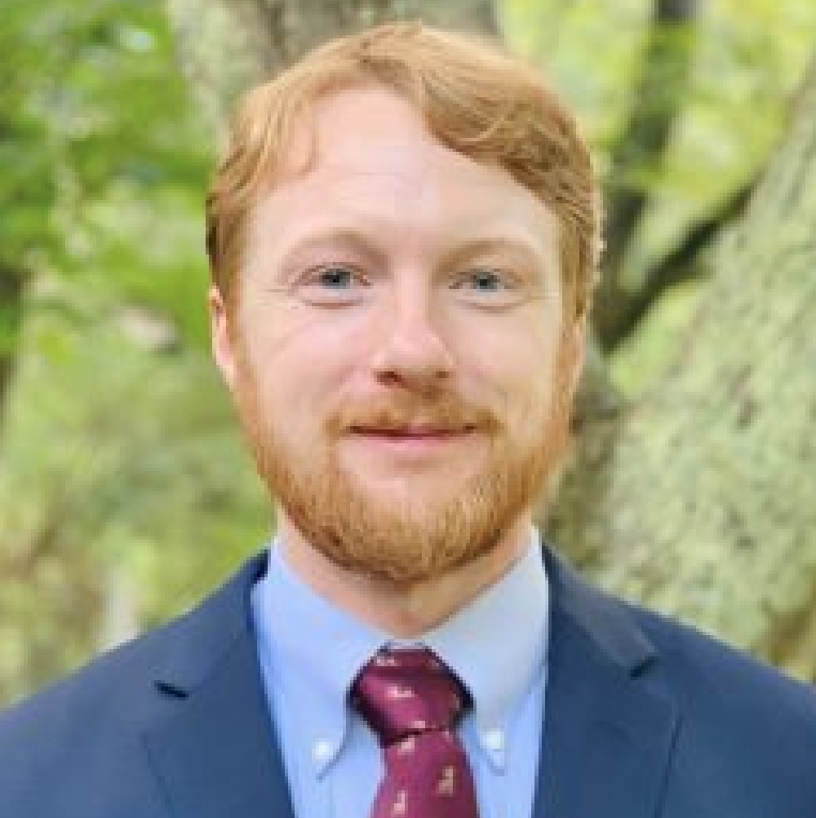
cahss.org
Swanny Evans
Director of Research and Partnerships
swanny@cahss.org

