Slide 1
Building Your Brand
An intro to social media for shooters
By: Abby Jackley

Slide 2
About ME
-
My names is Abby Jackley, and I am 18 years old
Competitive shooter for 5 years & currently shoot for team Ruger
I hold 4 national SASP titles for 2023
I am a published writer
Contributing writer and Social media manager for Junior Shooters magazine

Slide 3
Why Social media?
They are already there !
Show the positives of shooting sports
Role model for youth shooters
Building your personal brand
Grow relationships in the industry

Slide 4
How to create your personalized brand

Slide 5
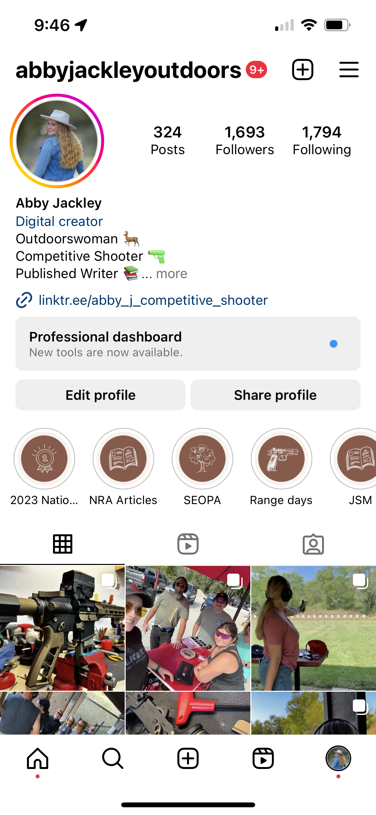
Social media to do's & do not's
To Do's
Do not's
Use your personal brand theme
Keep your page organized
Post fun and relatable content
Comment and support others in the industry
Safe and age-appropriate content
Inappropriate language
Wreckless handling of firearms
Arguing online
Share outside your values

Slide 6
Tips for reaching out to brands
Hashtags #letsgoshooting
Tagging @midwayusafoundation
Using DM's
In-person meet & greets
Creating an elevator pitch

Slide 7
Potential benefits
Personal Growth
Career Opportunities
Industry relationships
Advocacy
Friendships
Confidence
Communication Skills
Writing
Marketing
Public Speaking
Sponsorships
Product Demos
Political Opportunities
Gun rights
Teammates
Social Media Friends
Squads

Slide 8
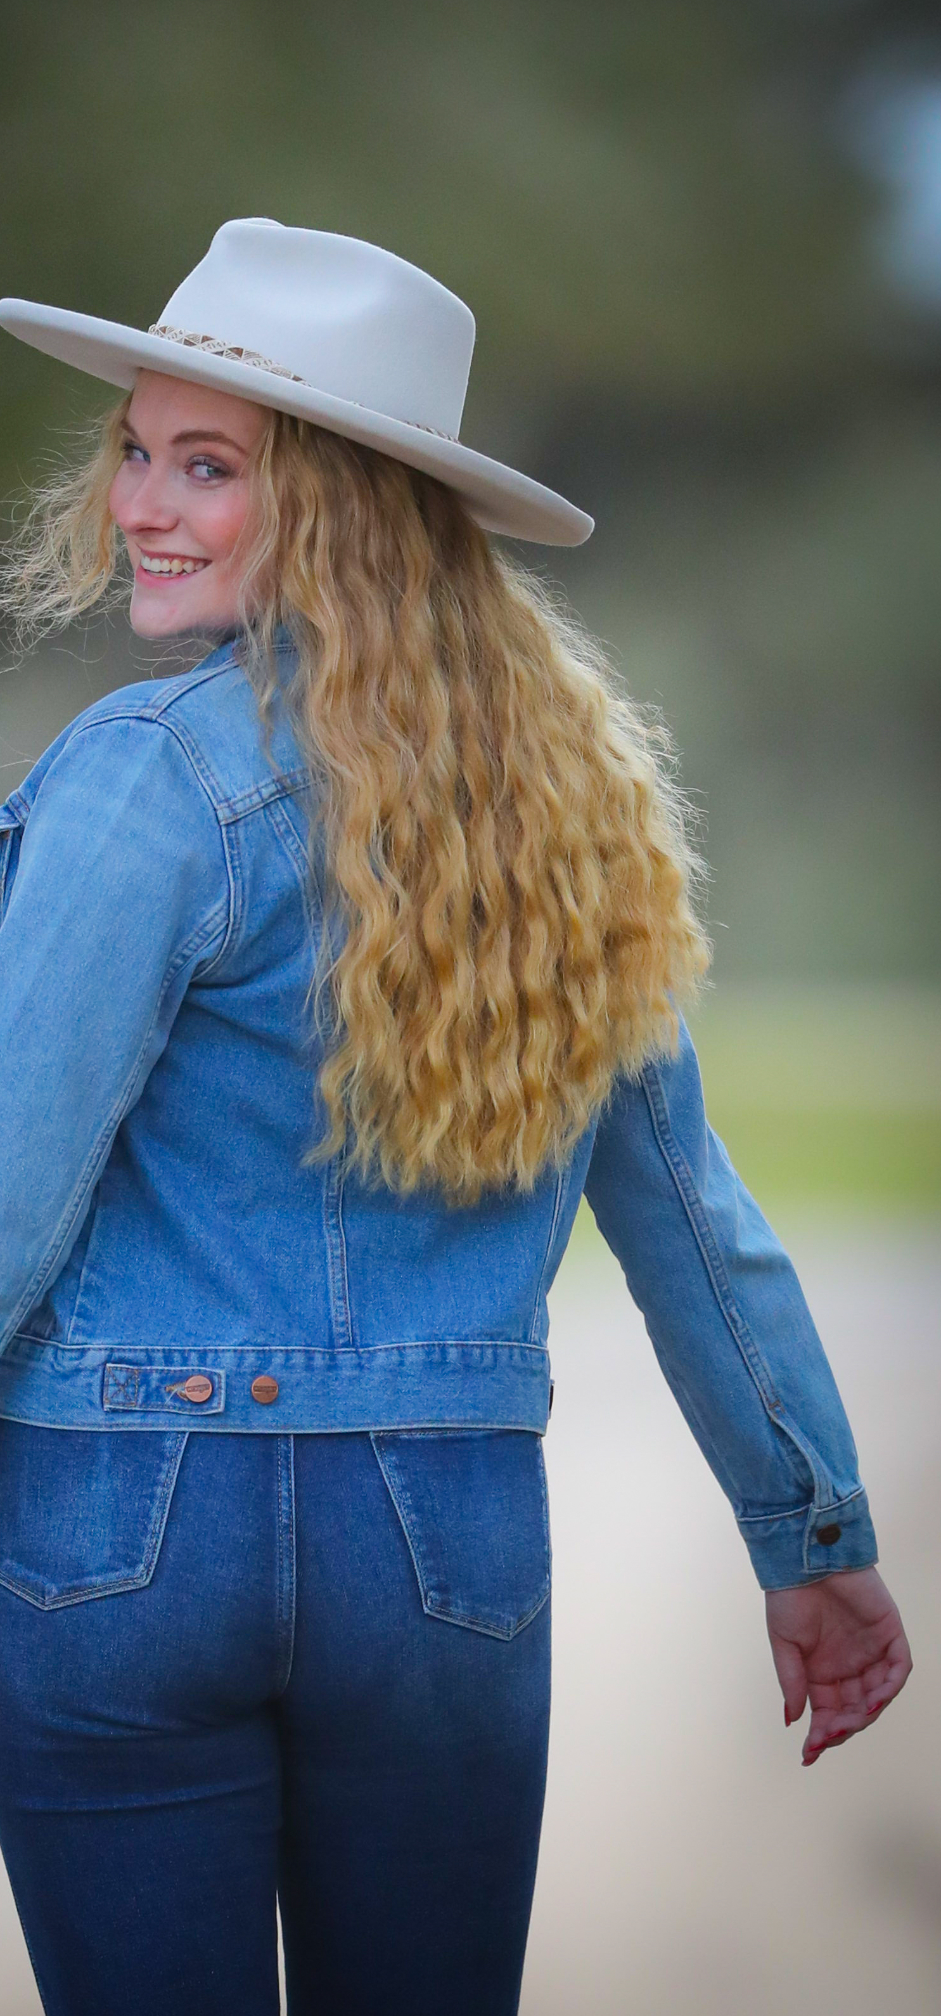
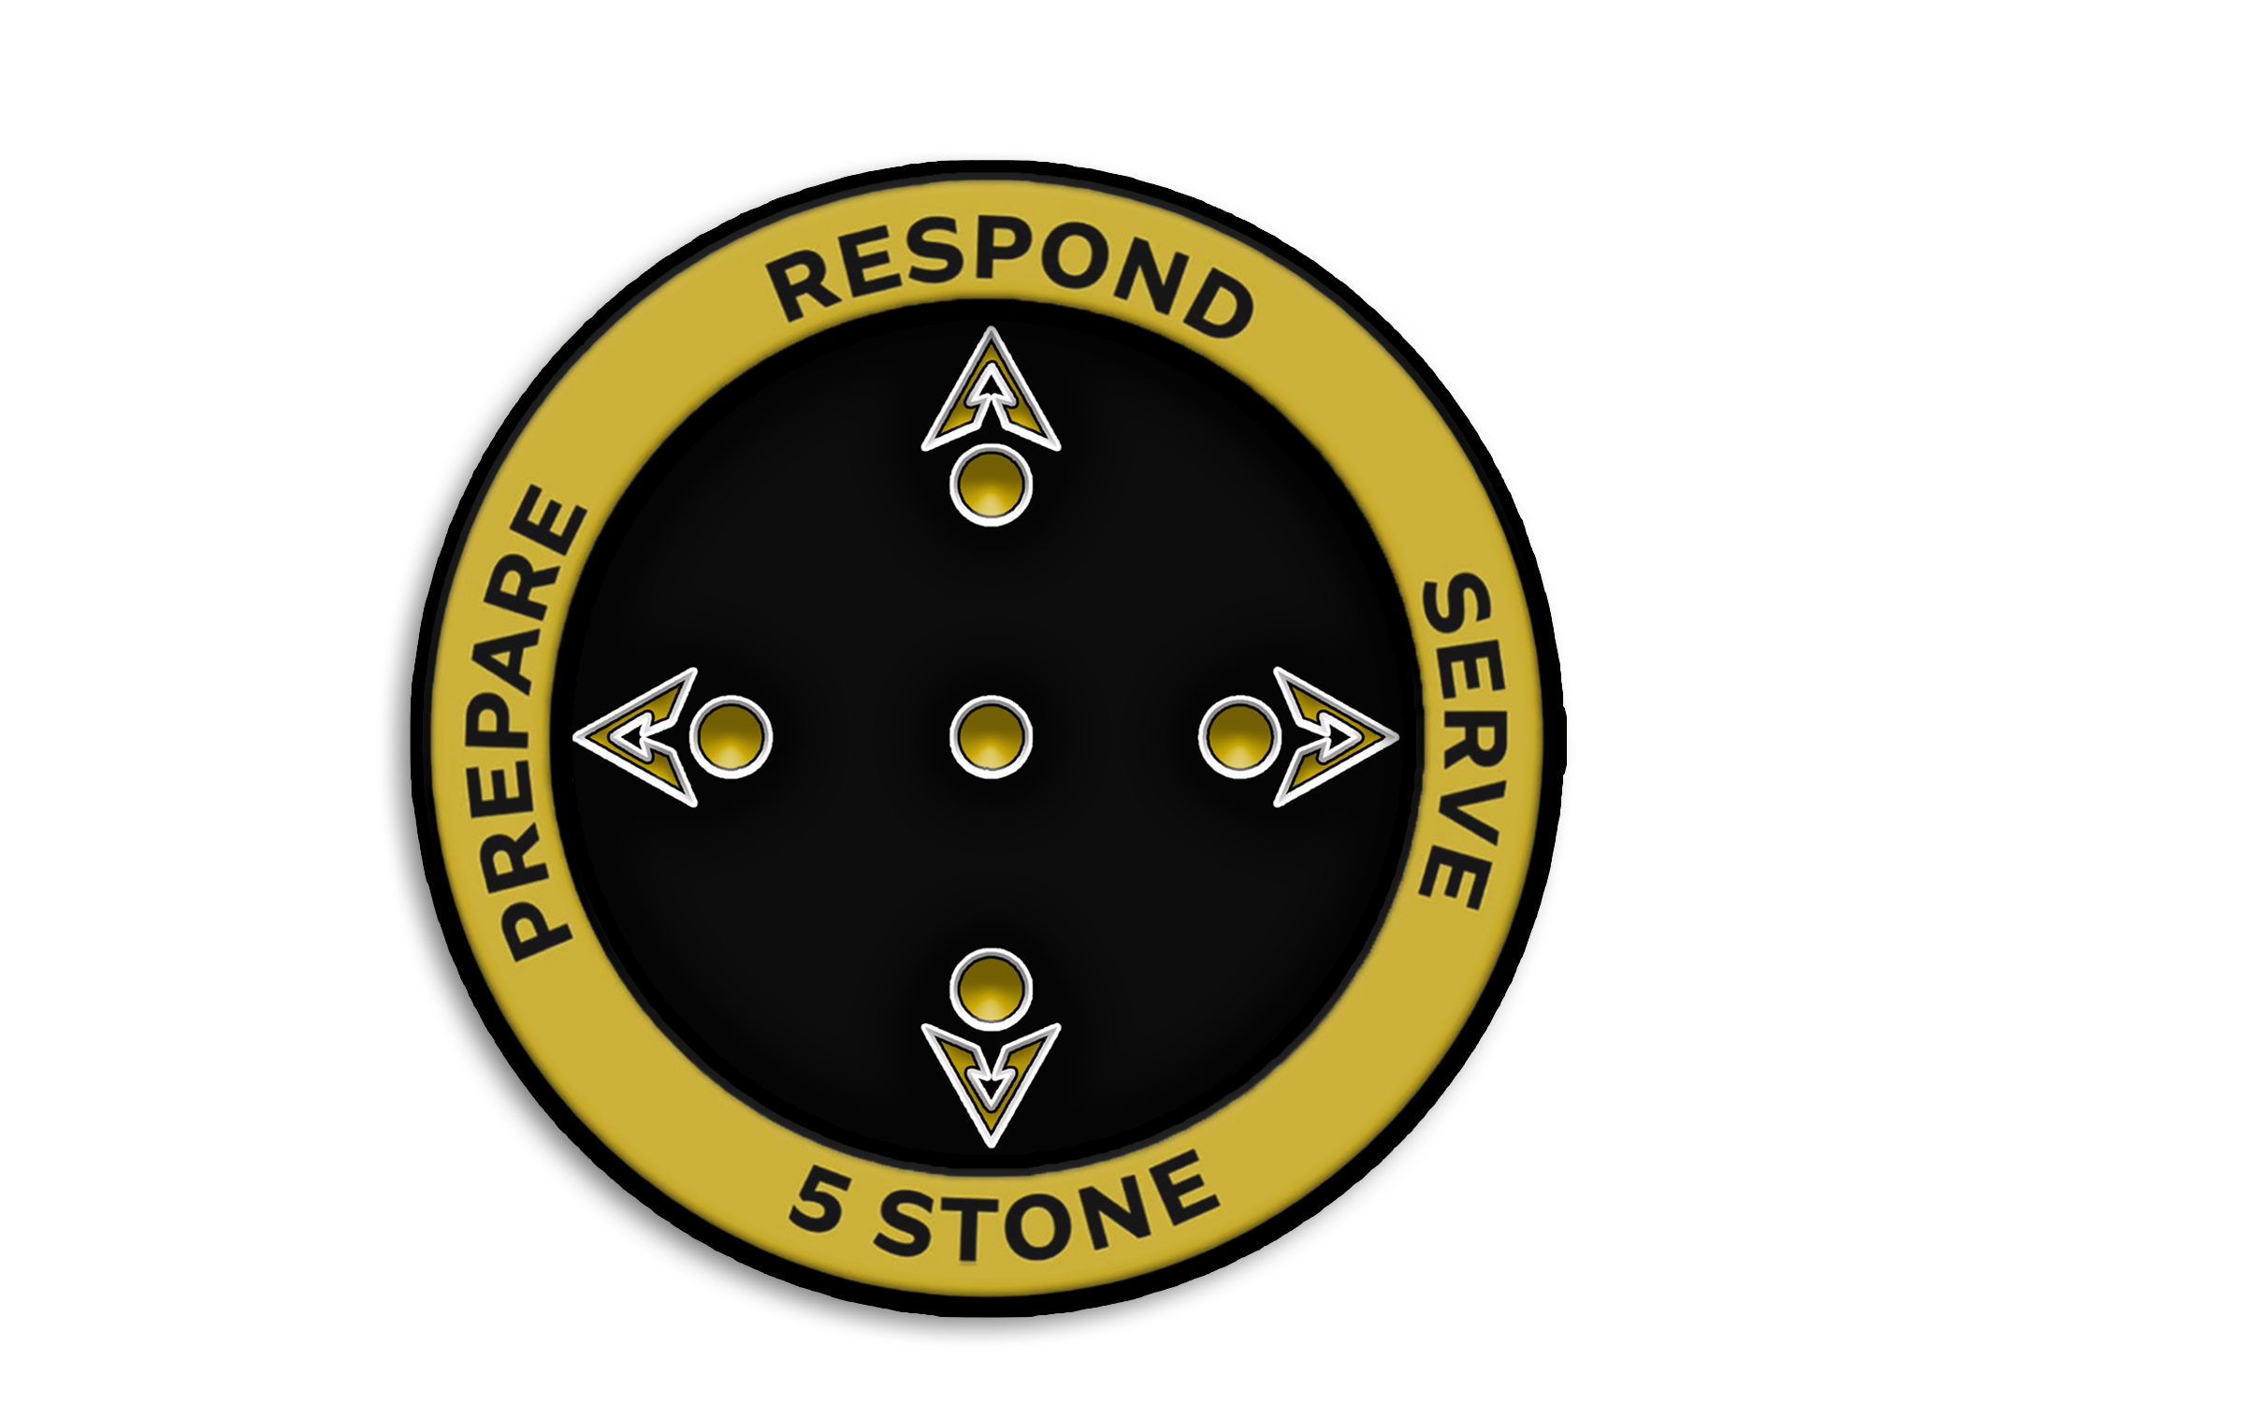
Thank You !

