Slide 1
Ducks Unlimited’s
Team Resource Assistance
Program
Justin Aycock
Manager of Youth Engagement Programs

Slide 2
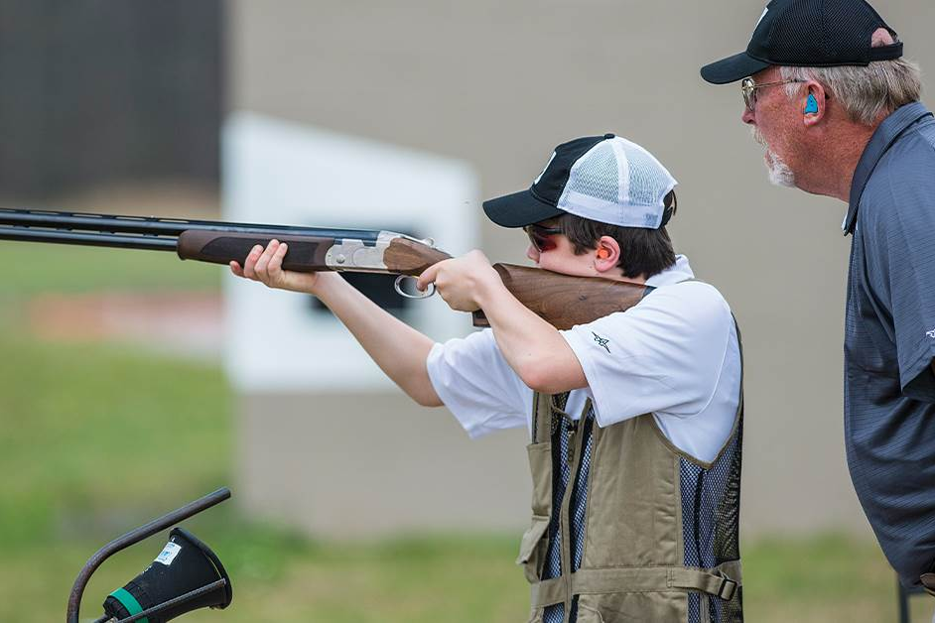
DU T.R.A.P. Program
What is DU T.R.A.P.?
T.R.A.P. is a turn-key fundraising program for youth shooting sports teams
This program is run through NHQ and is not a program run by DU chapters
DU provides professional marketing and ticket printing services to teams and discounted merchandise for teams to host a raffle

Slide 3
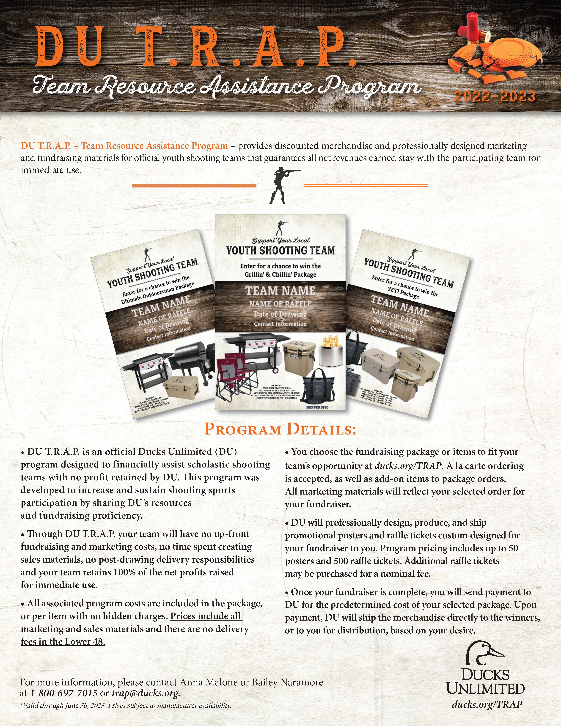
DU T.R.A.P. Program
How does DU T.R.A.P. work?
Teams select a package or al cart items to build a raffle, and we send them the tickets and promotional posters
Teams then sell their raffle tickets, hold their drawing, and send DU the winners shipping information and payment for the package after the raffle is complete.
The team keeps all net revenue for immediate use

Slide 4
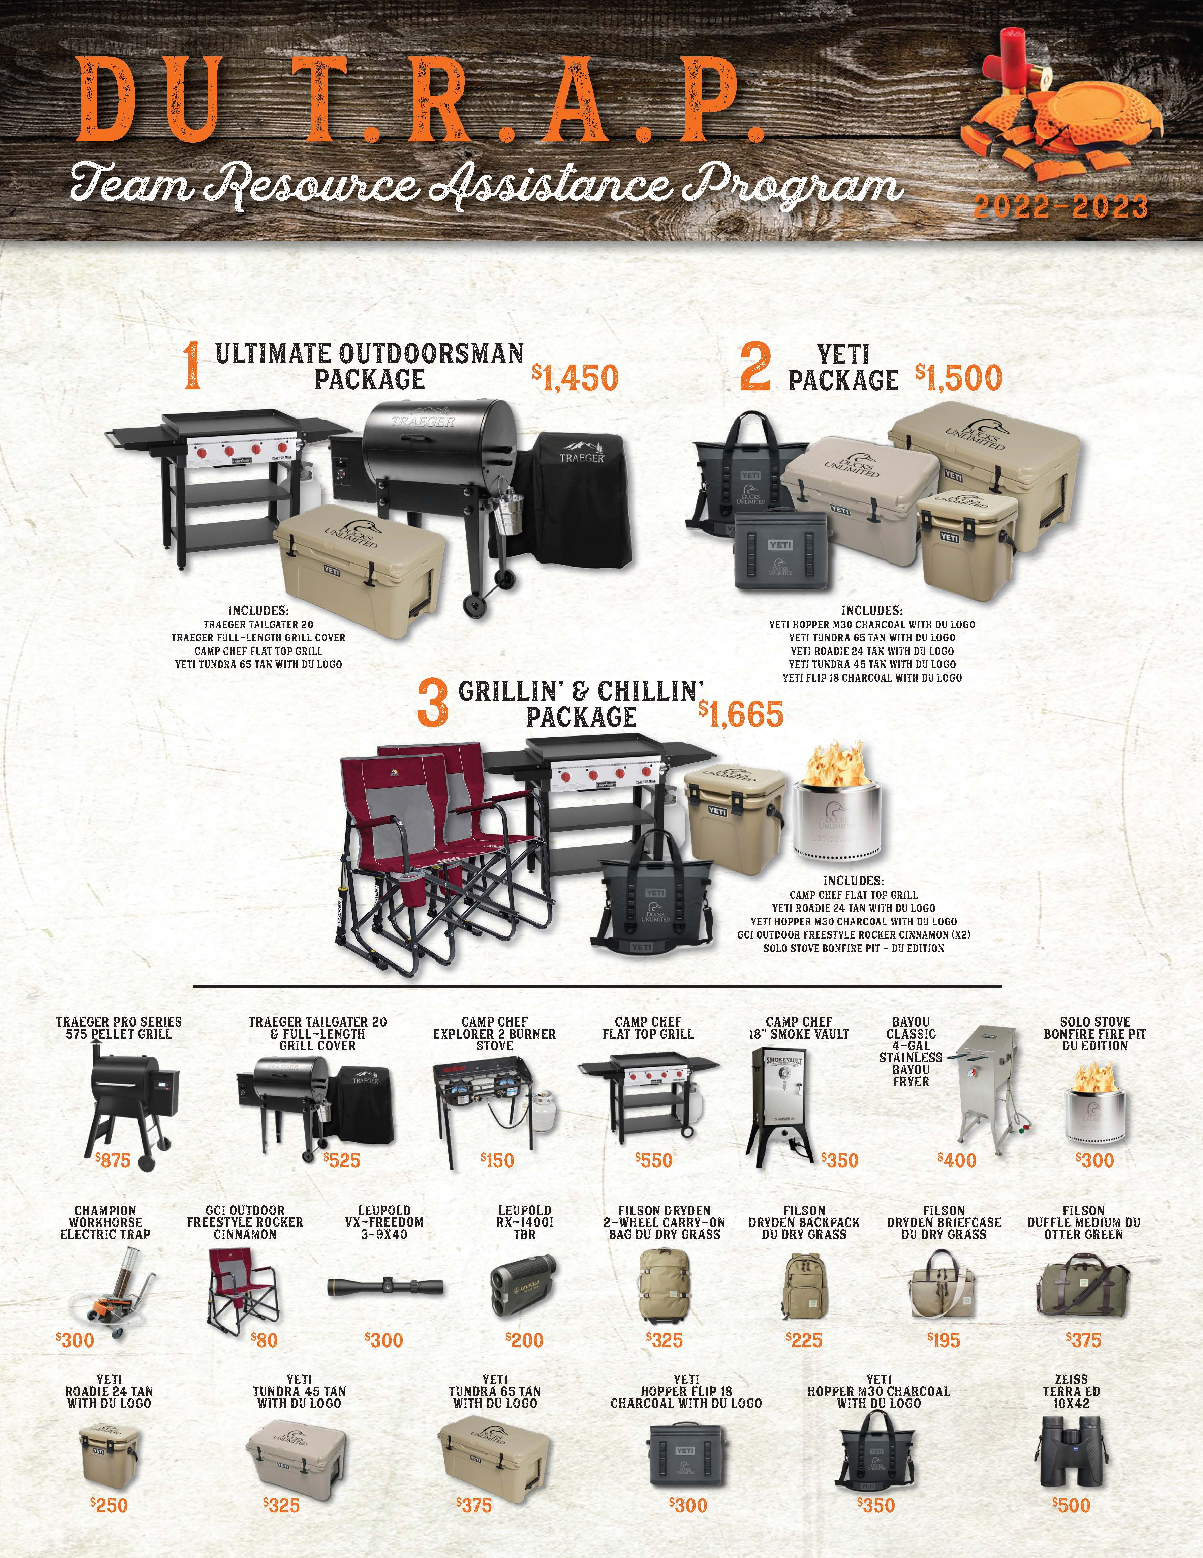
DU T.R.A.P. Program
How can you order a DU T.R.A.P?
Go to www.ducks.org/trap
Complete the online submission form and a DU representative will contact you with proofs of your tickets and posters for your approval.
Tickets and promo posters will arrive in two weeks of approval.

