Slide 2
3GE, LLC
Coaching and range experience in USA and overseas
Range consulting, design and build services
International Bunker, Trap, Skeet, Sporting Clays and Overlays
Maintenance Services

Slide 3
3GE, LLC - Past Projects
Built bunker at Ft Worth Trap and Skeet; new design, installation
5 bunkers at USA Shooting Olympic Training Center – COS
Consulted on layout and design for 4 bunkers at Hillsdale College
Upgrade and maintenance at Texas A&M – College Station
Upgrade at North Mountain – PA – USA Shooting Certified Training Center
Metal bunker design and build at Minute Man Sportsman’s Club for New England Junior Shooting Sports (NEIJSS) a USA Shooting Certified Training Center
Consulted on build for Chad Wittenberg bunker – TN – USA Shooting Certified Training Center
Mini Bunker build and grant program in PA
Designing new ATA house in kit form for release in 2023
In negotiations for 3 new bunkers for 2023

Slide 4
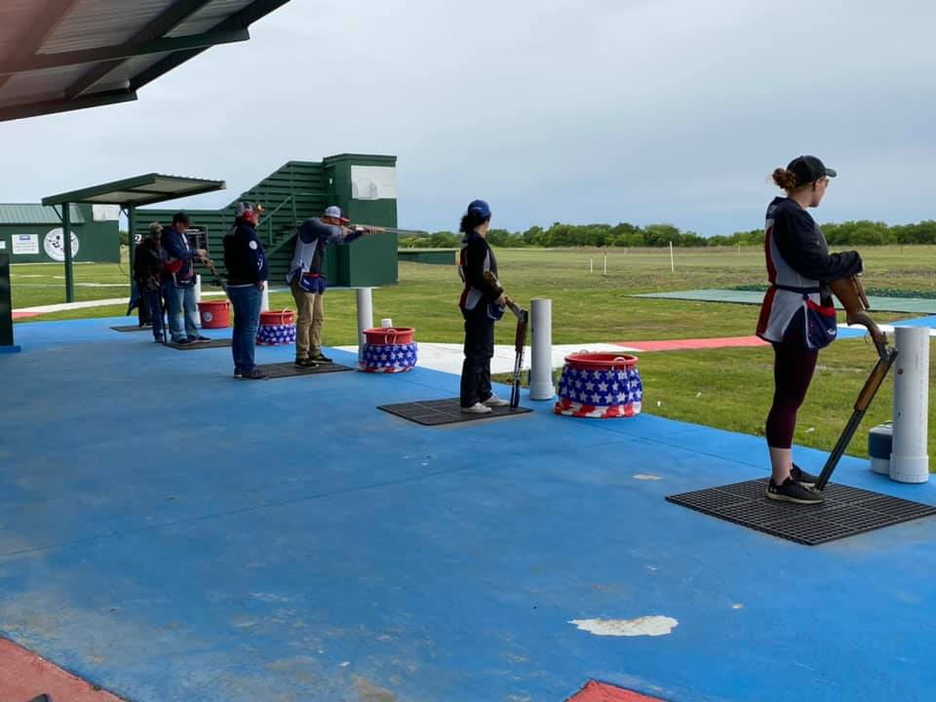
Fort Worth Trap and Skeet Bunker

Slide 5
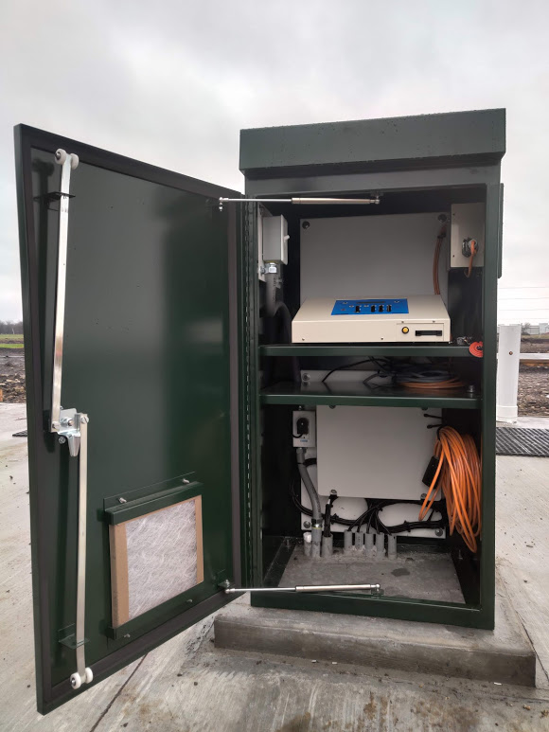
Fort Worth Trap and Skeet Bunker

Slide 6
Fort Worth Trap and Skeet Bunker

Slide 7
Fort Worth Trap and Skeet Bunker

Slide 8
USA Shooting Olympic Training Center Bunker – Colorado Springs

Slide 9
NEIJSS Bunker - Massachusetts

Slide 10
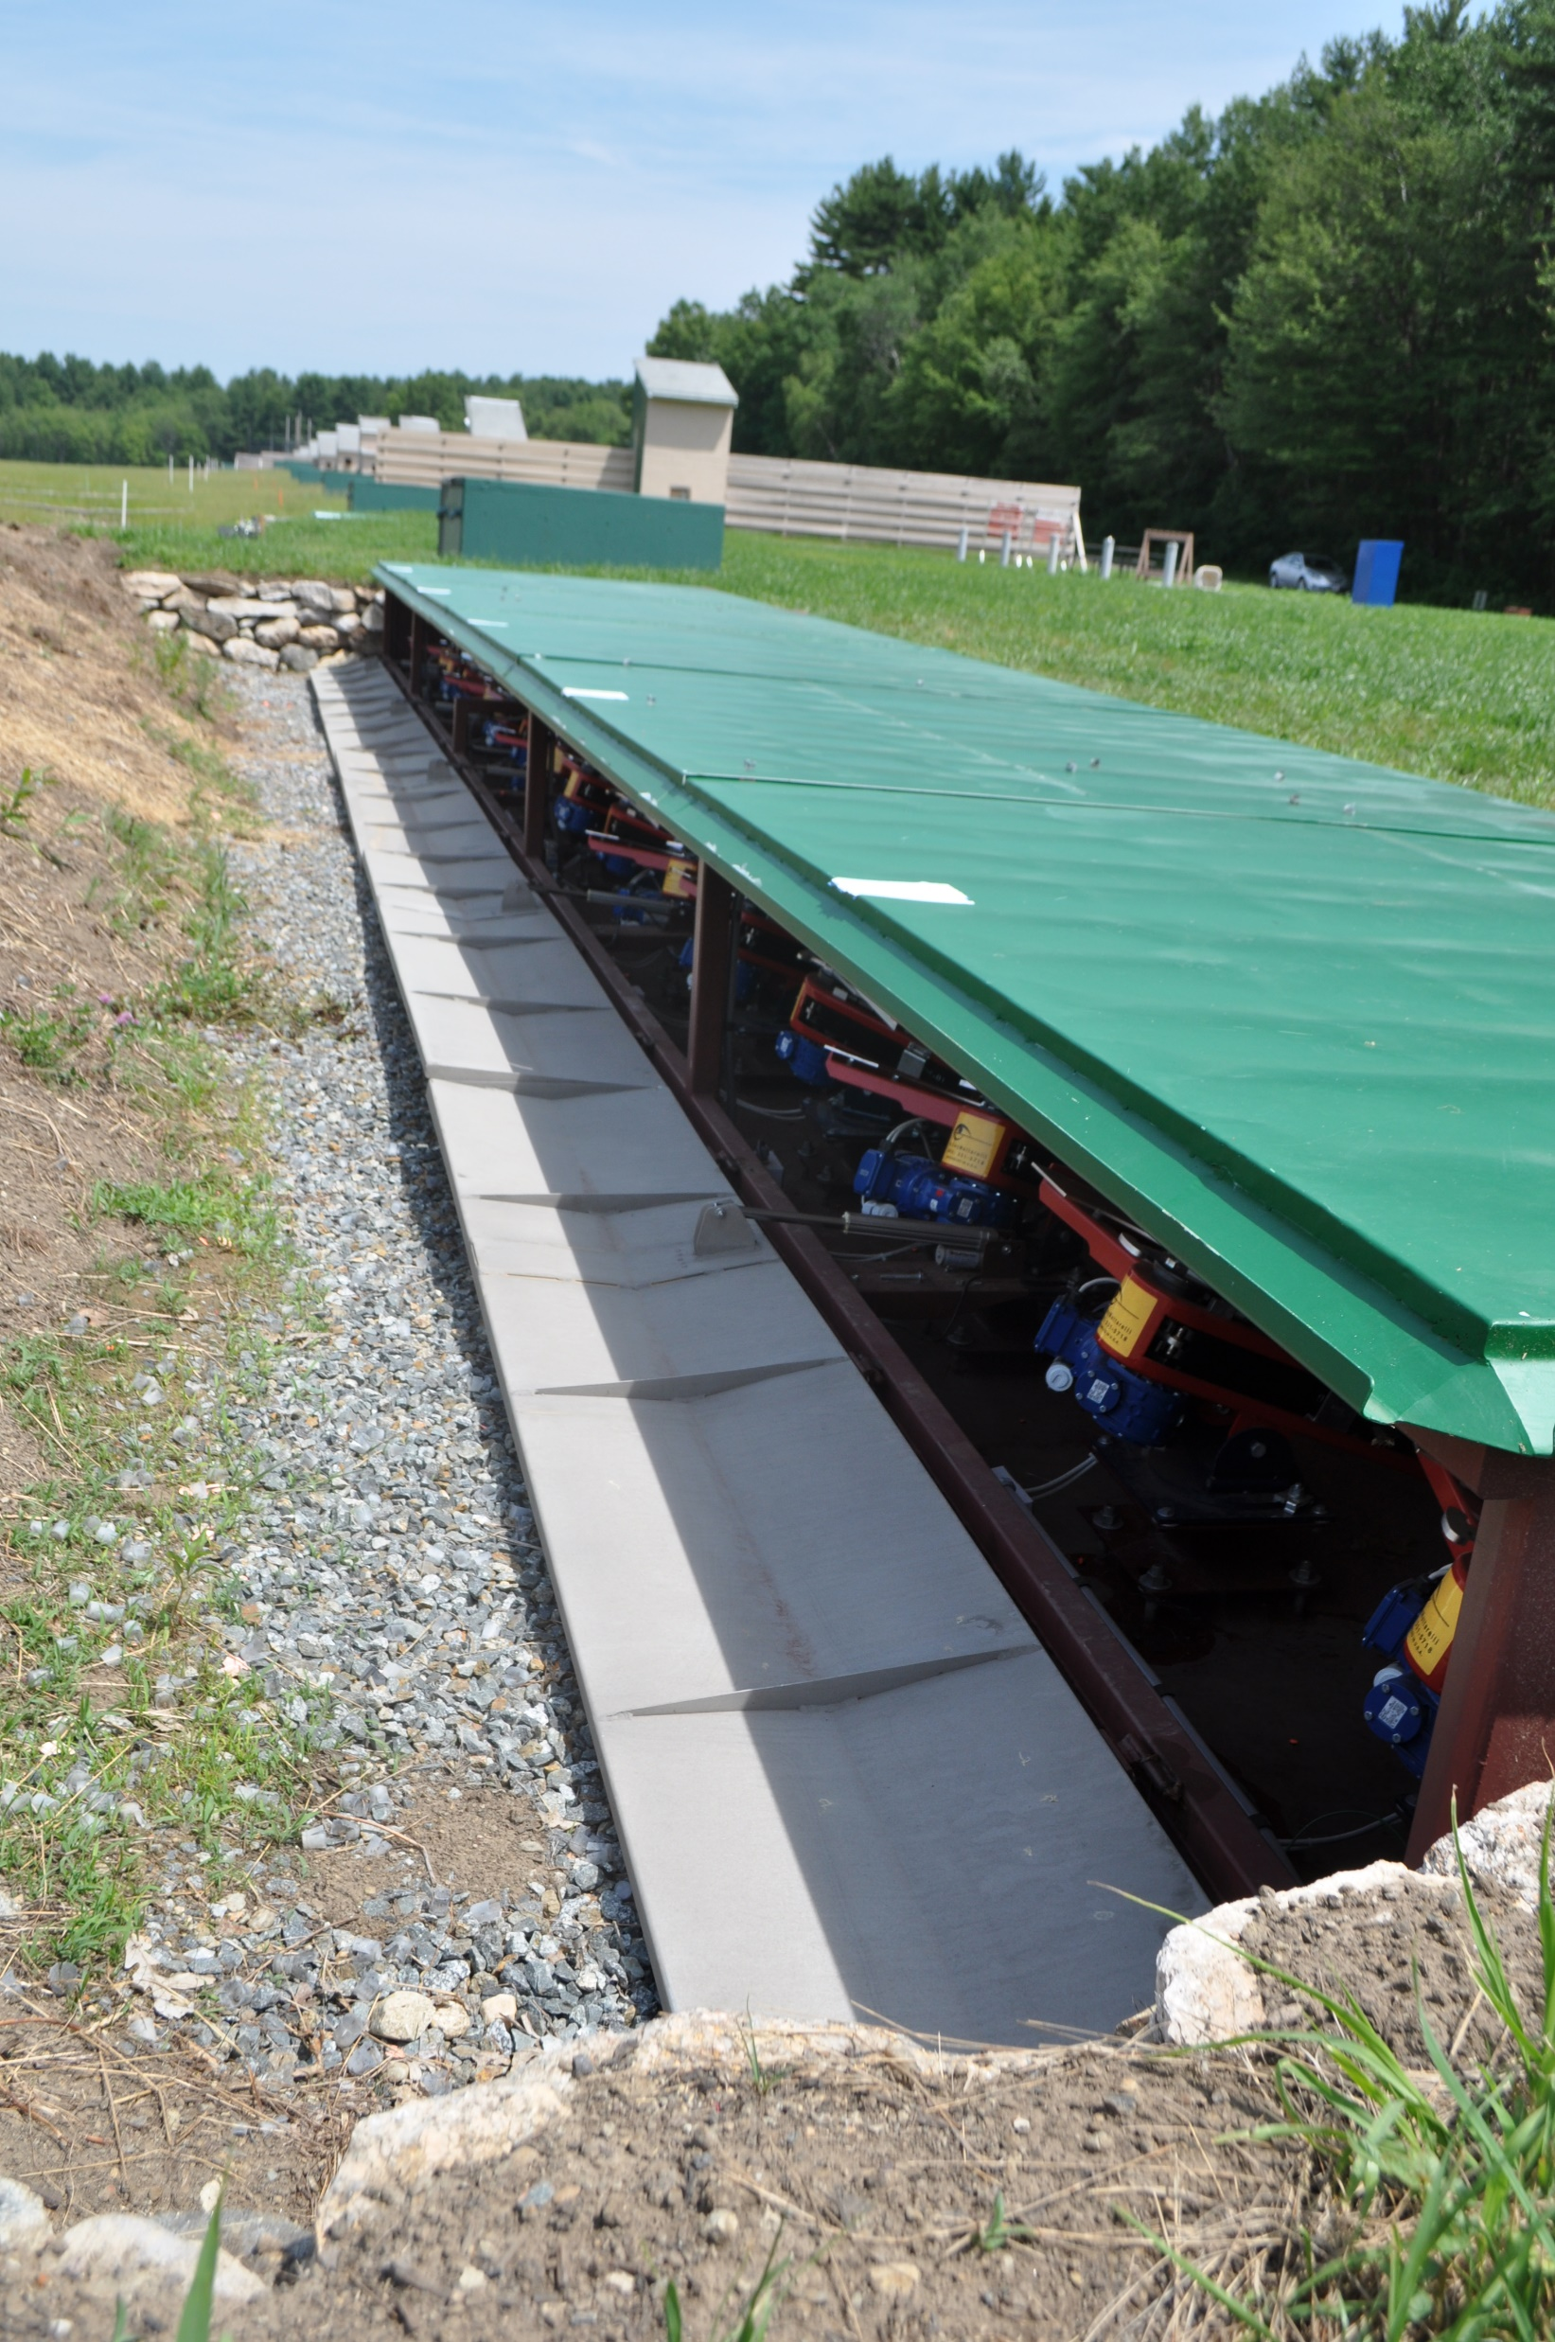
NEIJSS Bunker

Slide 11
NEIJSS Bunker - Massachusetts

Slide 12
NEIJSS Grant Program

