Slide 1
R3 Initiatives to Increase Participation

Slide 2
NSSF’s Mission
To promote, protect and preserve hunting and the shooting sports
Formed in 1961, NSSF has a membership of thousands of manufacturers, distributors, firearms retailers, shooting ranges, sportsmen’s organizations and publishers nationwide
Why do most companies join and participate? To support the mission, stay and grow the business!
2

Slide 3
3

Slide 4
NSSF Consumer Websites
Info Clearing House
Get People Started / Restarted / Fully Activated
Have Content to Share?
4
Notes:
LetsGoShooting / LetsGoHunting – Are go-to resources designed to provide everyone from beginner to experienced participant with everything they need to make their next hunting or target shooting experience the best it can be. Whether you’re new or experienced, these sites offer a wealth of information on how to get started, what to expect, how to invite someone new, hunting and target shooting activities, where to shoot/hunt and more. The sites also serve as our main stages to promote the +ONE Movement and National Shooting Sports Month.

Slide 5
About
Launched in 2018
Ongoing National Recruitment Campaign
The Power of Peer Influence
2.2 Million Pledges
5
Notes:
+ONE Movement – is an initiative that encourages target shooters and hunters to introduce someone new. To date over 2.26 million people have taking the +ONE pledge. Businesses and organizations can support this effort by encouraging their audiences to join the +ONE Movement and by hosting events or promotions that encourage people to introduce someone. NSSF has developed a digital toolkit and a promotional package with a variety of resources to help raise awareness and to acknowledge mentors and their +ONE’s. We also created a “Shooting Mentorship | +ONE Movement” Facebook Group that includes more than 22,000 members who share their +ONE experiences, highlight events and provide guidance to newcomers. To access these resources, go to nssf.org/plusone.

Slide 6
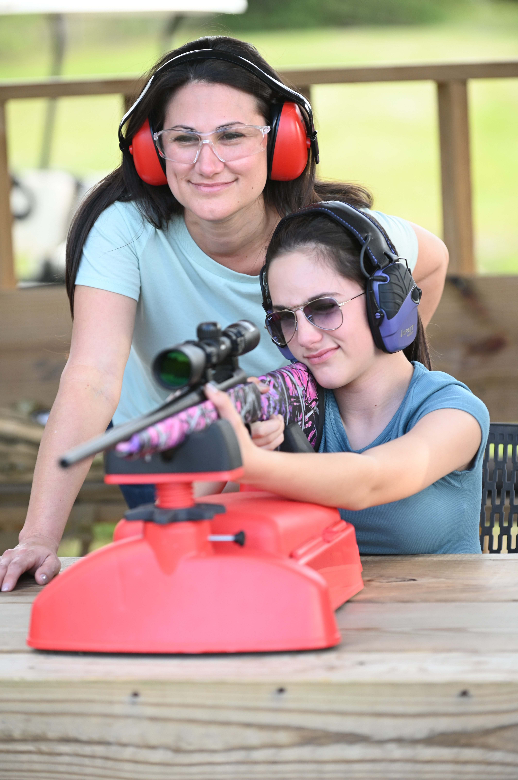
Resources
Digital Tools
Build Out +ONE Events
Shooting Mentorship | +ONE Movement Facebook Page – 22K followers
NSSF.ORG/PLUSONE
LETSGOSHOOTING.ORG/PLUSONEMOVEMENT
6
Notes:
+ONE Movement – is an initiative that encourages target shooters and hunters to introduce someone new. To date over 2.26 million people have taking the +ONE pledge. Businesses and organizations can support this effort by encouraging their audiences to join the +ONE Movement and by hosting events or promotions that encourage people to introduce someone. NSSF has developed a digital toolkit and a promotional package with a variety of resources to help raise awareness and to acknowledge mentors and their +ONE’s. We also created a “Shooting Mentorship | +ONE Movement” Facebook Group that includes more than 22,000 members who share their +ONE experiences, highlight events and provide guidance to newcomers. To access these resources, go to nssf.org/plusone.

Slide 7
Become a Partner
Help Spread the Word
Raise Awareness at Events
Provide content to NSSF to promote +ONE partnership
Highlight mentoring moments on social media
Contact Justin Morrissey jmorrissey@nssf.org
Official +ONE Partner
7
Notes:
+ONE Movement – is an initiative that encourages target shooters and hunters to introduce someone new. To date over 2.26 million people have taking the +ONE pledge. Businesses and organizations can support this effort by encouraging their audiences to join the +ONE Movement and by hosting events or promotions that encourage people to introduce someone. NSSF has developed a digital toolkit and a promotional package with a variety of resources to help raise awareness and to acknowledge mentors and their +ONE’s. We also created a “Shooting Mentorship | +ONE Movement” Facebook Group that includes more than 22,000 members who share their +ONE experiences, highlight events and provide guidance to newcomers. To access these resources, go to nssf.org/plusone.

Slide 8
Turnkey Introductory / Refresher Program
Digital Tools
Program Support
No Cost To Host – Membership Covers It
Built In Rewards Program to Increase Repeat Business
How Youth Programs Can Leverage this Program
8

Slide 9
9
Notes:
National Shooting Sports Month - A monthlong celebration of shooting sports and our second amendment freedoms designed to increase participation throughout August. Businesses and organizations can get involved in many ways from promoting the month through their communication channels, doing a giveaway or a sweepstakes, to hosting events or promotions. Last August more than 500 ranges and retailers hosted over 1000 events to celebrate the month and we had 21 state proclamations declaring August as Shooting Sports Month. NSSF has developed a promotional toolkit that includes logo’s, posters, a Social Media Helper and other resources to help you boost your success throughout August. Sign up today and learn more at shootingsportsmonth.org.

Slide 10
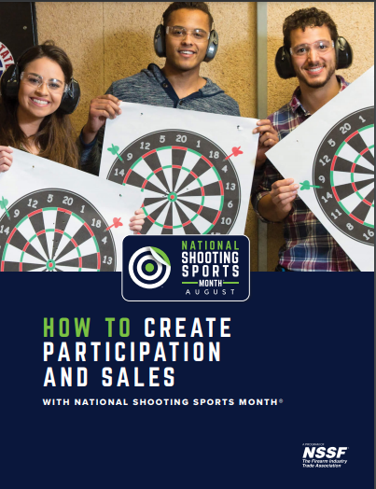
Promotional Toolkit Resources
Logos
Social Media Helper
NSSM E-Book
Templates
Posters, Flyers and Press Releases
Social media ads
Digital Banners
And More!

Slide 11
Models of Success
Family Days
Charity Shoots / Social Outings
Discounts for New-Shooter Classes (host First Shots events)
Bring a Friend Promotions
+ONE Wednesdays or Weekends
NSSM +ONE Movement Gun Giveaway
For More Ideas – Check out our NSSM Event Ideas List
Notes:
Bristlecone Shooting Training & Retail Center – hosted a family day with food trucks and a bouncy house to attract all ages – they offered 10% discounts on new-shooter classes and a referral program incentive that rewarded the referring customer and newcomer with either $10 dollars off their tabs or a $10 gift card to use during their next visit
Deep River Sporting Clays – hosted a charity event that attracted more than 150 shooters and about $36K to support a local cancer fund. They also hosted First Shots events throughout the month that attracted new people who are now active shooting sports participants
Most recently – Ultimate Defense Firing Range & Training Center rolled out a +ONE Gun Giveaway promotion – they kicked it off prior to August and it has already produced more than 90 +ONES and has generated over $8000 dollars in sales

Slide 12
Questions?
Zach Snow
Director, Member Development zsnow@nssf.org 203.426.1320 x224
203.545.6614 cell
Ann Gamauf
Member Development Coordinator agamauf@nssf.org
203.299.2079
12

