Slide 1
Range Grants
Wildlife Restoration Funding
Peter Novotny, Assistant Chief

Slide 2
Notes:
My Story – No Hunt/Guns –Wildlife Academy – 29 other officers were sharing stories on the family tradition of firearms and hunting – I wanted to write the same story
While on Patrol – stop at our ranges and I noticed a significant amount were not hunters – I saw shooters were better reflected in the community which I grew up in with being more ethnically diverse and from all walks of life. Often I would be approached “gun safety” class
I am an advocate for the 2nd Amendment and this was my calling to add to the community the value of firearm safety from the Agency. Throughout this opportunity to help make decisions about investing in ranges , I had the opportunity to provide why ranges are important to the Agency. I don’t have the hunting family tradition, including firearm safety, but throughout my career as a wildlife officer , I knew I wanted to provide a safe learning environment to support the 2nd amendment.
SIGNALING – Wildlife agencies pride themselves on staff having an important connection to our mission to conserve wildlife resources. In Ohio this is found in our Strat plan

Slide 3
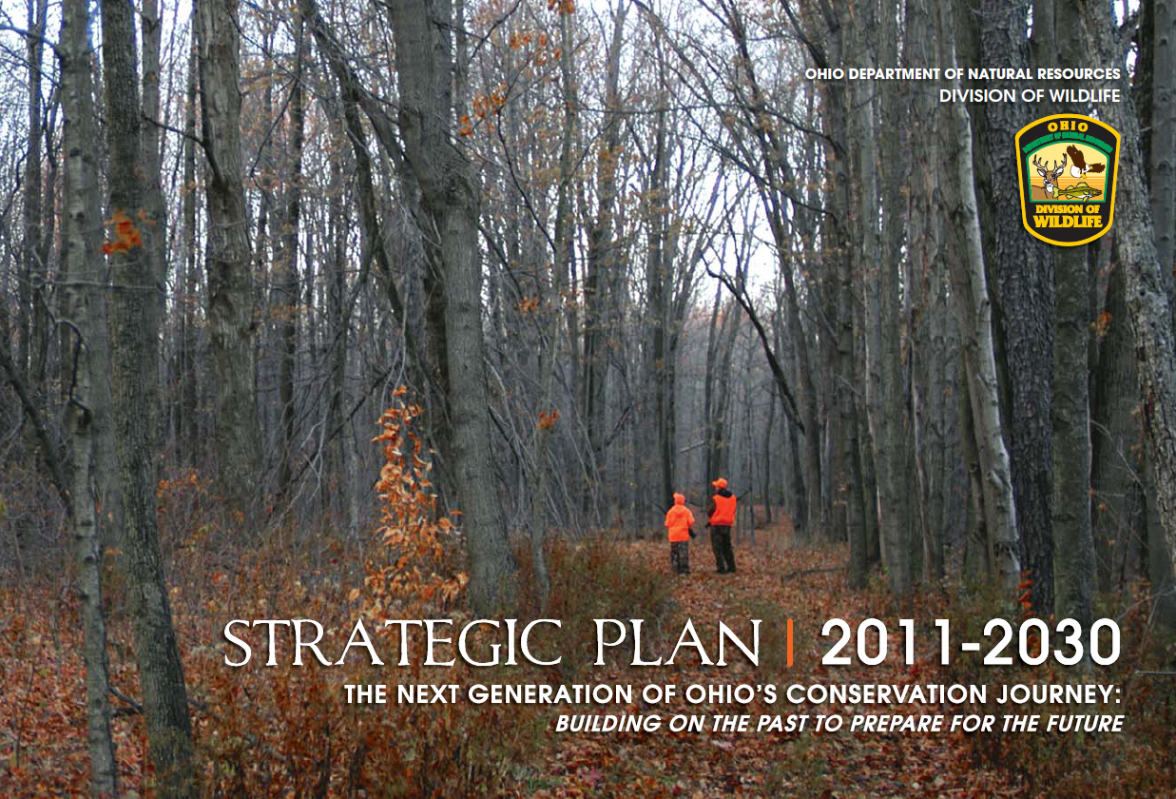
Notes:
Wildlife Agencies have many facets for us as staff to connect with our mission – hunt/wildlife diversity Angling/Trapping
Shooting sports was my way to identify with the agency, but it was not as highly visible within my agency
Why this is important – as we talk about relevancy for Wildlife Agencies our range systems can play a key component to a historically neglected and growing customer base
TRANSITION – Where does this fit within our agency value system?

Slide 4
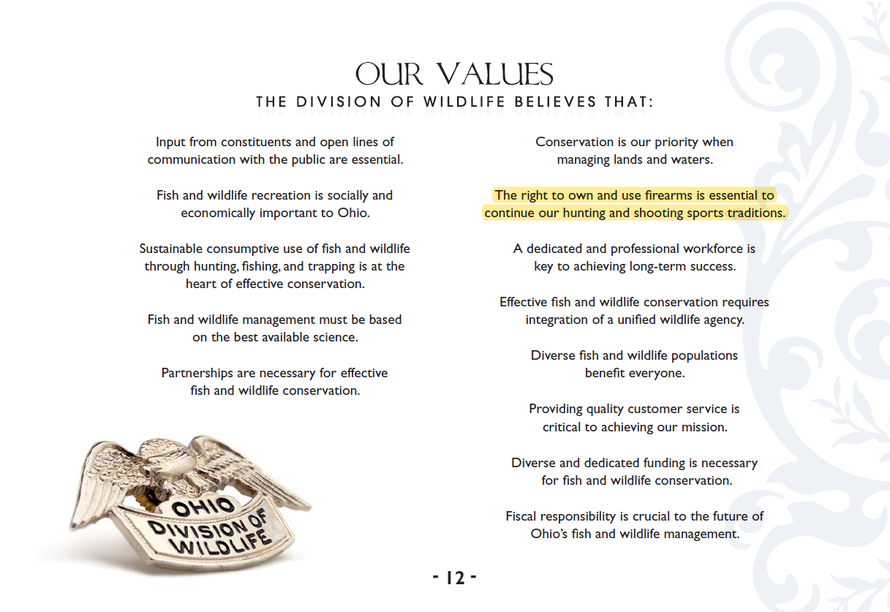
Notes:
Yet the right to Own and Use Firearms is identified as one of our Core values
Why this is important – as we talk about relevancy for Wildlife Agencies our range systems can play a key component to a historically neglected and growing customer base
TRANSITION - Please allow me to share my thoughts on how Range Development and Grants

Slide 5
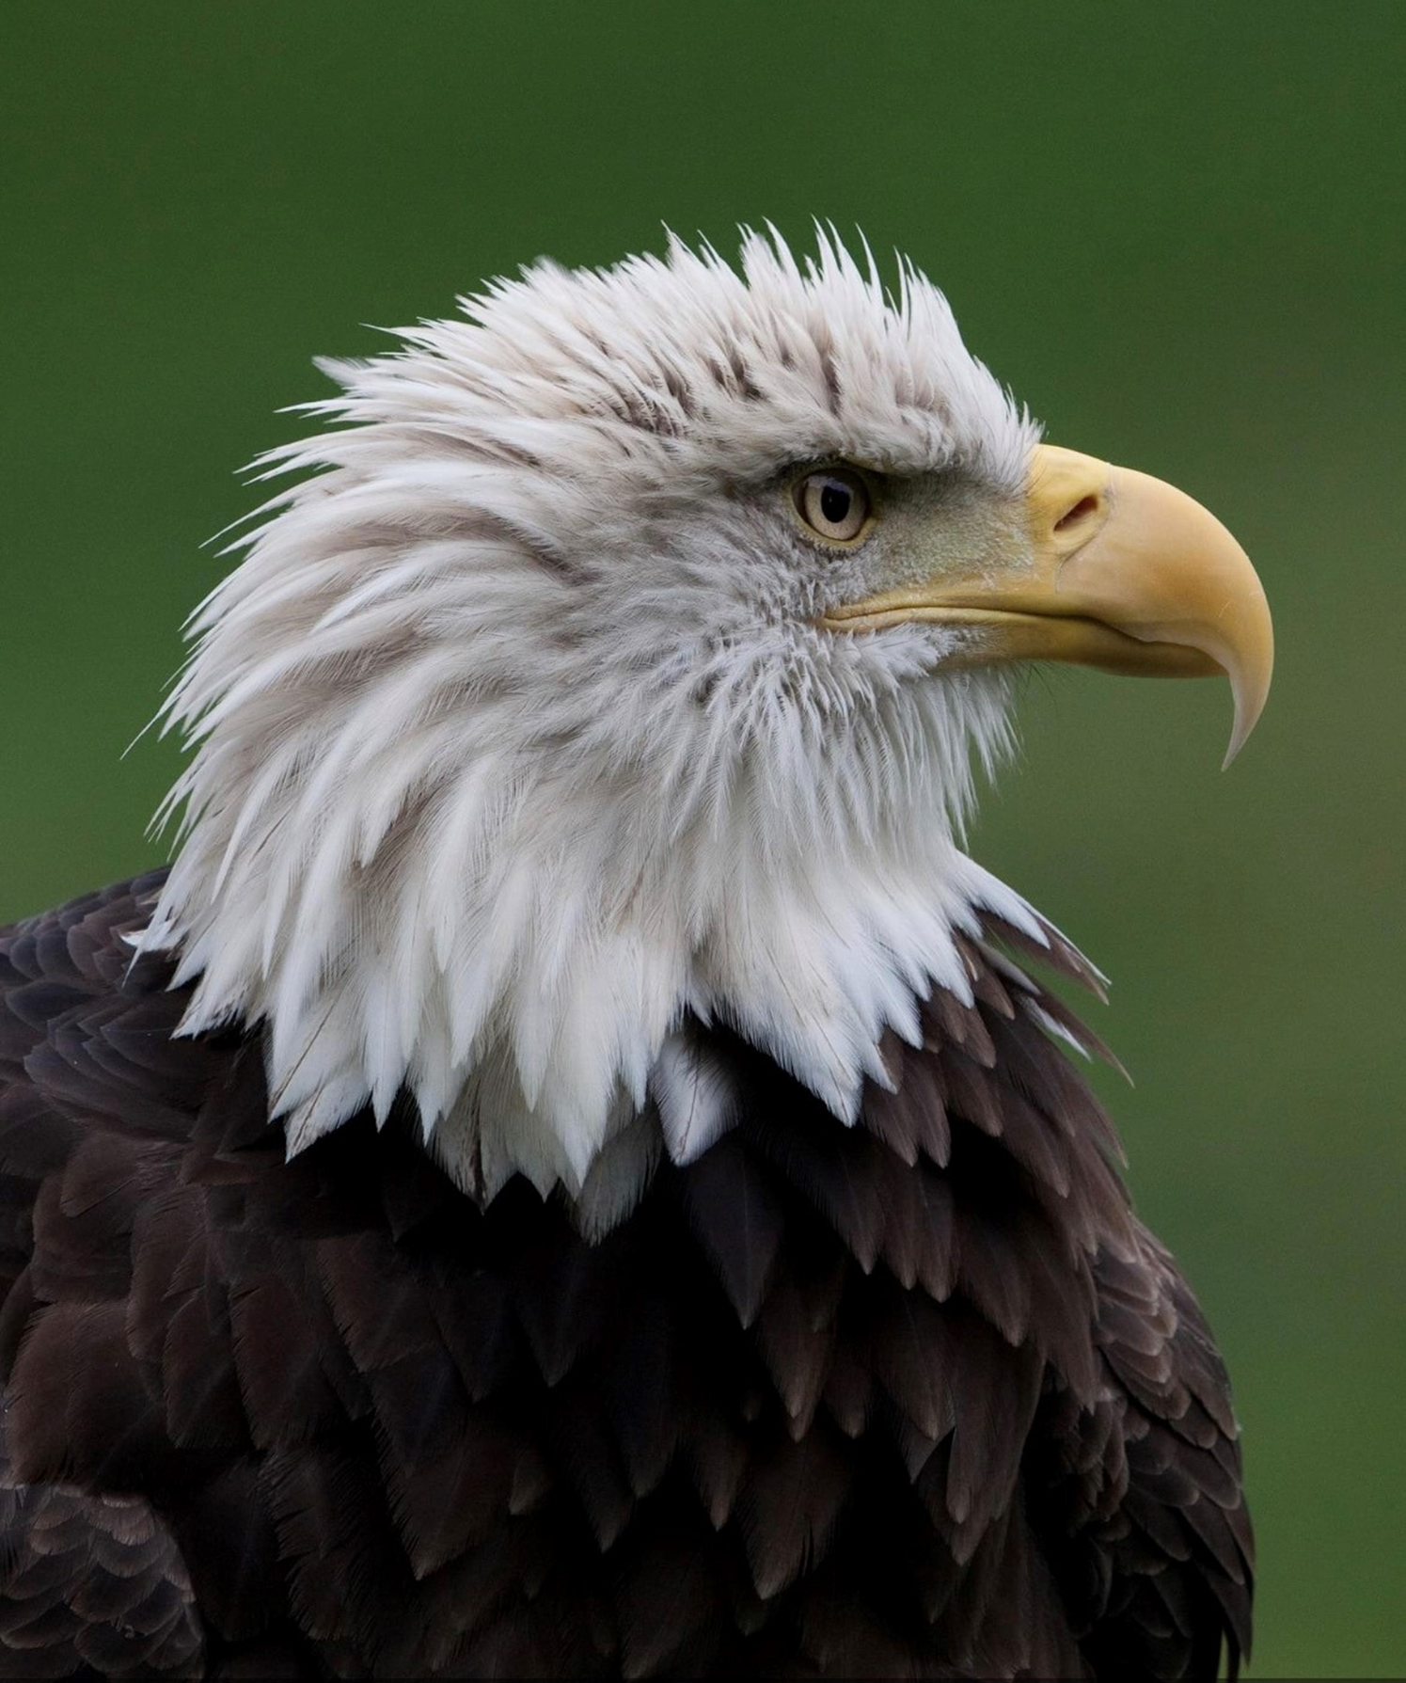
Wildlife Restoration Funding
Firearm, Ammunition and Archery industry contributed $1.1 Billion to Wildlife Conservation in 2021
Notes:
TRANSITION – The North American Model

Slide 6
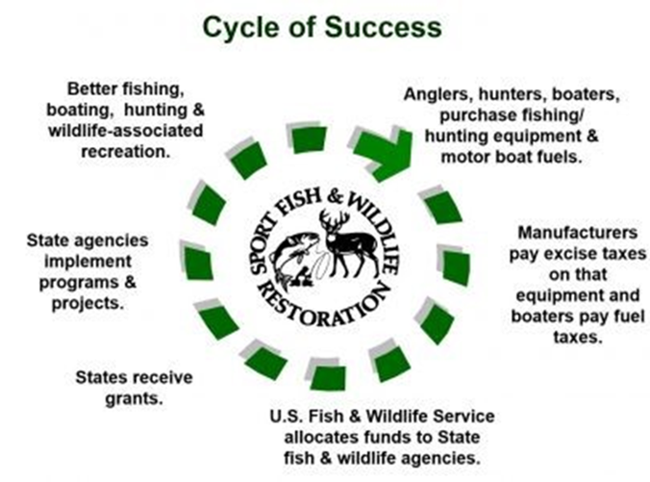
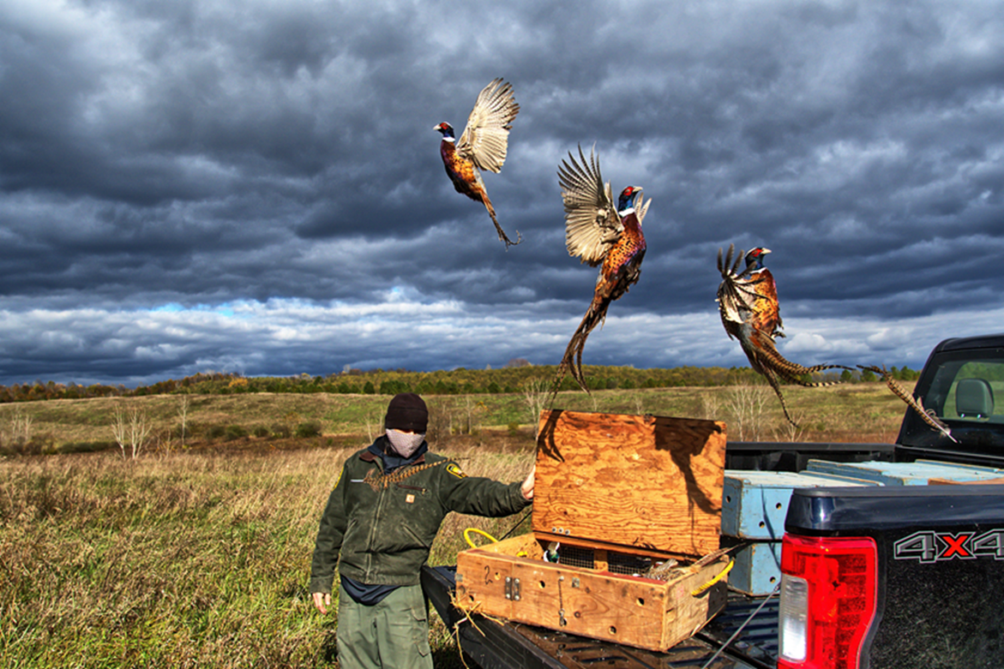
$3 Million per day is invested in Wildlife Conservation
Notes:
Highlight – cycle of success is not recognizing Recreational Shooting which includes firearms and archery equipment EVEN internally we are not recognizing the contribution from shooting sports
TRANSITION – Because the contribution from the shooting sports is the primary supporter of The North American Funding model

Slide 7
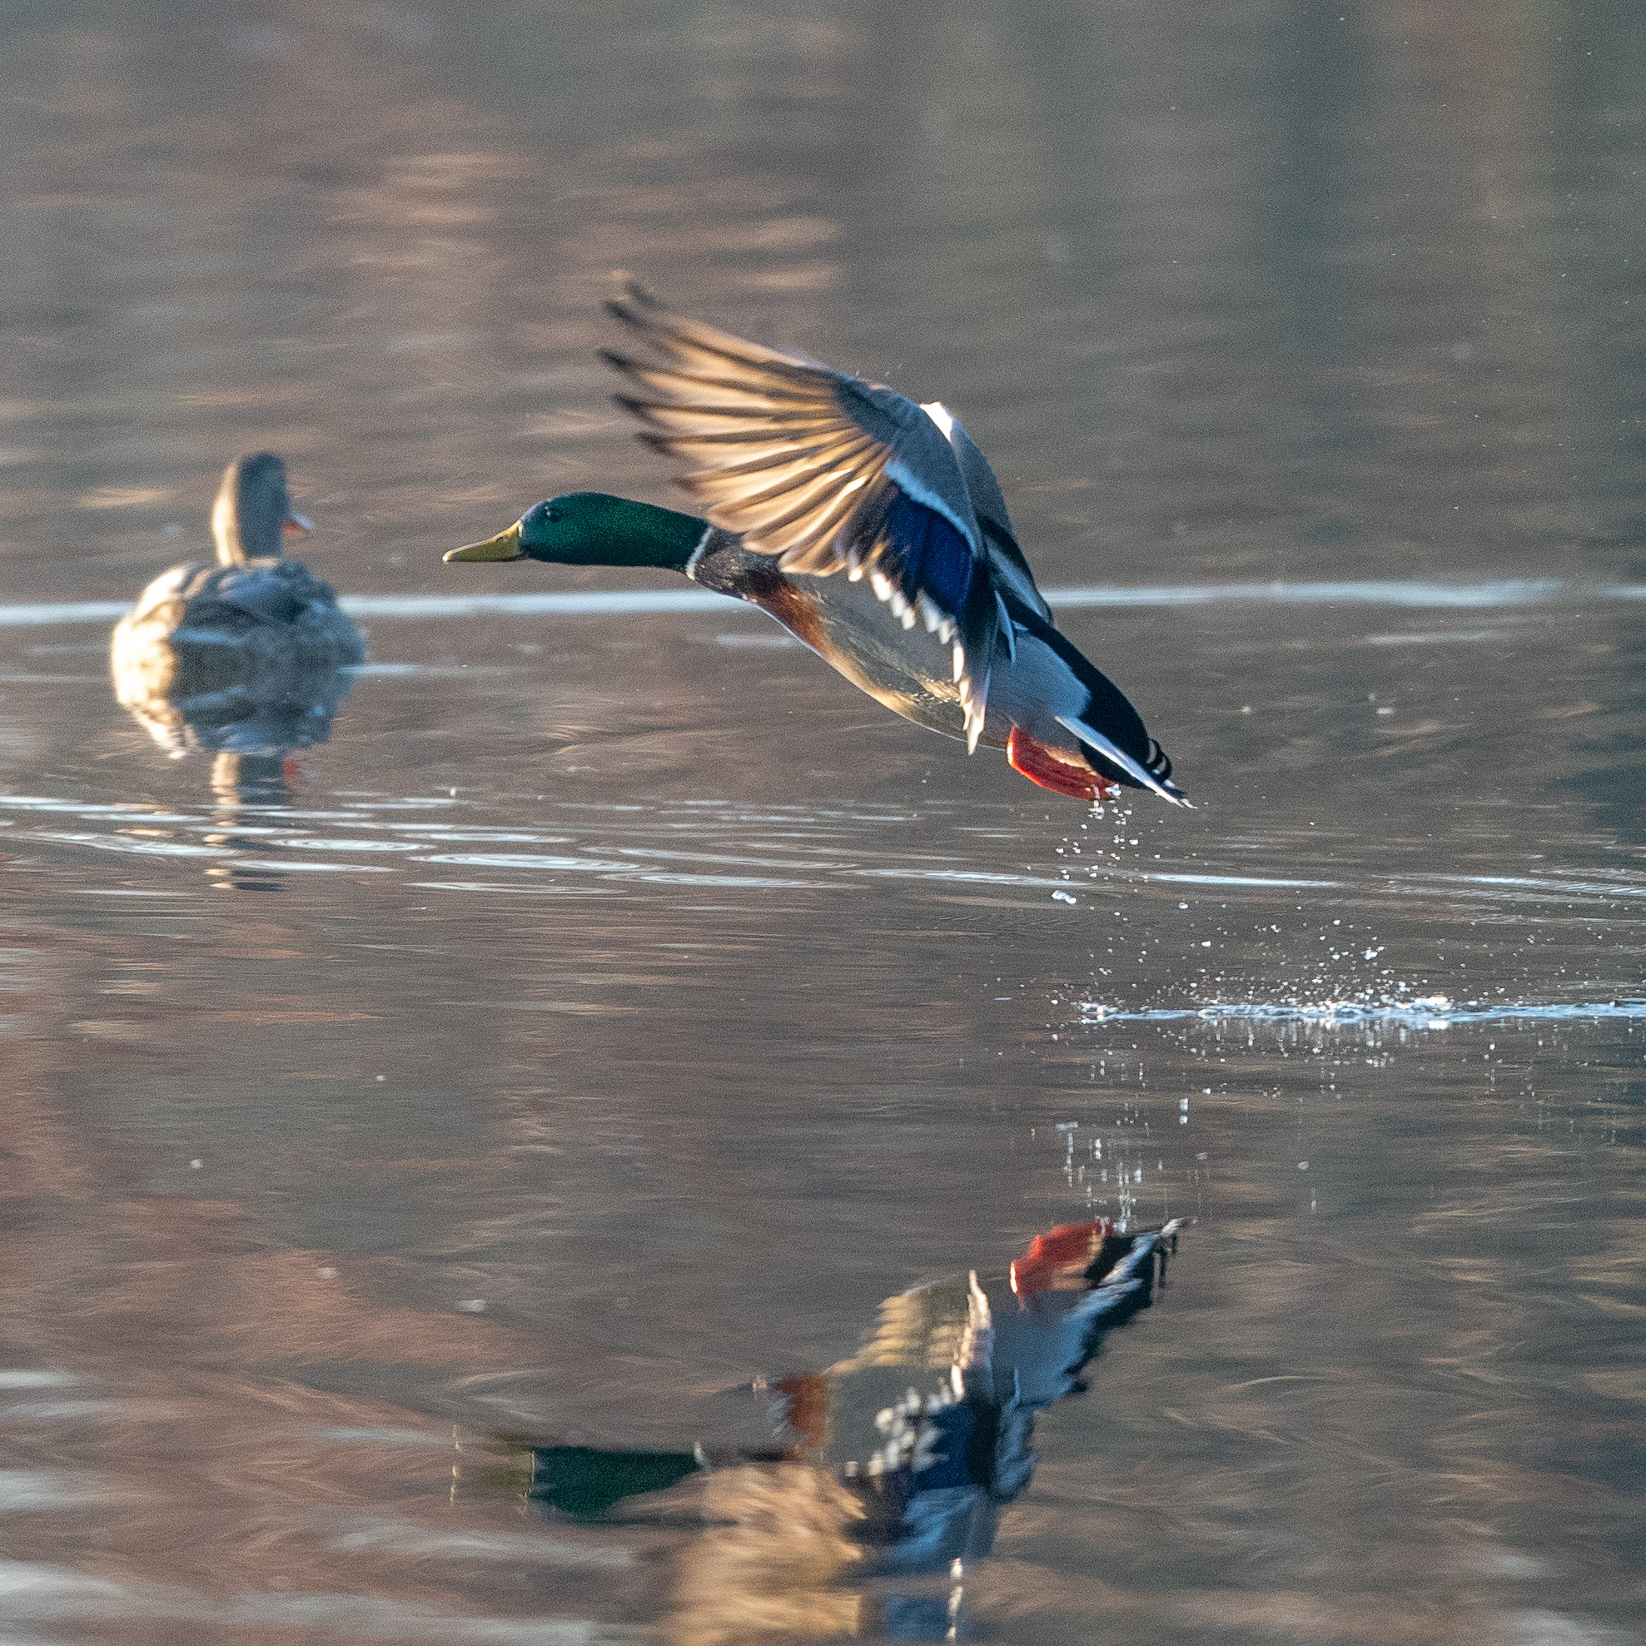
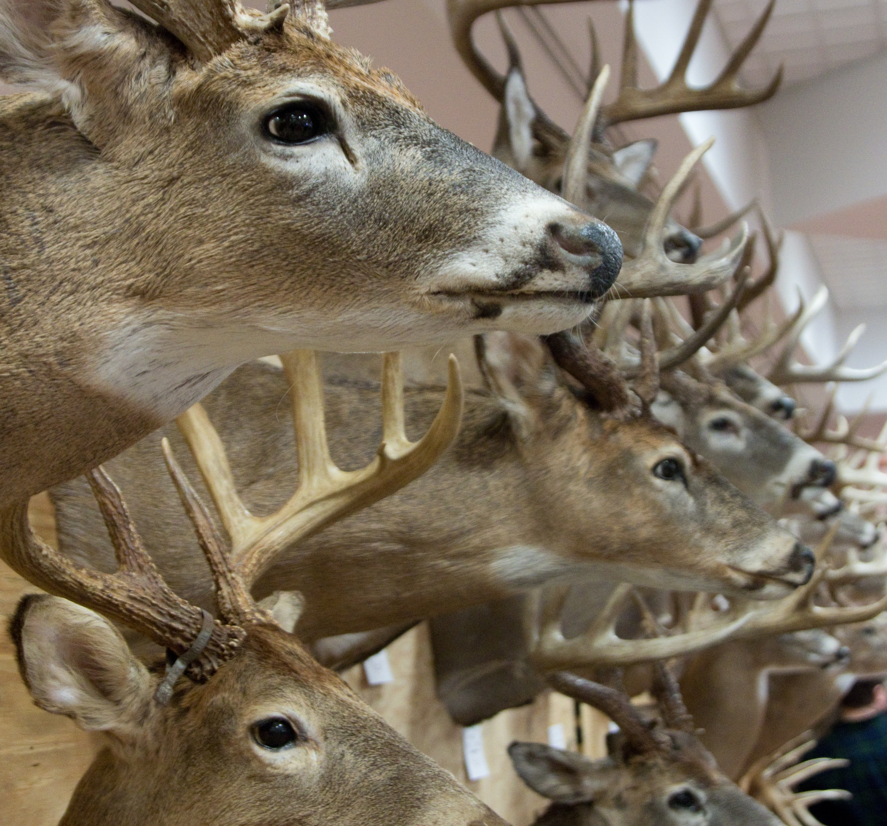
Almost 3 out of every 4 dollars for Wildlife Conservation is Funded by Recreational Shooting
Notes:
Since 2008 PR excise tax primary from Firearms Ammunition and Archery that support Wildlife Conservation is up by 214% As HUNTING PARTICIPATION HAS DECLINED
WHY THIS IS IMPORTANT TRANSITION: However the question is being asked, especially by the Industry, ARE STATE AGENCIES expanding opportunities with this funding

Slide 8
Notes:
For many of those years, the lack of understanding of this funding model was swept aside as a minor issue for state fish and wildlife agencies. We had the same conversations every DNR has had – what is our role in shooting sports – OUR RANGES DID NOT REFLECT COMMITMENT TO THE SHOOTING SPORTS
Wildlife Restoration Act is the primary funding mechanism

Slide 9
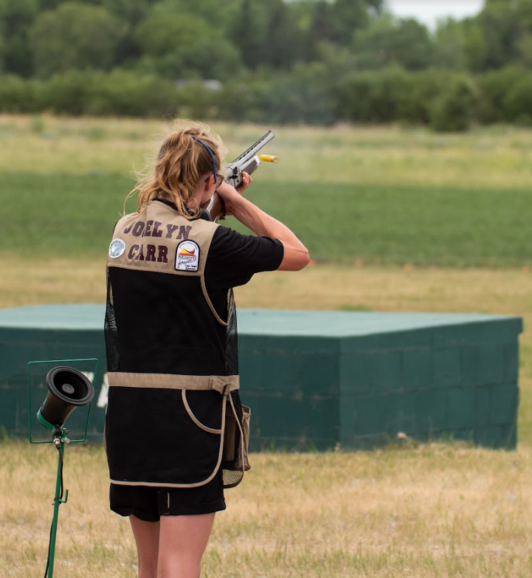
Wildlife Restoration Act 1937
Target ranges
  Operations and Maintenance
  Land Acquisition
  Range Development and Enhancement
Hunter Education use
75% Federal Share
Notes:
Recognition that the wildlife restoration Act, as known as P-R Act, was not enough to meet the expectations from Recreational Shooters
TAR-MARK

Slide 10
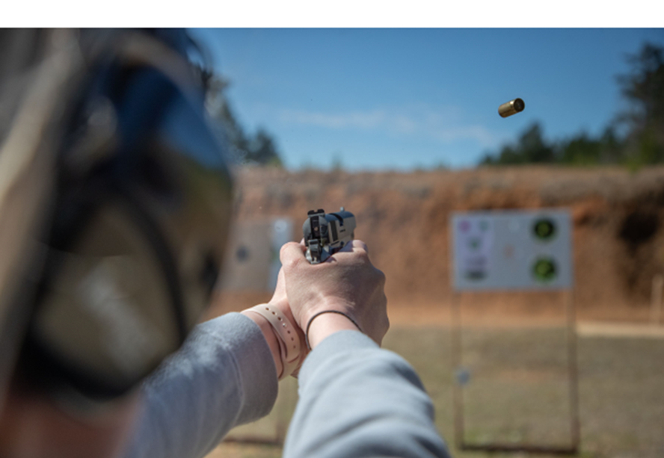


Tar-Mark Act 2019
Target Practice and Marksmanship Training Support Act 2019
  Land Acquisition
  “construction and expansion of public target ranges…”
  Increased use and participation
  “90/10/5”
Notes:
Tar-Mark

Slide 11
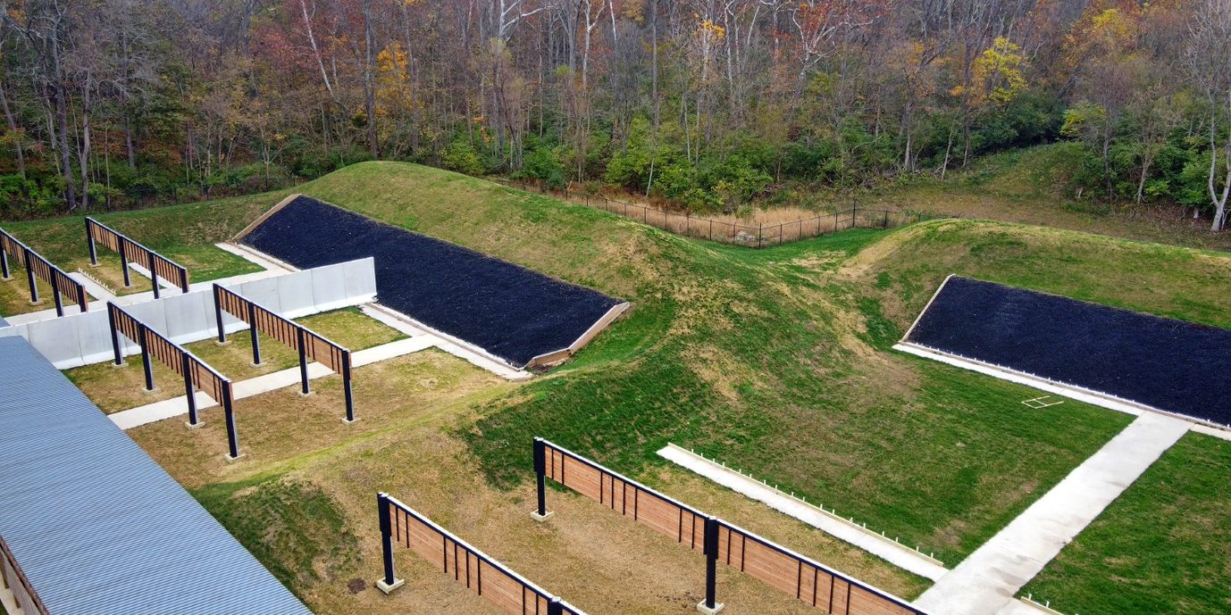
Tar-Mark Act 2019
Up to 10% of a State’s WR funds
Mobile target ranges
Utilize Federal lands
Staffing
Operations and maintenance activities and some enhancements still need 75% Federal Share
Notes:
TRANSITION – How are Ranges viewed by the Agency

Slide 12
Notes:
Wildlife Agency Story EPG – Wildlife Managers – we are not in this game We took the data and provided the leadership to invest
TRANSITION – instead of bulldozing them down we are building

Slide 13
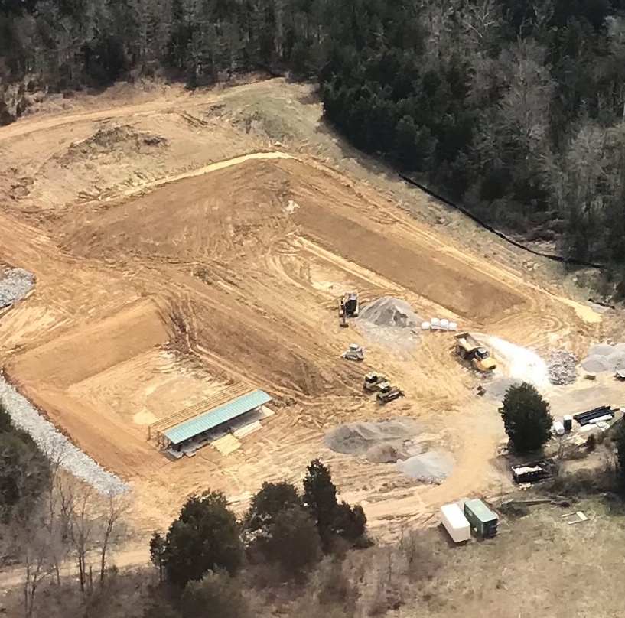
Notes:
In the last 6 months there are 7 new ranges being built as well as 54 Ranges being upgraded or expanded. State Agencies across the country are building firearm and archery ranges to meet this increased demand

Slide 14
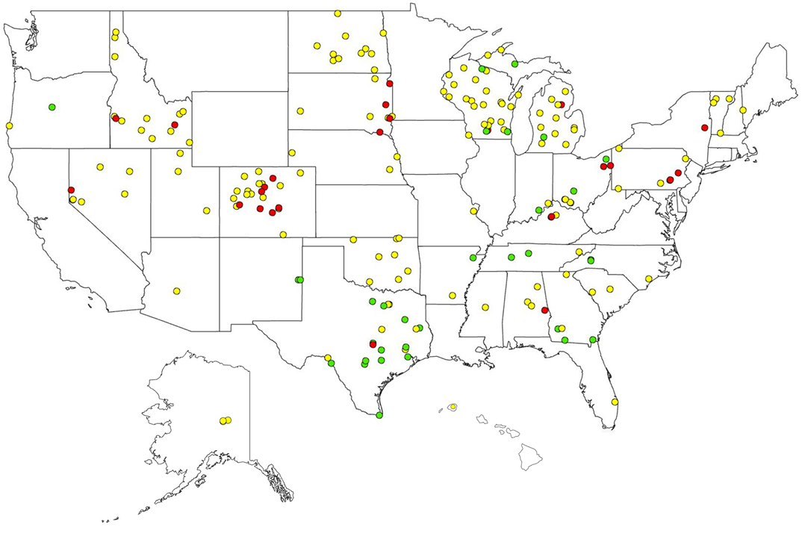


233 New Ranges from Tar-Mark
Notes:
States are investing – 233 ranges with $91M in Grants
Ranges supported by WR

Slide 15
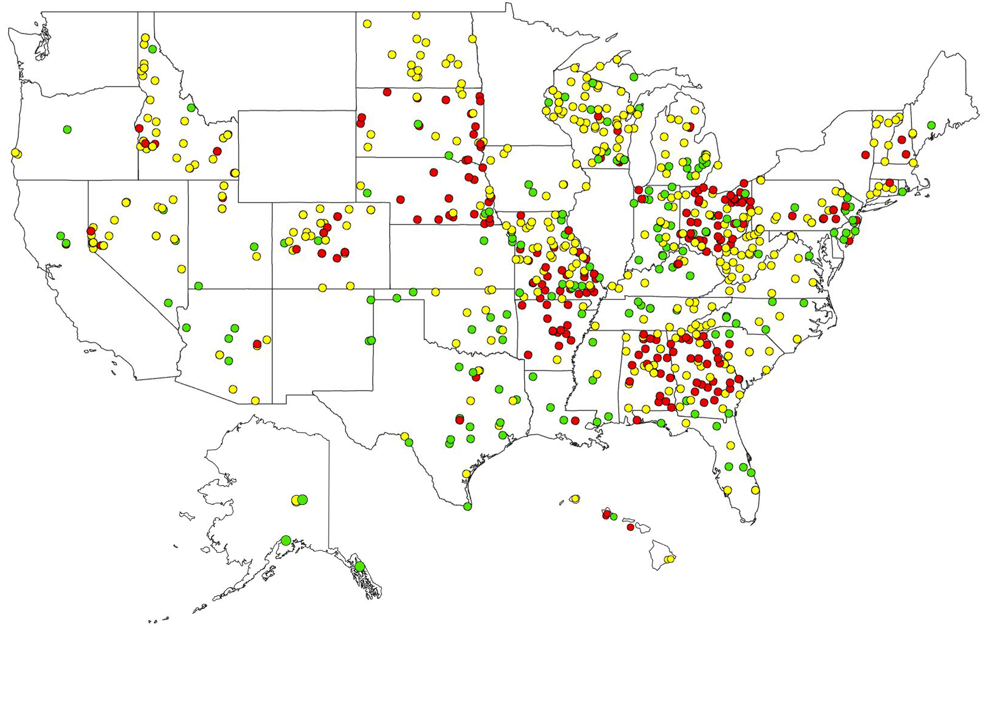
856 Ranges supported by WR Funds
Notes:
Important Access to new firearm owners
States Scorecard that are supporting Range investment

Slide 16
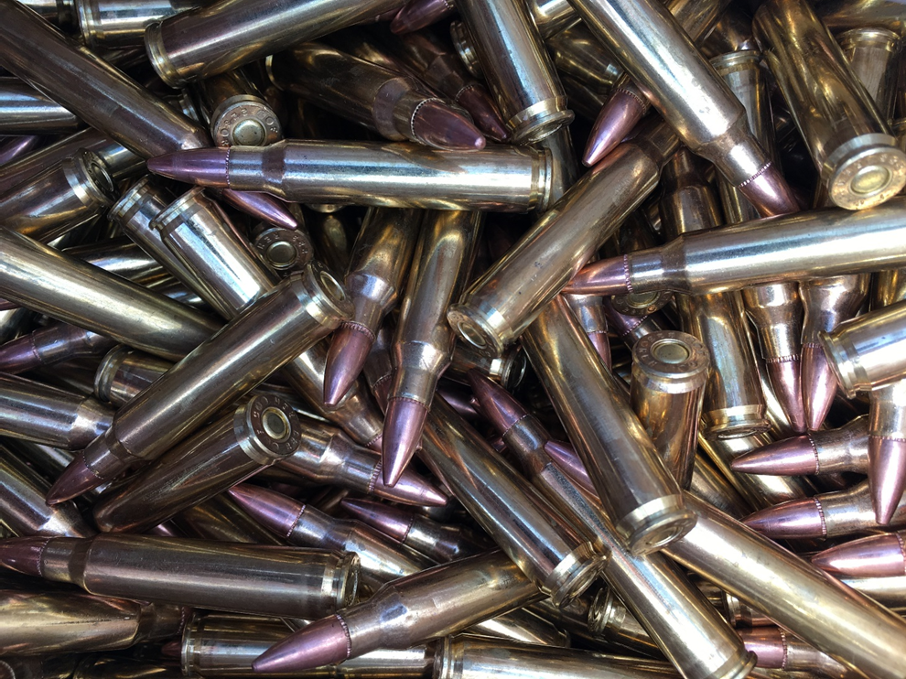
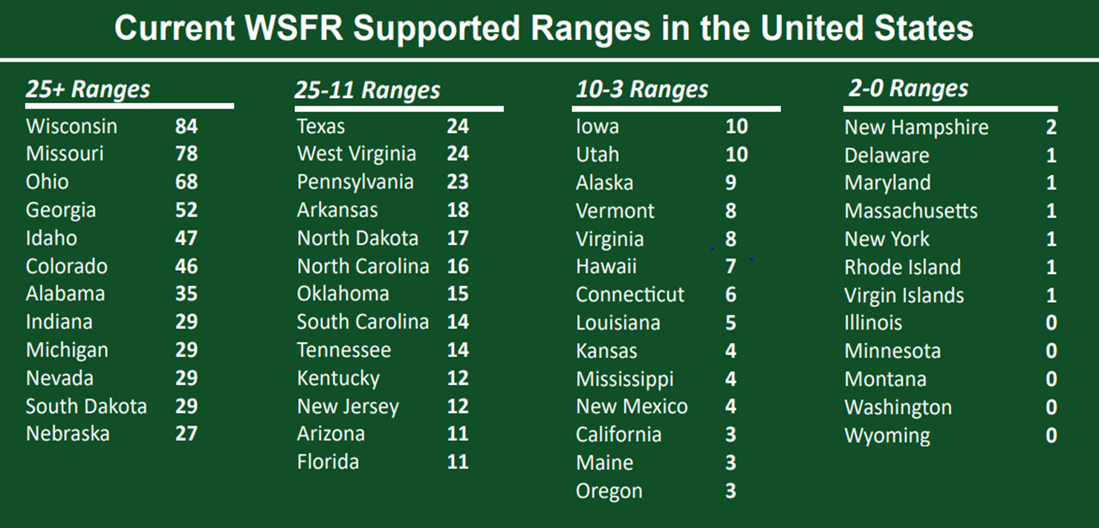
Notes:
Ranges are being built

Slide 17
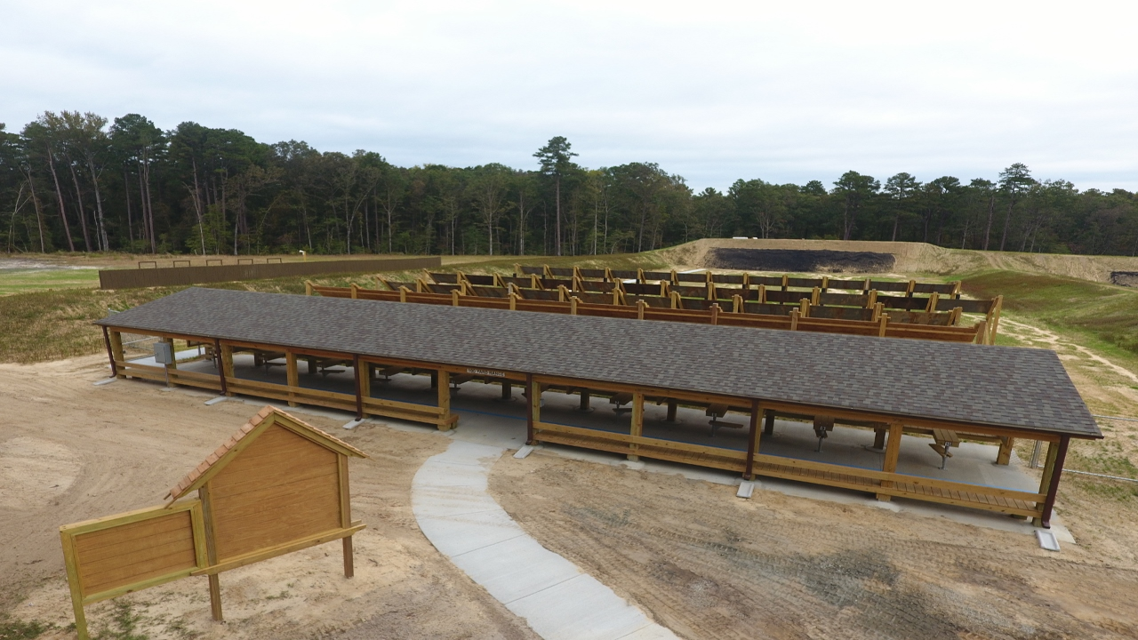
Notes:
State of the art facilities to meet this demand
TRANSITION – not only a dirt mound – a shooting complex

Slide 18
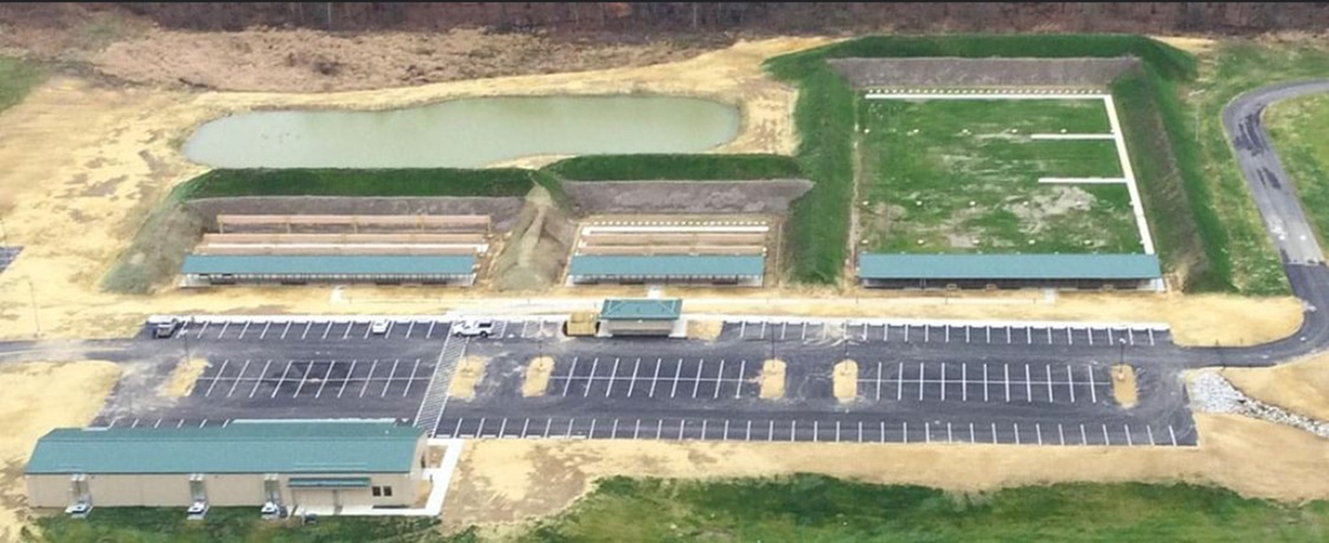
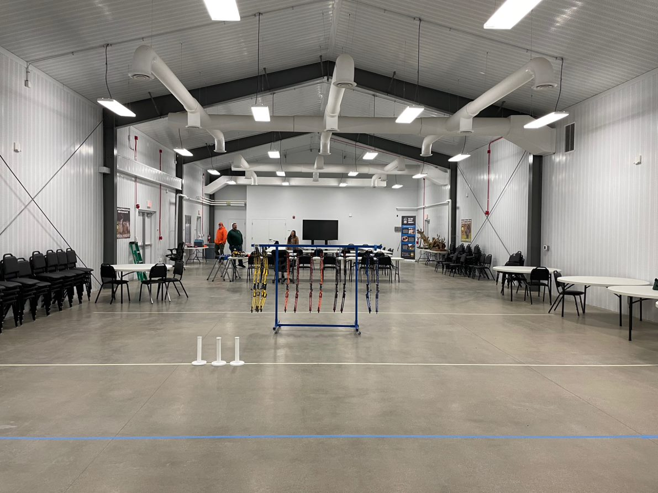
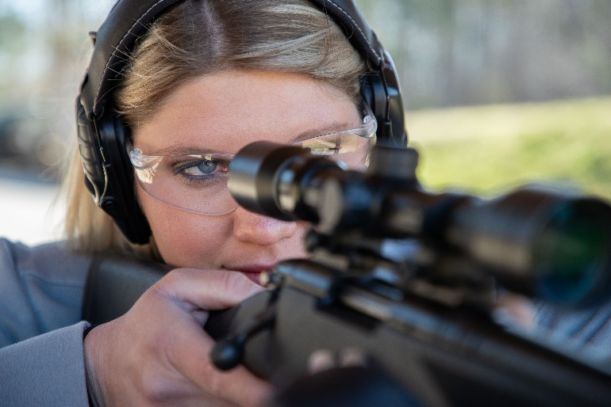
Notes:
By 2025 Ohio will invest in almost $40M in range development

Slide 19
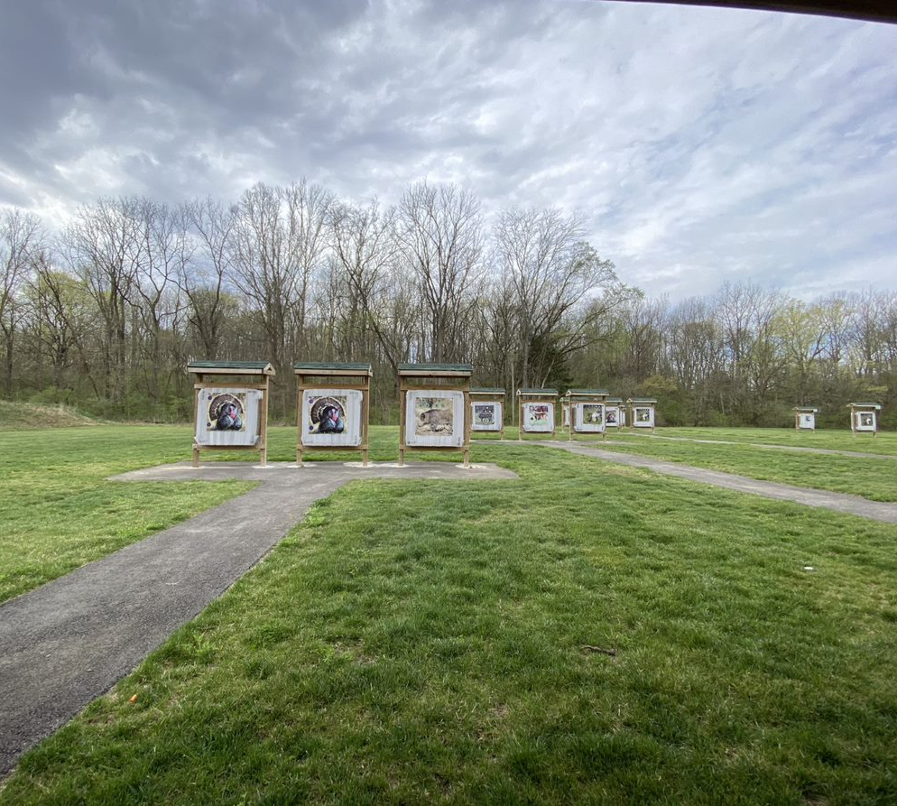
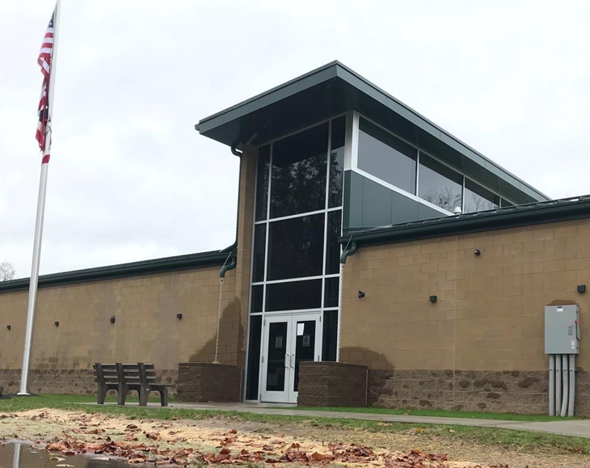
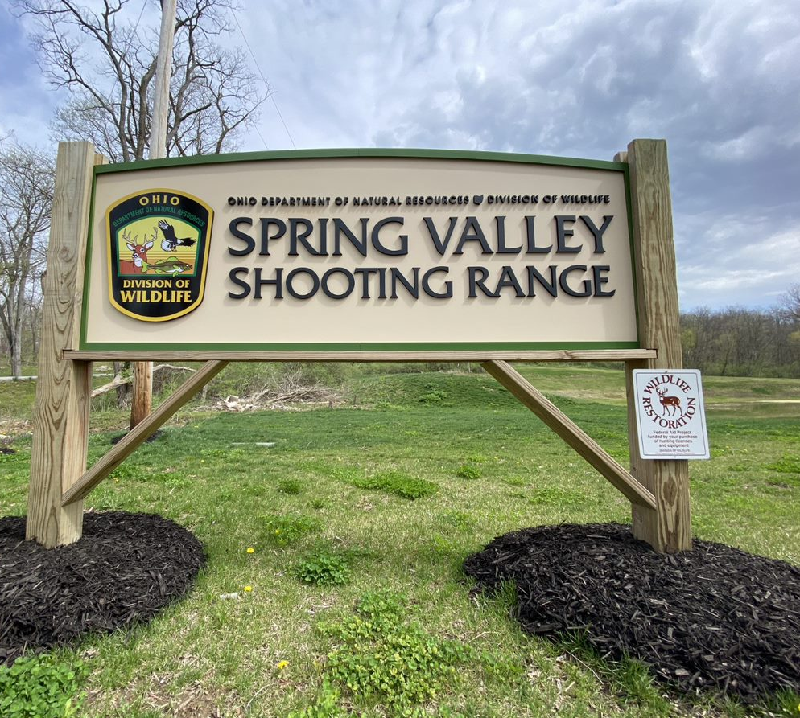
Notes:
Archery ranges, shotgun and classrooms – LEARNING ENVIRONMENT
Staffing with R3 Practitioners
TRANSITION – even our state fair

Slide 20

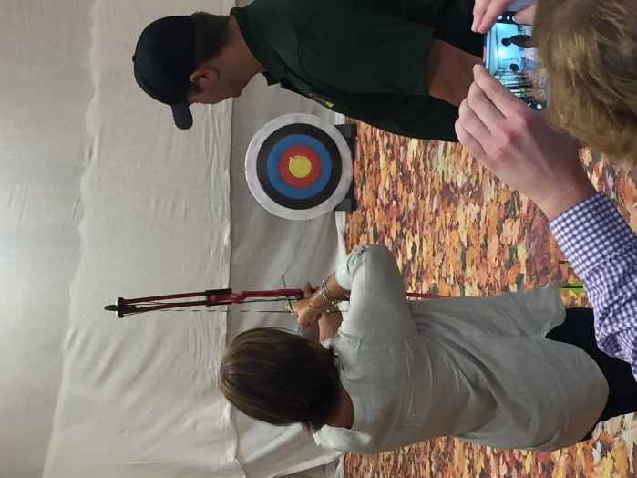
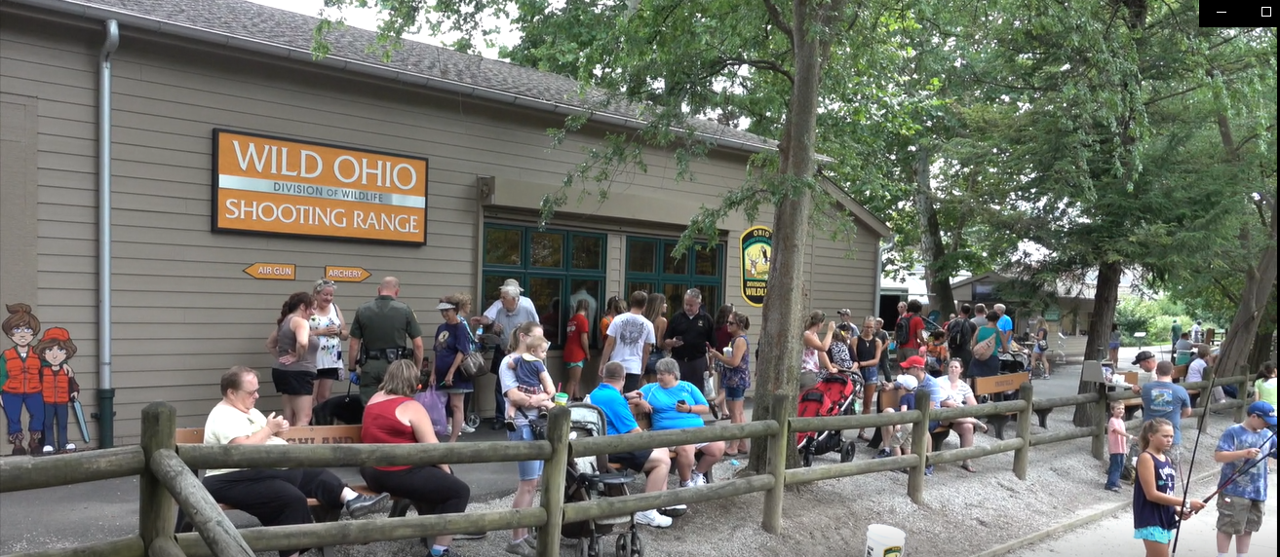
Notes:
Almost 1 million people attend the Ohio State Fair – we built a shooting and archery range Creating awareness trial
Youth programming and support needs to part of our system - PARTNERSHIPS

Slide 21
Partnerships
State Wildlife Agencies are recognizing the value of recreational shooters
Youth Opportunities
Notes:
From 4-H Shooting Sports as Jon Zinnel
Fish and Wildlife Relevancy

Slide 22

Opportunity
Range access are an important bridge for Recreational Shooters to State Wildlife Agencies
Notes:
We have new audiences that we have not historically focused on Unprecedented opportunity to implement the Roadmap in a meaningful way
CLOSING

Slide 23
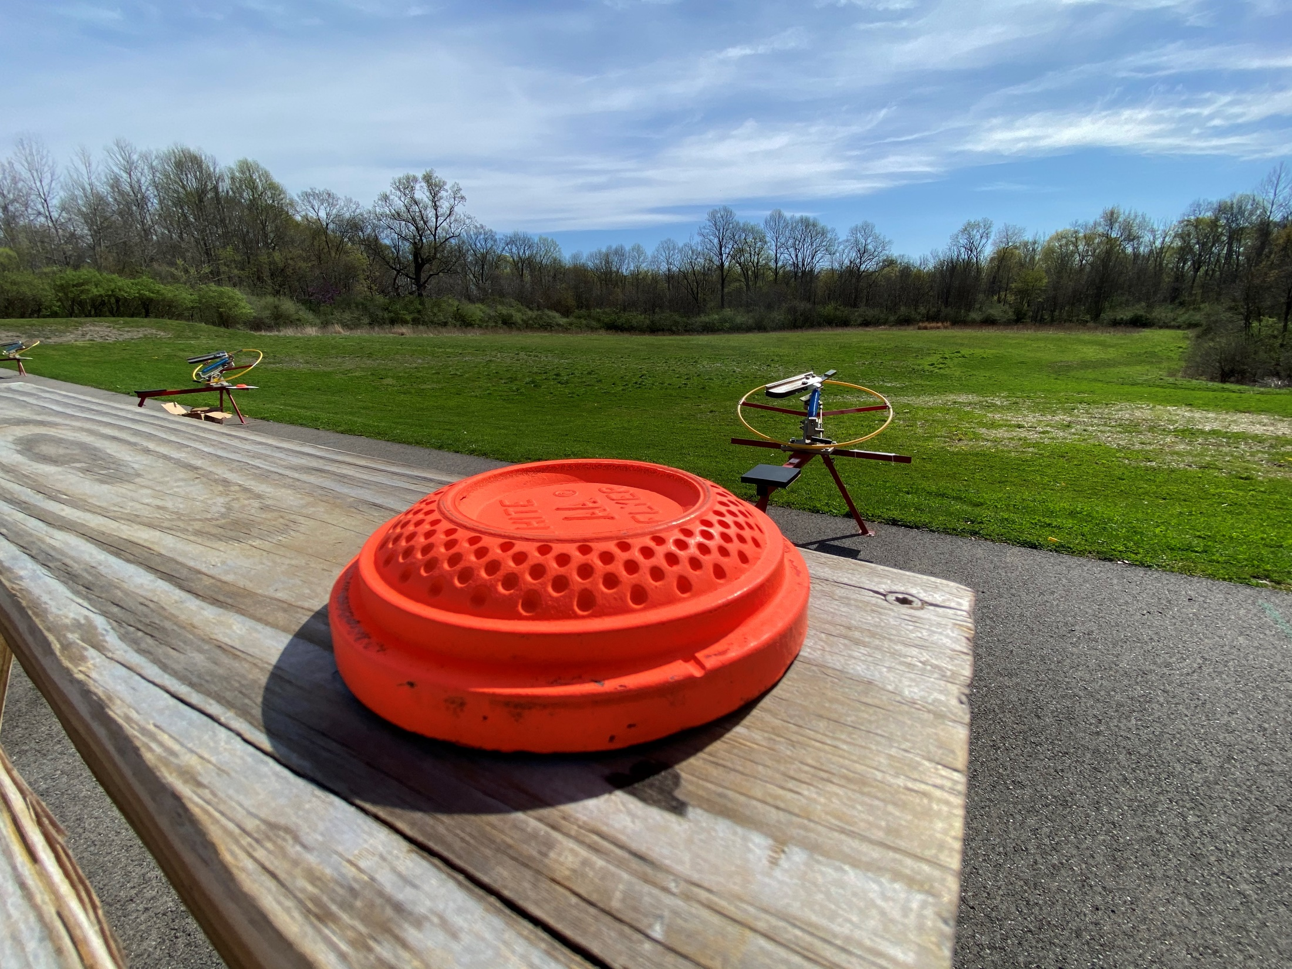
Recreational shooting funds Wildlife Conservation
Tar-Mark funding is important for Range Development
Ranges offer opportunities to increase Relevancy
Notes:
In closing Shooting ranges Calls to action
1.Take advantage of the TARMARC 90-10 match by building ranges designed for engagement
2. We should offer specific outreach for shooting sports outside of the role firearms play for hunting.
3. Shooting Sports are a gateway into increasing our relevancy

Slide 24
Thank You
Peter.Novotny@DNR.Ohio.gov

