Slide 1
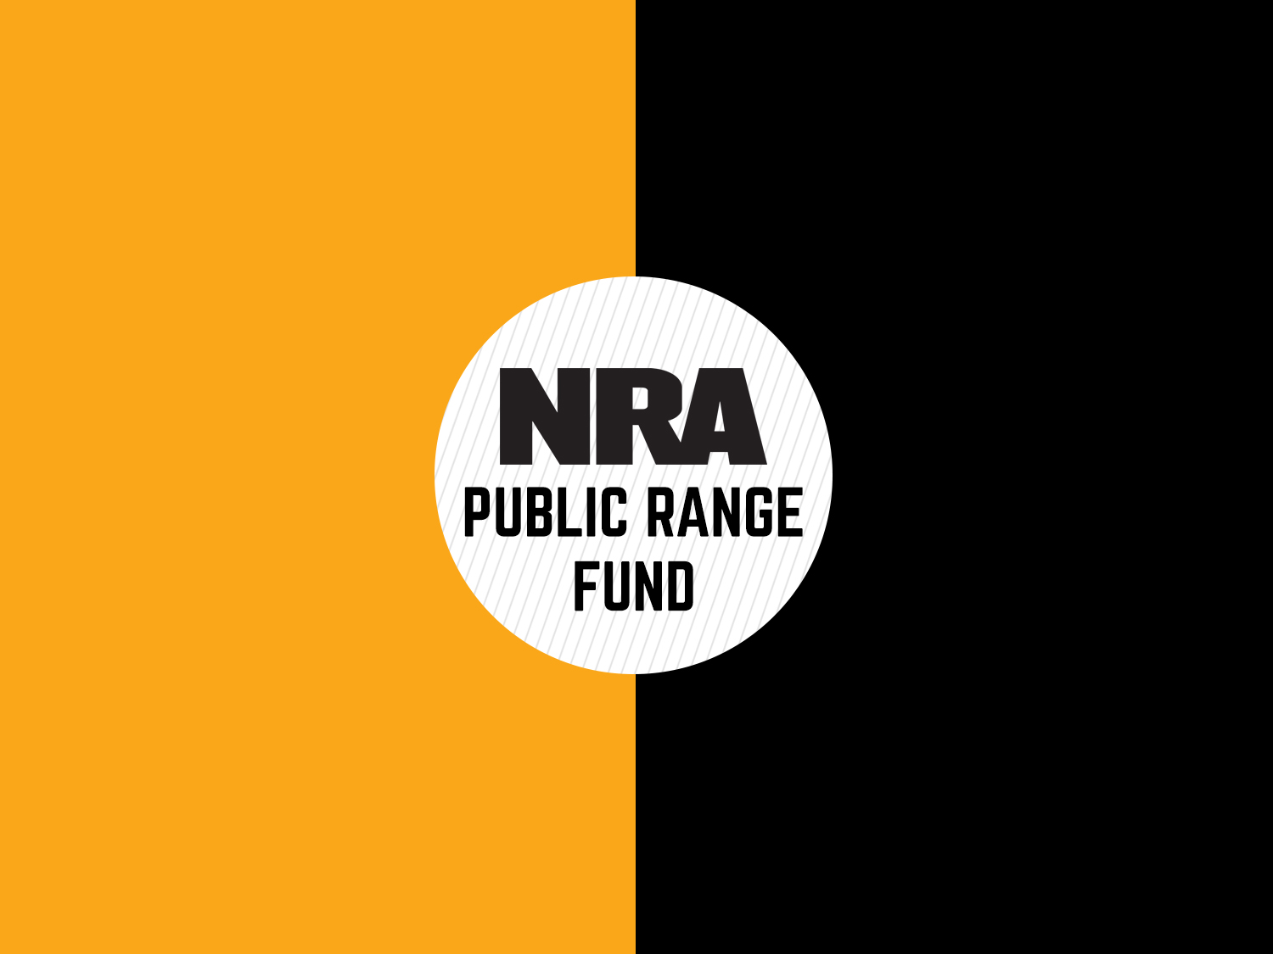

Slide 3
Total of $2.2 Million given since 2009 to 96 different range projects
$100,000 a year @ a max of $25,000 a grant – Hope to increase this??
Must be a city or county government / state or federal agency
50/50 matching basis with 50% of the cost of the project being provided by the applicant and 50% awarded from the NRA Public Range Fund. In-kind services of labor, materials, and equipment may be considered to provide the applicant’s 50% contribution to the project.
Pittman-Robertson Funds are being used, the applicant’s share will be 90% of the project, with the remaining 10% coming from the NRA Public Range Fund

Slide 4
NRA Affiliated Range Services
Applicants for this program must be a 100% NRA membership NRA-Affiliated Club
This Range Grant program is limited to $5,000 per applicant per year, and the deadline for submission is August 1 annually.
Any NRA-affiliated club or association of which 100% of the club's members are also NRA members is eligible to apply for a NRA Range Grant. Preference will be given to recipients of the Gold Medal Club Award.
About $135,000 is available yearly
2022 we gave away $80,000

