Slide 1
Boone County Nature School
Columbia Public Schools
Missouri Department of Conservation

Slide 2
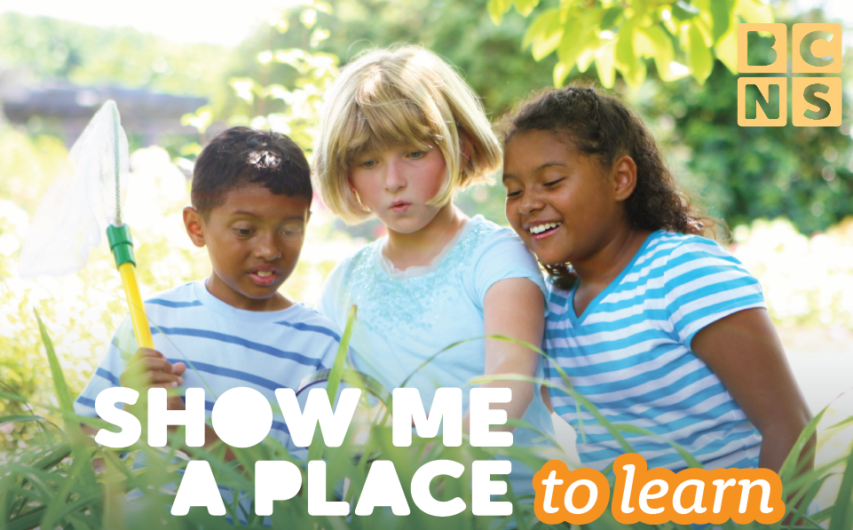
Boone County Nature School
Columbia Public Schools
Missouri Department of Conservation

Slide 3
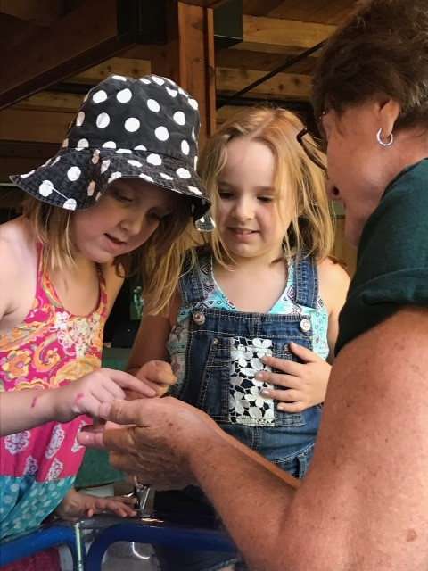
“at the heart of the issue is the notion that direct personal encounter with nature, and the attendant feelings of wonder and delight, form the basis of a genuine ethos of protection of the natural environment. We will honor and preserve what we have come to love and admire, and such feelings find their source in personal experience”
George K. Russell
Children & Nature, Making Connections

Slide 4
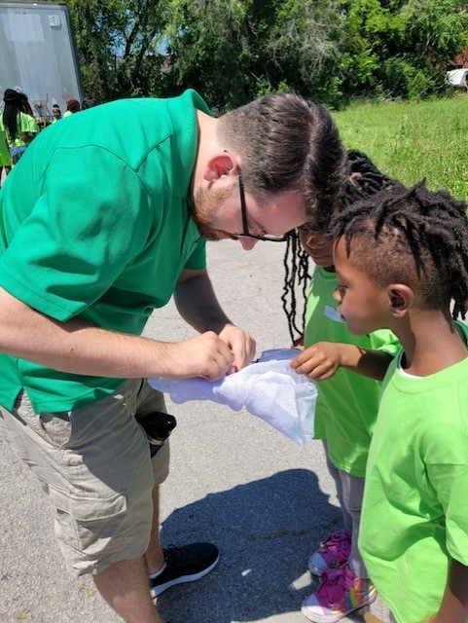
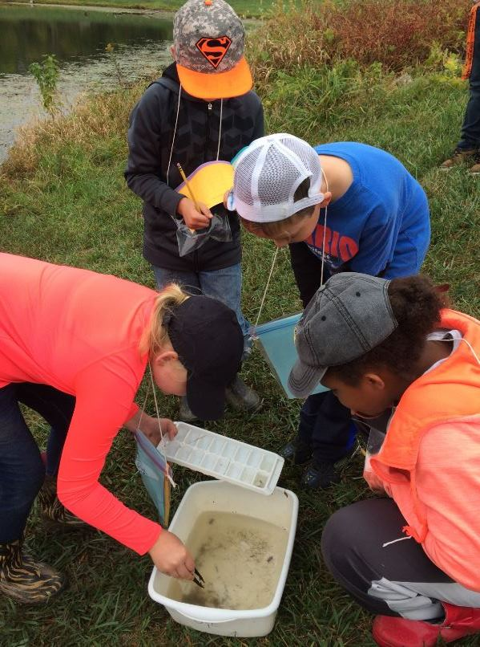
What is “Place based” education?

Slide 5
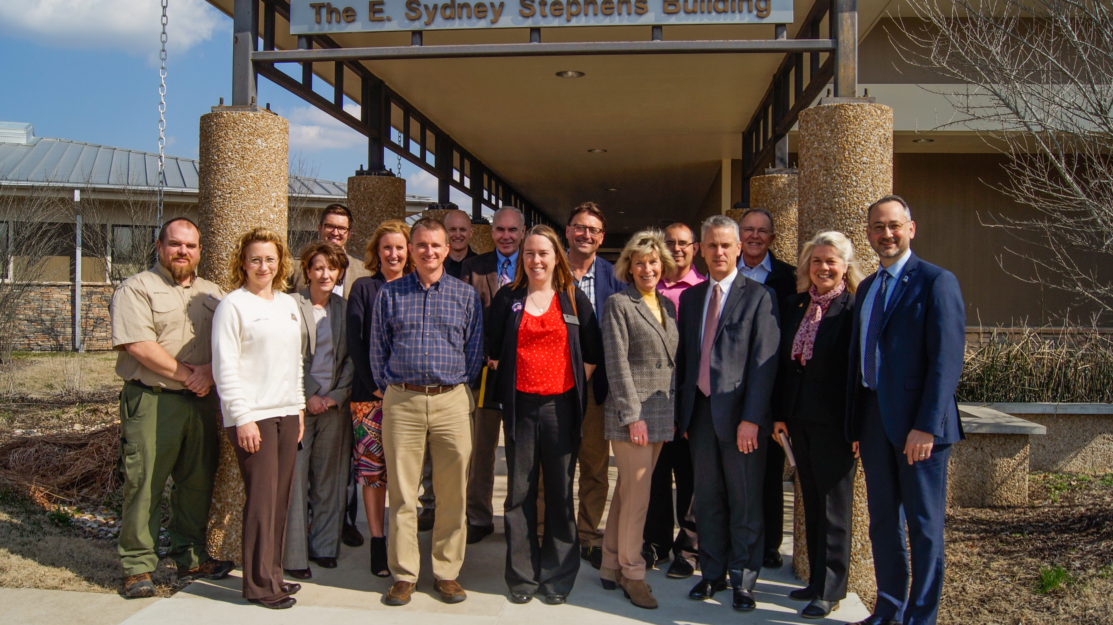
Building a Foundation……
BCNS Steering committee
Began meeting in September 2018
Columbia Public Schools officials - MDC staff - Community leaders
Created a partnership that would result in the acquisition of property and the construction of a Nature School

Slide 6
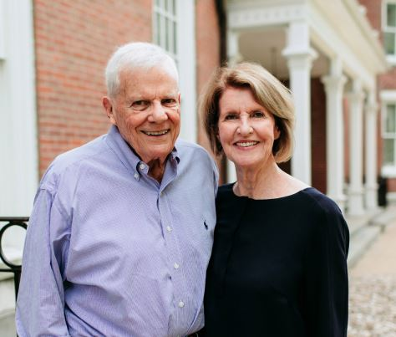
Finding a home for BCNS
Property acquired in fall of 2019
Hank Waters & Vicky Russell
111 acres with an additional 100 acres to be conveyed in the future
Named: Waters-Russell Unit of Three Creeks Conservation Area
Property borders Three Creeks Conservation Area. 1,500 acres of public property open to hunting, fishing, camping, hiking and nature viewing.

Slide 7
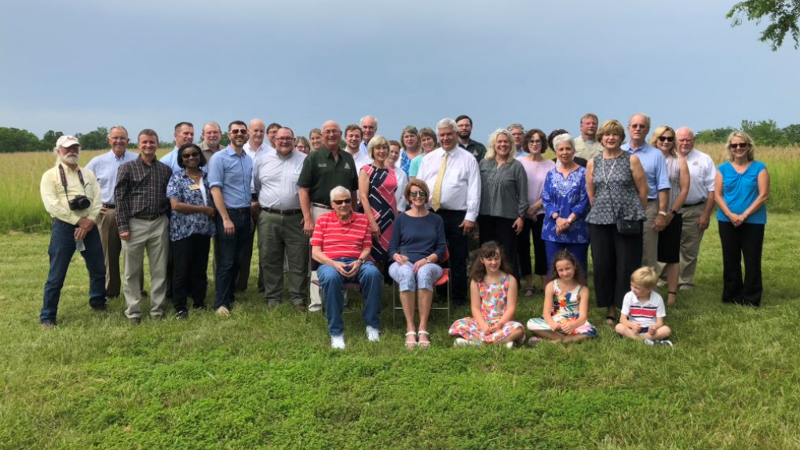
The BCNS Partnership…..
MDC – 22% Infrastructure development, property acquisition & restoration of native species
CPS – 45% School building construction
Private Fund Raising – 33% building construction

Slide 8
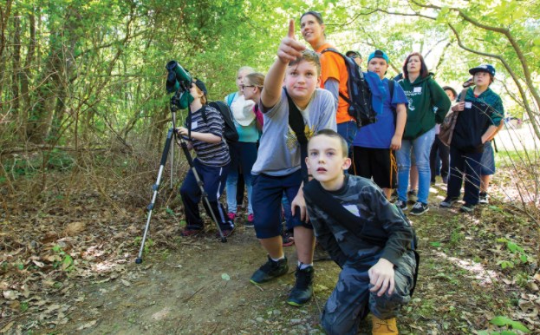
Boone County Nature School (BCNS)
Goal: to give students from all Boone County schools the opportunity to engage in place-based learning, which is:
Immersive
Hands-on
Teaches a unique curriculum of natural resources education through the lens of the environment, culture, history and economics.
Uses existing district and state educational standards to take students on an exploratory journey into how their community operates and sustains itself.

Slide 9
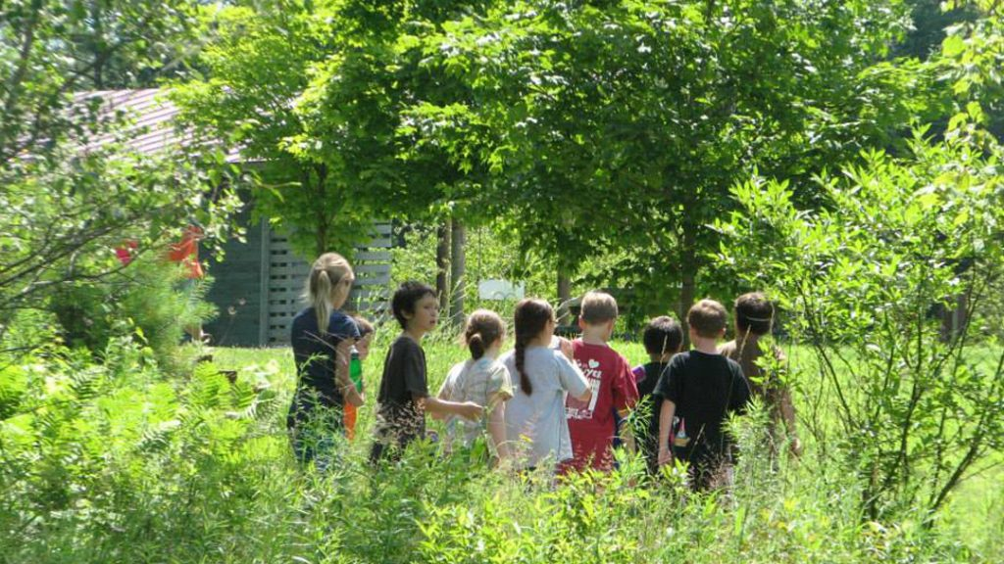
The bcns concept
BCNS is located within the Waters-Russell Unit of Three Creeks Conservation Area
The school will be operated & managed like any other school building
11,000 students annually
2,200 normal school attendance (six Boone County School Districts)
6,000 one-day field experiences students, i.e.,…MDC DNS field trips
2,500 summer program students
Numerous public conservation education program participants

Slide 10
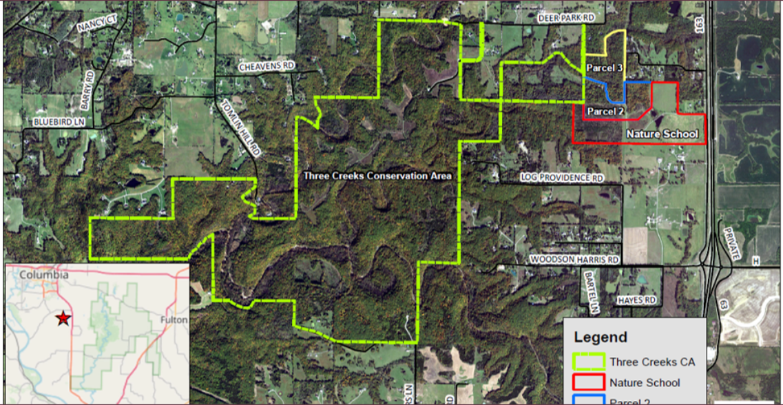

Slide 12
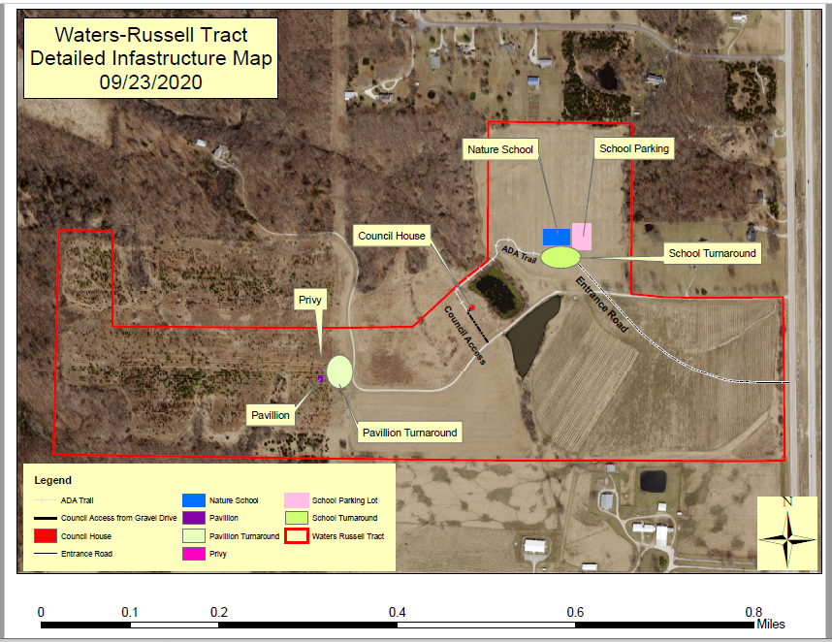

Slide 13
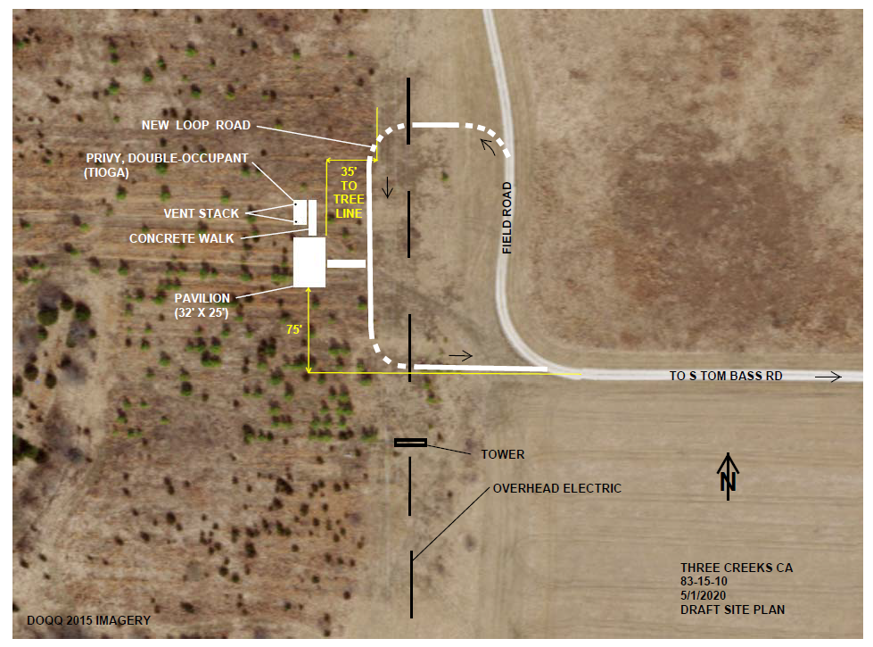
Phase 1
Nature School campus began winter of 2021 with the construction of an educational pavilion, double occupancy privy.

Slide 14
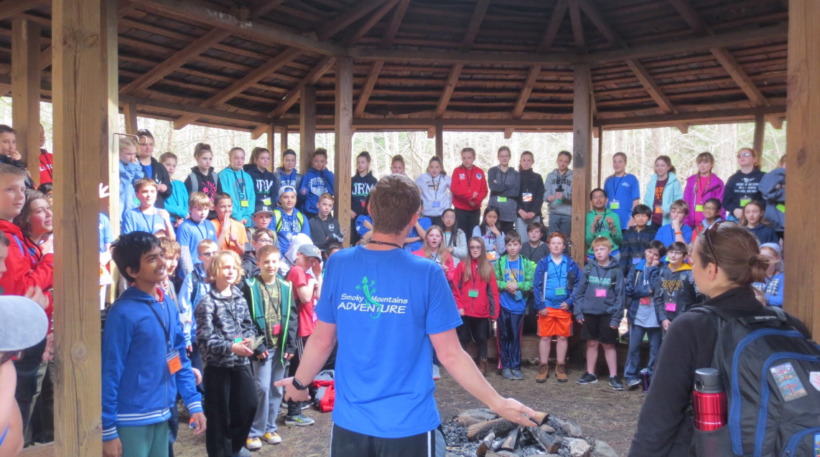

Slide 15
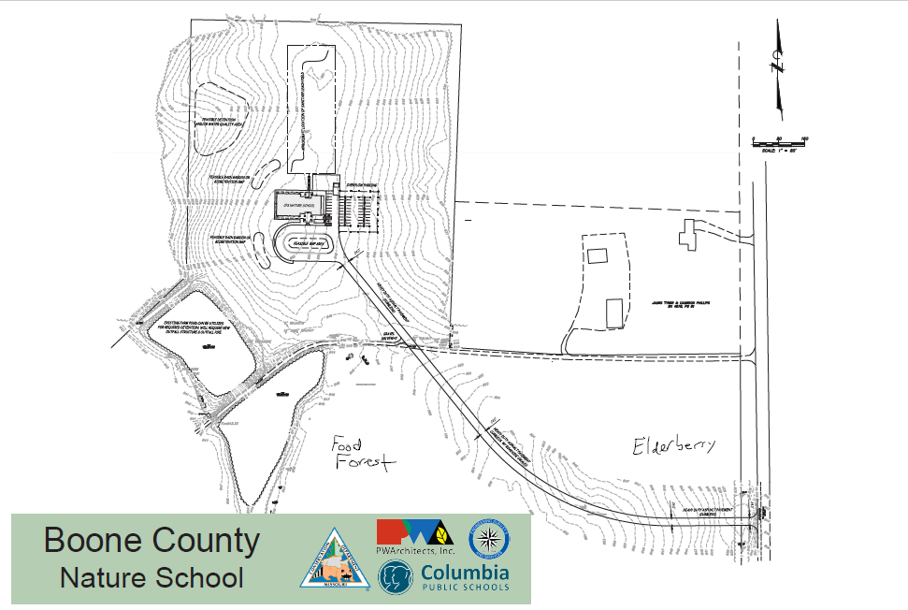
Phase 2
Construction of a Nature School building
PW Architects
8,000 sq. ft.
Four classrooms
Lobby
Public meeting/classroom space
Offices

Slide 19
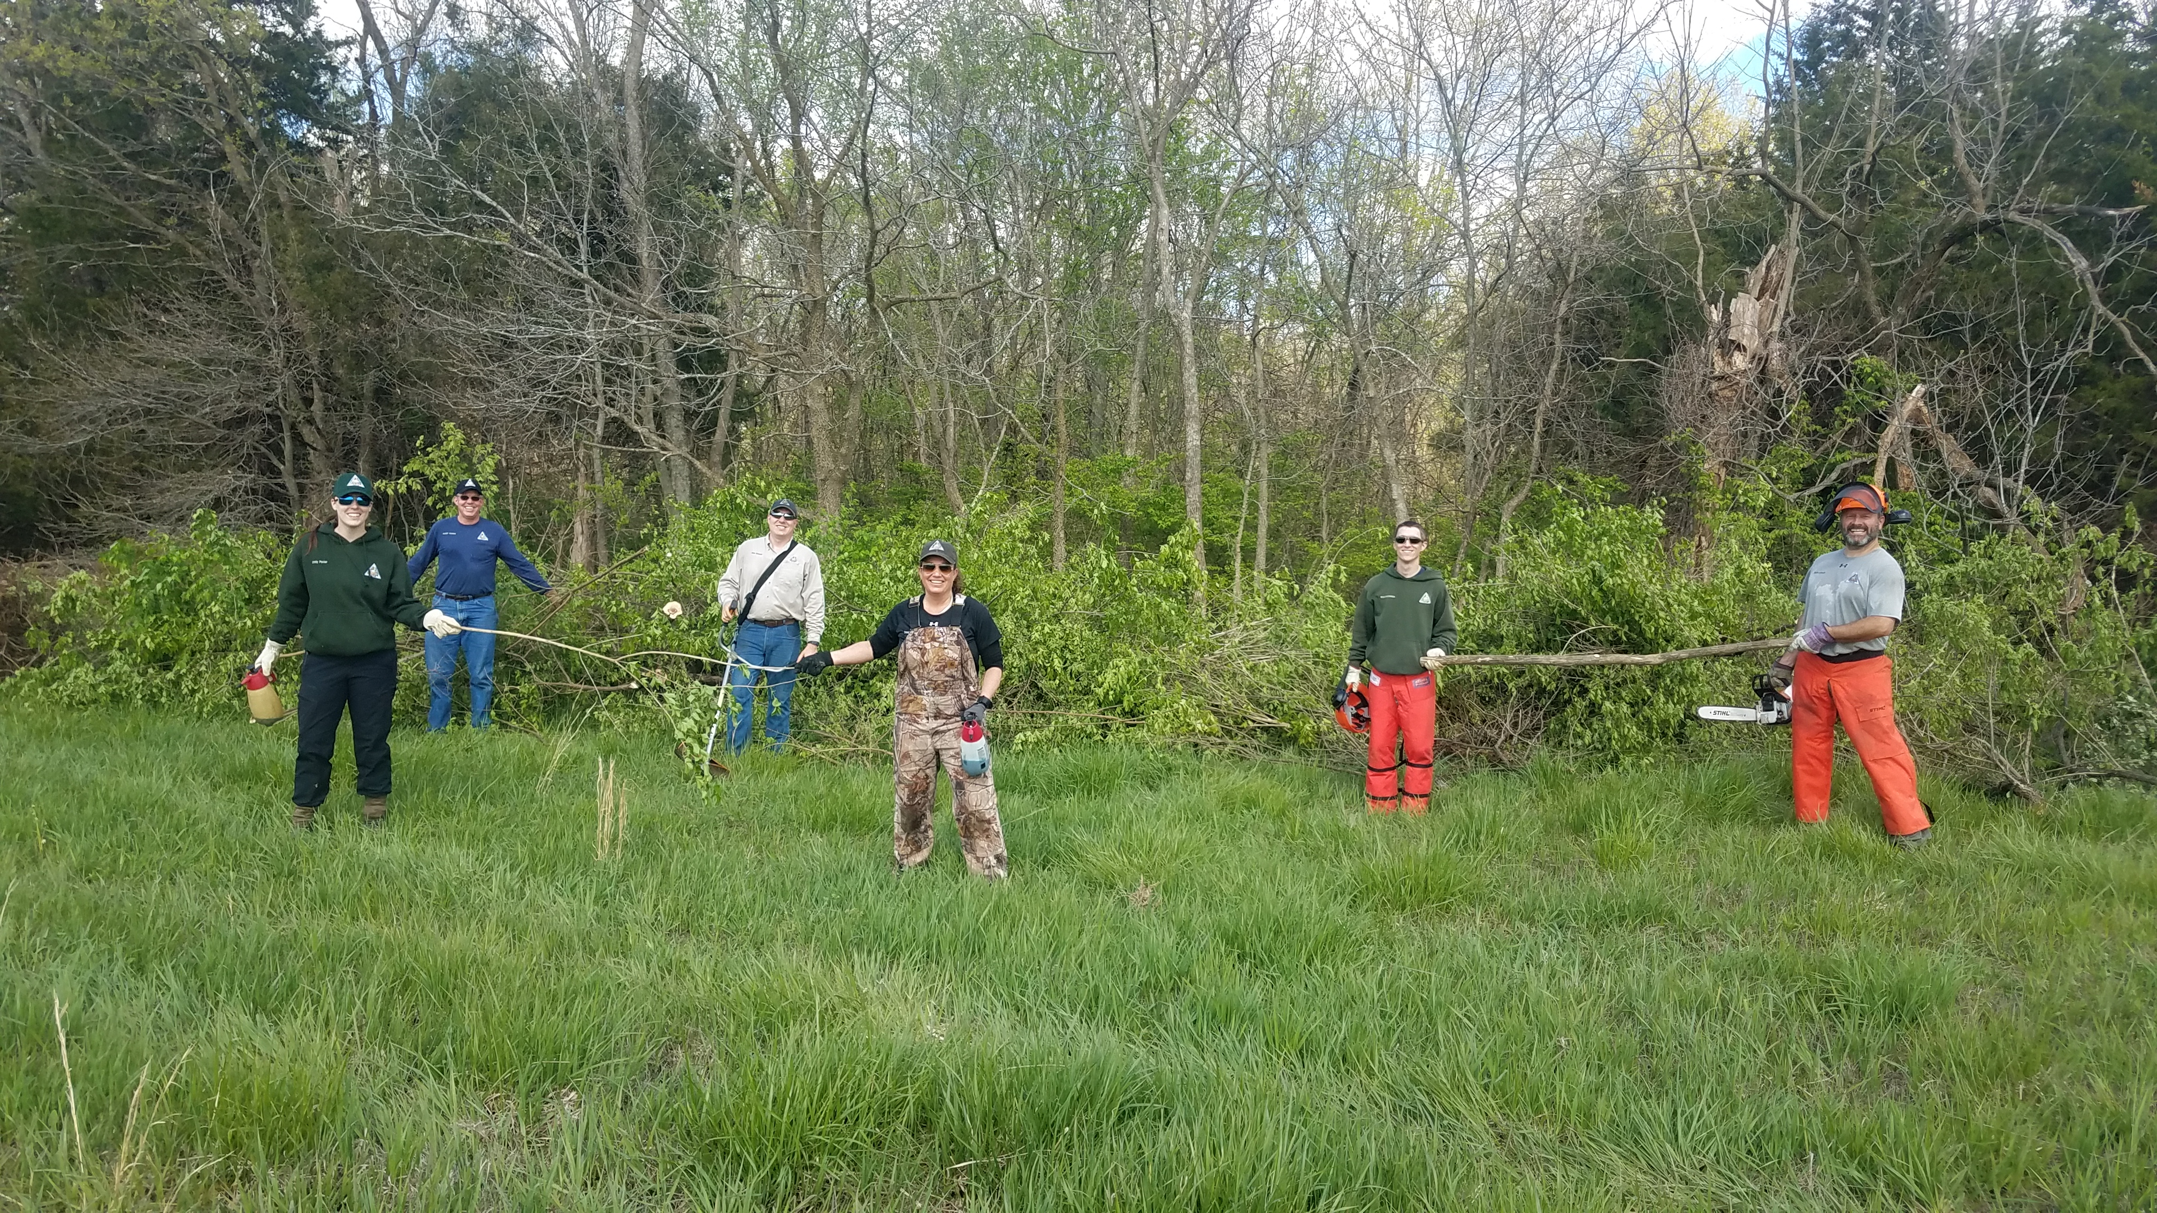
Field work
Removal of exotic invasive species
Restoration of native species and prairie
Bull hog work
Trail marking
Road maintenance
Pollinator Garden
Prepping area for archery and air rifle range

Slide 20
BULL Hog work

Slide 21
BULL Hog work
Access across the Jacobs Tract to Turkey Creek for aquatic education activities!

Slide 22
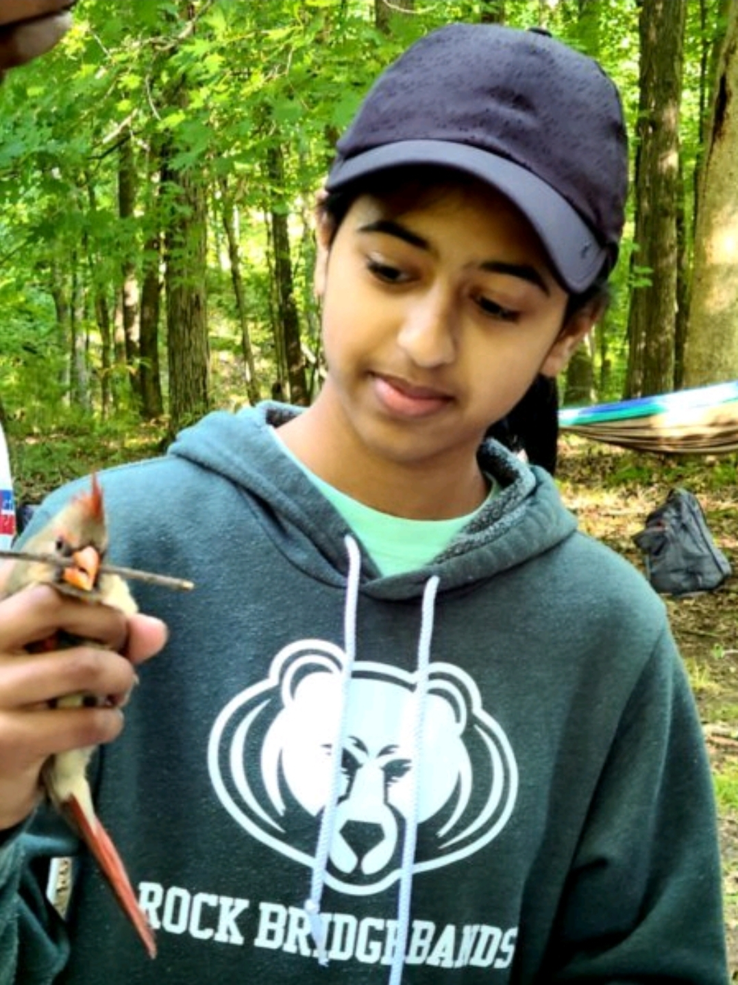
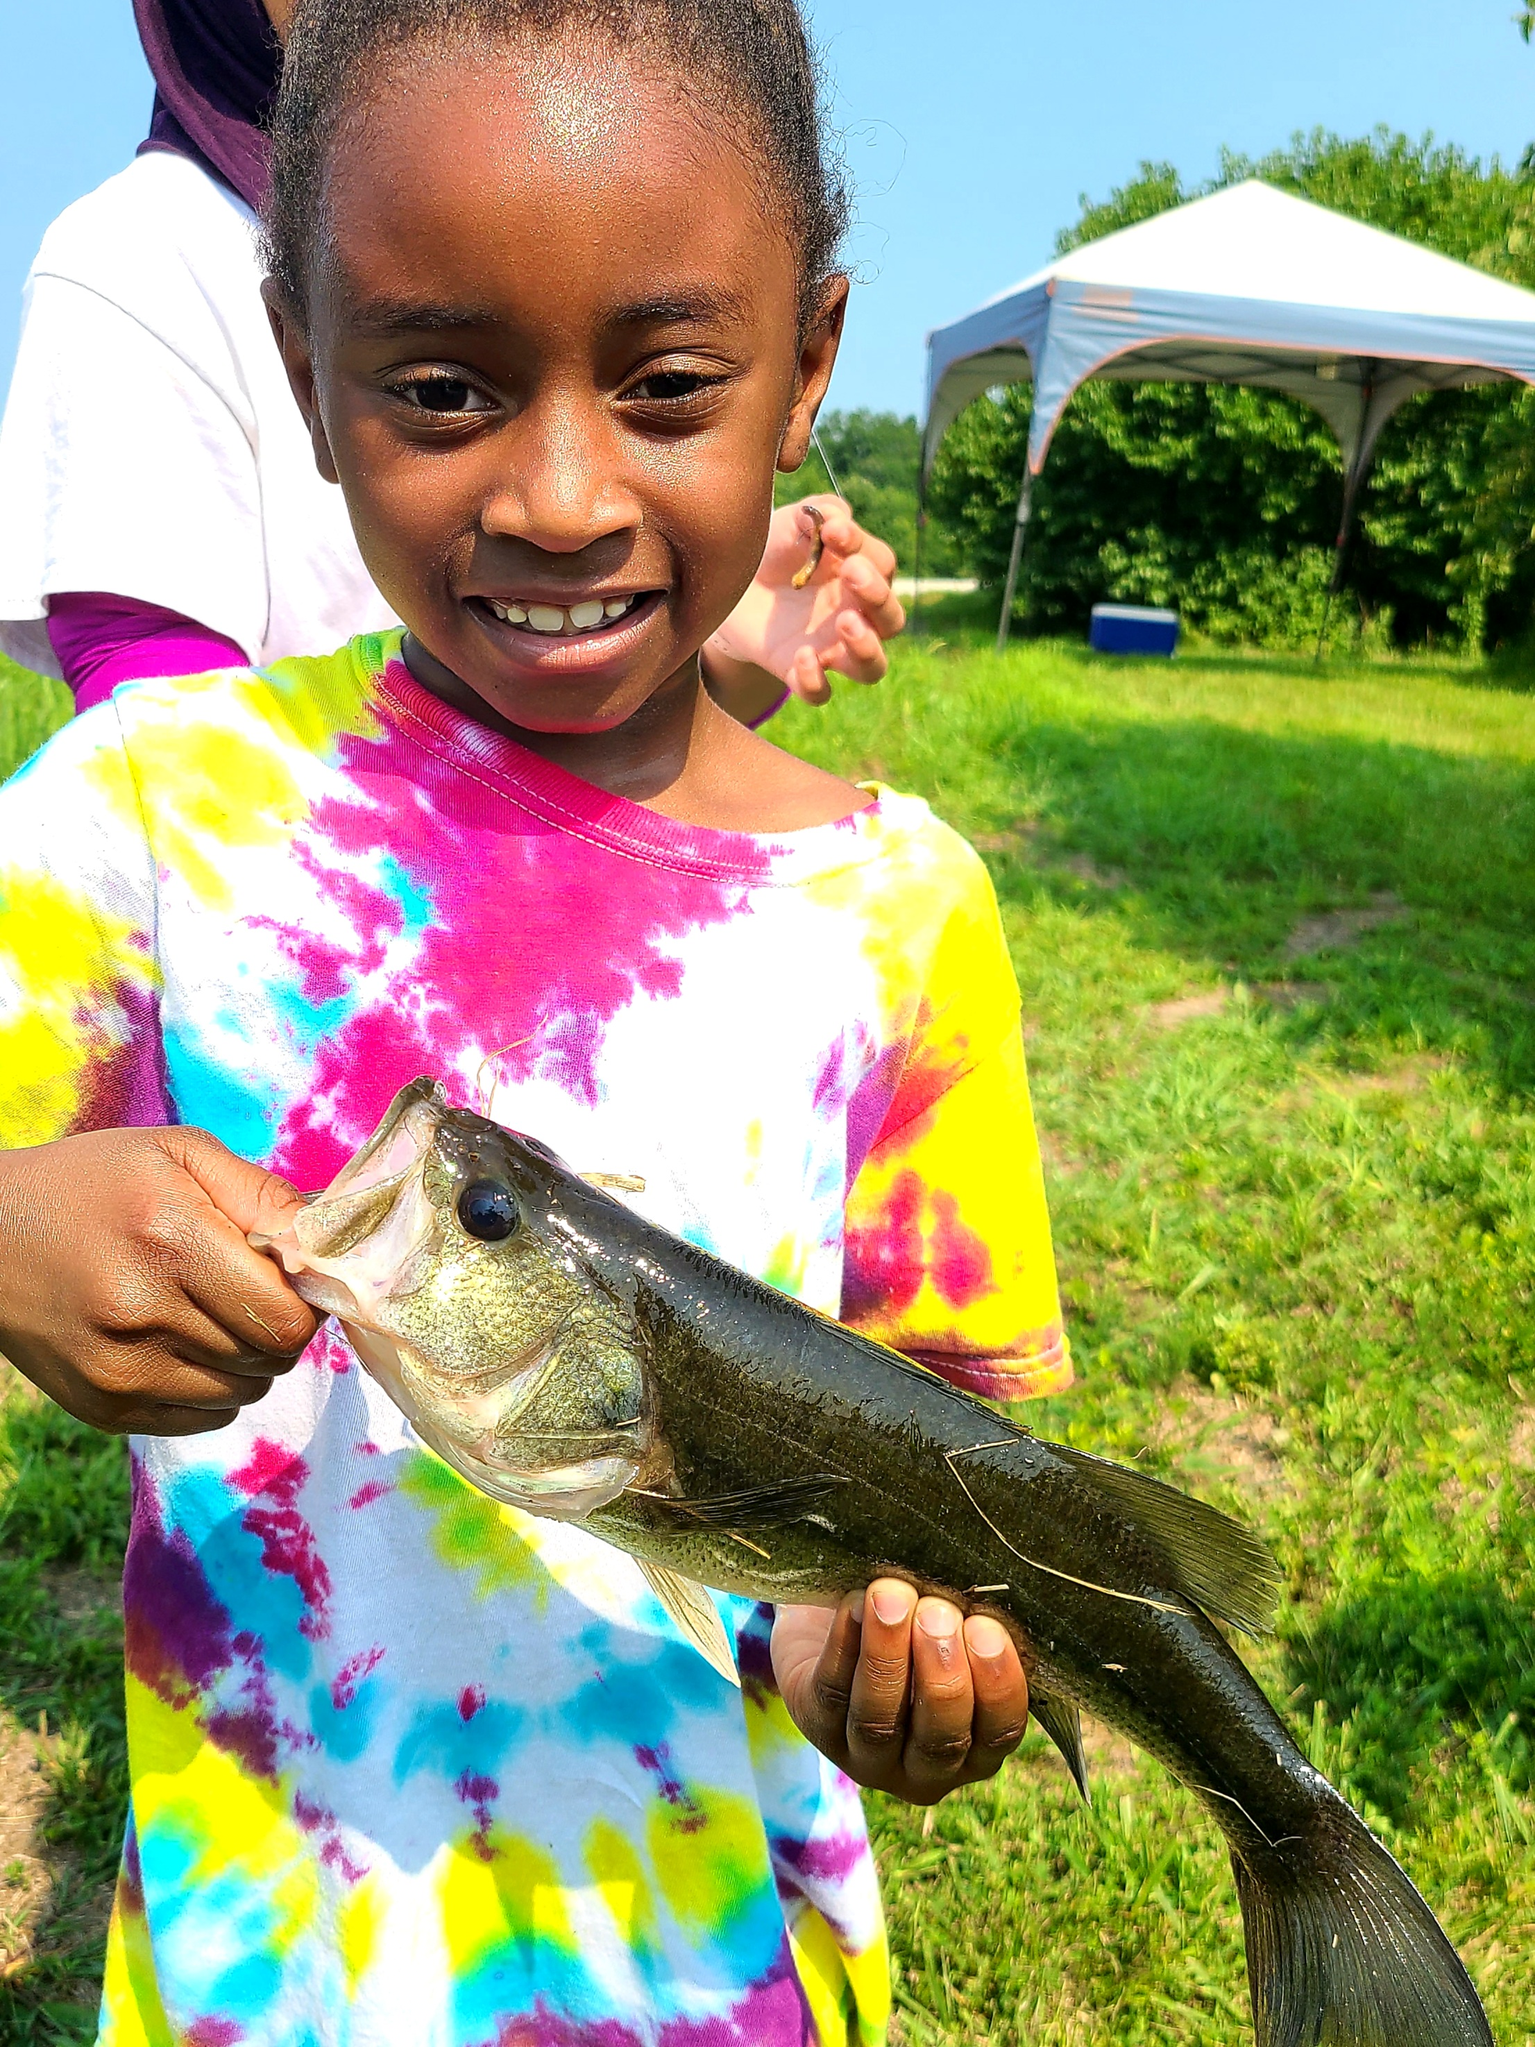
What’s happening now?
Group programming on-site
Rock Bridge High School Field Ecology bird banding
CPS Middle School Science Camps
Fishing
Hiking
Archery
Paddle sports
Camping

Slide 23
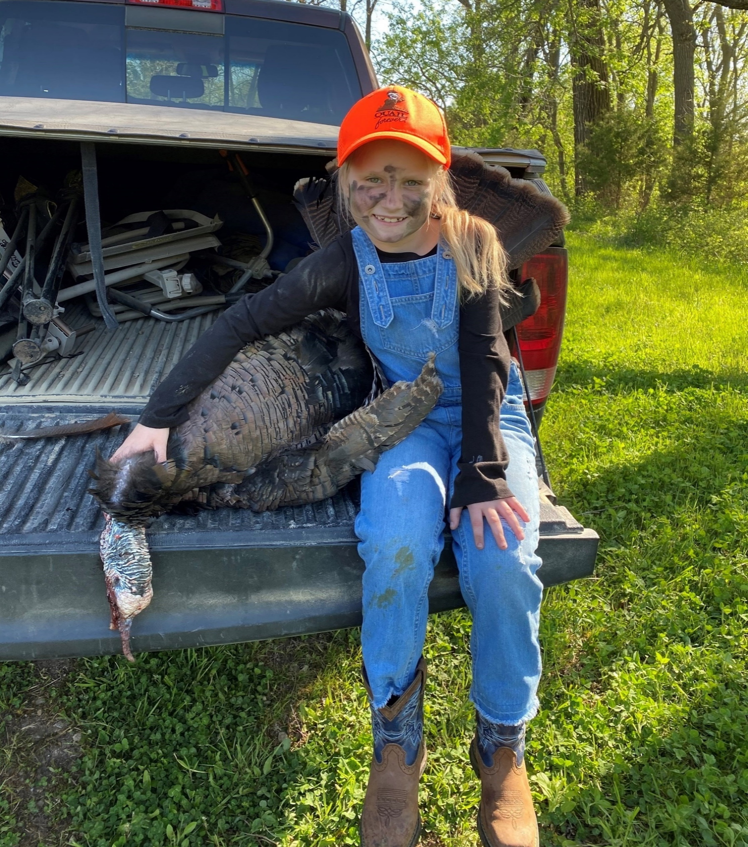
Connections – Youth & Shooting Sports
Provide Mentored Hunts
Deer
Turkey
Pheasant
Duck
Shooting programs for youth, women, first time participants and general citizens
Shotgun
Handgun
Hunter Education

Slide 24
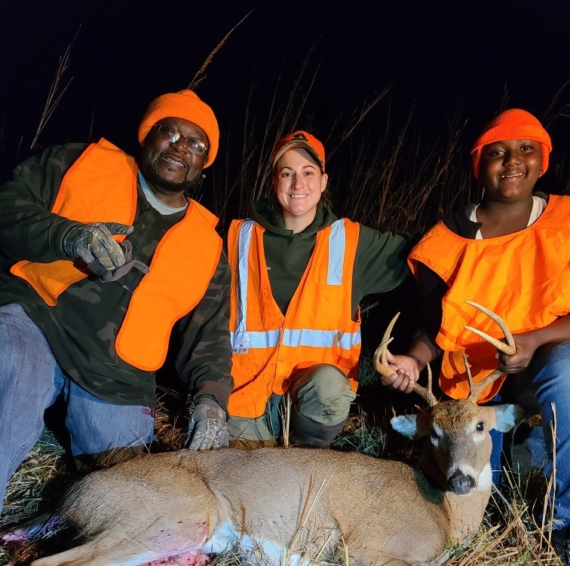
Mentored Hunts

Slide 26
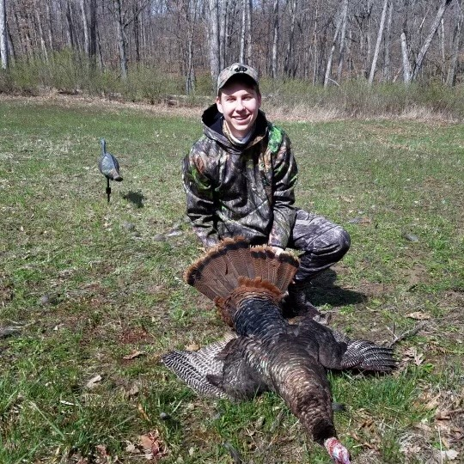

Slide 27
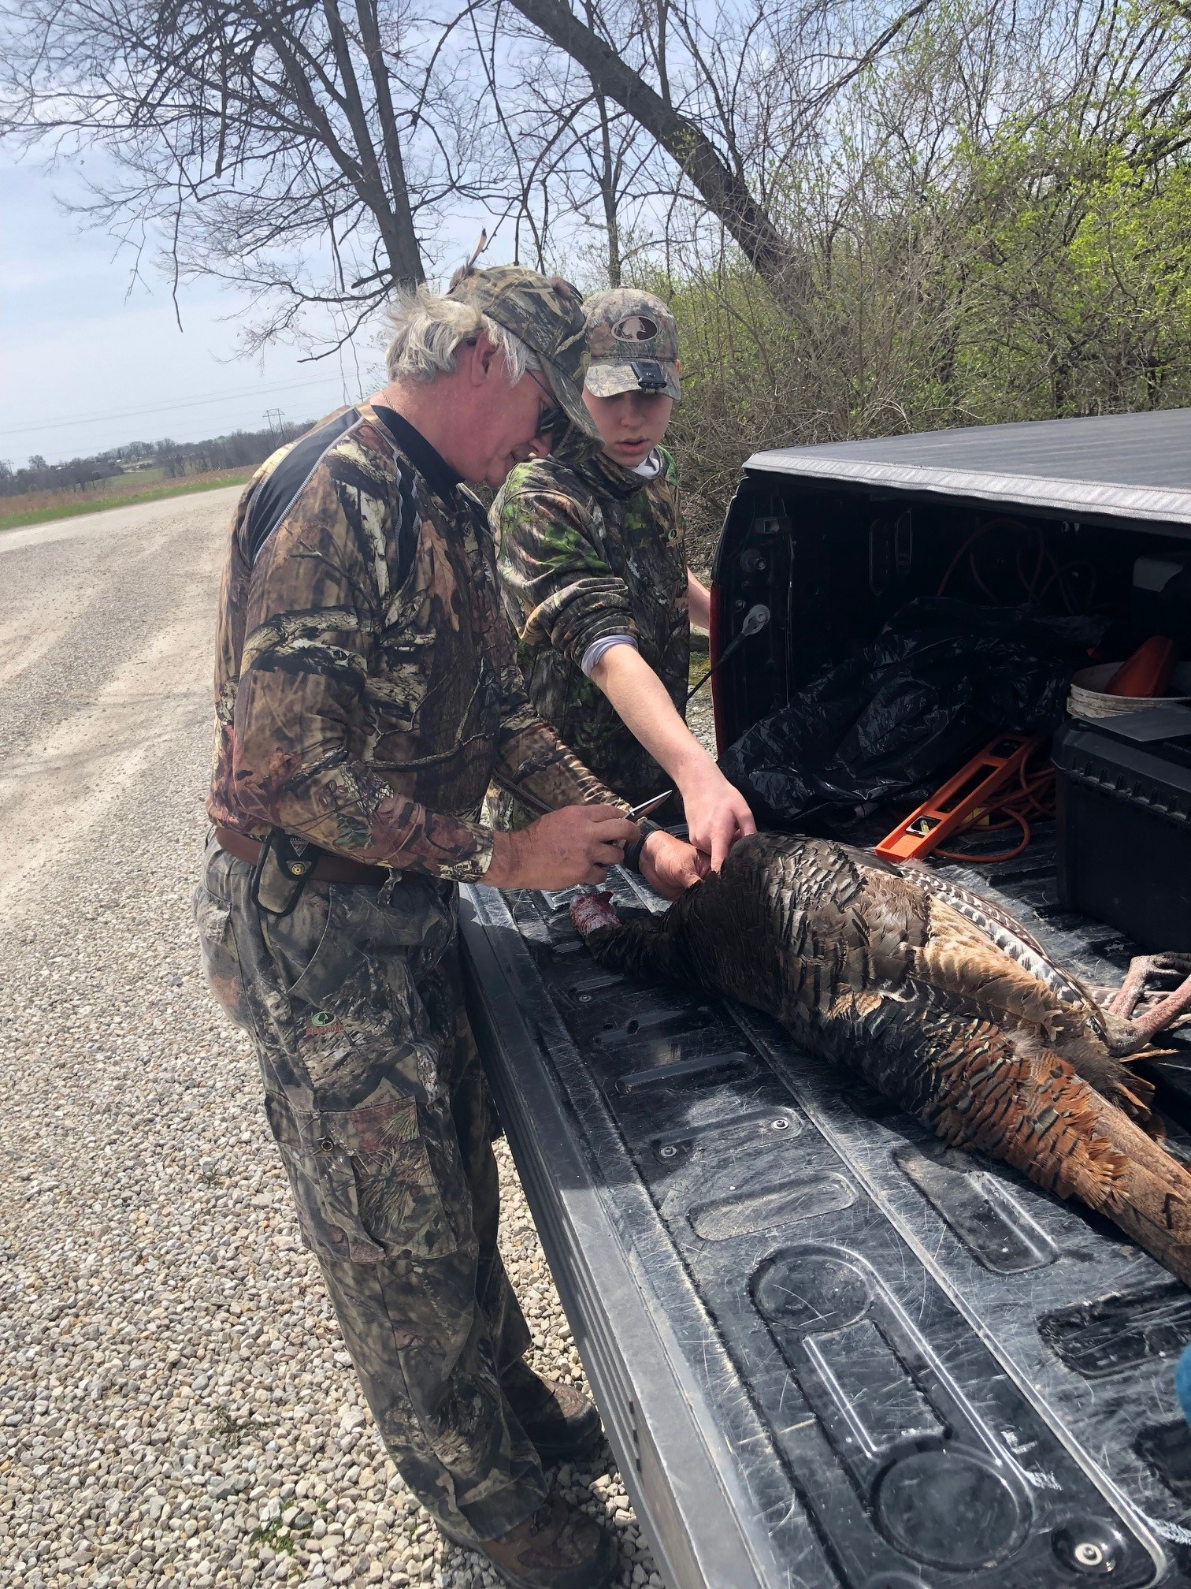

Slide 28
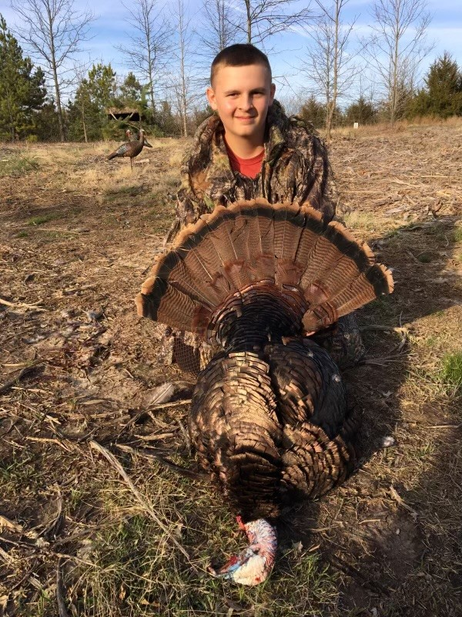

Slide 29
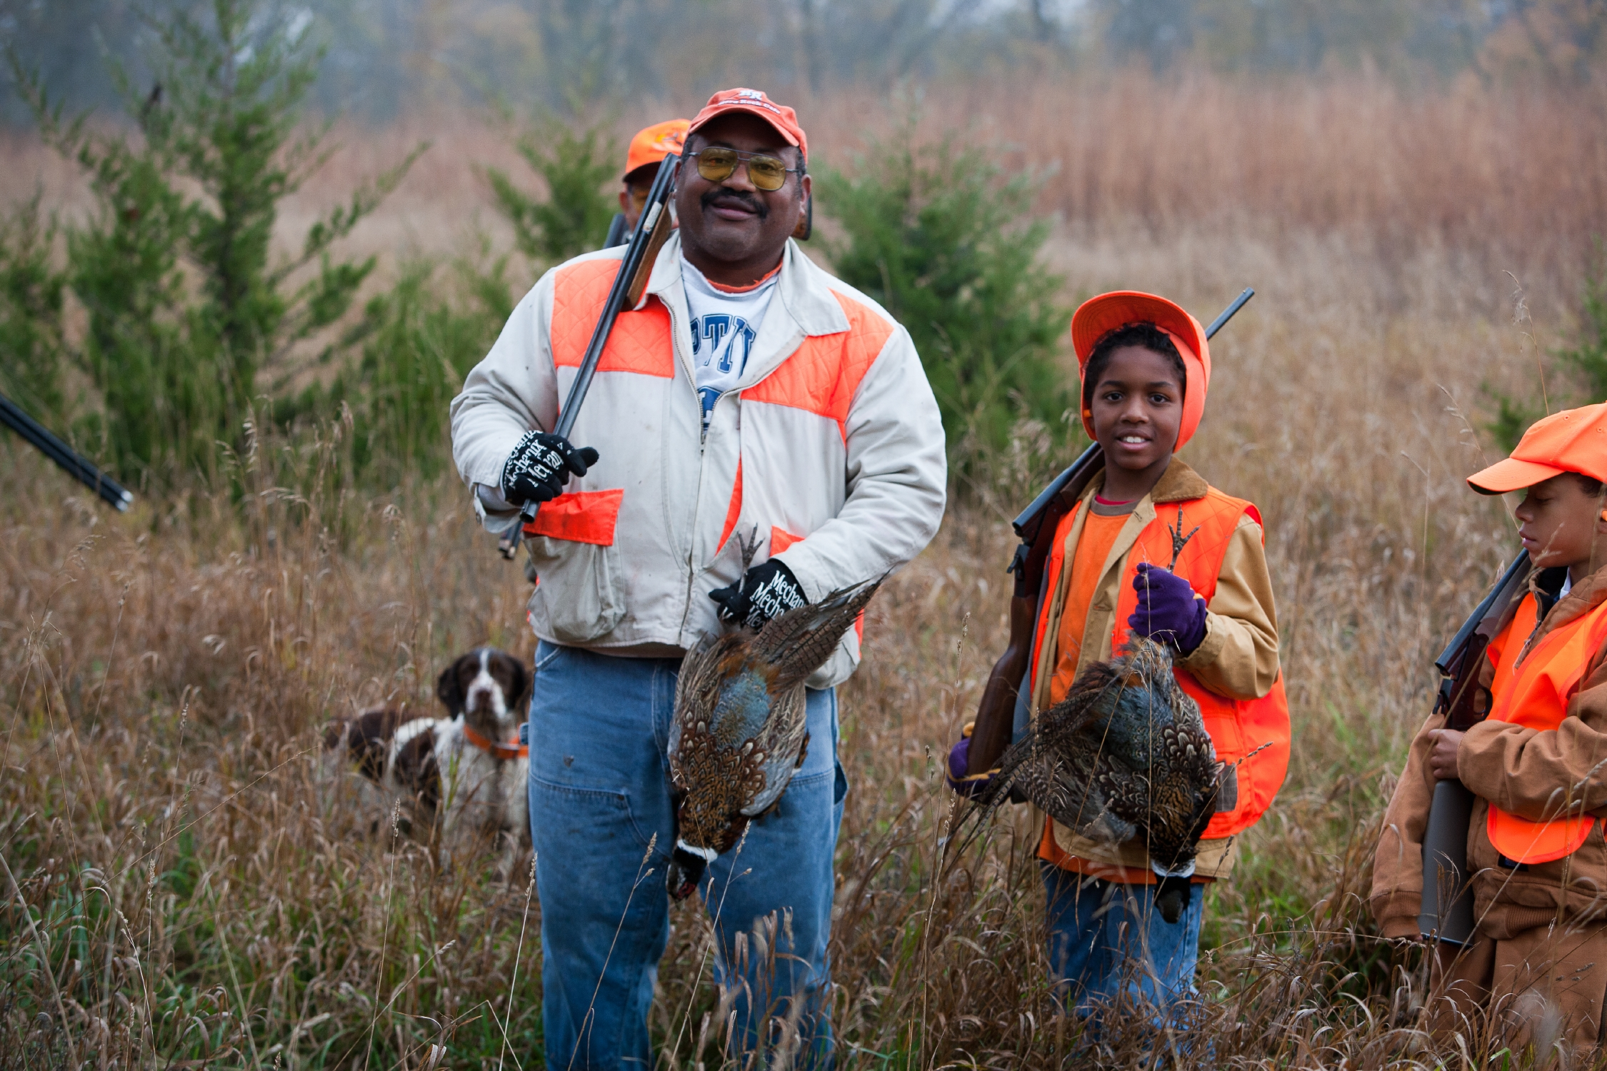

Slide 32
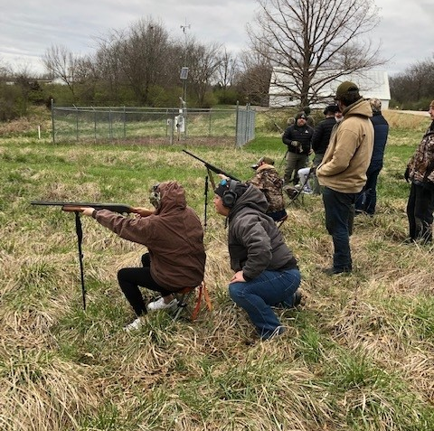
Target Practice

Slide 33
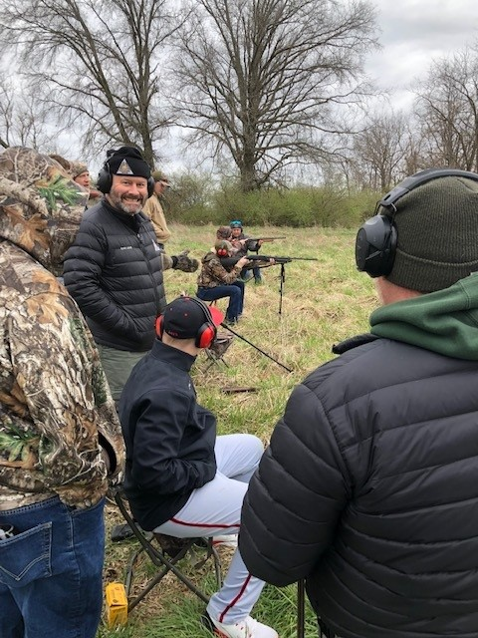
Target practice

Slide 35
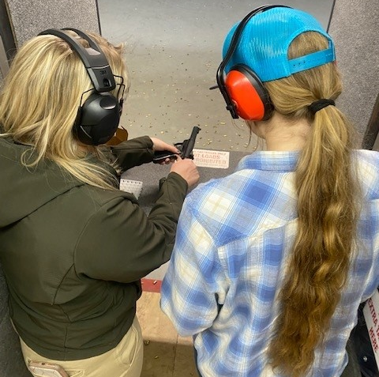
Women's Handgun

Slide 38
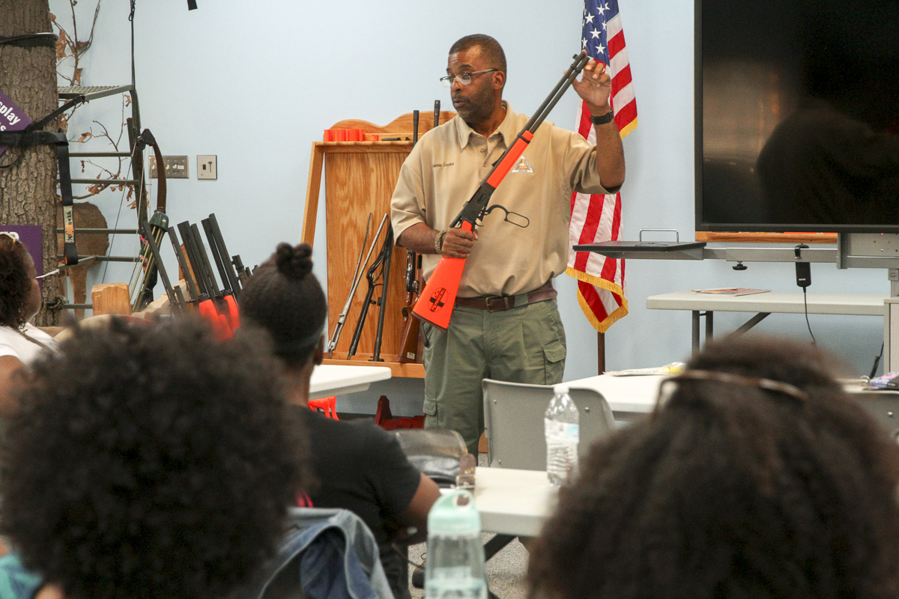

Slide 39
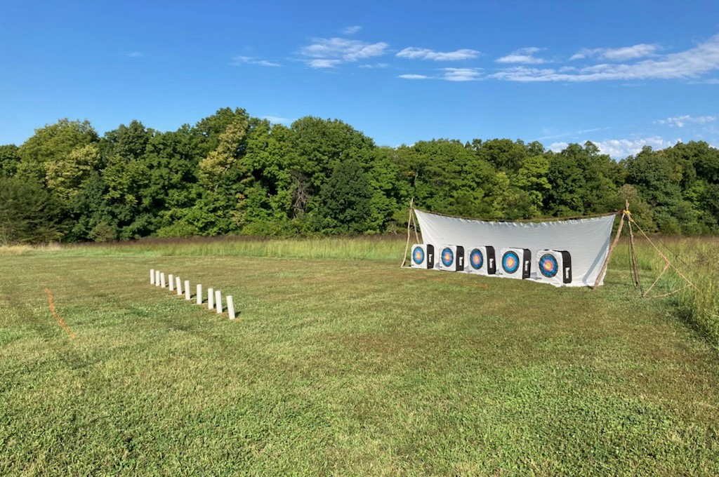

Slide 41
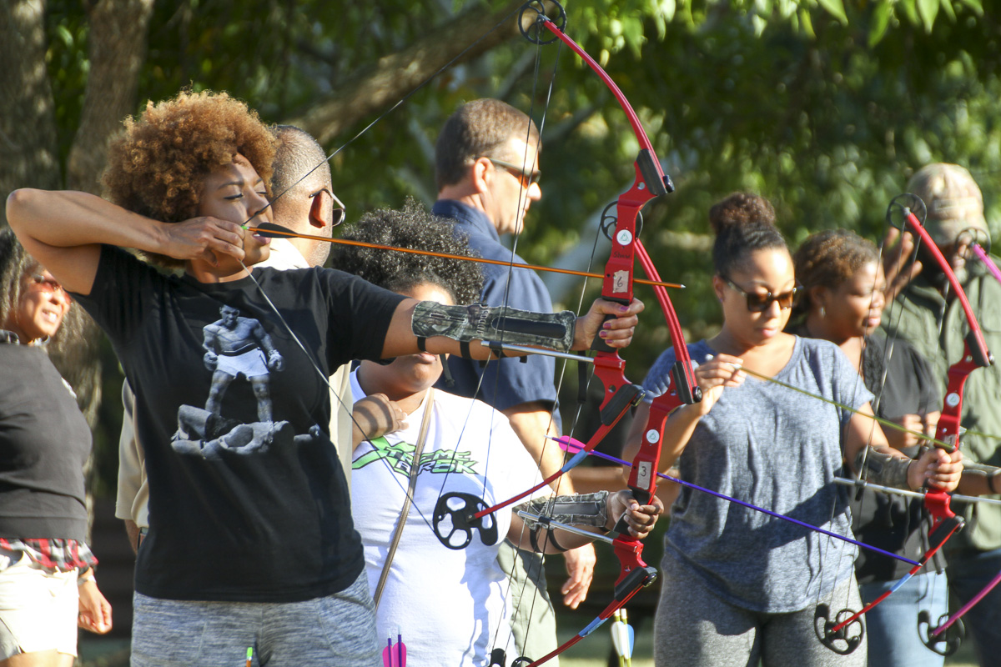

Slide 42
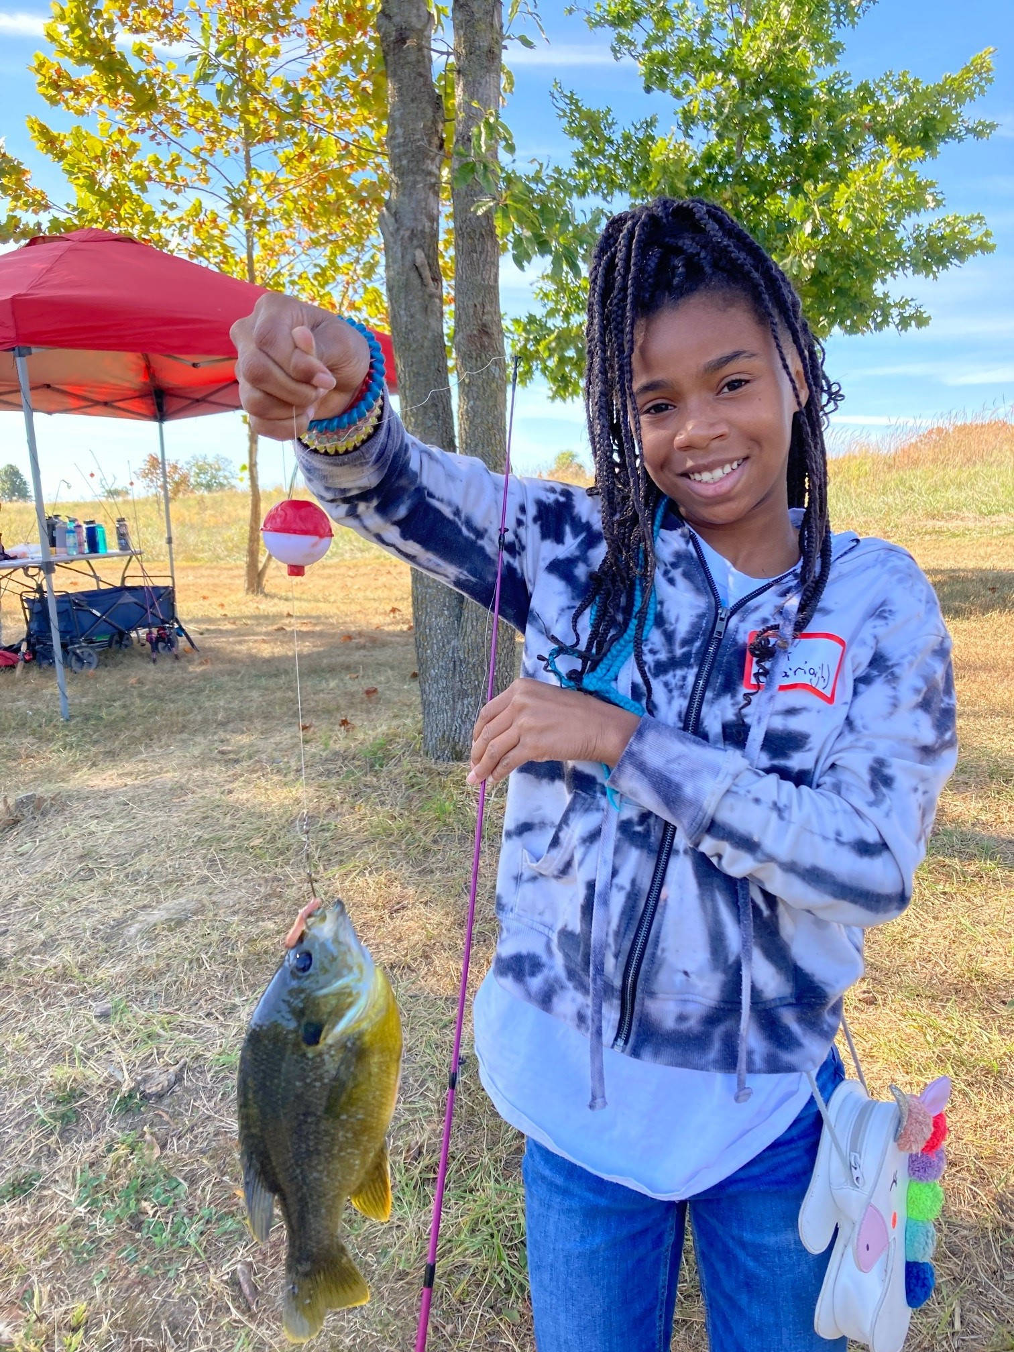

Slide 43
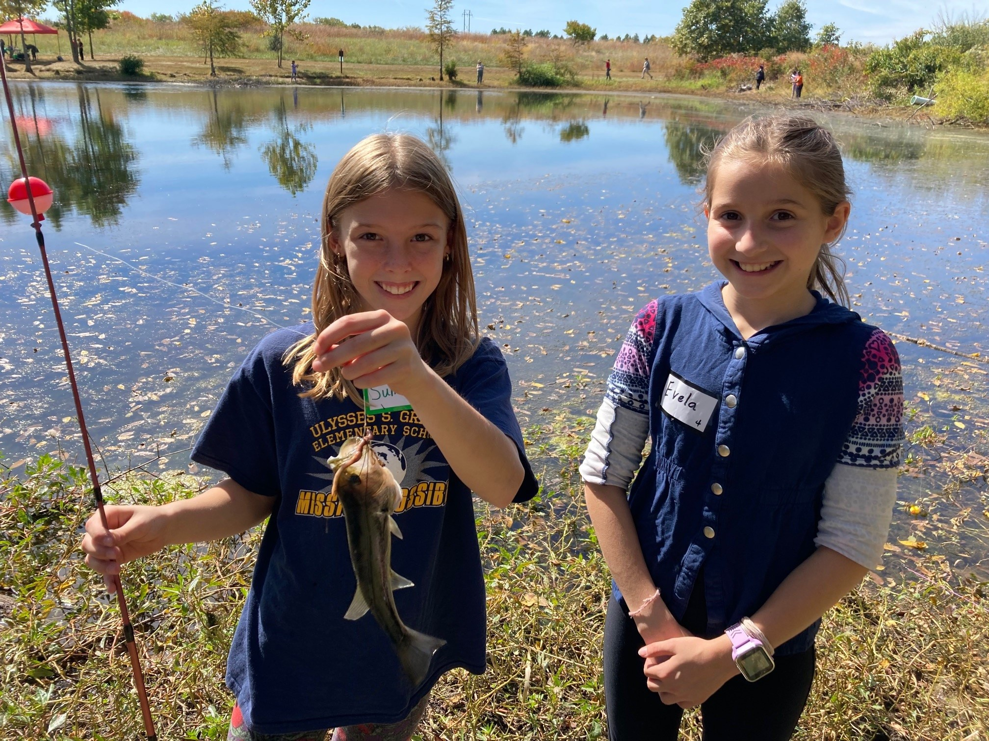

Slide 46
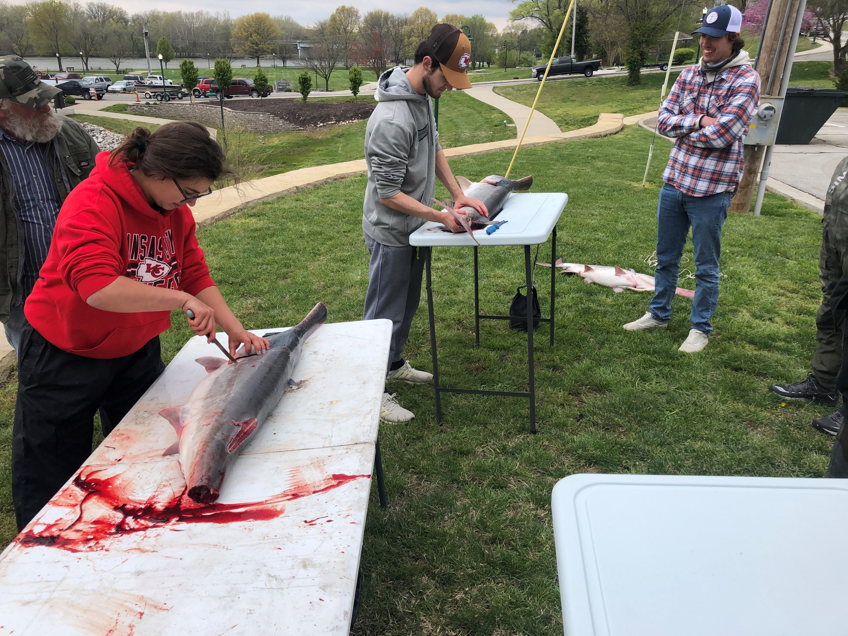
General programs
Outdoor Cooking
Hiking
Fishing
Fire starting and smores
Paddle sports
Deer scouting
Gun cleaning
Shooting sports
Archery and atlatl
Field to table

Slide 47
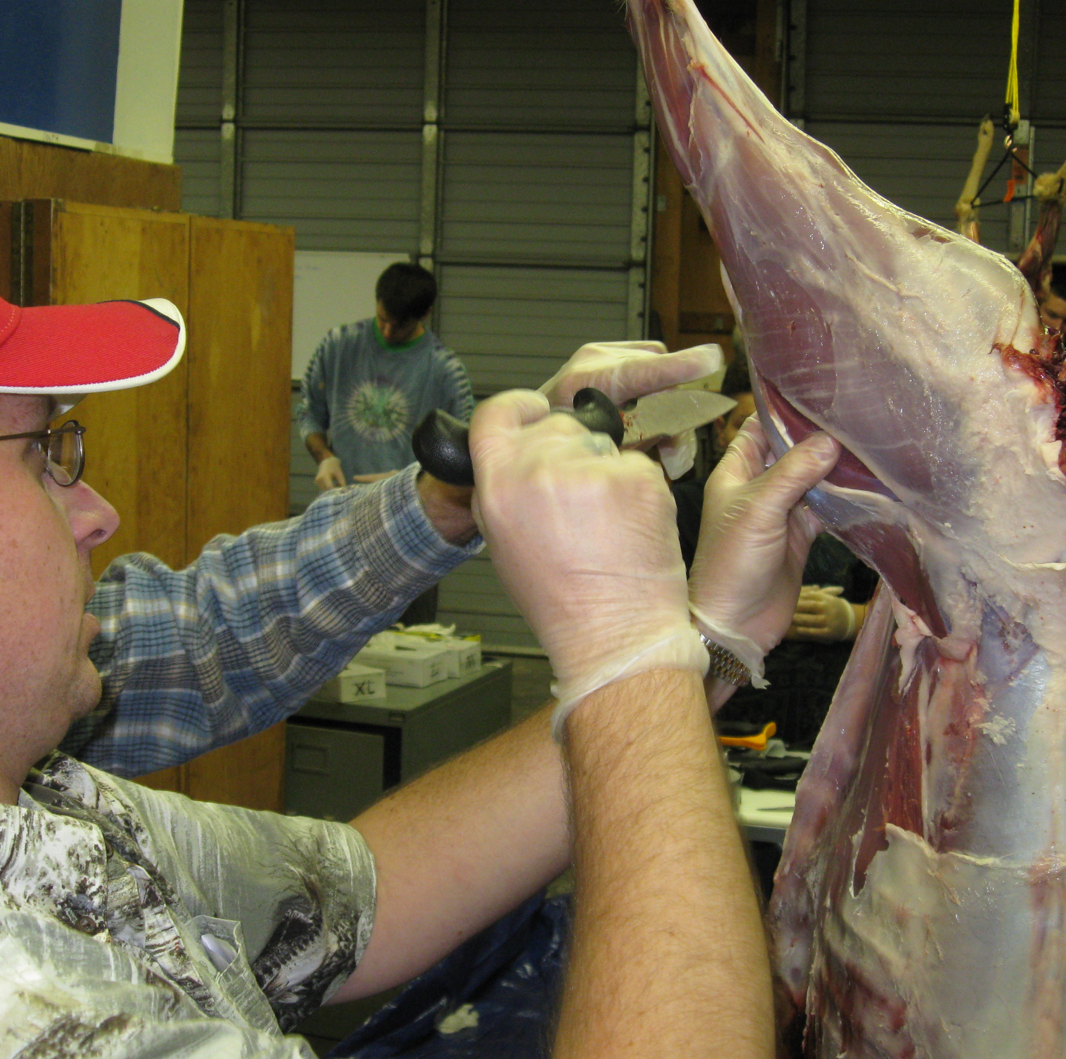
Field to Table

Slide 48
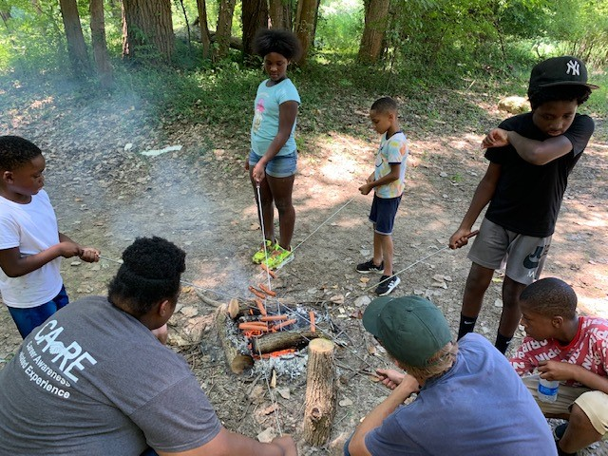
Camp Fire and smores

Slide 49
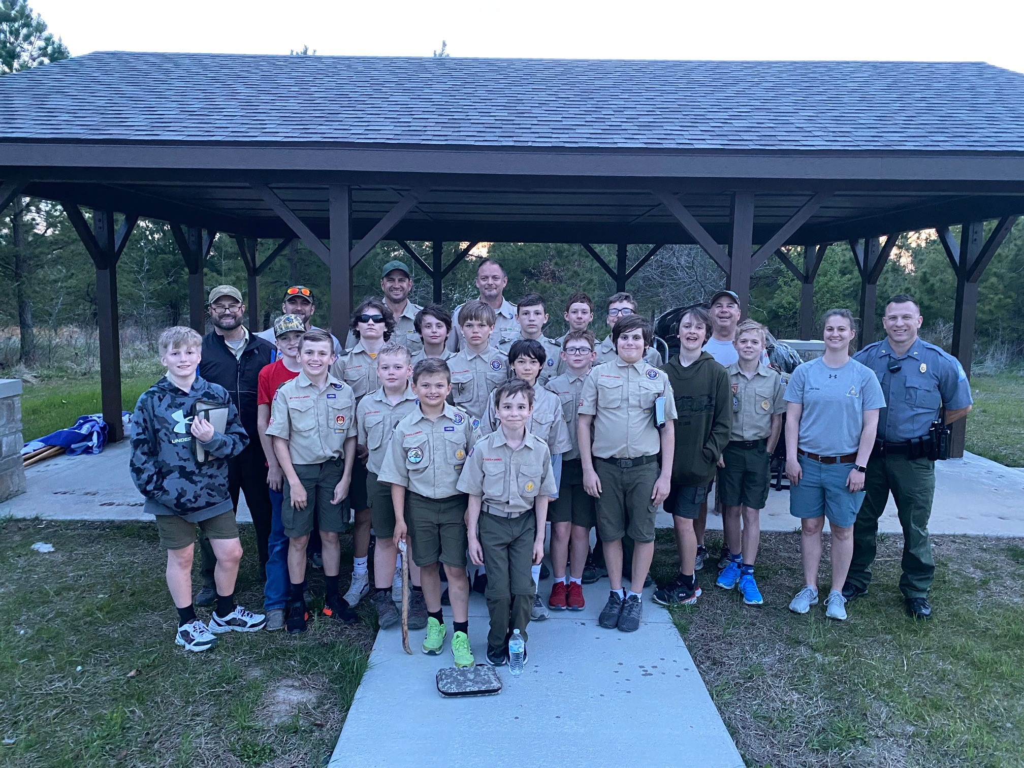

Slide 50
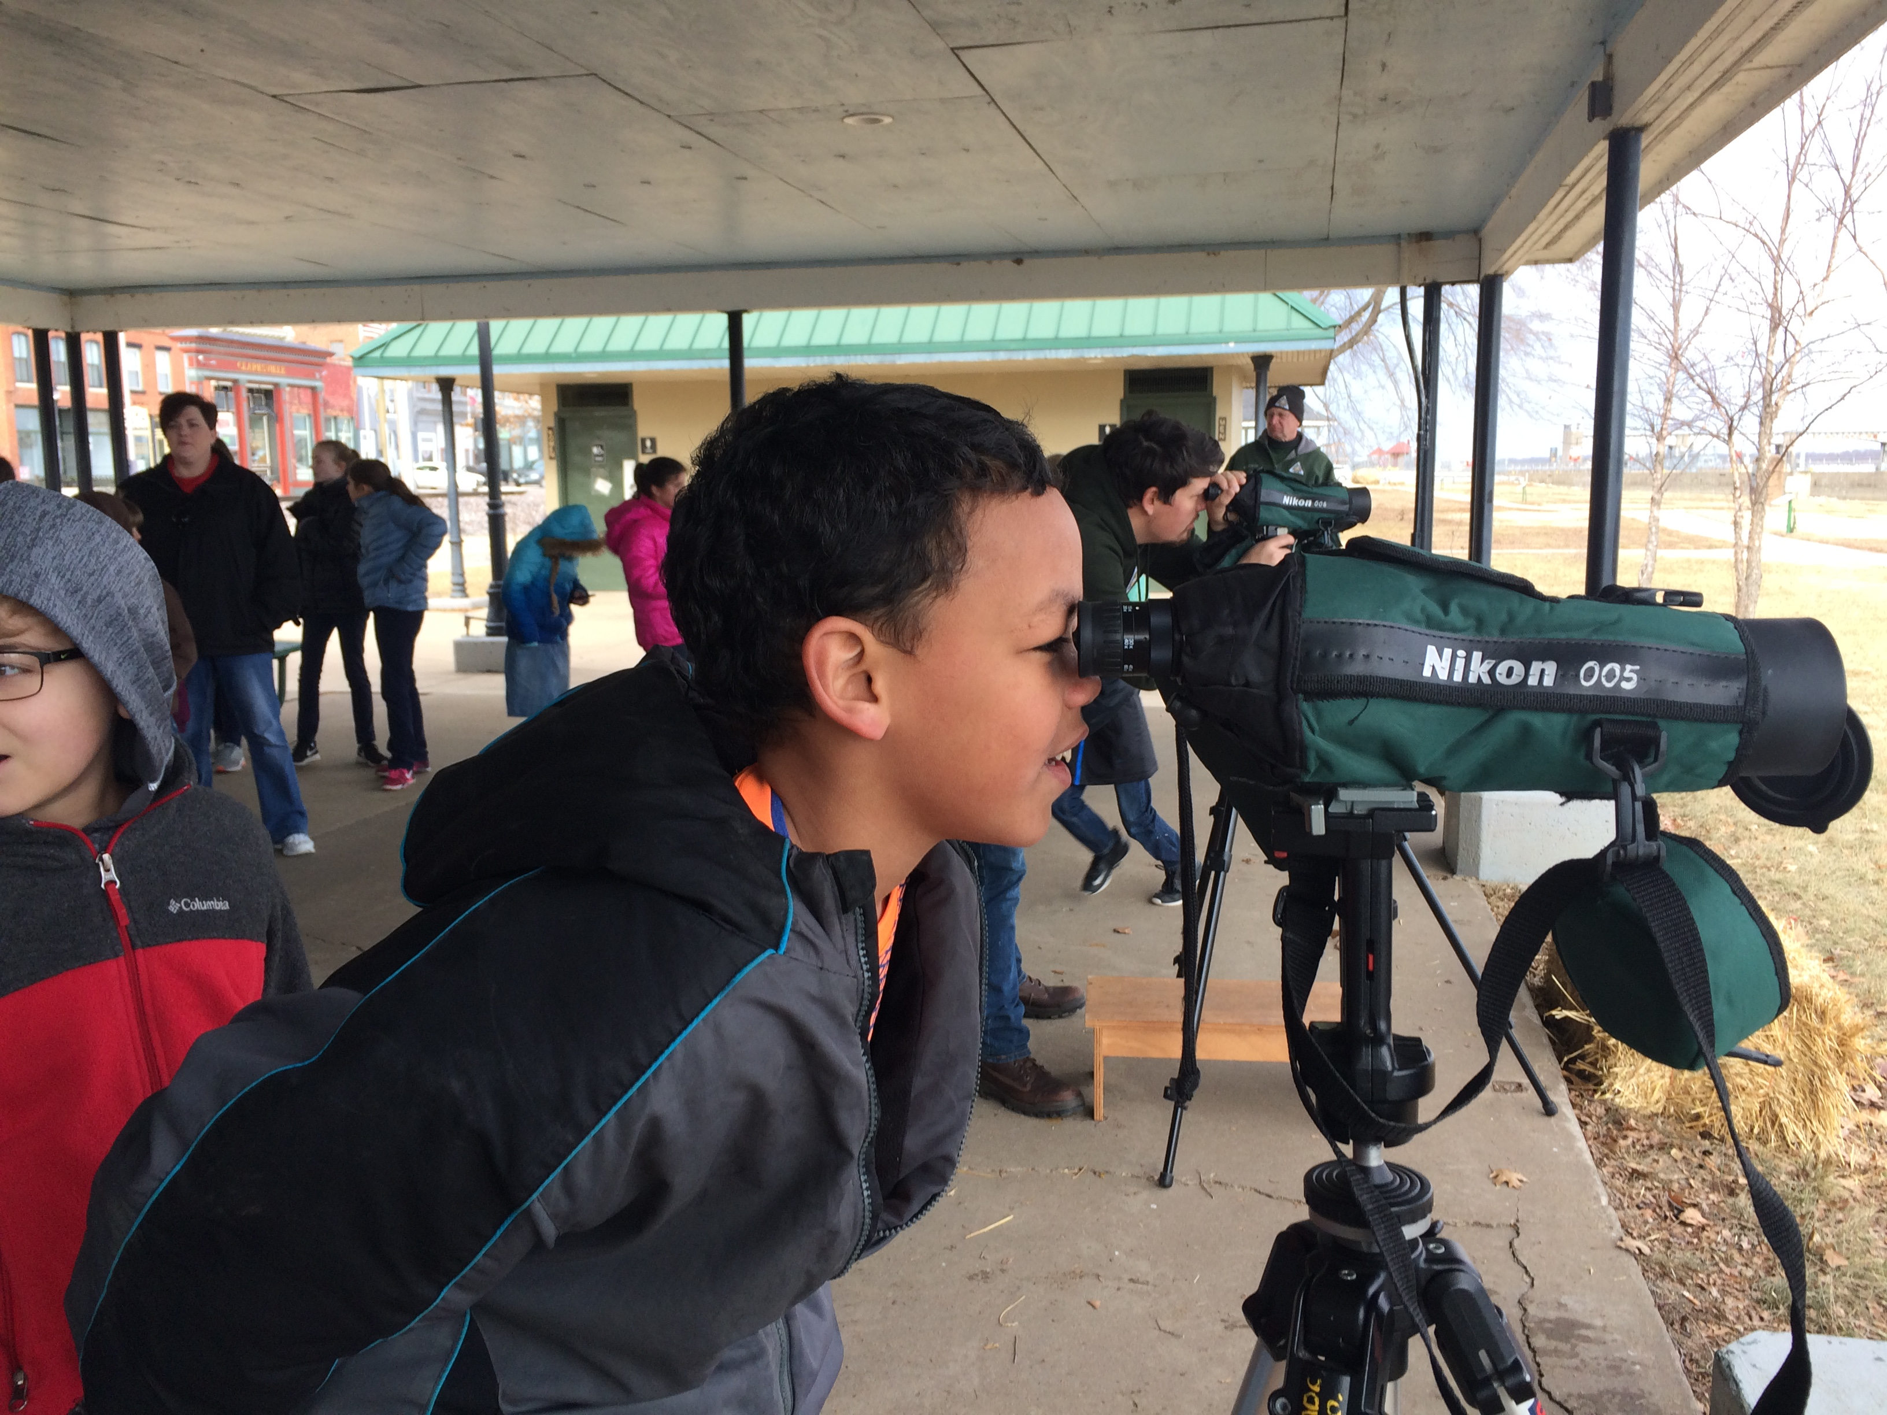
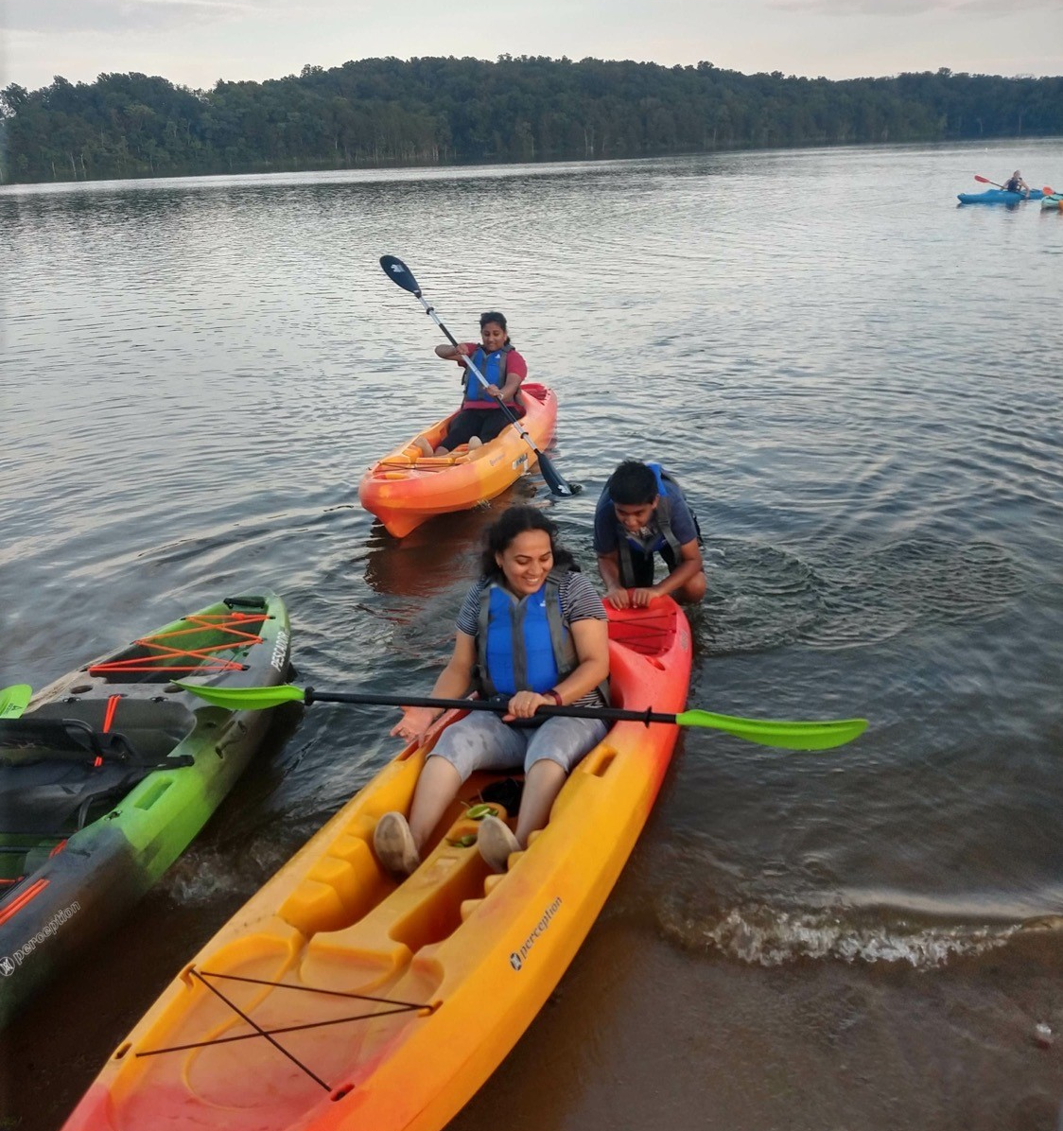
Our future…..
BCNS will make conservation relevant to thousands of students and citizens each year!

