Slide 1
Creating a Pipeline 1/Youth Shooting Sports 2/Collegiate Shooting Sports 3/Careers in Shooting Sports industry
Presented by
Robbi Vincent President/CEO
FutureU Sports Corp. College Shooting Sports Recruiting/ NCSSAA/ Careers4Athletes
MIDWAYUSA FOUNDATION
National Youth Shooting Sports Conference 2022

Slide 2
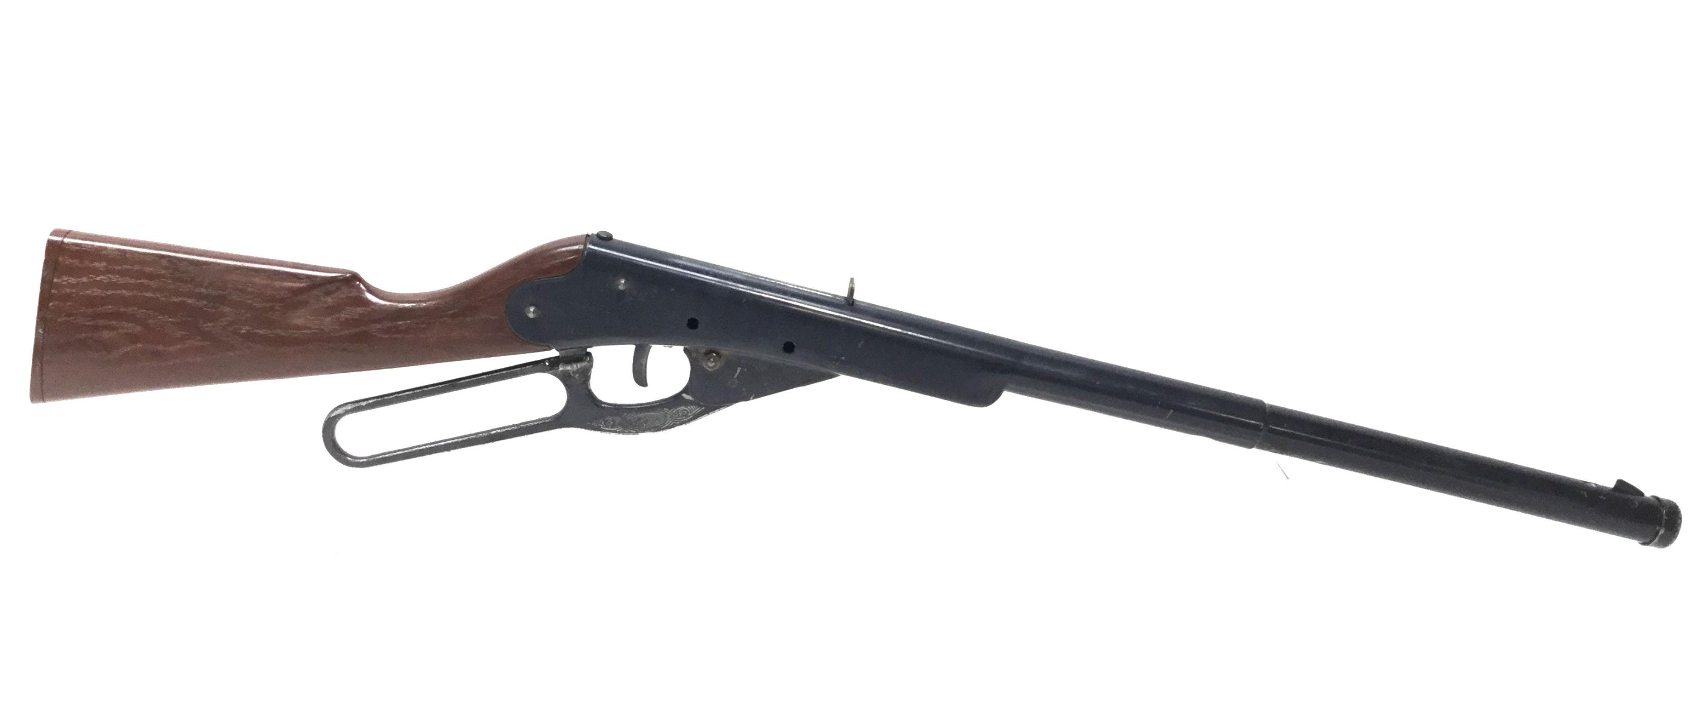
Your Youth Shooting!
Think back to the very first trigger you pulled?
If I ask you these questions which is the easiest to answer?
What was the gun?
What was your target?
What were the surroundings ( day, time, weather, location)?
Who helped you?
What stories do you tie around your first-time shooting
Welcome to your personal shooting heritage and the conservation of it.
Welcome to your very own R3 initiative you where (recruited, retained, reactivated)
Daisy 102 model 36

Slide 3
Youth Shooting! – High School
Where are we today?
The Good
based on youth shooting associations enrollment and shoot totals reporting , 125,000 competitive high school shooters
You can find a youth shooting event in almost every state, in almost any discipline, any weekend.
There is a good volunteer base for teams.
New teams are starting regularly (established teams are reaching out to help new teams get started).
Numerous Associations such as: usayess, sssf (sctp/sasp), usa clay target, boy scouts, ffa, 4h, ata/aim, nssa, nsca, usashooting, (lots of avenues to shoot)
The interest is growing for shooting sports at the collegiate level among high school competitors.
The Challenges
Politics
Ranges
Qualified coaches
Expenses /equipment, travel
Managing Expectation, parents/athletes, realistic opportunities
Us
RECRUIT-for the right fit for their education while continuing to compete in shooting sports

Slide 4
Collegiate Shooting
Where are we today?
The Good
A growing list of colleges +/- 137 with collegiate accounts currently as of April of 22’
4 yr. , 2 yr. , Tech, Trade, Military
Club teams / Funded teams (Coach Employed by institution, endorsed by Athletic department and or Administration, Financial aid for shooting sports awarded)
Several new Collegiate programs have started this year.
The Recruiting tool available to High School student athletes and families has shown to be a great aid in finding the right fit in education and continuing to compete in shooting sports.
It has helped the collegiate coaches gain a deeper reach of student athletes throughout the country without challenging their budgets. Also staying within all compliance rules and regulations for athletic recruiting.
Scholarships, we saw an average of $25,000 and largest for the 22’ class was $48,500.
Proud to announce the First of its kind Scholarship award program for Shooting Sports
MURRAY STATE COLLEGE “Winners Scholarship Award”
Entrusted to College Shooting Sports Recruiting with 20/ $10,000.00 scholarships for Student Athletes to attend Murray State College, In addition to the scholarships available, Murray State College is adding to their well-known Gun Smithing 2yr degree and will now be offered also as a 4yr Bachelor's degree, as well they are adding Range management , Ranch Management, Ranch Hospitality, Wildlife Management to their long list of academics within Murray State College.
The Challenges
Politics
Liability
Ranges
Qualified coaches
“1%’r” athlete mentality
Expenses /equipment
US
Retain- maintain contact with shooters throughout college education and competitions

Slide 5
Into The Industry
Where are we today?
The Good
NSSF CEO Joe Bartozzi was quoted in Aug 22’ “this is a $70 billion dollar industry, that currently employs 375,000 people”
Pre Covid the shooting industry had a daily impact on the economy of $46 million
Huge Applicant pool wanting to work within the industry from 4 yr. , 2 yr. , Tech, Trade, and Military institutions.
We have everything from factory- legal, medical-marketing, there isn’t one career path you can think of that we don’t employ somewhere within our industry
We have career assistance to help through Careers4Athletes.
We can now deliver real industry data of progressions from high school to college to working in the industry, to beginning coaching and mentoring
The Challenges
Politics
Creating reality of the opportunities.
Not everyone is a TV star
US
Reactivate- after college, student athlete find a career and they will become coaches, mentors, and donors

Slide 6
What are you doing? What are we doing together?
Earlier I asked, Who helped you with your first shot? Hopefully that moment gave you something greater than a memory, it gave you a passion. The passion has either stayed with you or it was rekindled, but that one small moment will never be lost. What are you going to do with it?
My personal beliefs, that many have heard me say
Making a Difference in people and this industry is bigger than making a dollar.
Do the right things for the Student Athlete, Institution, and the Industry.
We have an incredible shooting sports history, it’s now time to advance and move the needle
We will work with anyone, anytime with shared beliefs and ideas.
This is Conservation!
This is the FutureU , and Our Shooting Heritage
Thank you, MidwayUSA Foundation for always being a great friend and partner

