Slide 1
The Journey of an Olympic Gold Medalist
Will Shaner- Air Rifle 2020

Slide 3
Will Shaner
Daisy - Red Ryder
BB Gun

Slide 4
Strong Parent Support!

Slide 5
Local & National
Grassroot
Organizations

Slide 6
Celebrate
All The
Success!

Slide 7
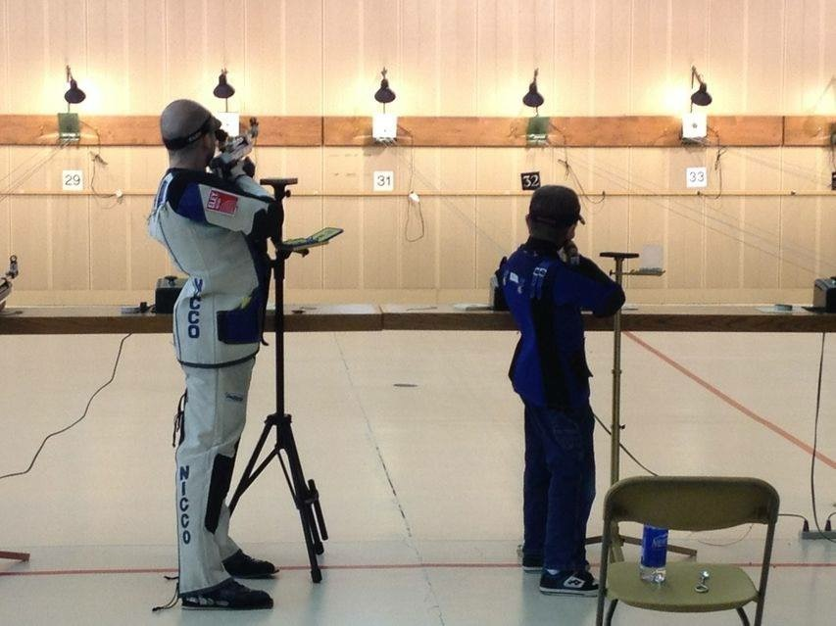
Our Sport Provides Opportunities
For Athletes Of All Levels!

Slide 8
Local Clubs
USA Shooting
Certified Training Centers
& Local Clubs

Slide 9
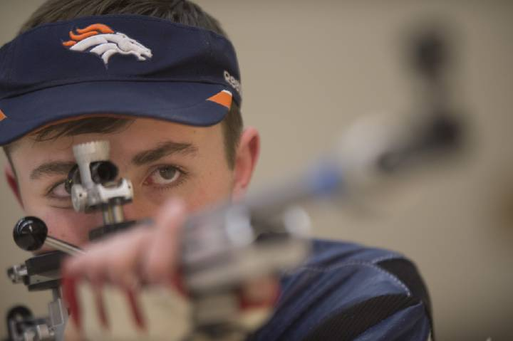
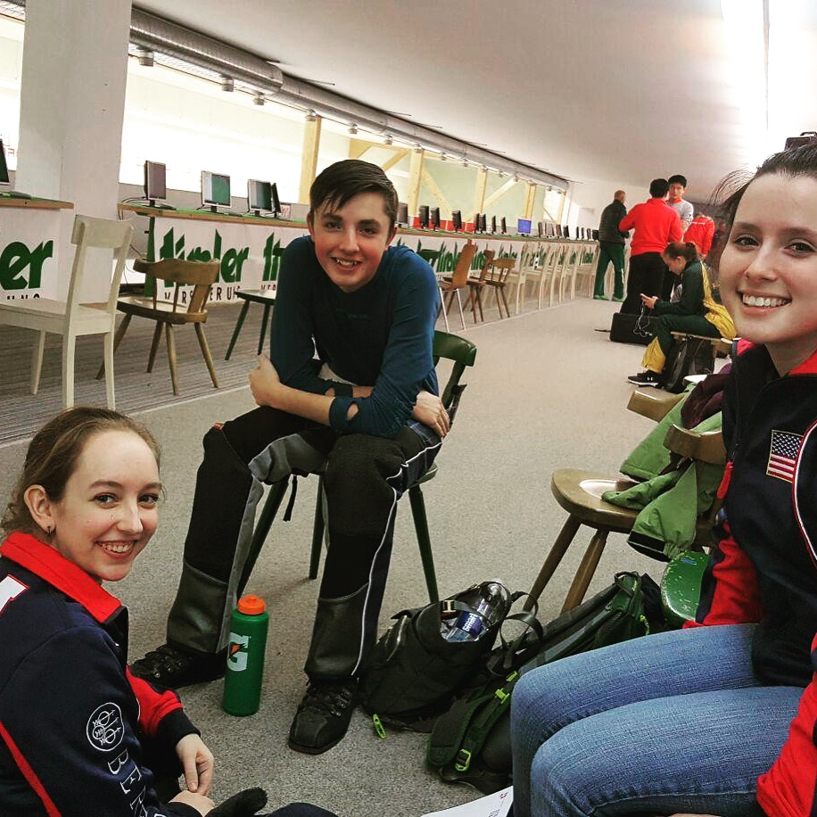
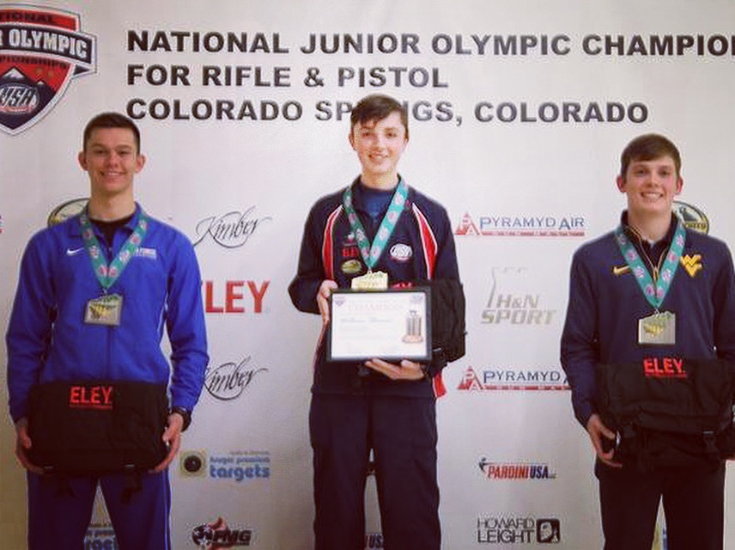
USA SHOOTING
State Junior Olympics
National Junior Olympics
National Matches

Slide 10
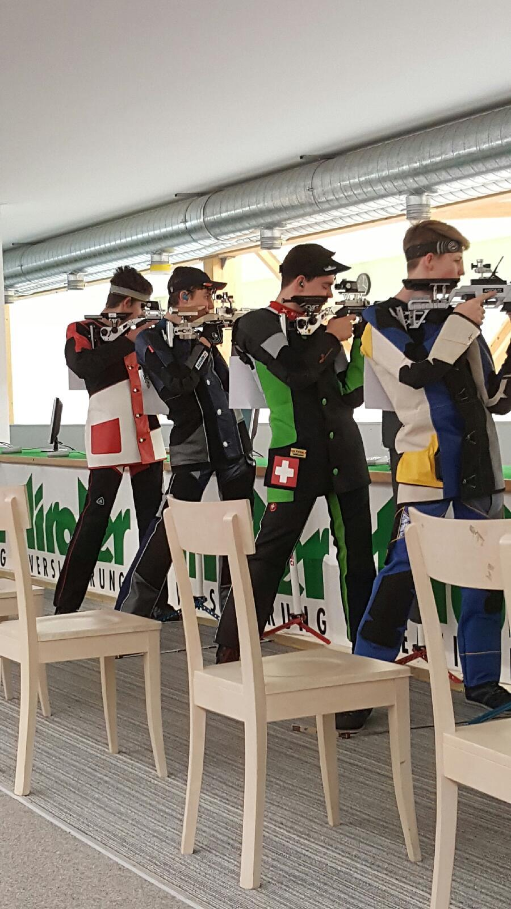
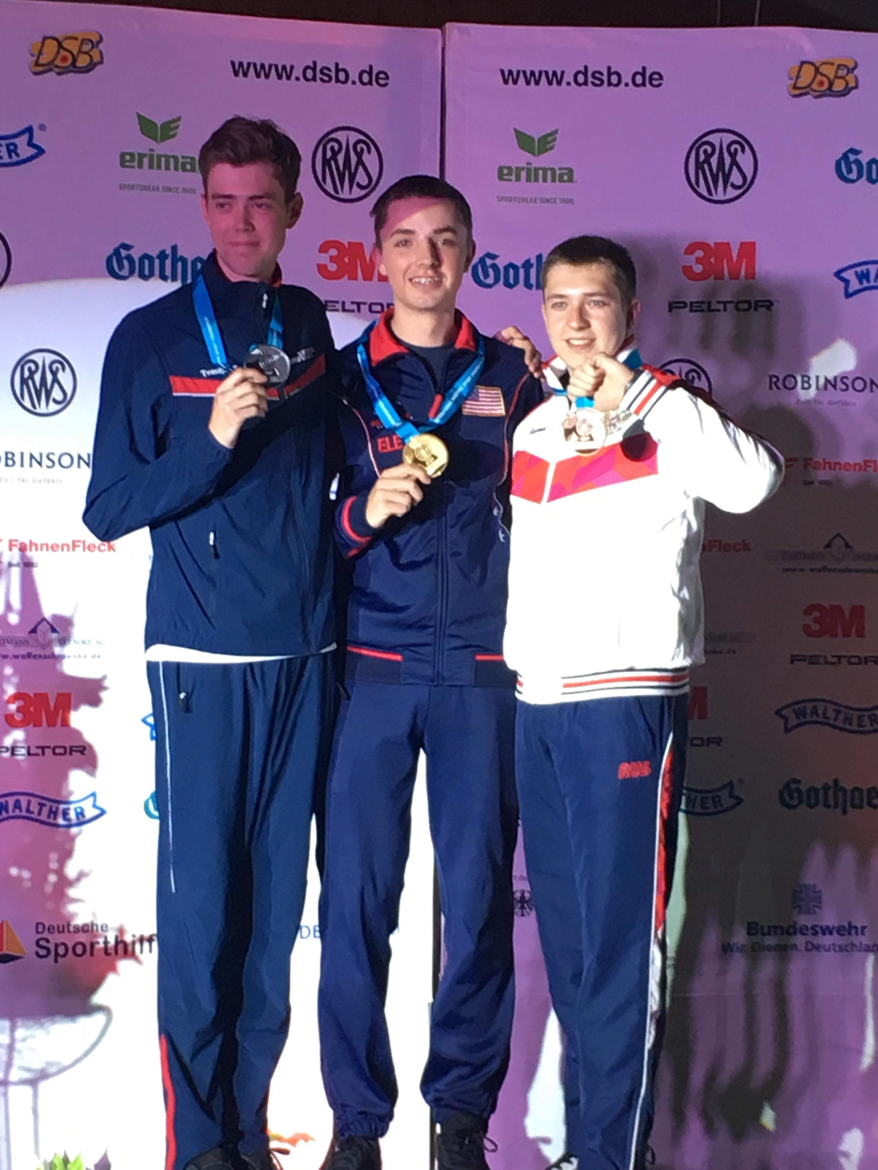
International Junior / Open
World Cups
World Championships

Slide 11
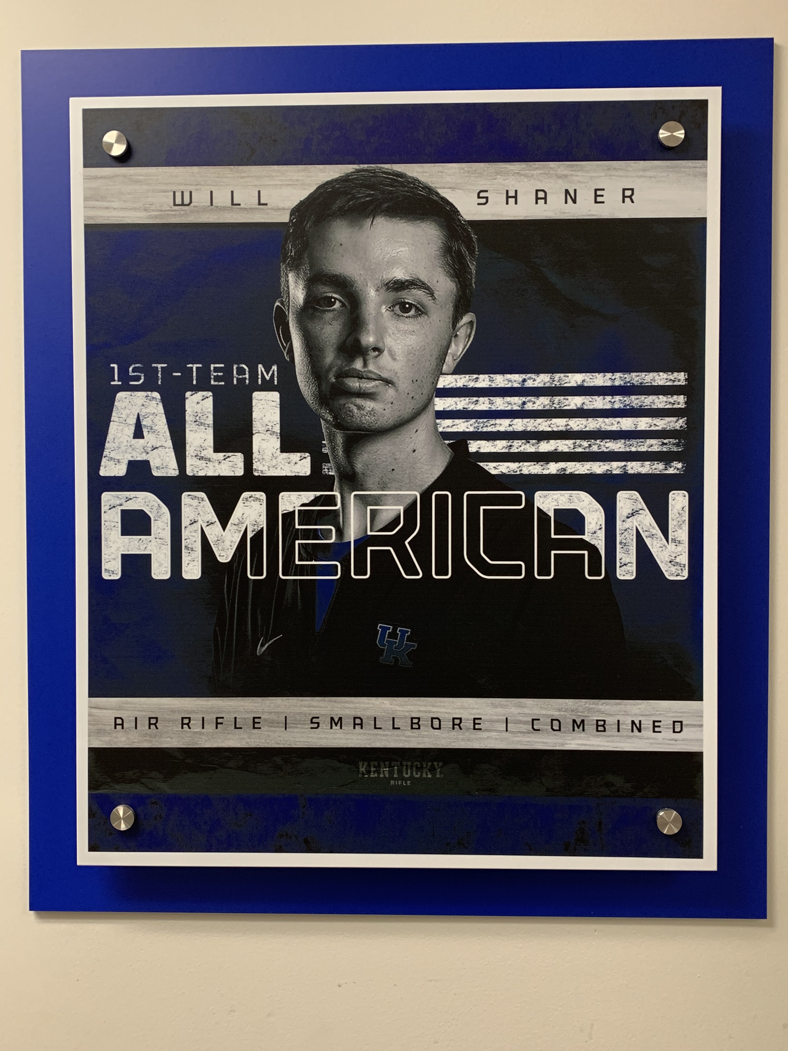
NCAA And Other Collegiate Shooting Programs

Slide 12
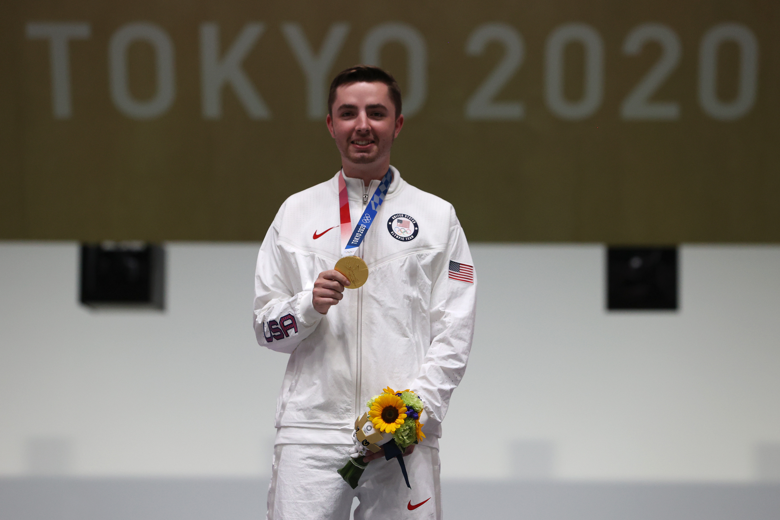
Olympic Gold Medalist

Slide 13
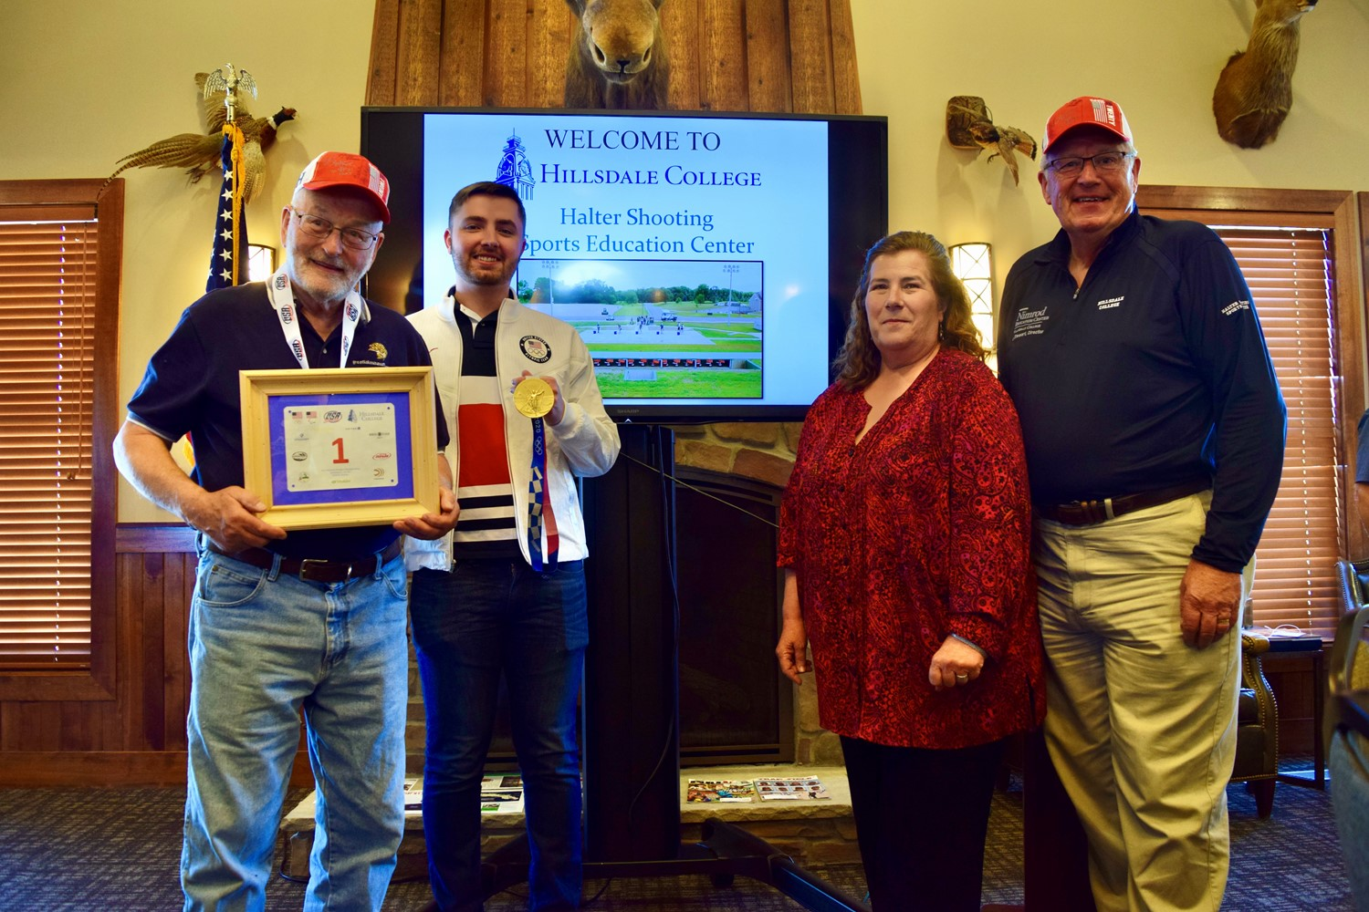
An Amazing Ambassador Of Our Sport!

Slide 15
THANK YOU Brent E. McPherson 719-651-3108 Cell Brent.mcpherson@usashooting.org

