Slide 1
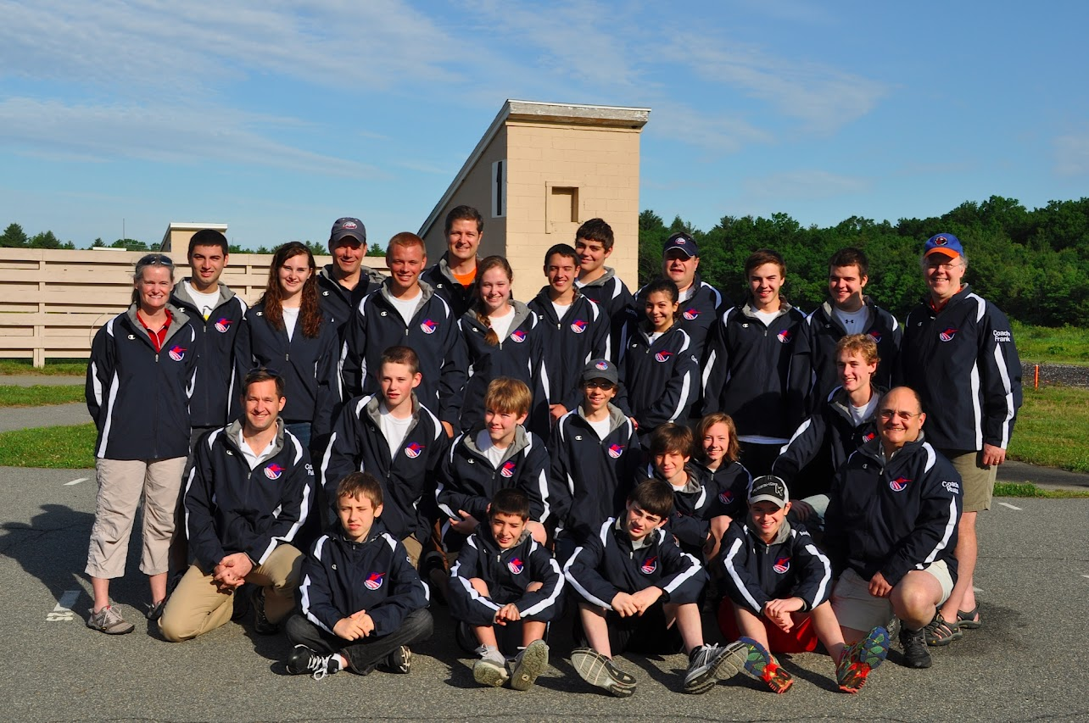
What are your Goals?

Slide 2
“Coaches want more information and knowledge to help their teams and athletes be more competitive”

Slide 3
Advanced Coach Topics
Troubleshooting athletes struggles - stance, mount, eyes, moves
Communicating to athletes in a positive manner
Drills and how to make practices much more effective to get results quickly
Gun fit issues
Executing an effective practice with many different athletes still levels

Slide 4
Advanced Coach Topics
Athlete goal setting and journaling
Planning shooting season down to a practice with season goals
Match preparation for team and athletes
Travel planning for team
High Performance training including visualization, sleep requirements and diet
How to handle athletes and parents on match day.

Slide 5
Advanced Coach Classes
WestPoint and Vermont classes conducted in 2022
2 day scheduled class plus
Friday observe practice
Saturday coach training and planning
Sunday team practice conducted with athletes with new tools
Scheduling for classes in 2023

Slide 6
Advanced Coach Class - WestPoint

