Slide 1
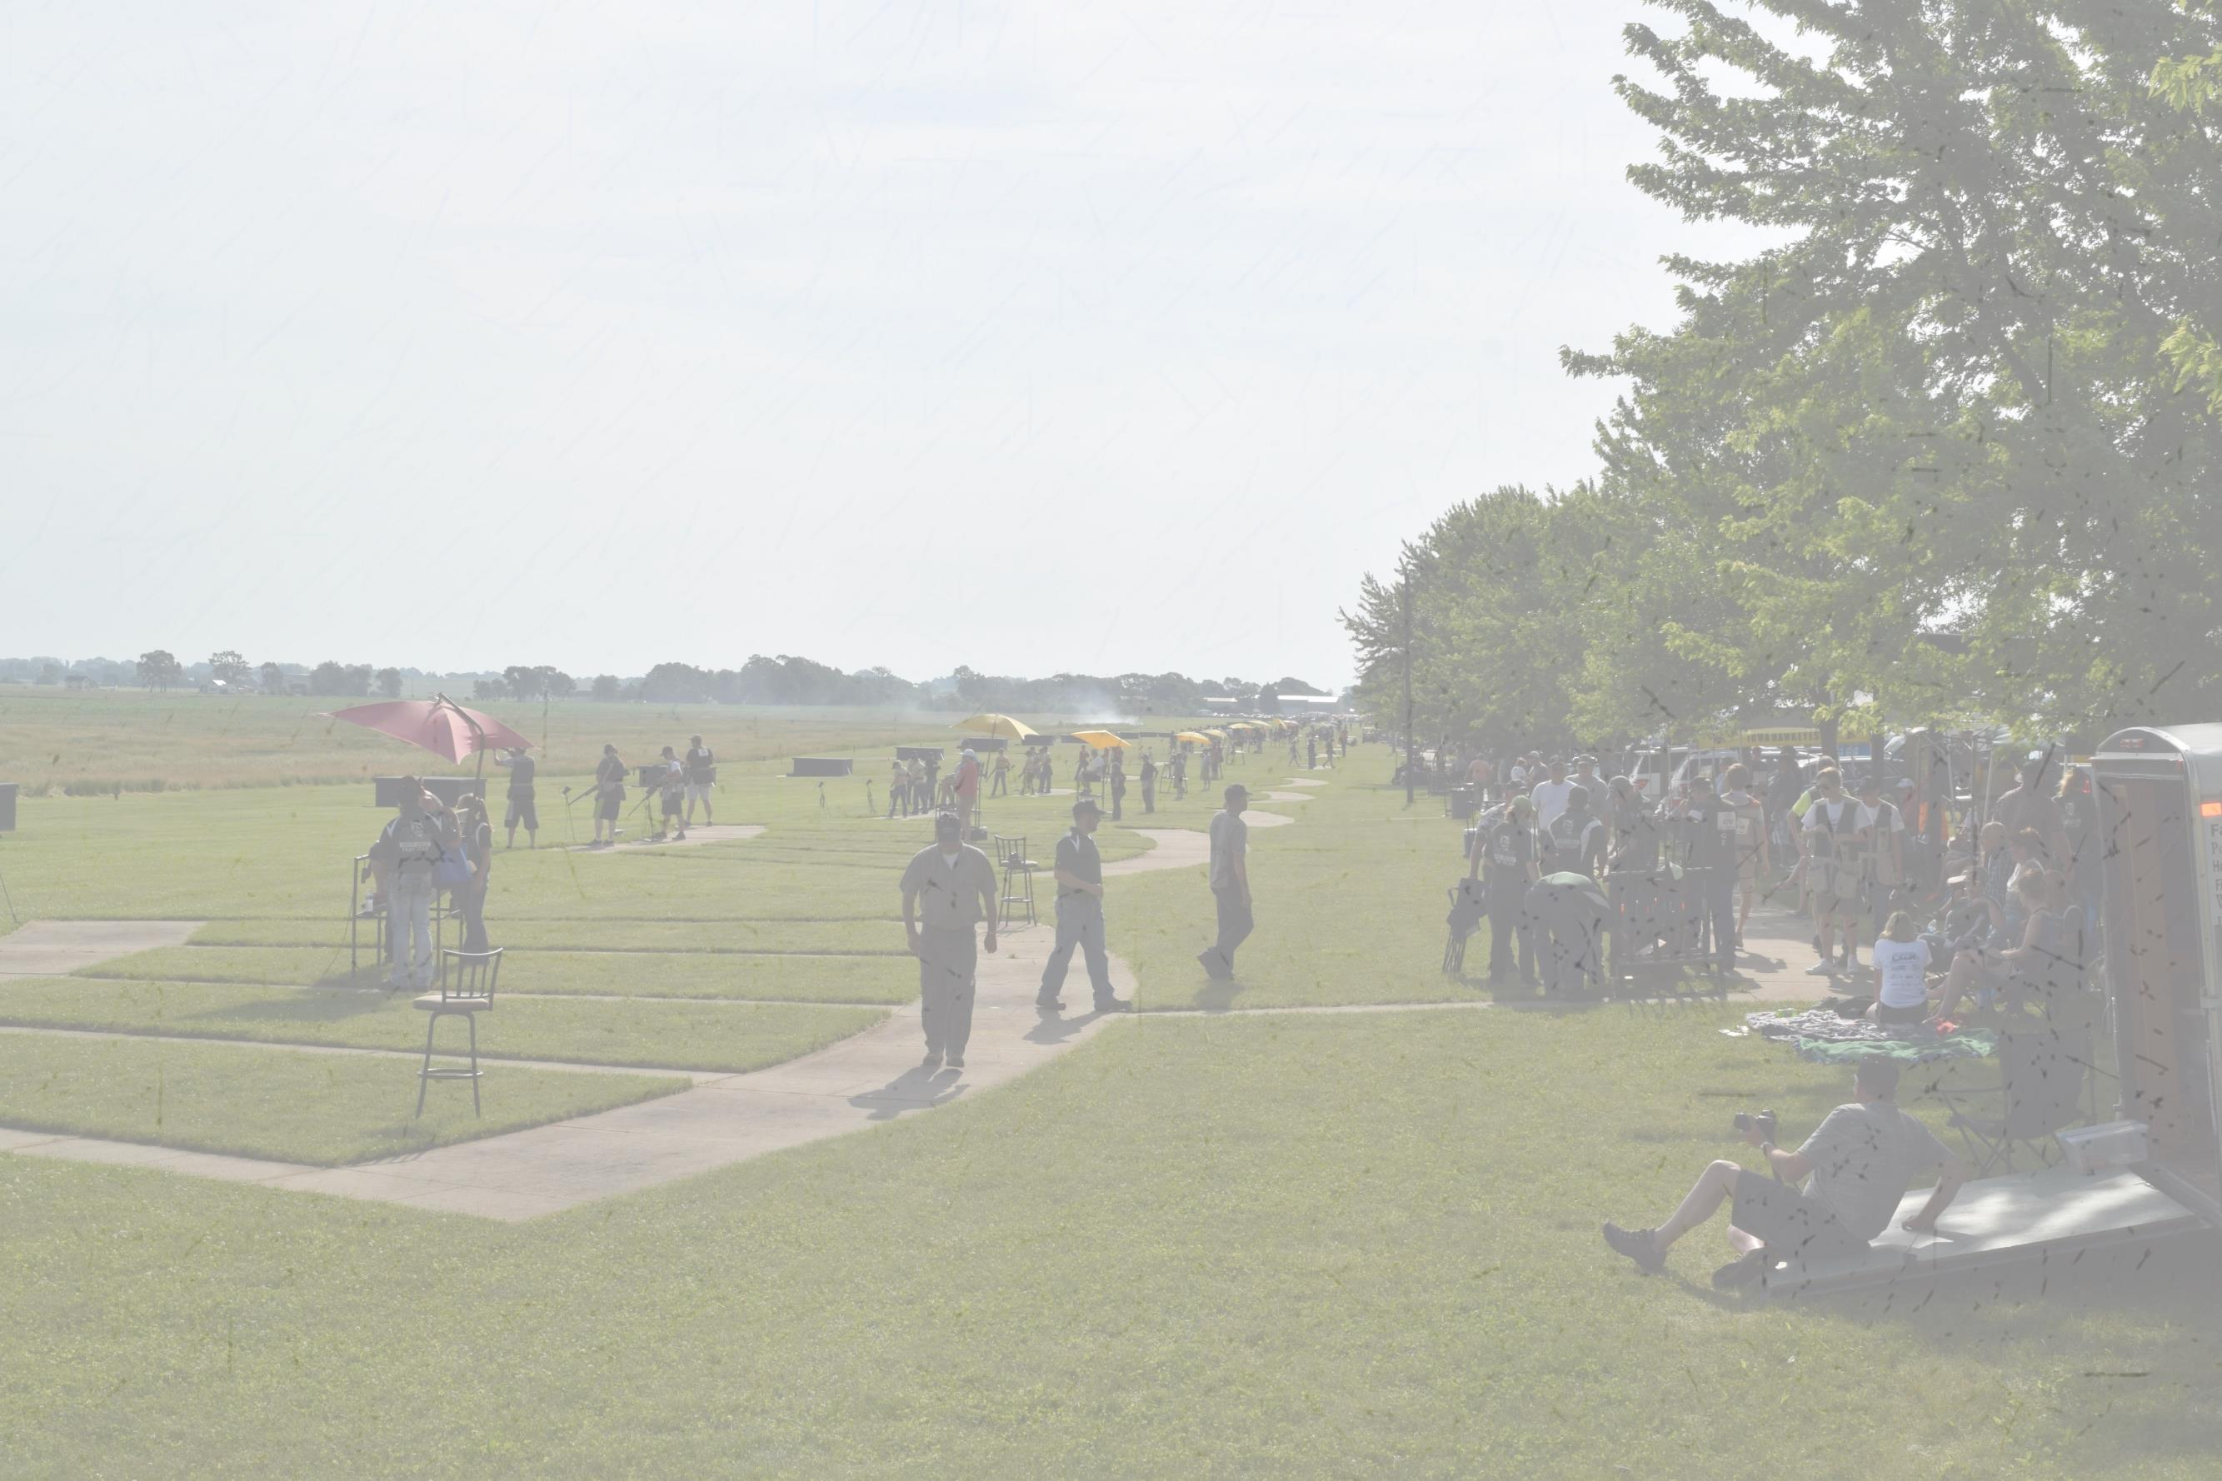
Iowa Department of Natural Resources Youth Shooting Sports Programs
Chris Van Gorp

Slide 2
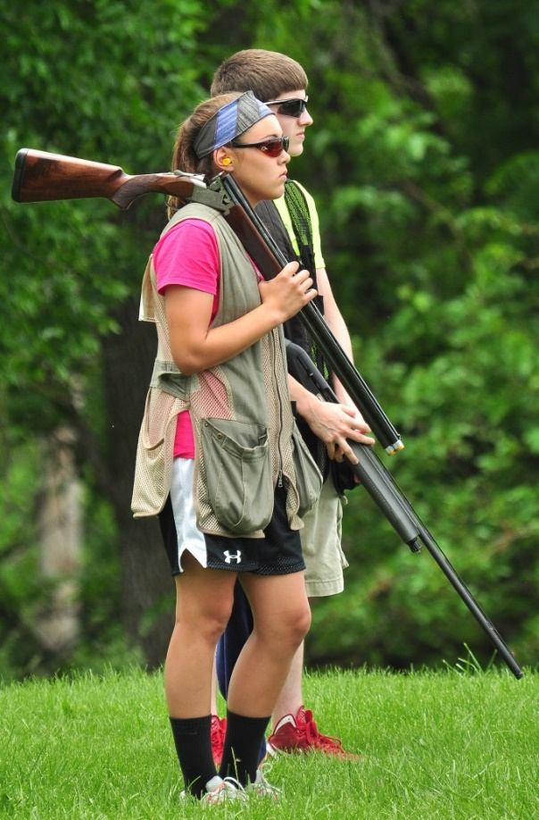
DNR and Shooting Sports
Supported Shooting Sports since 2006
Focus has been on Youth Programs
National Archery in the Schools Program
Scholastic Clay Target Program
Scholastic Action Shooting Program
In-school or school affiliated where possible

Slide 3
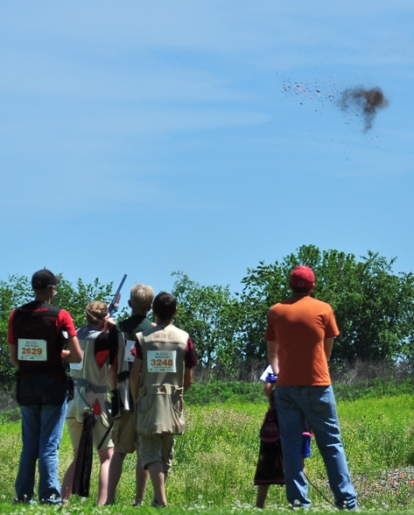
Why Are We Involved?
Nontraditional means of getting kids outside
Youth Development Programs
Generate PR funds
Creating future license buyers
Other Benefits
Unbiased 3rd Party Managing the Program
Positive PR for the Department, especially COs

Slide 4
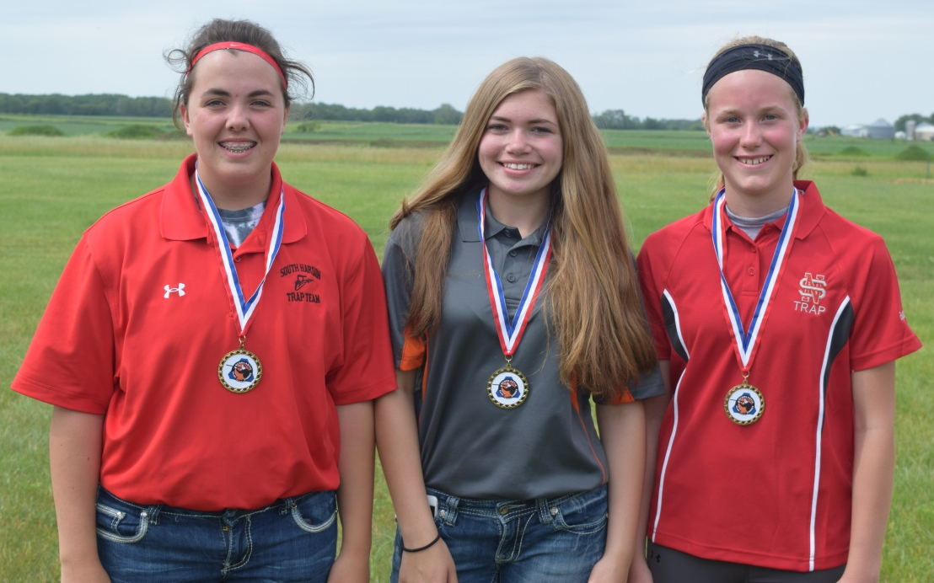
Youth Shooting Sports Benefits
Everyone can play
Engages the ‘unengaged’
Improves school attendance
Holds students to academic standards
Builds lifelong skills such as safety, teamwork, respect for self and others, mental focus, and self-discipline
Extremely safe

Slide 5
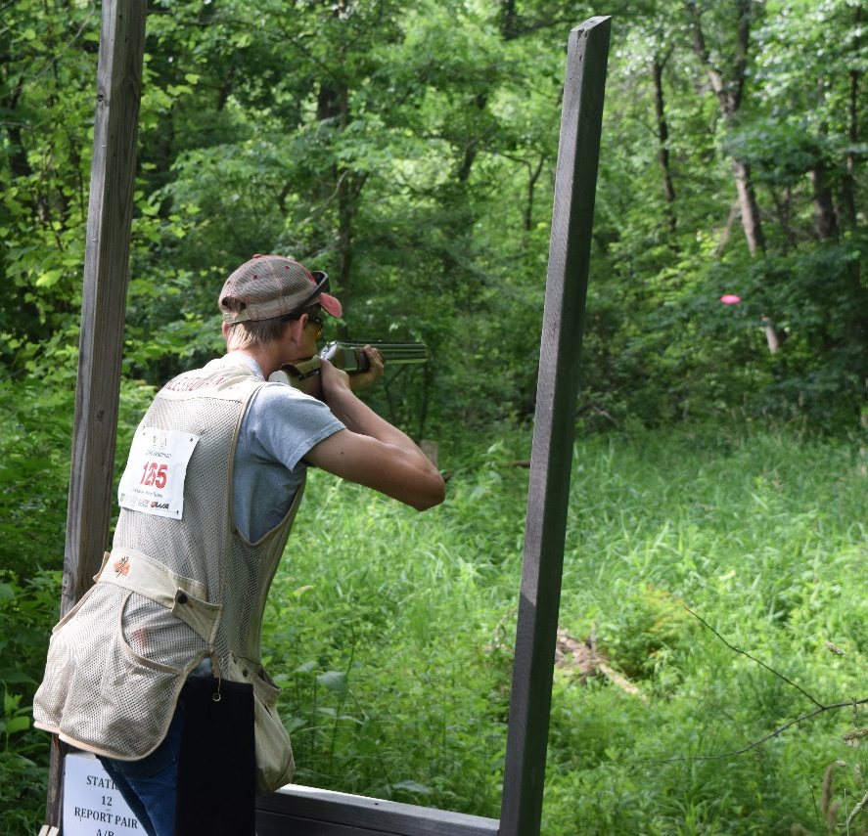
Scholastic Clay Target Program
Youth Trapshooting in Iowa began 25+ years ago
DNR involved since 2006
We serve as the State Advisor- administer the program in Iowa
Coach and athlete training
Manage Leagues
Championship Events
Resolving issues

Slide 6
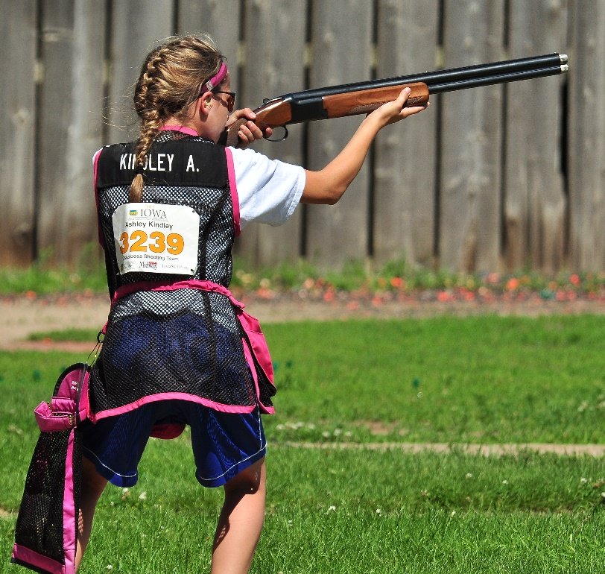
SCTP in Iowa
Athletes can participate from 4th grade – college
Over 140 teams
Nearly All Clay Target games
Participation
38% age 6-14
59% age 15-18
3% age 19-24
17% female

Slide 7
Participation/Growth

Slide 8
Iowa Competitions
Leagues
Run from September 1 – first part of June
State Championships
Mid May – End of June
National Championships

Slide 9
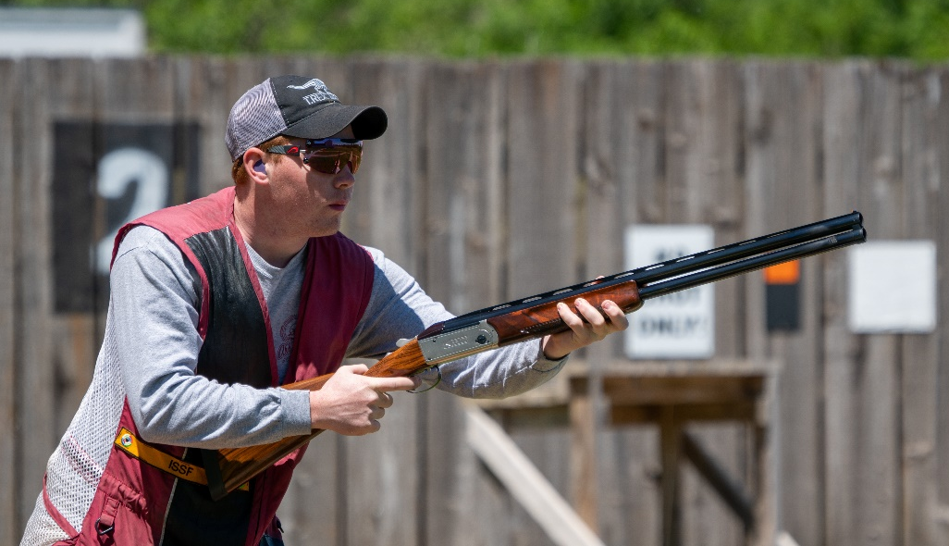
League Summary
Leagues in Trap, Doubles Trap, Handicap Trap, Skeet, Sporting Clays, 5-Stand
Compete in as many competitions as they want
Minimum # of scores for league awards

Slide 10
2022 League Events
League Summary
Singles Trap League – 442 events: 1,684,750 targets
Doubles League - 221 events: 209,450 targets
Handicap League – 193 events: 226,100 targets
Skeet League – 119 events: 129,000 targets
Sporting Clays League – 71 events: 145,150 targets
5 Stand League – 29 events: 31,750 targets
2,426,200 targets shot in league play!

Slide 11
State Championships
Collegiate Championships in November
International Skeet and Bunker in May
State Trap Championship
Singles, Doubles, and HCP, 4th grade – High School
Expanded from 3 days in 2015 to 6 days in 2022
Sporting Clays Championship
Skeet Championship

Slide 14
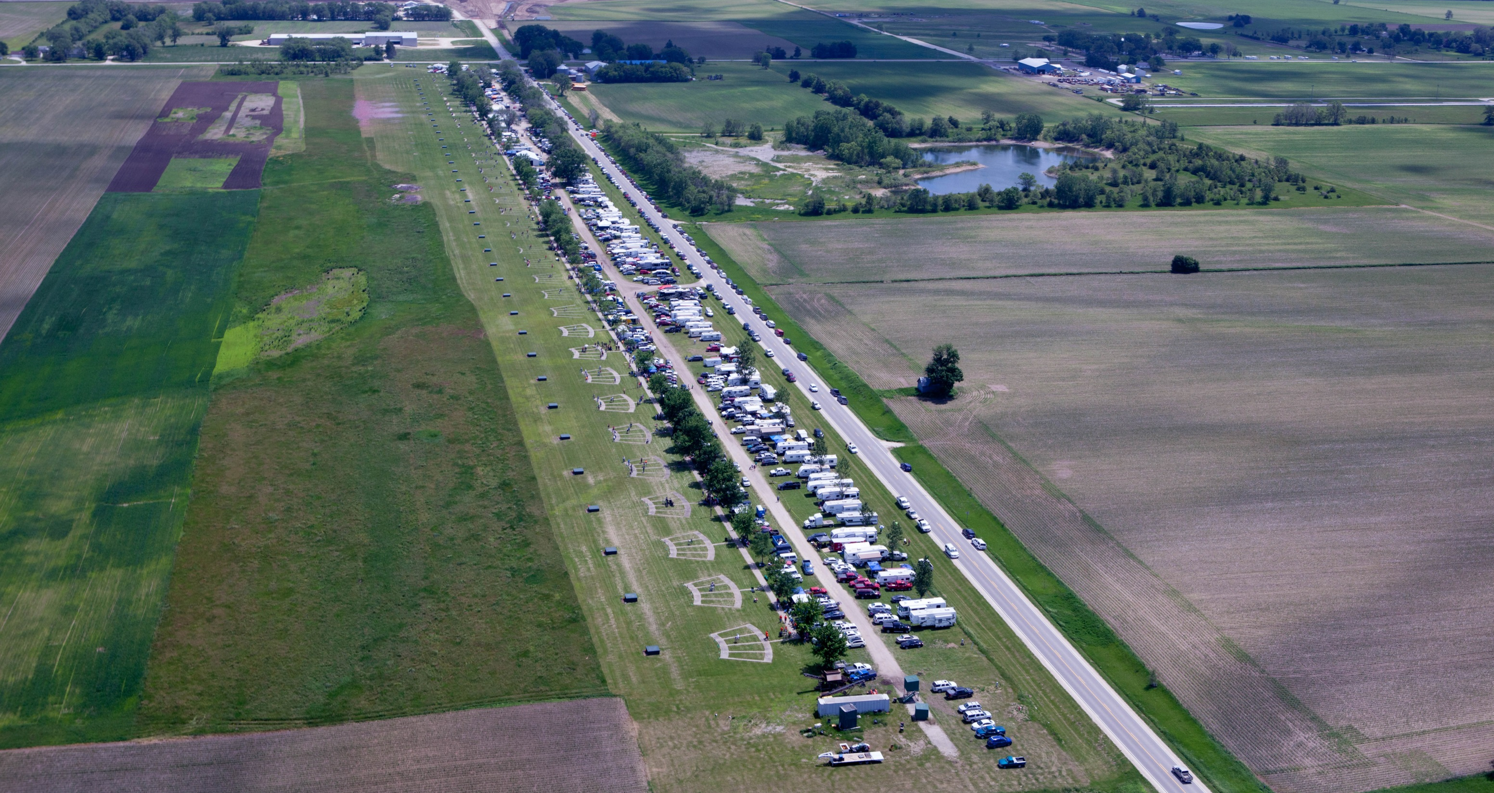

Slide 15
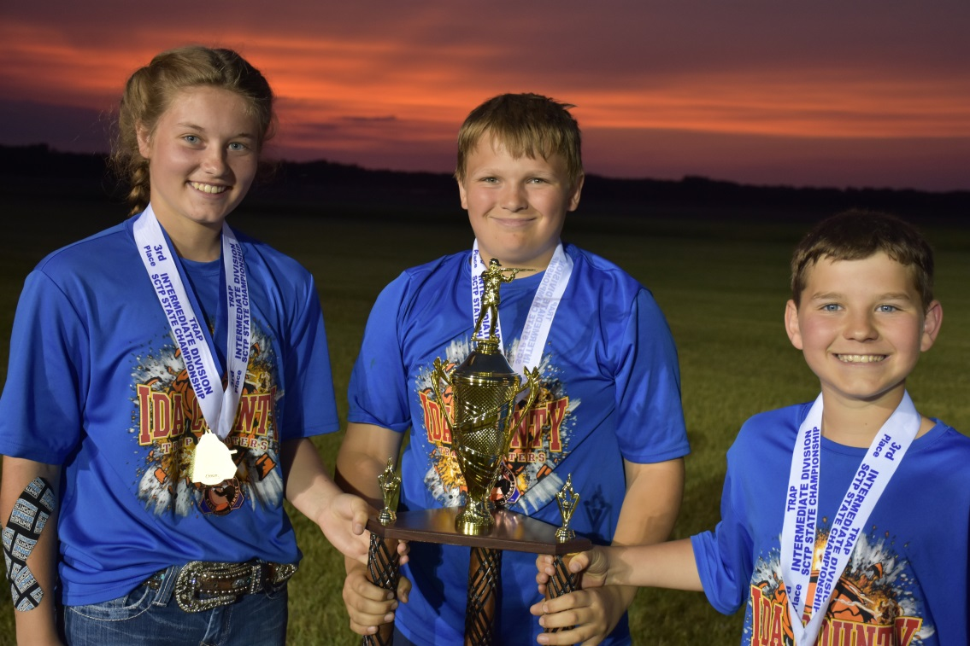
2022 Target Count
Iowa Leagues totaled 2,426,200 targets
State Competitions totaled 822,775 targets
Overall 3.25 million competition targets in 2022!

Slide 16
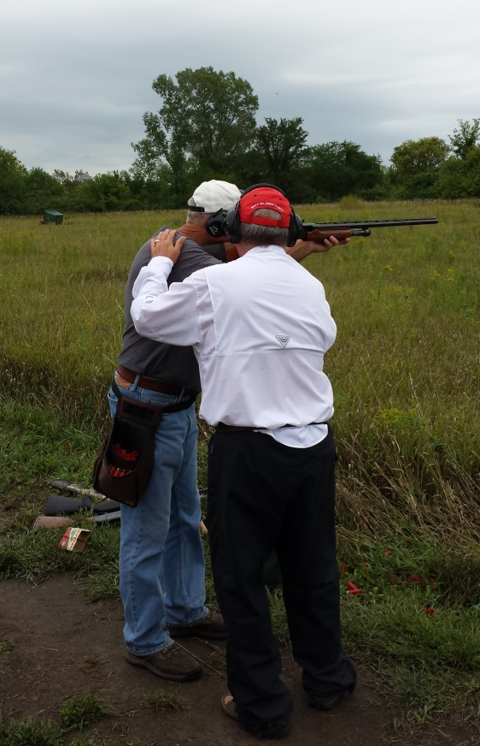
Iowa SCTP, Inc
Nonprofit Partner
State MidwayUSA Foundation Endowment Holder
Support Various Efforts
Coach Training
Awards
Annual Coach Meeting

Slide 17
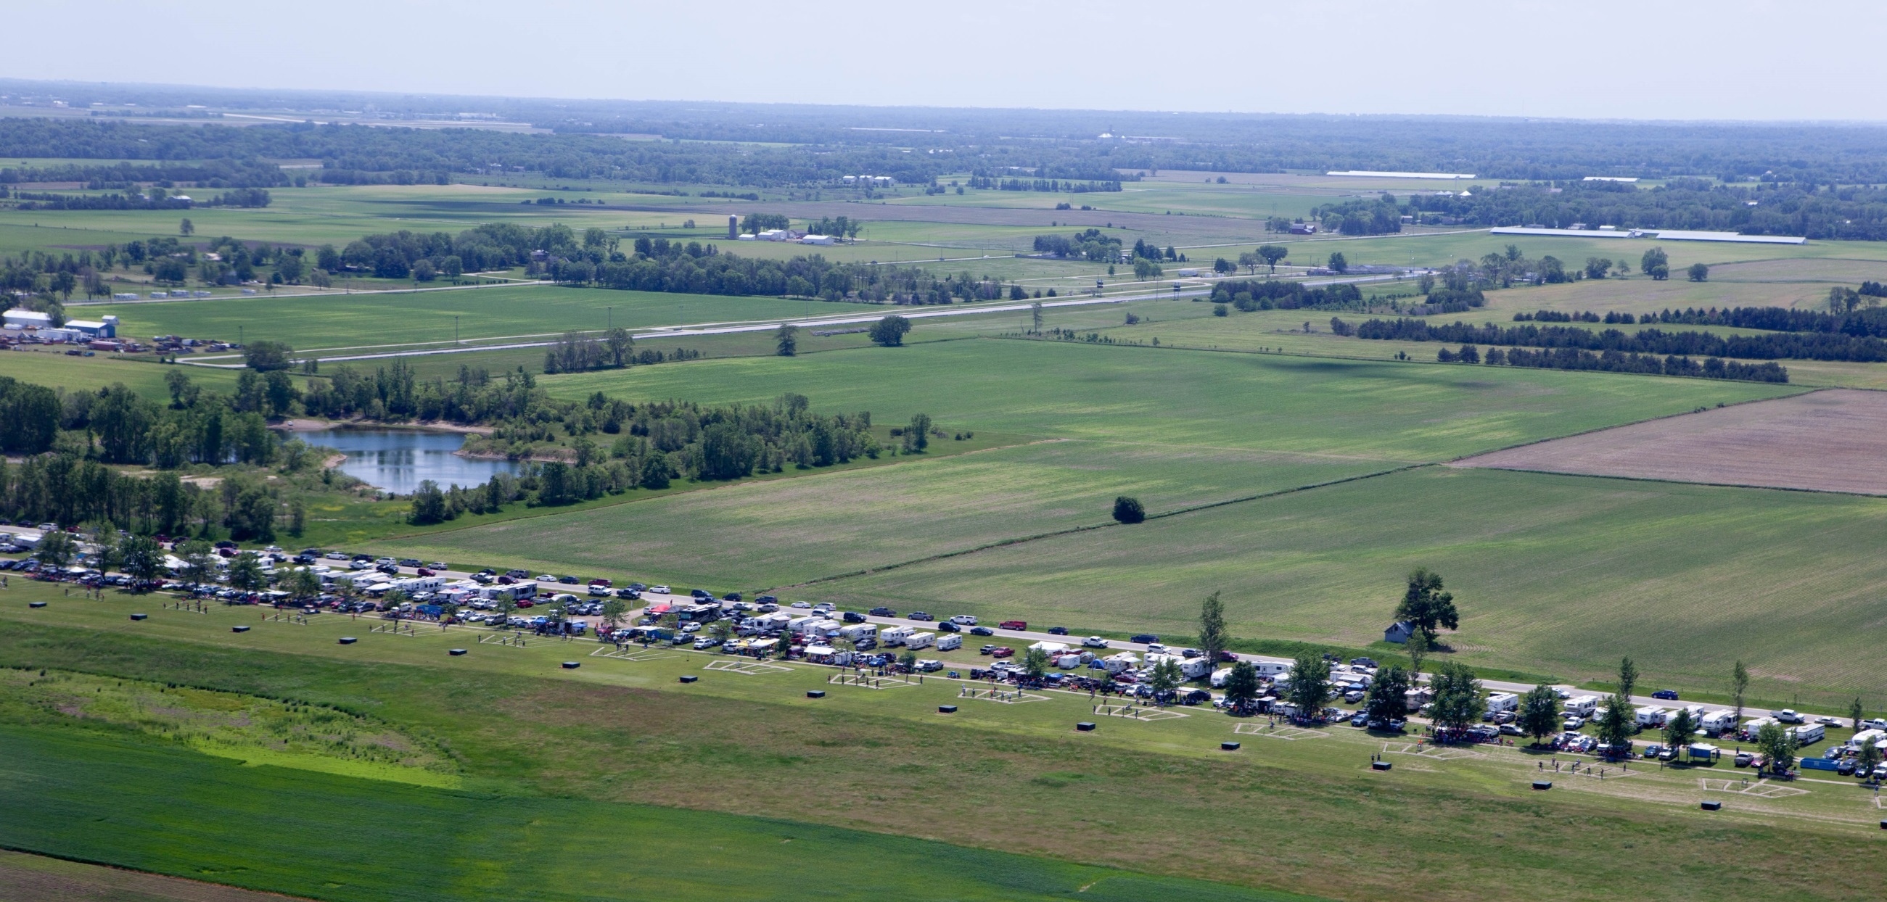
Questions?
Comments?
www.iowadnr.gov/sctp

