Slide 1
Connecting Youth Shooting Sports to Hunting
MidwayUSA Foundation National Youth Shooting Sports Conference
October 8, 2022

Slide 2
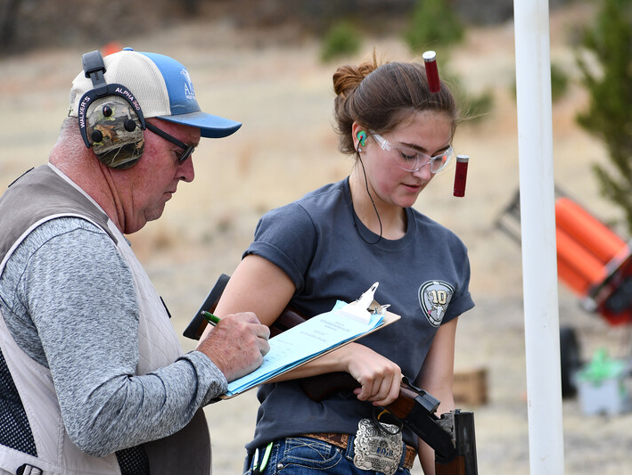
How are youth shooting sports and hunting connected?
A bit of an opinion piece
Money: Youth shooting sports and hunting/conservation are inextricably linked financially due to our natural resource funding model.
Mechanics: Youth shooting sports are commonly seen as the perfect gateway to hunting due to their inherent mechanical head start. Is this a viable link?
Movement: Should we promote movement in our philosophy and typical leanings toward think of youth shooting sports as a ripe hunting audience or should they stand on their own importance?

Slide 3
Money
Overall contributions of target shooting (2020)
Almost a $40 billion economic impact
Hunting has about a $110 billion economic impact

Slide 4
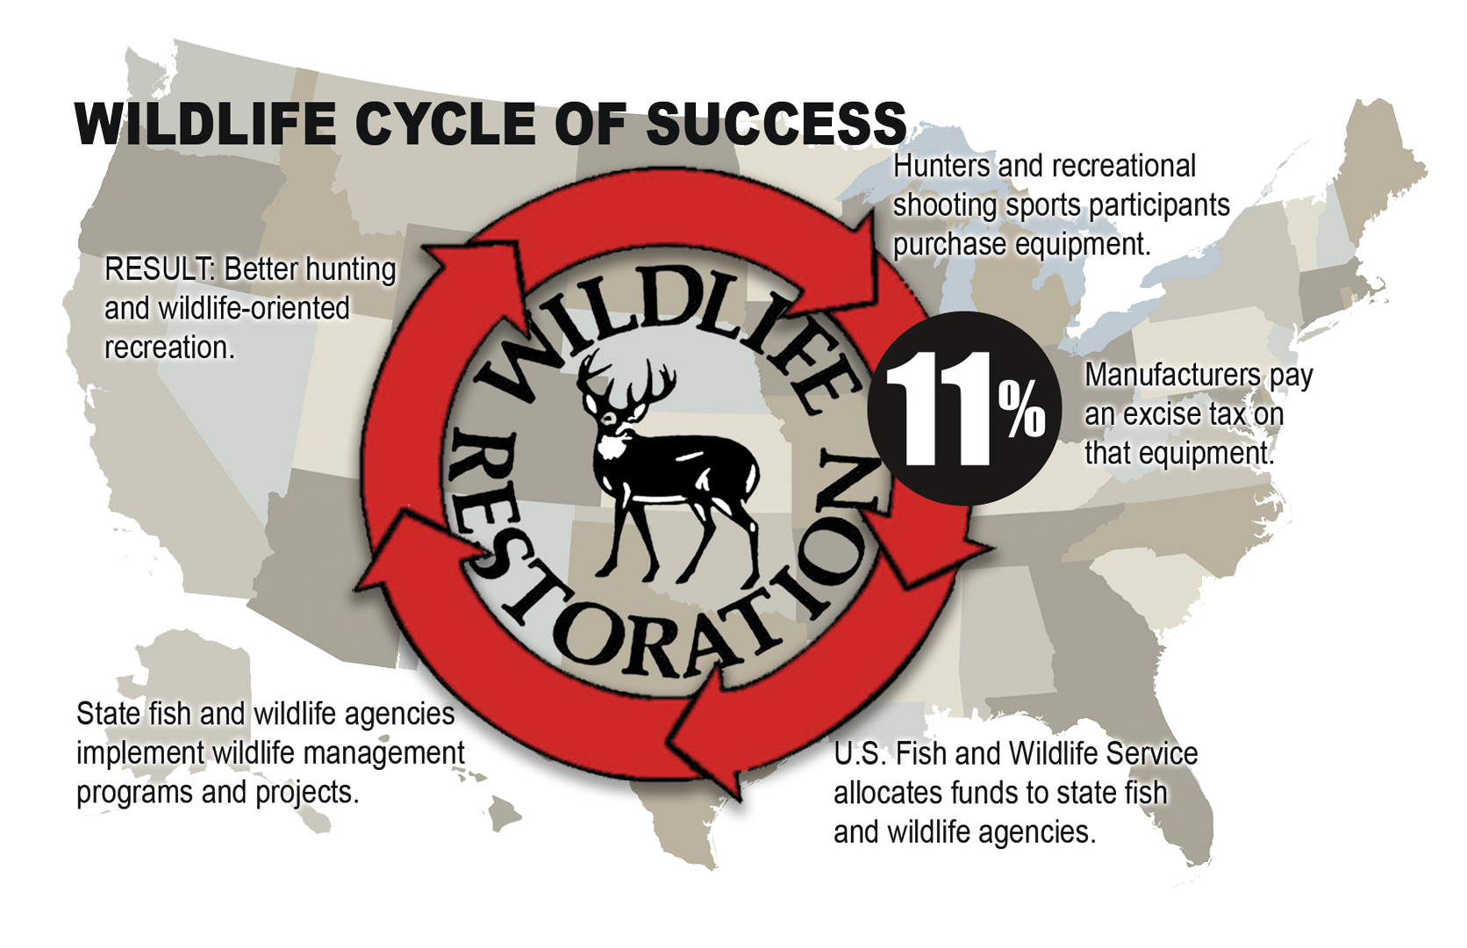
Money
Contributions to conservation
Pittman-Robertson Act

Slide 5
Money
Contributions to conservation
Overall
More than $15 billion
500 species of wildlife monitored, researched, and managed
800+ ranges supported
Past three years
37 laboratories funded
85 grants for wildlife diseases
2 million hunter education students
Annually
$1.1 billion in funding
partnerwithapayer.org

Slide 6
Money
Contributions to conservation
Return on Investment (ROI)
Estimated the ROI of excise tax to the industry
Case studies:
OK Lexington WMA Range: 358%
SD Walk-In Area Program: 165%
ID Black Creek Range: 62%

Slide 7
Money
Contributions to conservation
Taxable firearm and ammunition sales (2020)
25.8% intended for hunting
74.2% non-hunting purposes

Slide 8
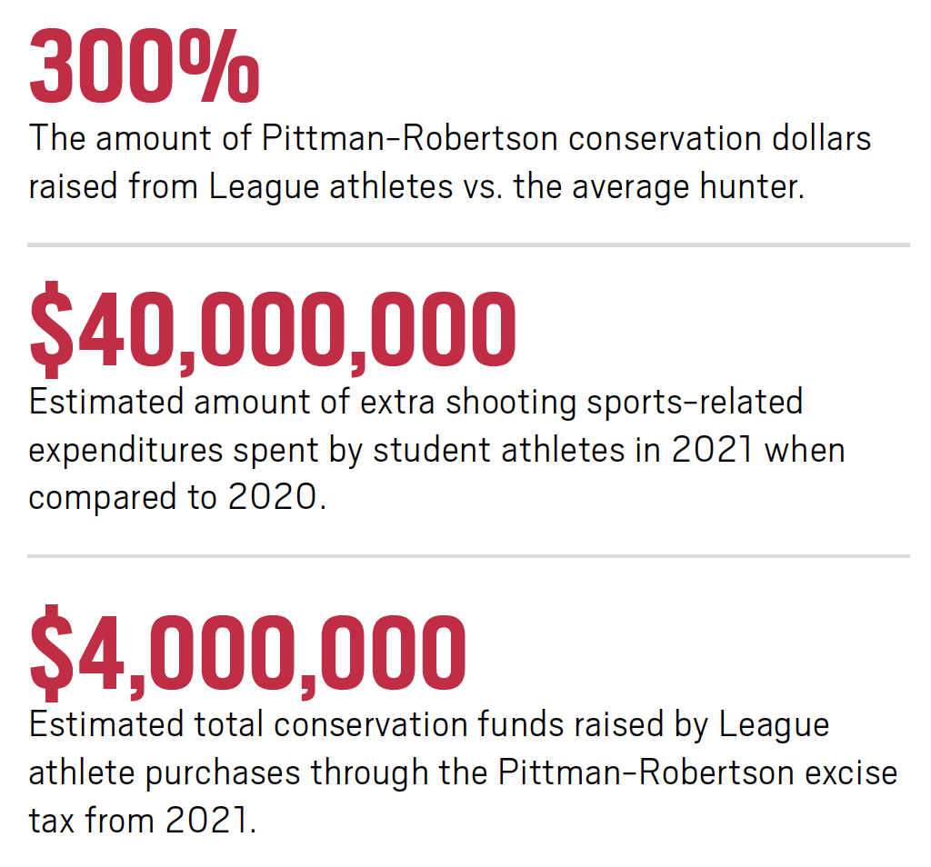
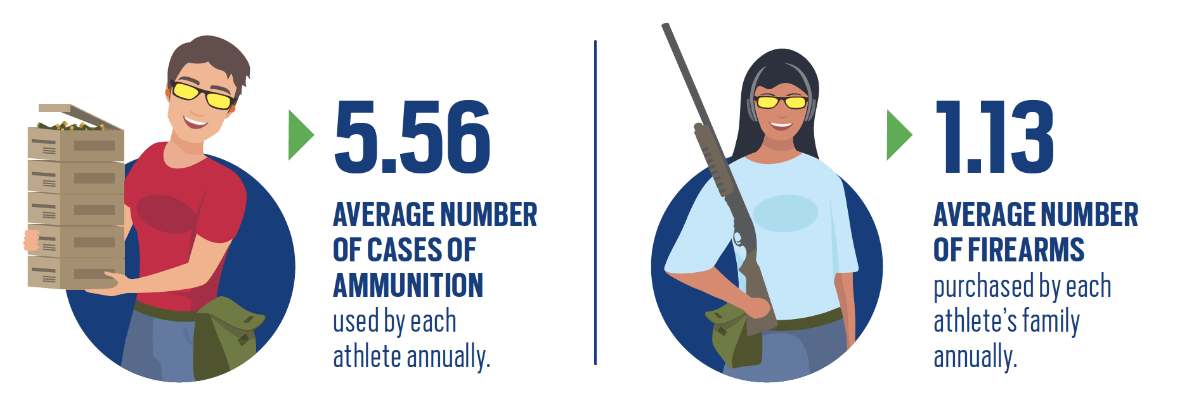
Money
Contributions to conservation
Example: USA Clay Target League
Substantial contributors to wildlife conservation

Slide 9
How are youth shooting sports and hunting connected?
Money
Large impact on overall economy
One of he main drivers behind conservation funding
Youth leagues are likely a key component

Slide 10
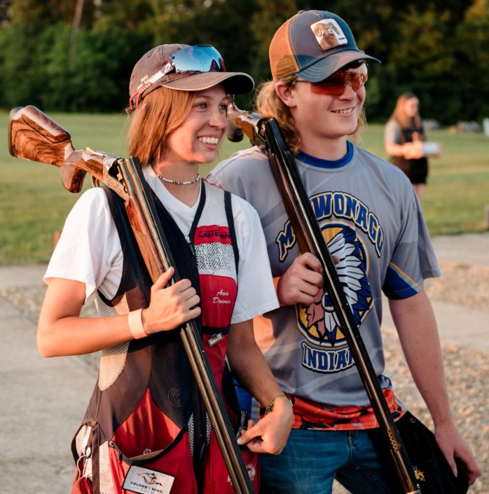
Mechanics
Youth shooting sports as a gateway to hunting
Natural resources agencies and nonprofits have frequently viewed youth shooters as potential hunters:
Have guns
Have a piece of the skillset
Are in a contained cohort
Credit: SSSF

Slide 11
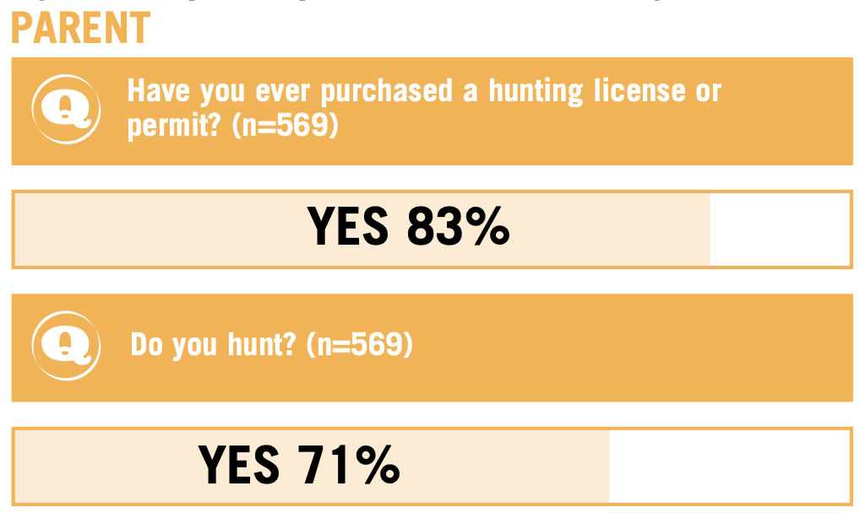
Mechanics
How many youth shooters hunt?
SSCTP/SASP
83% of parents had purchased a hunting license
71% of parents actively hunt

Slide 12
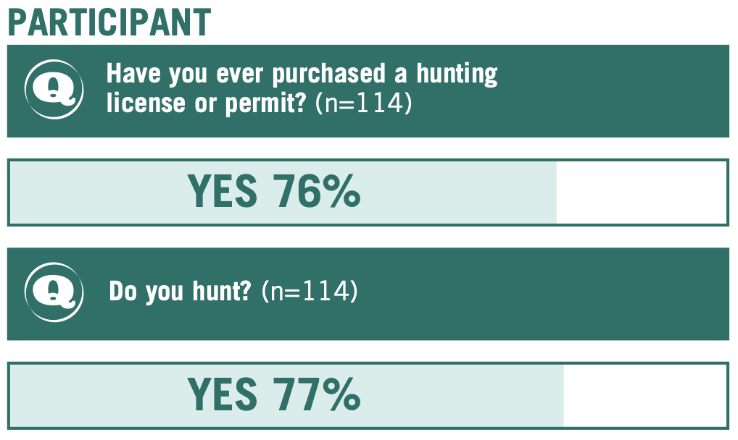
Mechanics
How many youth shooters hunt?
SSCTP/SASP
76% of student athletes have purchased a hunting license
77% of student athletes actively participate in hunting

Slide 13
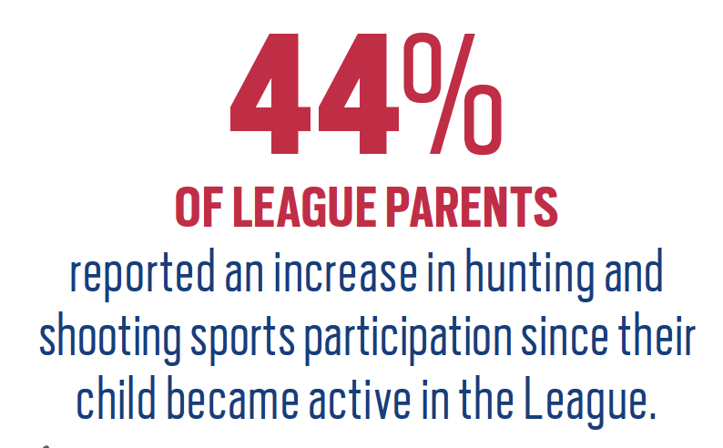
Mechanics
How many youth shooters hunt?
USA Clay Target League
76% of student athletes purchased a hunting license in the past two years
44% of league parents reported an increase in hunting and shooting sports

Slide 14
How are youth shooting sports and hunting connected?
Money
Large impact on overall economy
One of he main drivers behind conservation funding
Youth leagues are likely a key component
Mechanics
Equipment, skillset, and contained in a cohort
Large percentage already hunt
Surrounded by other hunters

Slide 15
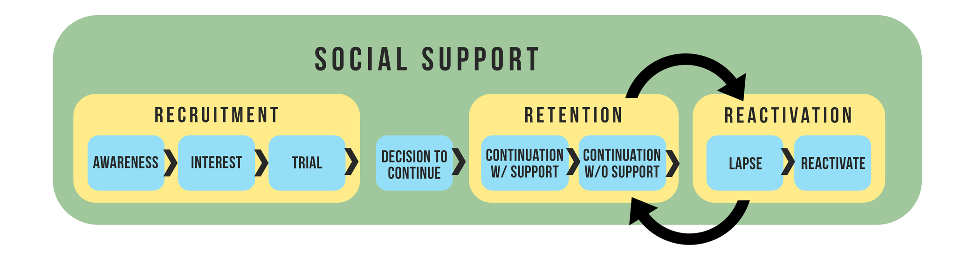
Movement
Are youth shooting sports a ripe audience for hunter R3?

Slide 16
Movement
Are youth shooting sports a ripe audience for hunter R3?
vs.
Image Credit: Southwick Associates

Slide 17
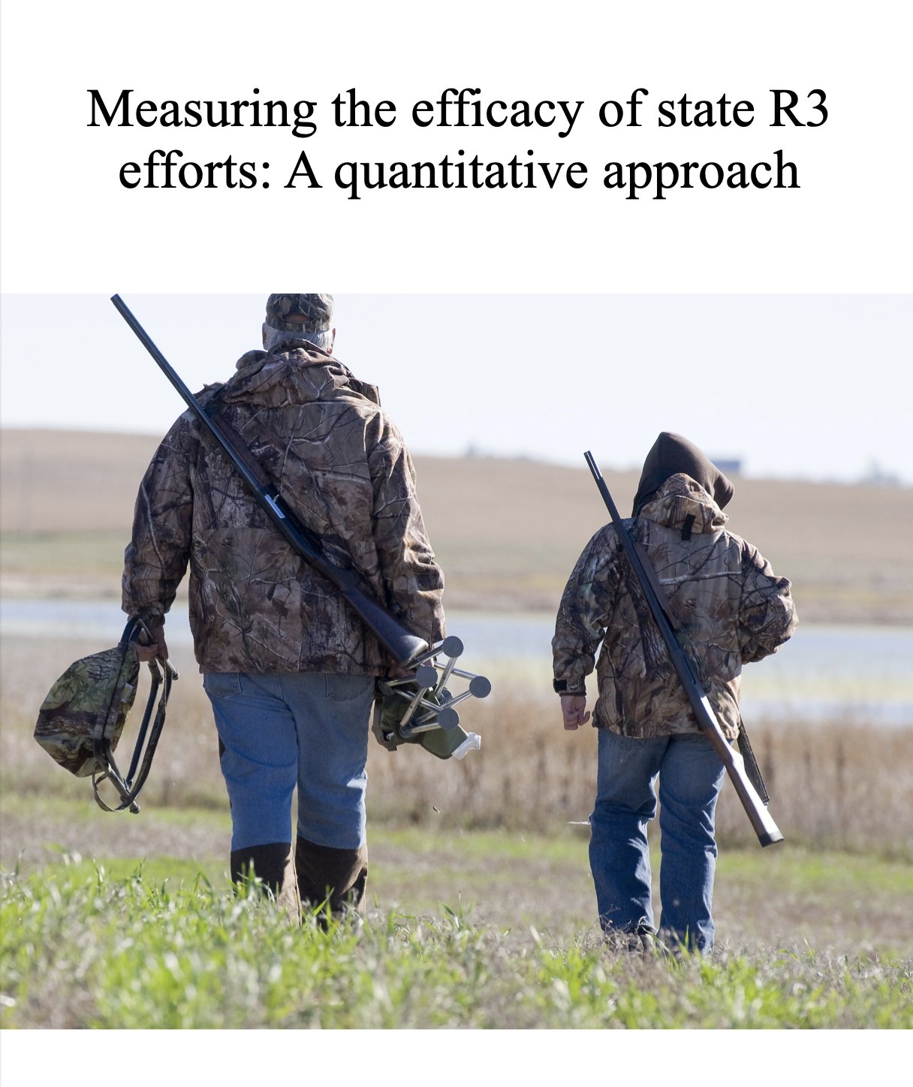
Movement
Are youth shooting sports a ripe audience for hunter R3?
Examined 60,000 R3 event attendees in hunting and angling
Investigated license purchasing behavior after events
Major finding:
“The greatest lift in participation and engagement was for adults aged 25 – 50, the least lift was for youth under the age of 18.”

Slide 18
How are youth shooting sports and hunting connected?
Money
Large impact on overall economy
One of he main drivers behind conservation funding
Youth leagues are likely a key component
Mechanics
Equipment, skillset, and contained in a cohort
Large percentage already hunt
Surrounded by other hunters
Movement
Youth shooting sports should stand on their own merits

Slide 20
cahss.org
Swanny Evans
Director of Research
And Partnerships
swanny@cahss.org

