Slide 1
SSSF SCHOLARSHIPS
Will pass 1 Million Dollars in 2023

Slide 2
Scholarships
Lastly, could we replace the pistol with a Glock (a pistol manufacturer). I'm attaching a picture (glock.jpg) I think if you just flip the image it should be fine. Glock is a founding partner of the Scholastic Action Shooting Program so we'd like to highlight their gun, plus we have the right to use their logo and gun images so we have no issues with copyright.
The Scholastic Shooting Sports Foundation (SSSF), offers a scholarship program to reward deserving, graduating seniors in the Scholastic Clay Target Program (SCTP) and Scholastic Action Shooting Program (SASP) with needed college assistance. The main objective is to award as many scholarships as possible to qualifying SCTP / SASP graduating seniors.
Since 2013, the SSSF has awarded over $927,000 in scholarship funds benefiting over 950 student athletes, from nearly all 50 states in the Scholastic Clay Target and Scholastic Action Shooting Programs.

Slide 3
Partnerships
Historically last several years giving around $100,000.00 a year.
In 2023 with our new SCTP partnership with ACUI, we will see that bumped up to a little over $160,000.00.
We also plan on that going up each year after.

Slide 4
International 2022

Slide 5
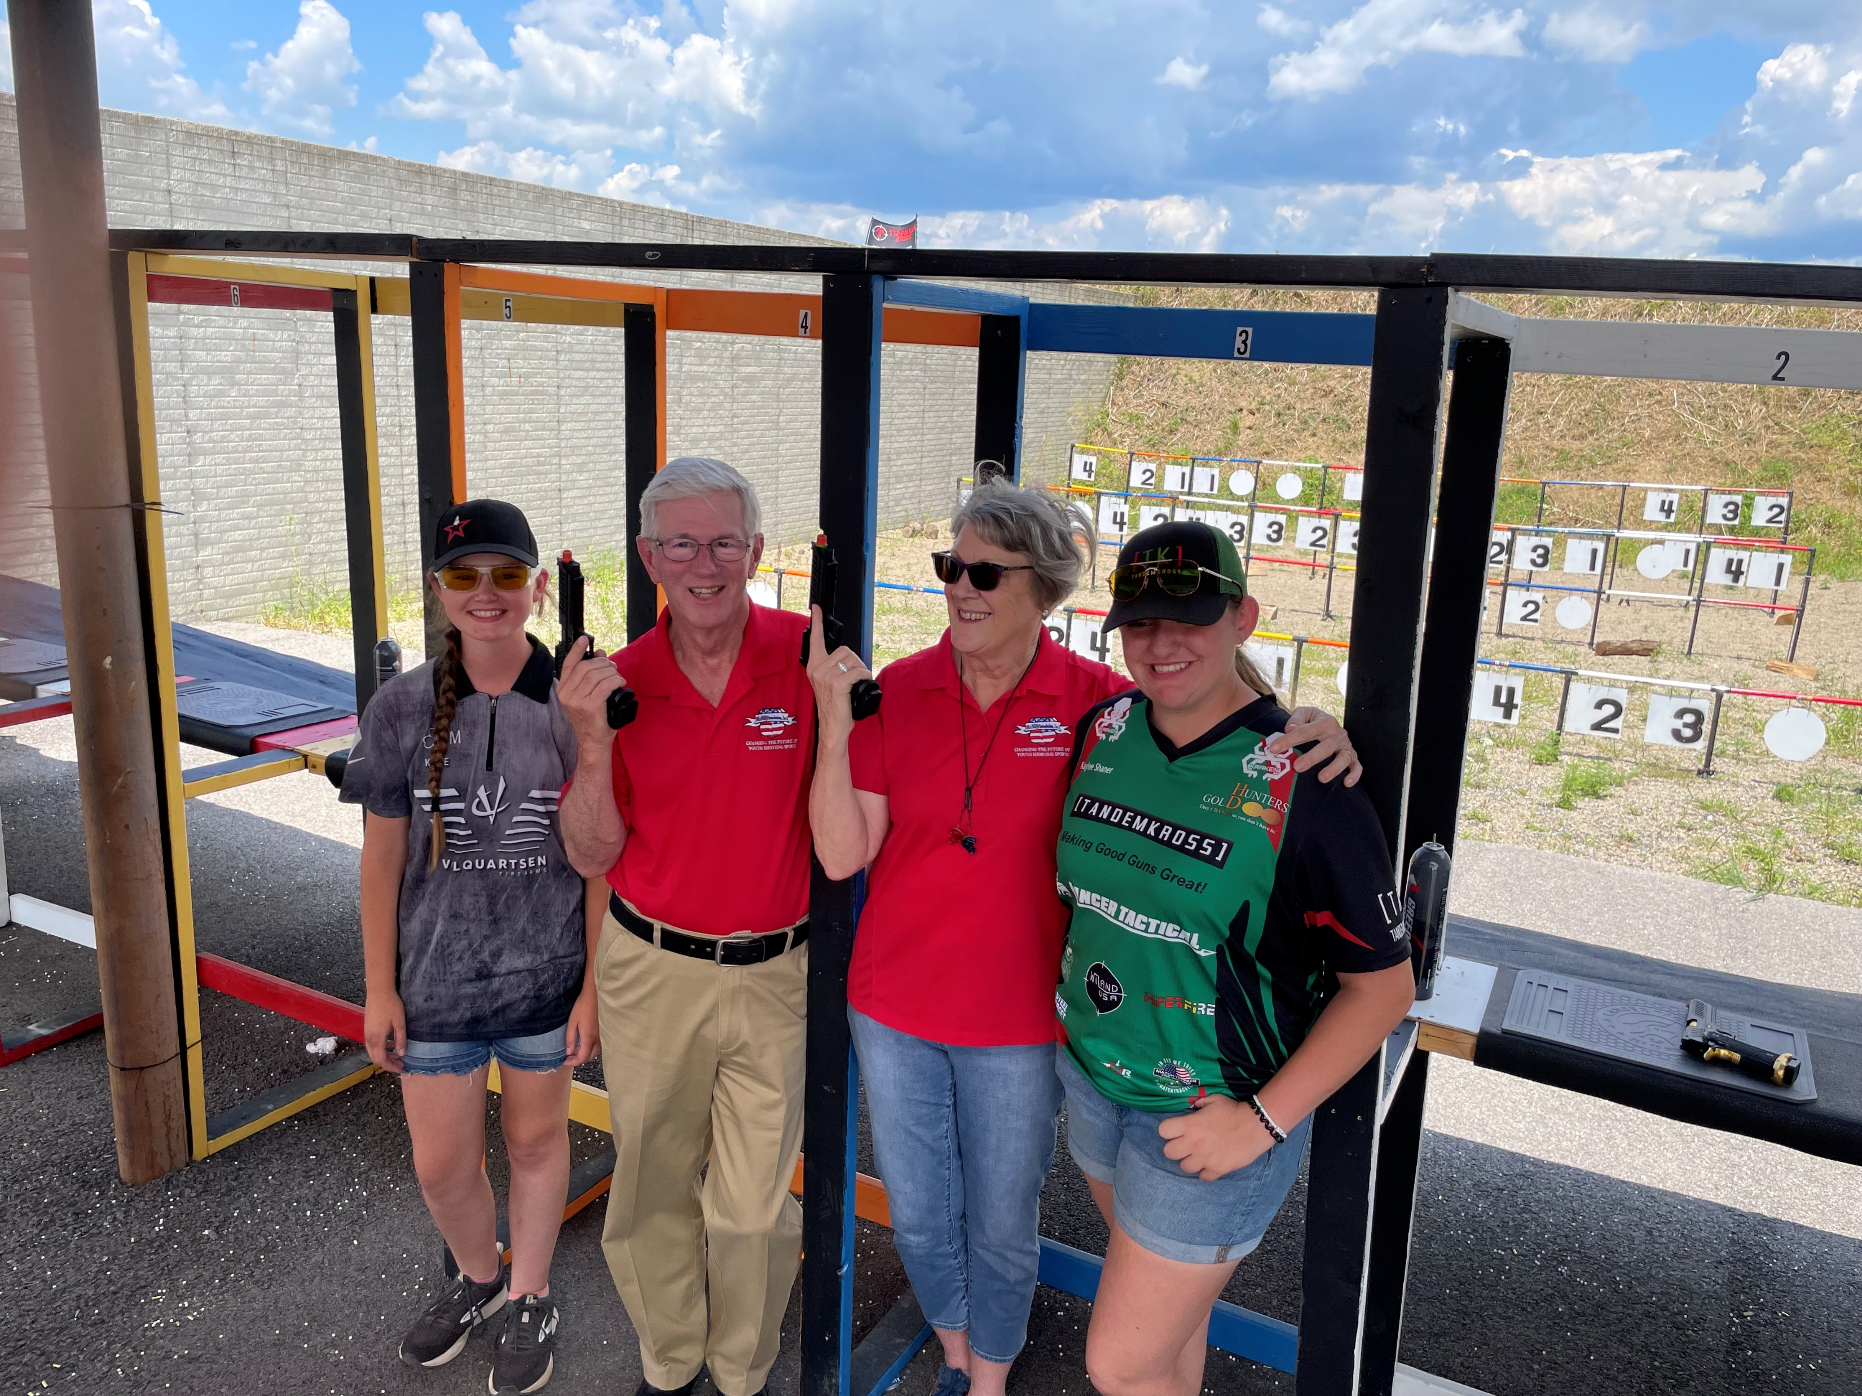

Slide 6
Don’t bet against Larry with a revolver

Slide 7
QUESTIONS

Slide 8
THANK YOU!
Lastly, could we replace the pistol with a Glock (a pistol manufacturer). I'm attaching a picture (glock.jpg) I think if you just flip the image it should be fine. Glock is a founding partner of the Scholastic Action Shooting Program so we'd like to highlight their gun, plus we have the right to use their logo and gun images so we have no issues with copyright.

