Slide 1
Why Ranges Should Be Expanded
MidwayUSA Foundation National Youth Shooting Sports Conference
October 7, 2022

Slide 2
Council to Advance Hunting and the Shooting Sports

Slide 3
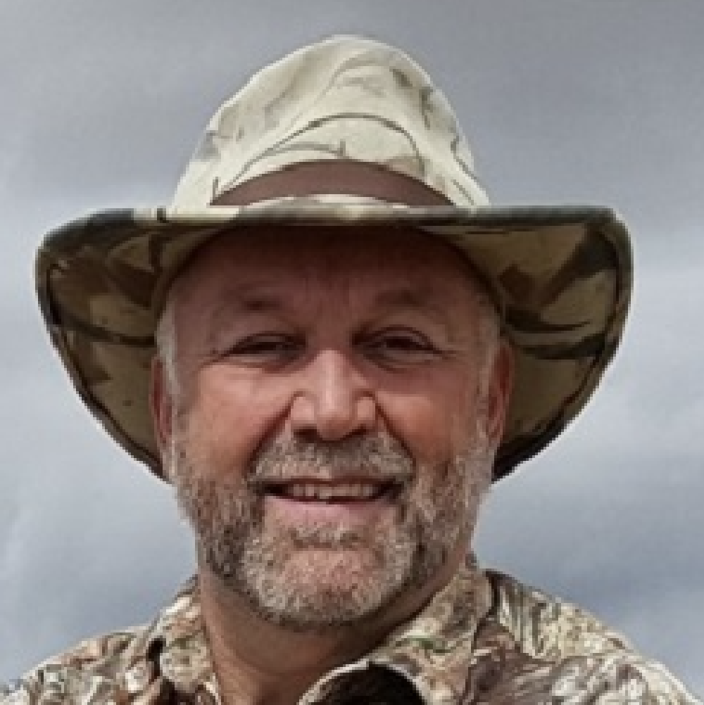
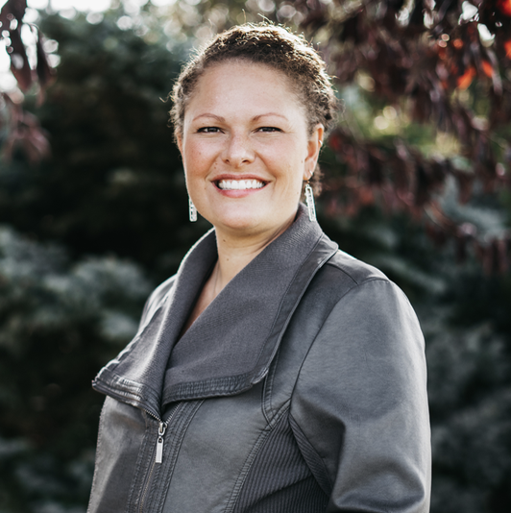
Council Team Members
Dr. Steven Leath
Executive Director
sleath@cahss.org
Swanny Evans
Director of Research
And Partnerships
swanny@cahss.org
Taniya Bethke
Director of Operations
taniya@cahss.org
Lance Cherry
Communications and Marketing Manager
lance@cahss.org
Amanda Pitman
Program Associate
amanda@cahss.org

Slide 4
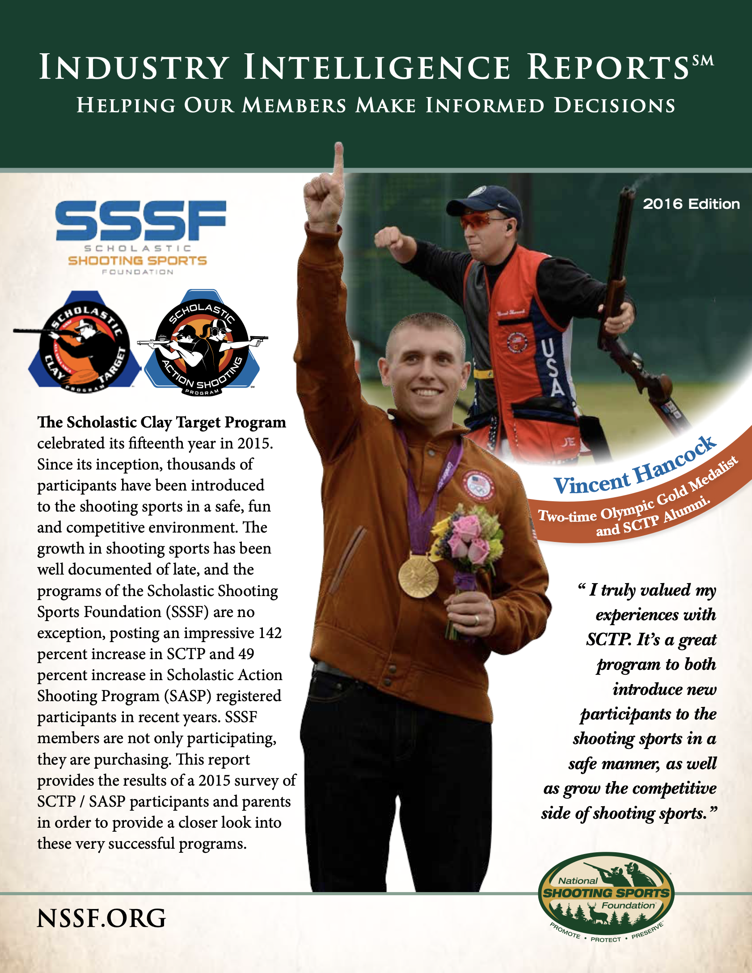
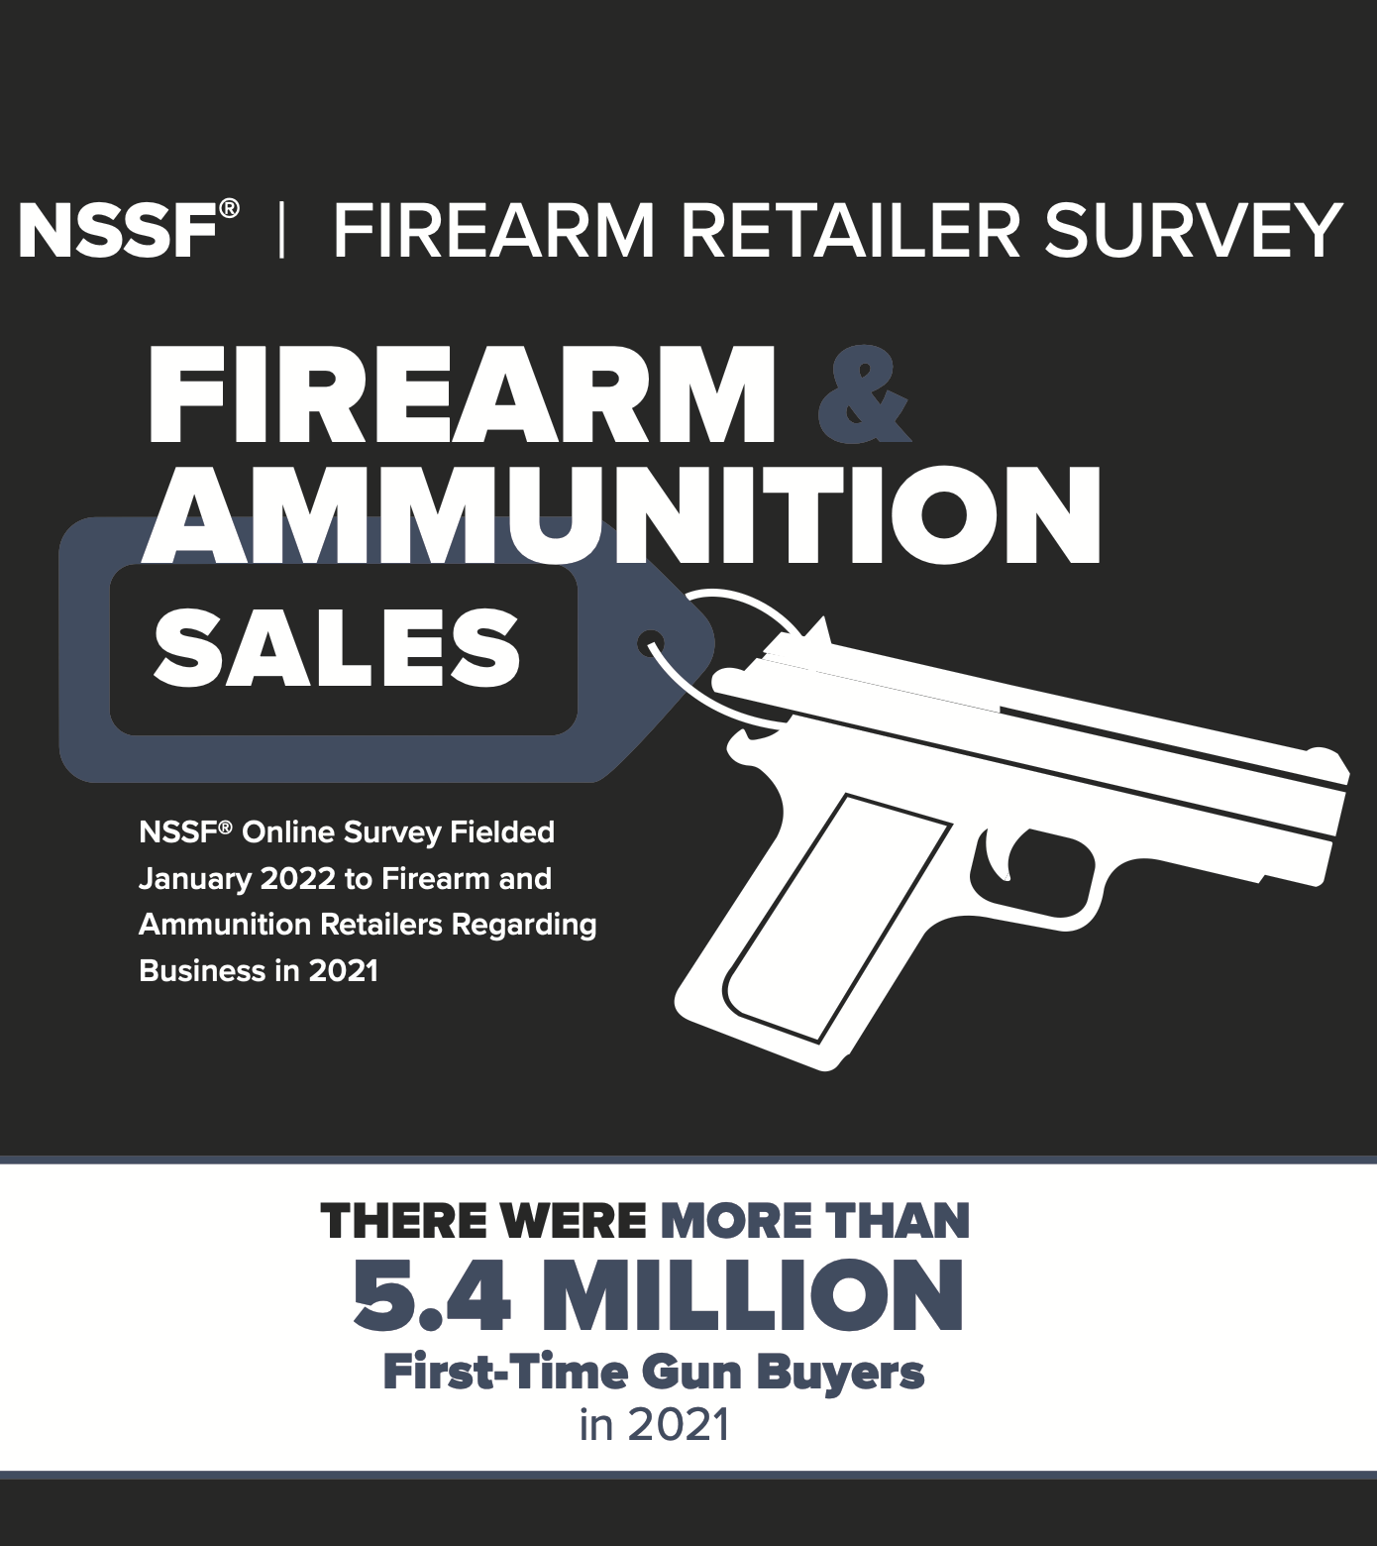
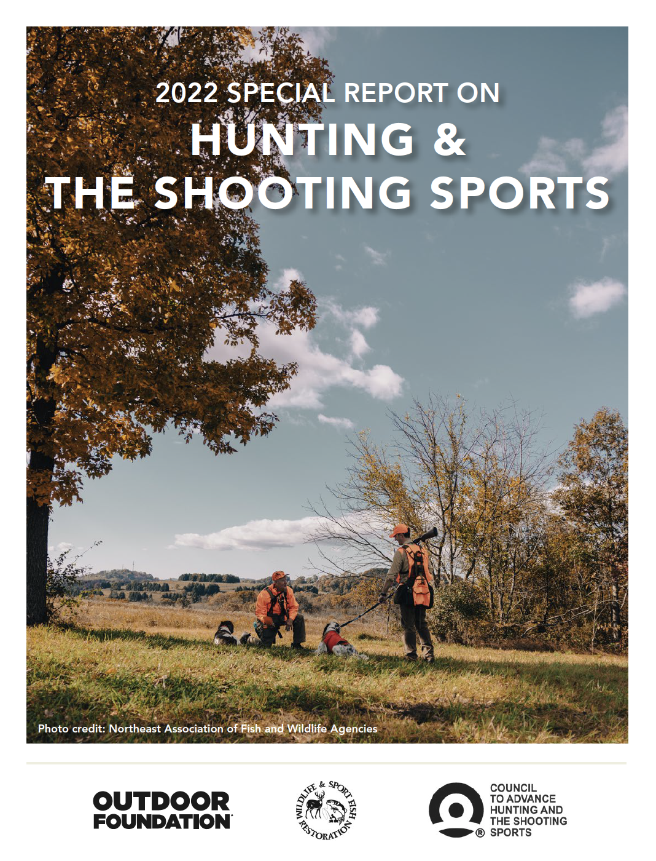
Should ranges be expanded?
Data from different angles
Purchasing: NSSF 2021 Firearm Retailer Survey
Participation: 2022 Special Report on Hunting and the Shooting Sports
Access: Assessing the Quality and Availability of Hunting and Shooting Access in the United States (2021)
Youth: Scholastic Shooting Sports Foundation Report (2016); USA Clay Target League 2021 Annual Impact Report
Range expansion/improvement

Slide 5
First-Time Gun Buyers
How many are there?
5.4 million first-time purchasers in 2021
Age and gender
49% age 40 and under
33% female
Retailers reporting increase in customer diversity
45% Black
37% Hispanic
27% Asian

Slide 6
First-Time Gun Buyers
Why do they buy?

Slide 7
First-Time Gun Buyers
What do they buy?
Firearms Purchased Most Frequently (Ranked from 1 to 6, where 1 is highest.)

Slide 8
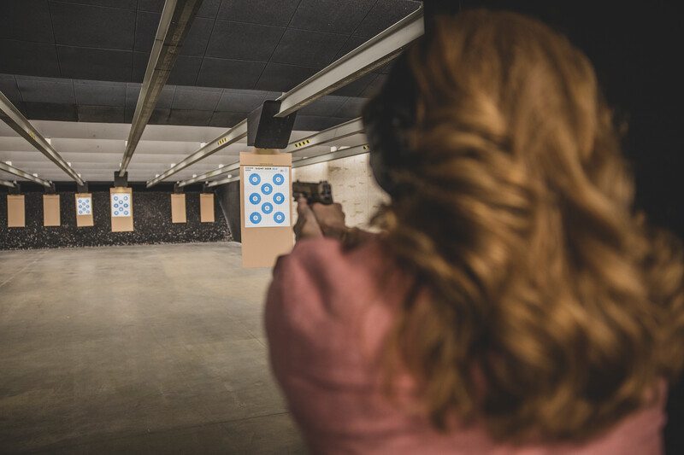
First-Time Gun Buyers
What is different about them?
Less likely to target shoot with a rifle
Less likely to have grown up in a household with a firearm present
More likely than established shooters to go to an indoor range
Credit: NEAFWA

Slide 9
Should ranges should be expanded?
First-time gun buyers
Substantial increases in number and diversity
Potentially different desires and motivations (e.g., defense prominent reason)
More likely than established shooters to go to an indoor range

Slide 10
Shooting Participation
New shooting sports report
Partnered with the Outdoor Foundation
Data from Physical Activity Council
18,000 interviews people 6 and older
Supplemental survey to hit specifics
2021 Participation
Hunting
Firearms Target Shooting
Archery Target Shooting

Slide 11
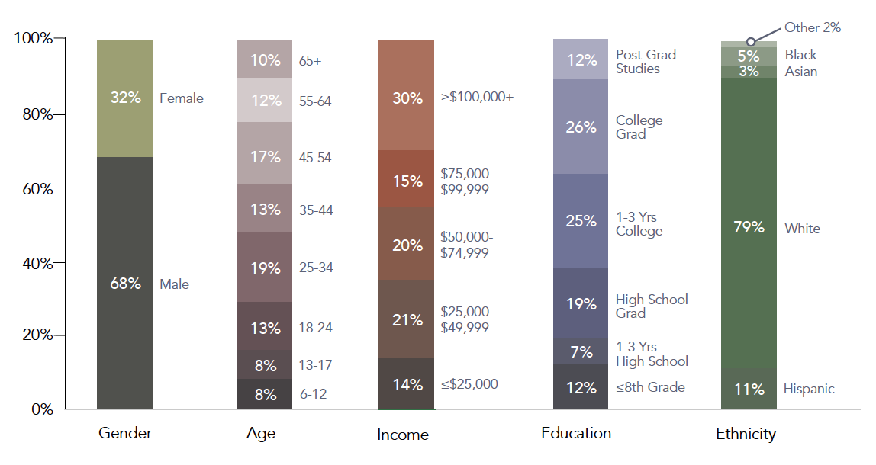
Shooting Participation
Demographics
16% youth
32% female (up 25% from a decade ago)
5% share growth among black participants (annually the past 3 years)

Slide 12
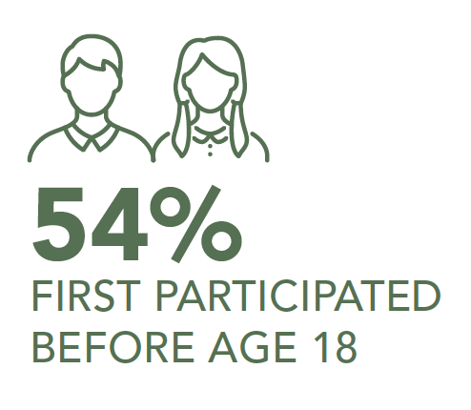
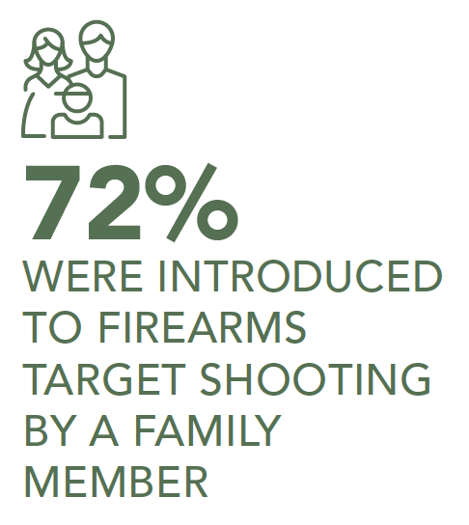
Shooting Participation
How and when did they get into shooting?
Over half started before the age of 18
The overwhelming majority were introduced by a family member

Slide 13
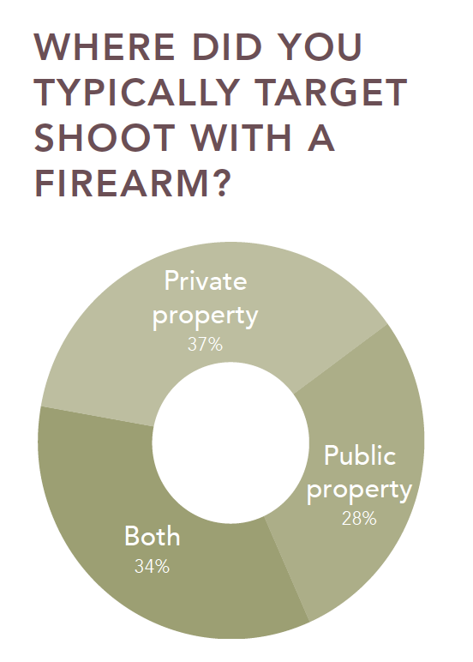
Shooting Participation
Where do they shoot?
A pretty even split between private and public
About a third shoot on both

Slide 14
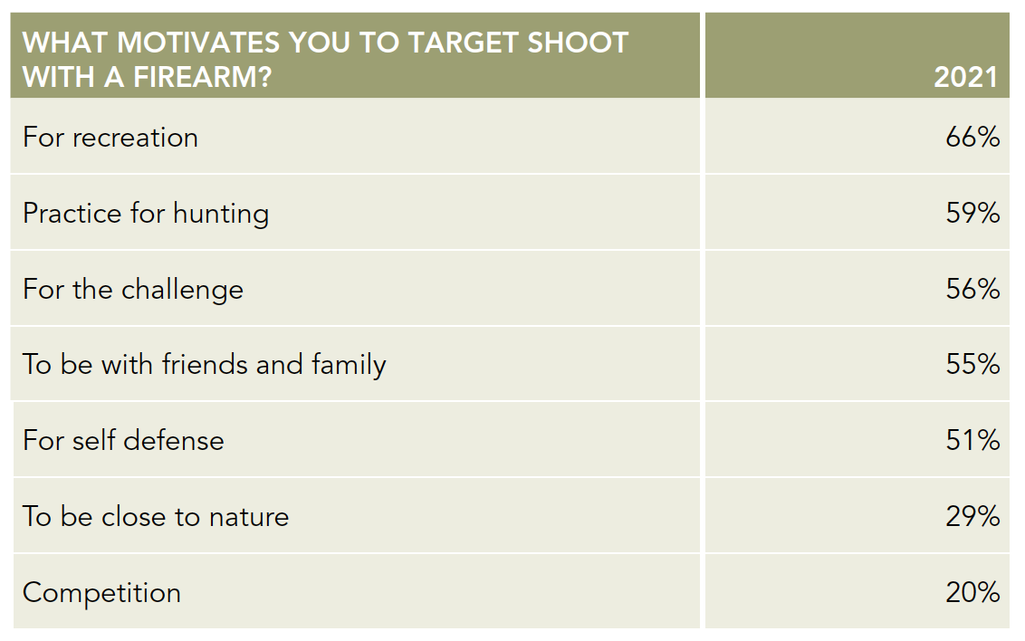
Shooting Participation
Why do they shoot?
Motivations vary

Slide 15
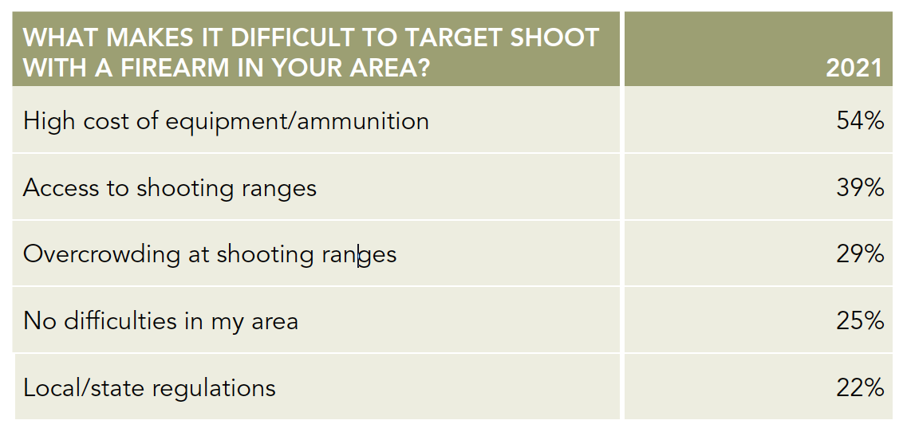
Shooting Participation
What makes it difficult to participate?
Almost 40% of shooters in 2021 rated access to shooting ranges as a difficulty

Slide 16
Should ranges should be expanded?
First-time gun buyers
Substantial increases in number and diversity
Potentially different desires and motivations (e.g., defense prominent reason)
More likely than establish shooters to go to an indoor range
Participation report
Increasing diversity (females up 25% from a decade ago)
Motivations vary and require different range types (e.g., hunting vs. self-defense)
Access reported as a major difficulty

Slide 17
Assessing the Quality of Shooting Access
Physical Aspects of Access
Availability: pertains to the actual land available for hunting and shooting.
Accessibility: pertains to the ability to get to the land; i.e., Is it landlocked, etc.
Accommodation: pertains to the ease of mobility and the experience once recreationists are on the land.
Social/Psychological Aspects of Access
Awareness: pertains to information and knowledge—to shooters’ awareness of the access options open to them.
Assumptions: pertain to shooters’ perceptions about opportunities.

Slide 18
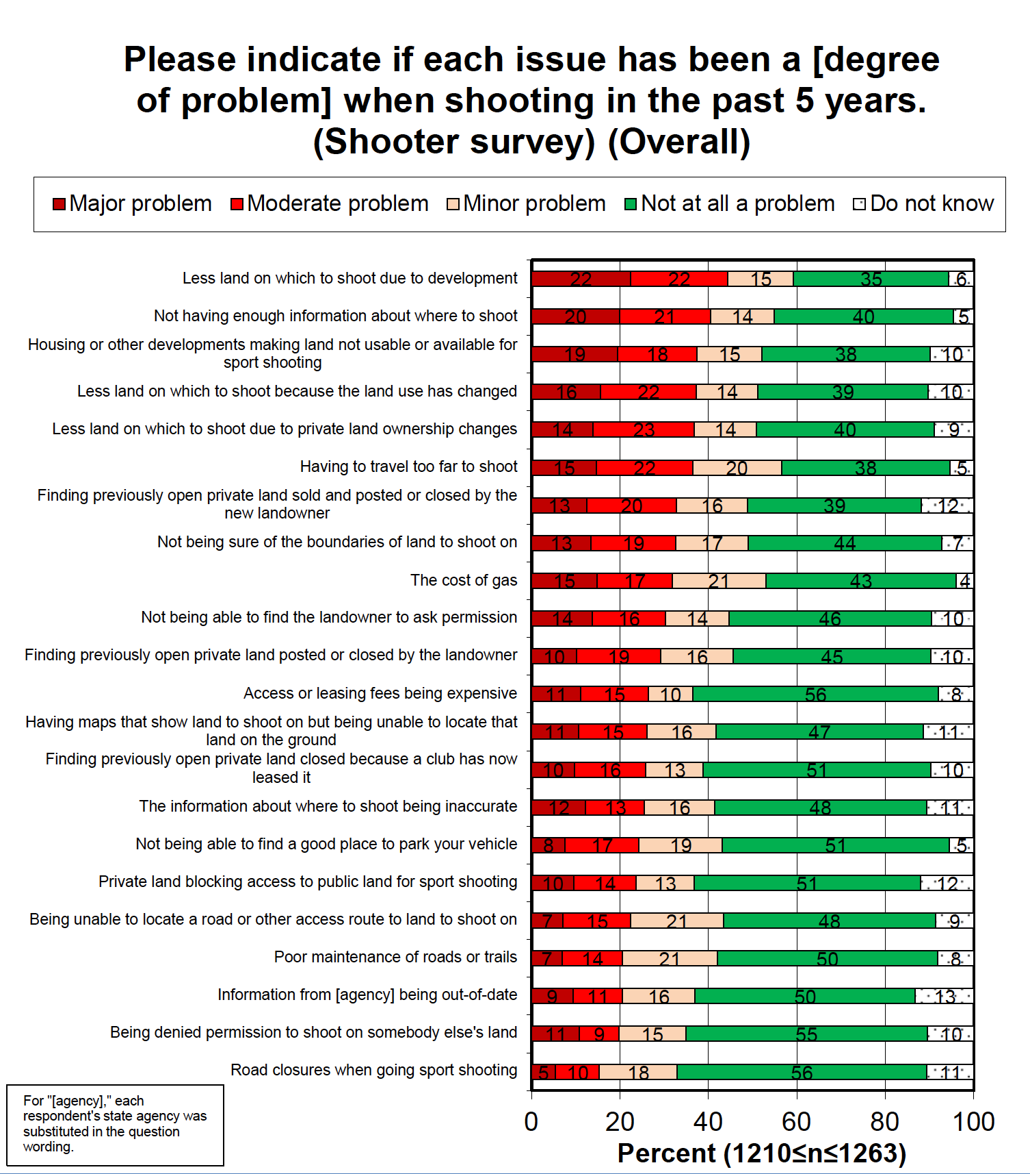
Assessing the Quality of Shooting Access
Over 50% reported these as problems for going shooting
Less places to shoot
Not enough information about where to shoot
Distance to travel to shoot
Cost to travel to shoot

Slide 19
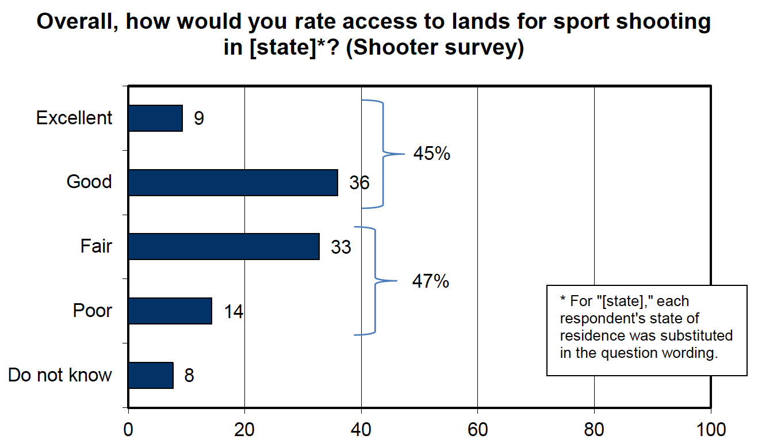
Assessing the Quality of Shooting Access
Rating of shooting access
45% excellent or good
47% fair or poor

Slide 20
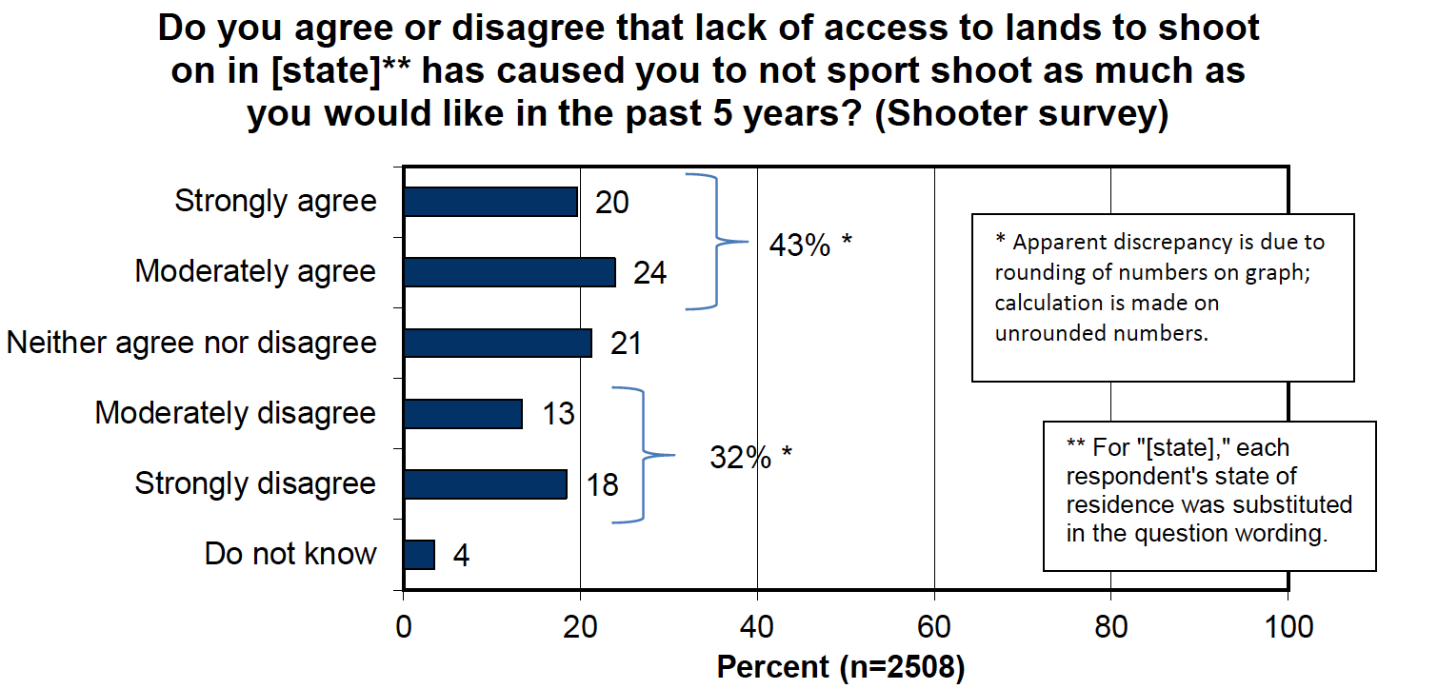
Assessing the Quality of Shooting Access
Lack of access caused people to shoot less
43% agree
32% disagree

Slide 21
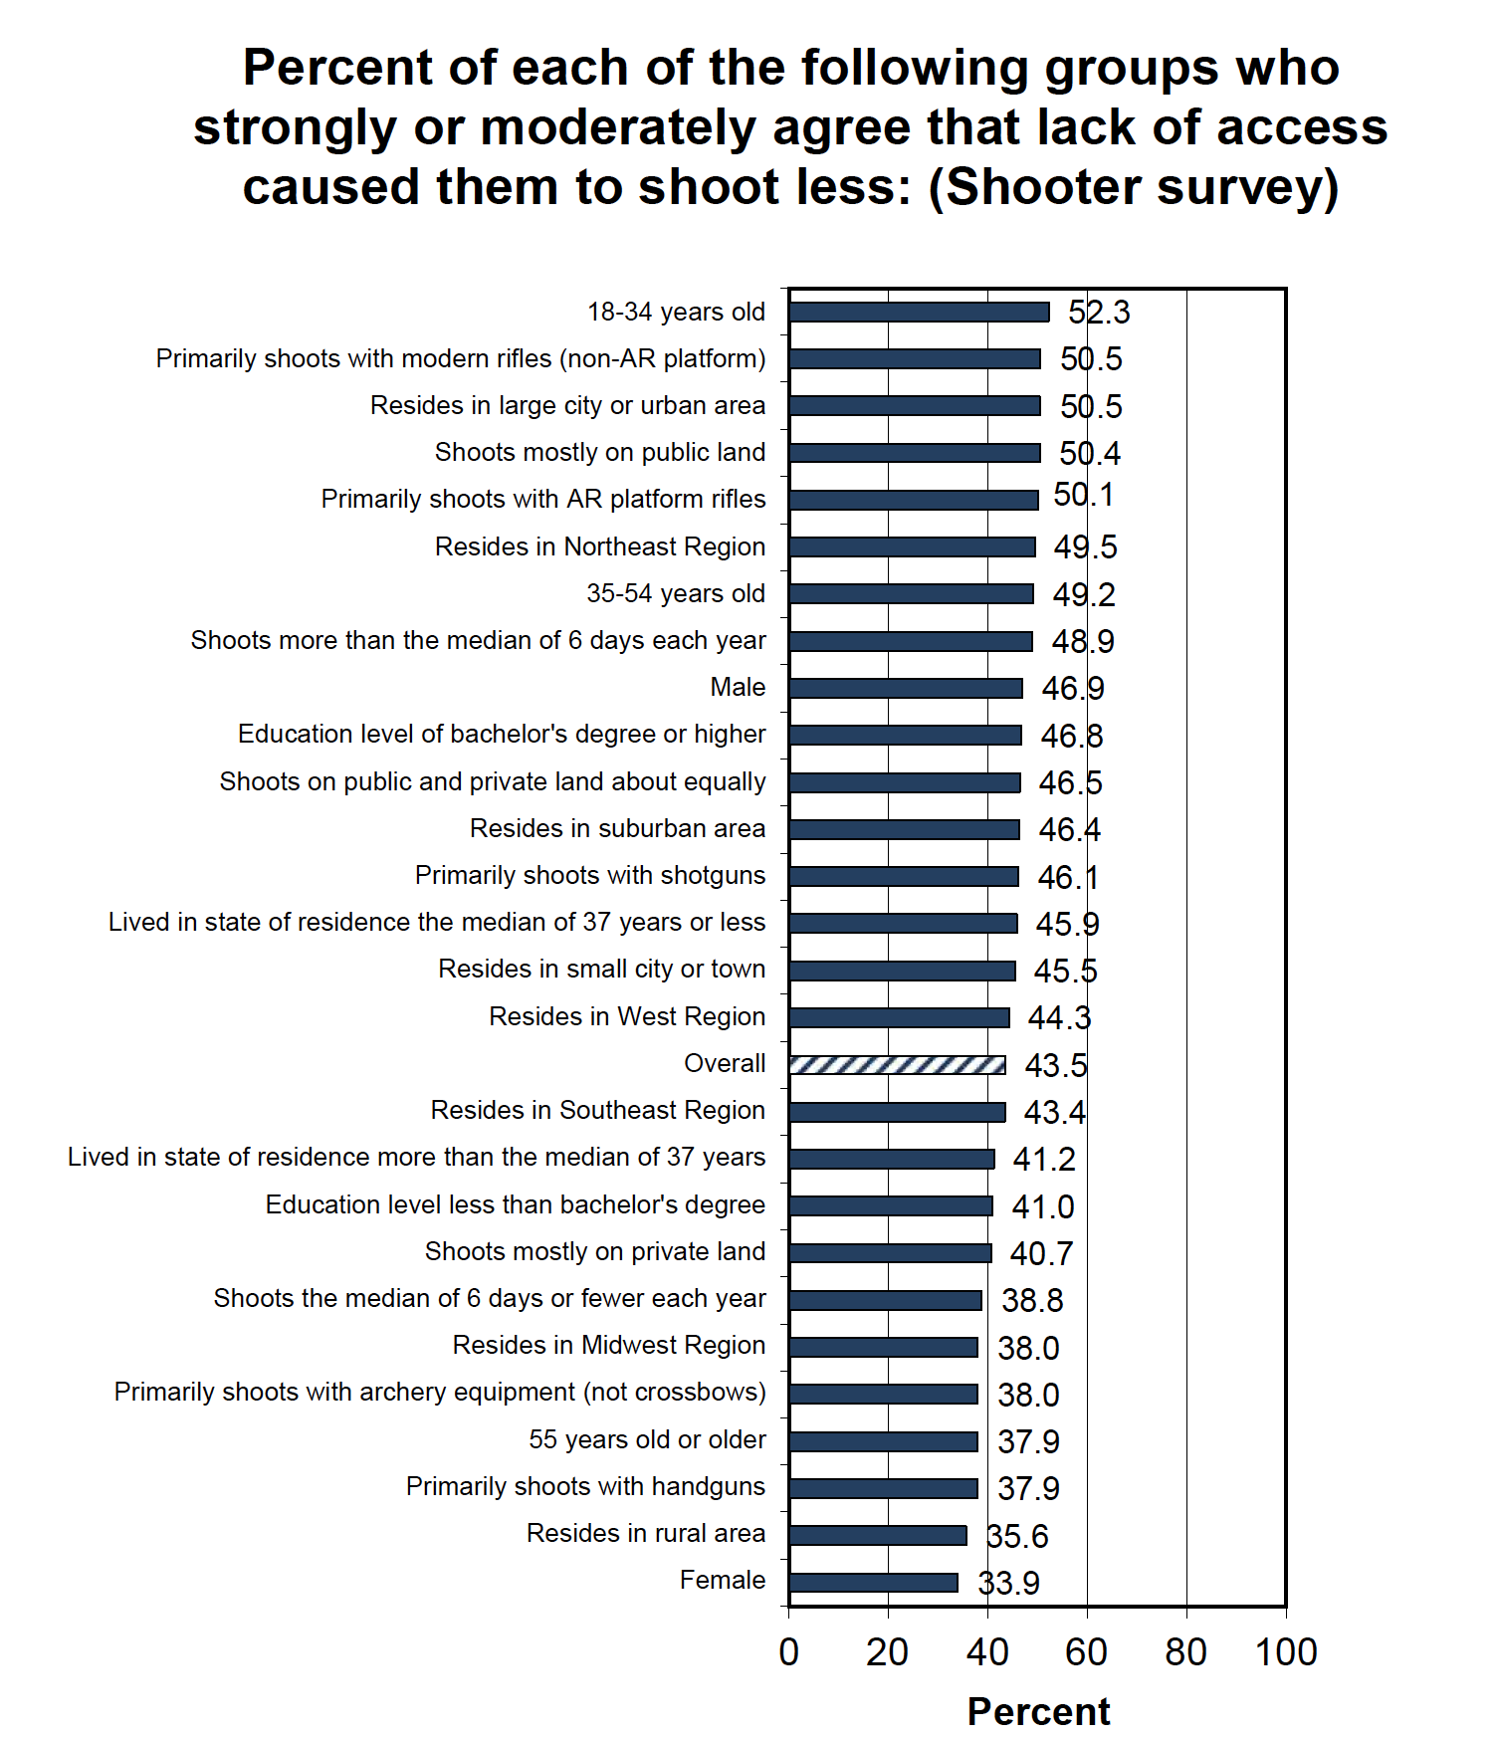
Assessing the Quality of Shooting Access
Over 50% these groups reported that lack of access cause them to shoot less
18 – 34 years old
Urban dwellers
Rifle shooters
Public land/range shooter

Slide 22
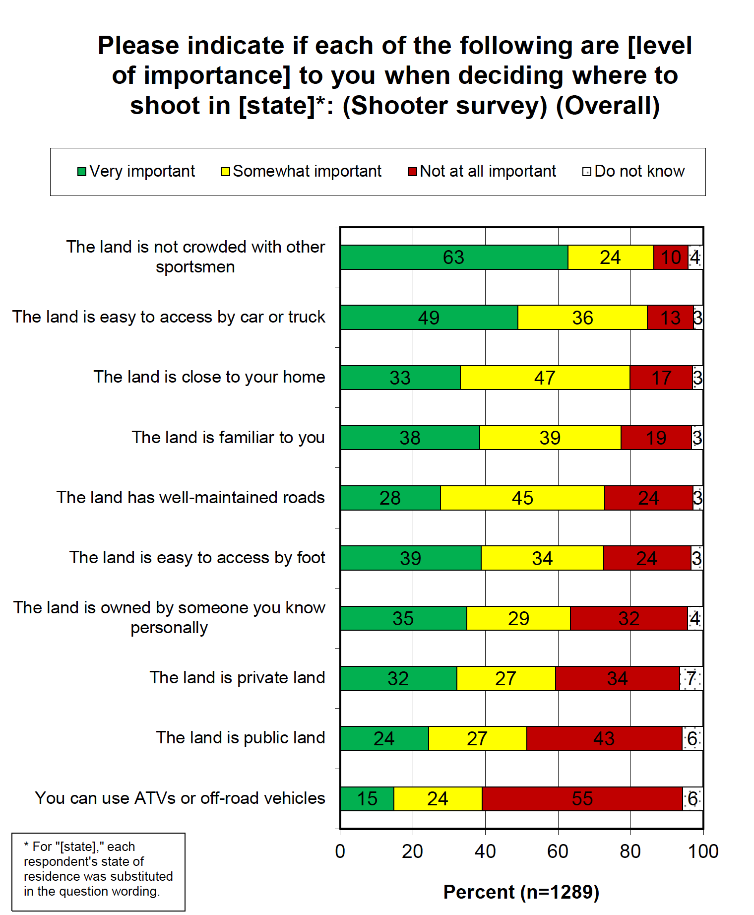
Assessing the Quality of Shooting Access
Public and private ranges are important
51% reported that it is very or somewhat important to them that the land is public
59% reported that it is very or somewhat important that the land is private
Crowding is an issue
87% reported that range not being crowded was important

Slide 23
Should ranges should be expanded?
First-time gun buyers
Substantial increases in number and diversity
Potentially different desires and motivations (e.g., defense prominent reason)
More likely than establish shooters to go to an indoor range
Participation report
Increasing diversity (females up 25% from a decade ago)
Motivations vary and require different range types (e.g., hunting vs. self-defense)
Access reported as a major difficulty
Shooting access assessment
47% currently rate access as fair or poor
Access continually cited as a factor reducing participation (especially among urban and younger participants)
Demand for public and private ranges, easy access, and no crowding

Slide 24
Scholastic Shooting Sports Foundation (2015)
Student athletes
89% shoot at ranges outside of of SCTP/SASP events
73% shoot at their local range more than 10 times per year
Visit and average of 8 ranges per year

Slide 25
USA Clay Target League (2021)
Challenges report by the league
“Many teams and/or shooting ranges do not have the capacity to add more student athletes”

Slide 26
Should ranges should be expanded?
First-time gun buyers
Substantial increases in number and diversity
Potentially different desires and motivations (e.g., defense prominent reason)
More likely than establish shooters to go to an indoor range
Participation report
Increasing diversity (females up 25% from a decade ago)
Motivations vary and require different range types (e.g., hunting vs. self-defense)
Access reported as a major difficulty
Shooting access assessment
47% currently rate access as fair or poor
Access continually cited as a factor reducing participation (especially among urban and younger participants)
Demand for public and private ranges, easy access, and no crowding
Youth shooting sports
Growing influence
Local ranges are important to participants
Range capacity is needed to further expand participation

Slide 27
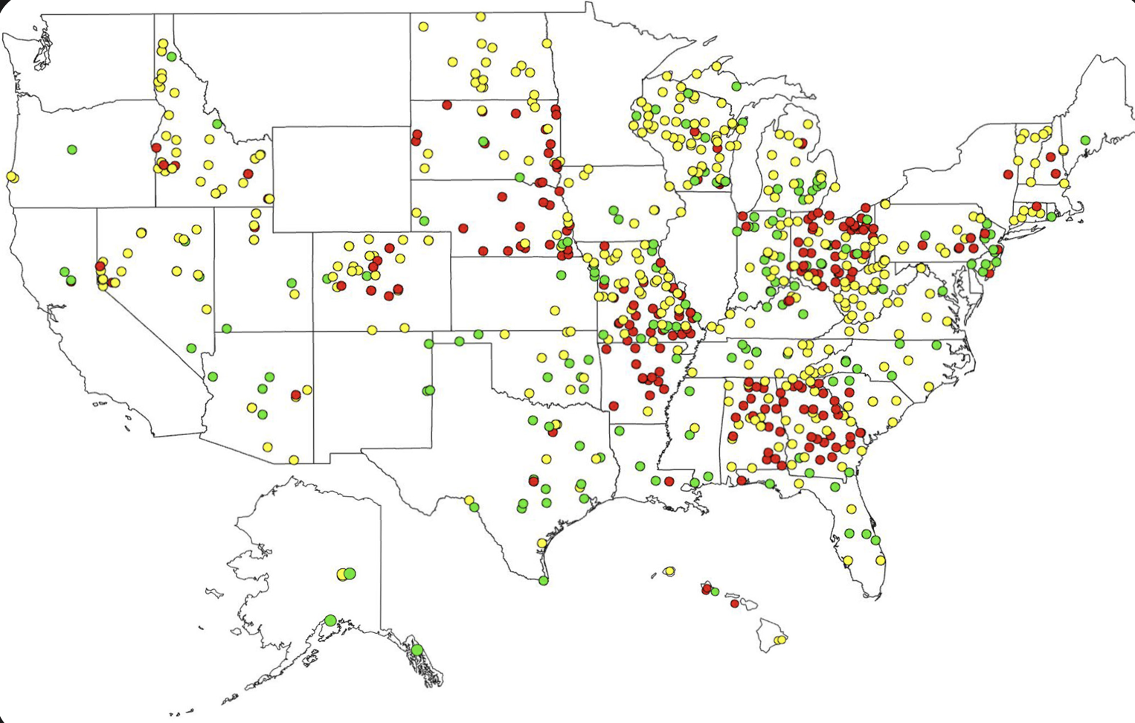
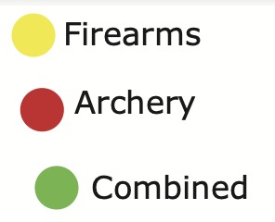
WSFR-Supported Ranges
Nationwide
856 total
453 firearms ranges
215 archery ranges
188 combined ranges
Grants submitted since 2019
‘Tar-Mark’ Act
233 total
168 firearms ranges
32 archery ranges
33 combined ranges

Slide 28
cahss.org
Swanny Evans
Director of Research
And Partnerships
swanny@cahss.org

