Slide 1
Doubling Youth Shooting Sports Participation in 5 Years
Jon Zinnel
Conservation & Youth Shooting Sports Program Manager
Federal, Remington, HEVI-Shot & CCI Ammunition

Slide 2
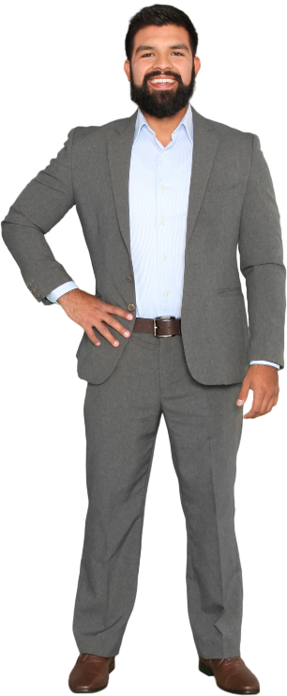
Topics:
- History of Myself & Motivation
- Introduction to Dennis
History of Our Company Support
- Hurdles We All Face
- Finding, Keeping and Supporting Partners
Choosing a Winning Strategy!

Slide 3
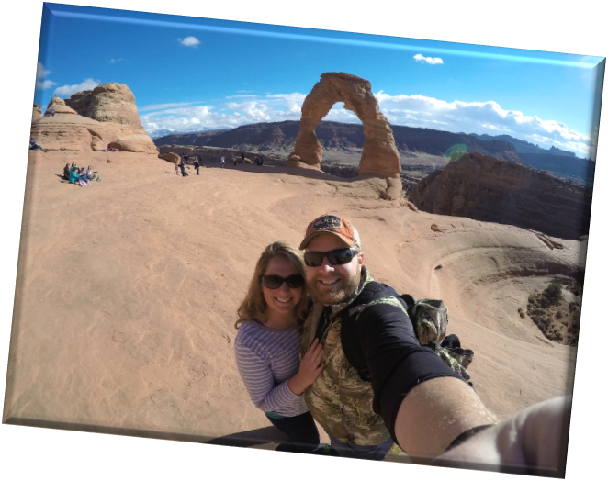
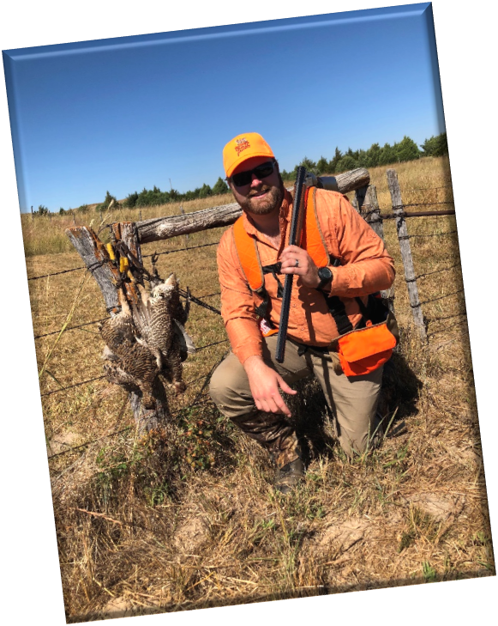
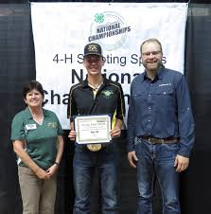
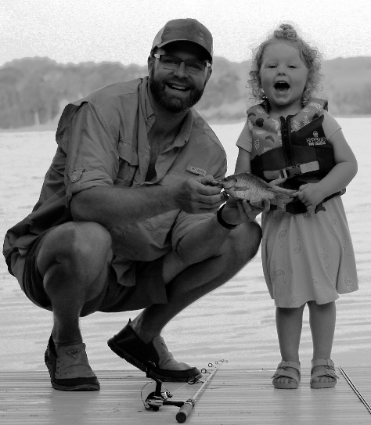
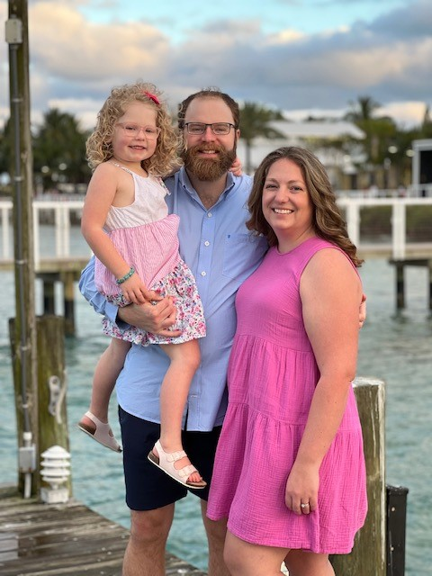
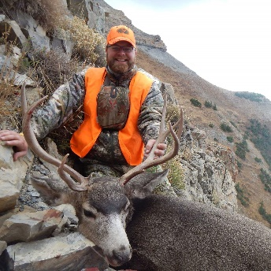
FUN
DEVELOPMENT
FAMILY
OUTDOORS
PASSION
LAUGHING
LEGACY
FUTURE
INDUSTRY
COMMUNITY
AMERICA
FRIENDS

Slide 5
Education & Youth Support

Slide 6
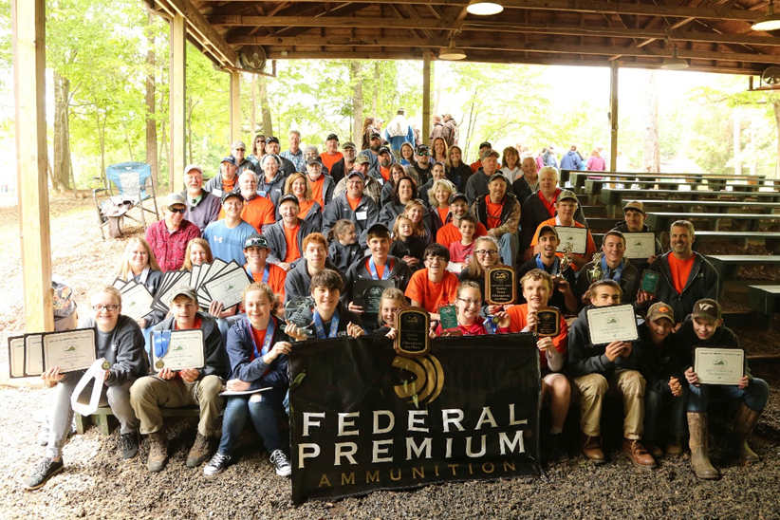
Support for National 4H Shooting Sports Programs.
Federal started its work with youth and conservation groups in 1937 when it founded the 4H Conservation Camps. We have built on that base, developing brand loyalty in young shooters, hunters and conservationists.

Slide 7
Conservation Support

Slide 8
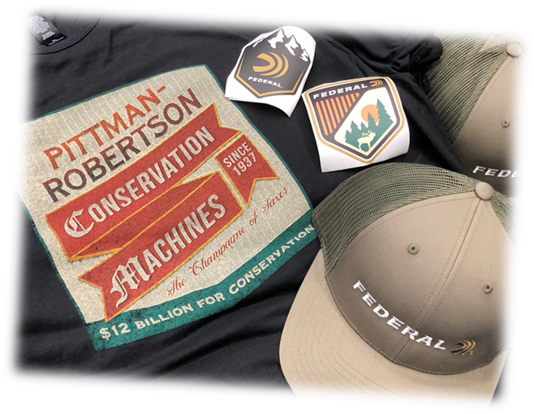
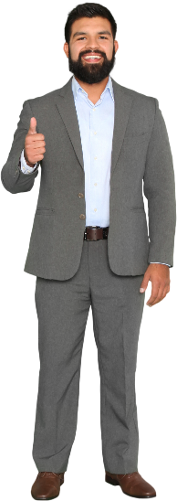
Funding Conservation in America Pittman Robertson Tax
You are supporting Wildlife Conservation every time you pull the trigger!
11% tax on ammo
11% on long guns
10% on pistols
*GUNS
*FINISHED AMMO
*ARCHERY GEAR
NOTHING ELSE PAYS THIS TAX!

Slide 9
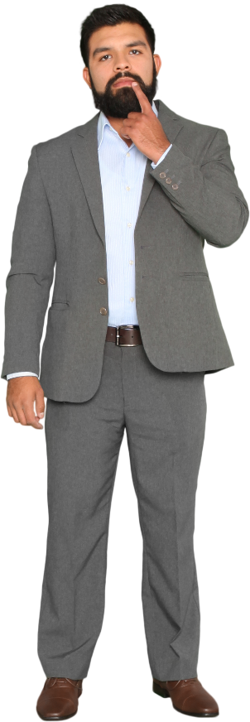
“WHY” are we here?

Slide 10
GROWTH FOR ORGANIZATIONS
- Participation Numbers Increasing?
- Number of Training Courses?
- Funding Increases?
- Finding, Keeping and Supporting Partnerships?
- ALL OF THE ABOVE?

Slide 11
Simple: Listen to Dennis
Break Down the Silos

Slide 12
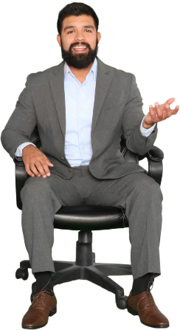
From Dennis’s Desk
Positive Attitude – Always smile, keep your head up, keep needle north…
Communication – Be open, be clear, be consistent, be bold…
Persistence – Never give up, keep moving, keep trying, be respectful…
Education – Always learn, be open to new things, diversify if needed…
Experience – Always try to bring in locals to assist and limit the “know it all's”
Dream – Set obtainable goals as well as stretch goals, never be satisfied…
Professional – Create a professional program and your program will flourish

Slide 13
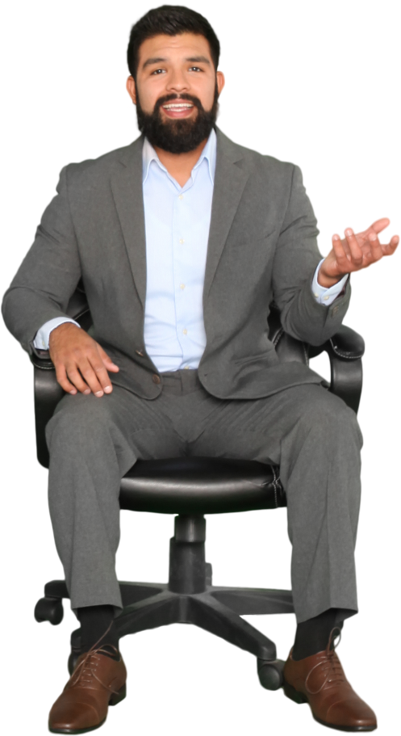
Jon Zinnel
Conservation & Youth Shooting Sports Program Manager
Federal, Remington, HEVI-Shot & CCI Ammunition
Jon.Zinnel@VistaOutdoor.com
Questions?

